Slide 1
Hosea
A call for Israel to repent, and a reminder of God’s unwavering love in the face of infidelity.
By Stephen Curto
For Homegroup
October 22, 2017

Slide 2
Lesson Outline
Introductory Issues
Background
Text

Slide 3
Introductory Issues
Authorship
Date
Message
Major Themes
Unique Features

Slide 4
Introductory Issues
Authorship
Hosea (1:1)
Date
Uzziah-Hezekiah in Judah (approx. 767-715 BC)
Jeroboam II in Israel (approx 782-753 BC)
Message
Repent. God will punish, but he will not destroy.

Slide 5
Introductory Issues
Major Themes
Israel’s (Gomer’s) Unfaithfulness
God’s judgment
God’s steadfast love
Unique Features
Half historical narrative (Jonah)

Slide 6
Background
2 Chron 26-32; 2 Kings 14-18
Judah: 2 Chron 26:1-15; 27:1-4; 28:1-8
Israel: 2 Kings 14:23-29; 15:8-31; 17:6-8,13
Judah
Uzziah (Azariah)
Jotham
Ahaz
Hezekiah
Israel
Jeroboam II
Zechariah
Shallum
Menahem
Pekahiah
Pekah
Hoshea

Slide 8
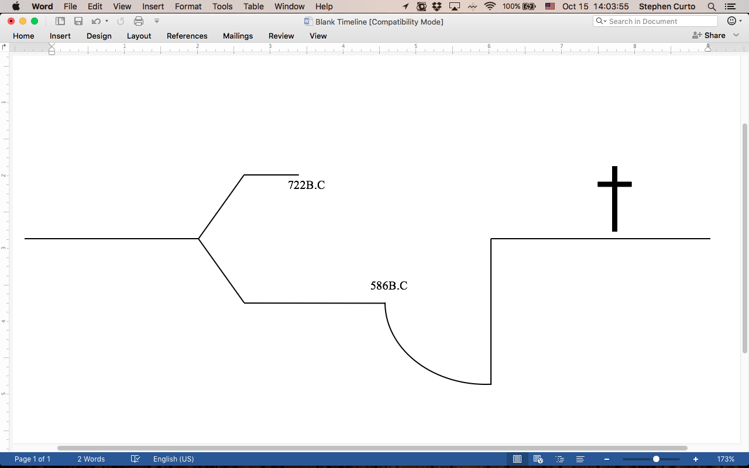

Slide 10
Background
“Ephraim” – the leading tribe in Israel. Many famous men came from this tribe (Joshua, Samuel, Jeroboam I), and at the time of Hosea the term was a another way of referring to ”Israel,” the northern nation
Israel = Samaria = Ephraim

Slide 11
Hosea Outline
History (Ch. 1-3)
Punishment Illustrated (1:1-2:1)
Punishment and Restoration Elucidated (2:2-23)
Restoration Illustrated (3:1-5)
Prophecy (Ch. 4-14)
God’s Case Against Israel (4-5)
The Coming Judgment(6-10)
God’s Grace (11)
The Coming Judgment Restated (12-13)
Promises to the Remnant (14)

Slide 12
Hosea Judgment/Salvation Pattern
 | Judgment | Salvation
1. | 1:2–9 | 1:10–2:1
2. | 2:2–13 | 2:14–3:5
3. | 4:1–5:14 | 5:15–6:3
4. | 6:4–11:7 | 11:8–11
5. | 11:12–13:16 | chap. 14

Slide 13
I.A. Punishment Illustrated (1:1-2:1)
“Take for yourself a wife of harlotry and have children of harlotry, for the land commits flagrant harlotry, forsaking the Lord.” (1:2)
1st Child = Jezreel = “God Sows”
A city and region in which Jehu began a bloody campaign to become king
2nd Child = Lo-ruhamah = “She will not be loved”

Slide 14
I.A. Punishment Illustrated (1:1-2:1)
“but I will love the house of Judah and I will save them by YHWH their God.” (1:7)
3rd Child = Lo-ammi = “Not my people”
Promise of Salvation 1:10-2:1
What is promised?
What previous promise is this alluding to? (Gen 22:17)
“And the sons of Judah and the sons of Israel will be gathered together…” (1:11)
What time period is this referring to?

Slide 15
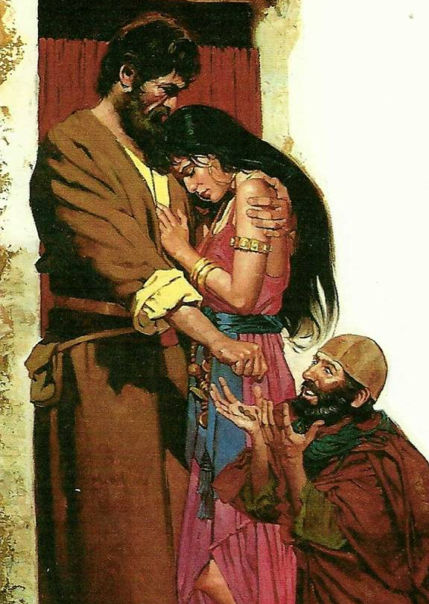
I.A. Punishment Illustrated (1:1-2:1)
Hosea = ?
Gomer = ?
3 Children = ?

Slide 16
I.B. Punishment and Restoration Elucidated (2:2-23)
“And let her put away her harlotry from her face And her adultery from between her breasts, Or I will strip her naked And expose her as on the day when she was born.” (2:2-3)
She said “I will go after my lovers…” (2:5)
then she will say “I will go back to my first husband...” (2:7)

Slide 17
I.B. Punishment and Restoration Elucidated (2:2-23)
“I will punish her for the days of the Baals... so she forgot me,” declares the Lord. (2:13)
Restoration promised (2:14-23) *read
What time period is being described?

Slide 18
I.C. Restoration Illustrated (3:1-5)
“Love again a woman... even as the Lord loves the sons of Israel…” (3:1)
“...an adulteress... though they turn to other gods...” (3:1)
What two events are verses 4 and 5 referring to?

Slide 19
II.A. God’s Case Against Israel (4-5)
Read 4:12-19; 5:3-6, 15
Compare to Deut 28-32 (28:15ff; 31:14-22)
Michaelangelo’s “Moses”

Slide 20
II.B. The Coming Judgment (6-10)
Read 6:1-3
What is the response of the people?
Read 6:4-7
What is God’s response?
What event is 8:9-10 referring to?
Read 10:1-8, 15
What is coming for Israel?

Slide 21
II.C. God’s Grace (11)
Read 11:1
Why the sex switch?
cf. Matt 2:13-15
11:5ff ”He shall not return to the land of Egypt, but Assyria, He will be his king, because they refused to return.”
Many of the plurals in the passage are actual masculine singulars.
“Flight Into Egypt” by Eugène Alexis Girardet (1853–1907)

Slide 22
II.D. The Coming Judgment Restated (12-13)
Read 12:9
sukkot – Jewish festival (in 2017, Oct 4-11) in which Jews live in temporary dwellings, to commemorate the 40 years wandering.
Read 13:1-8
What is the picture for Israel?
What three animals are pictured for God’s judgment? Remind you of anything…?

Slide 23
II.E. Promises to the Remnant (14)
Read 14
Who is God talking to with these promises?
What does he promise?

