Slide 1
Islam and Mormonism
An Introduction

Slide 2
Outline
Islam
Origin/History
Main Doctrines
Modern Practice
Sunni and Shia
FAQ’s
Mormonism
Origin/History
Main Doctrines
Modern Practice
FAQ’s
Christian?

Slide 3
Preliminary Thoughts
What constitutes “Islam” and “Mormonism,” is it what their holy books teach, or what the majority of their adherents practice?
What constitutes “Christianity”? Is it what the Bible teaches, or what the majority of their adherents practice?
This presentation will give more credence to what Islam and Mormonism's holy books teach, while noting the most highly regarded and common interpretations of those books for practice.

Slide 4
Preliminary Thoughts
Video of Reza Aslan on CNN.

Slide 5
https://www.youtube.com/watch?v=G1QfgDkFR5E

Slide 6
Video Observations
Reza Aslan doesn’t believe “religion” can “promote” things outside of the people who adhere to it.
Reza Aslan rightly draws a distinction between “Muslim countries” and Militant Islamic groups
Aslan also rightly draws a distinction between the practices of “Islam” and the practices of certain Muslim majority countries
Broad-brush painting is usually a bad idea when discussing religious practice
… but what about religious dogma?

Slide 7
Islam – Origin/History
Mohammad – 570-632AD
Revelation from Gabriel (Age 40)
Fled to Yathrib (618AD)
Conquest of Mecca (629AD)
Died 632
Caliphate (caliph- “successor”)
Abu Bakr (632-634)
Umar (634-644)
Uthman (644-656)
Ali (656-661)

Slide 8
Islam – Origin/History
Arab Conquest of 7th-8th Century

Slide 9
Islam – Main Doctrines
Monotheism
Prophets of God
Abraham, Noah, Moses, Jesus, Mohammad
Qur’an (Koran)
114 Surah’s (Chapters) arranged by length
Given to Mohammad by Gabriel
Al-Qadar (predestination)
Hadith (The sayings of Mohhamad)
Day of Judgment

Slide 10
Islam – Modern Practice
5 Pillars:
Shahada (Testimony)
“There is no God but Allah and Mohammad is his prophet.”
Salat (Prayer)
5 times a day facing Mecca following the proper form.
Zakat (Almsgiving)
Giving generously to those in need.
Sawm (Fasting)
Fasting from food from dawn to dusk during the month of Ramadan.
Hajj (Pilgrimage)
Making a journey to Mecca and following the rituals associated with it. (circling Kaaba and going between the hillocks of Safa and Marwa.)

Slide 11
Islam – Sunni and Shia
Sunni
followers of the first three Caliphs (Abu Bakr, Umar, Uthman)
~85% of Muslims
Concentrated in South East Asia, Saudi Arabia, and Turkey
Shia (Shiite)
followers of Ali (Shait Ali)
~13% of Muslims
Concentrated in Iraq and Iran

Slide 12
Islam – Sunni and Shia

Slide 13
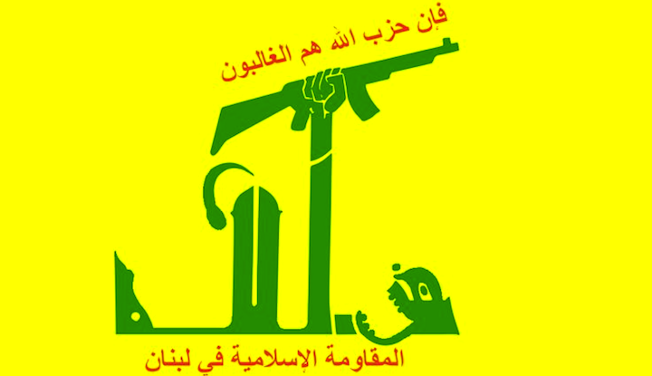
Islam – Sunni and Shia
Both Sunni and Shia contribute to Radical Islam Terrorism
ISIS and Al Qaeda are Sunni Salafist (conservative/fundamentalist) movements
Hezbollah is a Shia group
Sunni and Shia are analogous to denominations in Christianity
Sunni and Shia Muslims can be either liberal or conservative in their theology

Slide 14
Islam – FAQ’s
Do Muslims and Christians worship the same God?
What does Islam teach about Jesus?
What is ISIS?
What about women in Islam?
What is Sharia Law?

Slide 15
Islam – FAQ’s
Do Muslims and Christians worship the same God?

Slide 16
Islam – FAQ’s
Do Muslims and Christians worship the same God?

Slide 17
Islam – FAQ’s
Do Muslims and Christians worship the same God?
2 Corinthians 11:3-4
Galatians 1:6-8

Slide 18
Islam – FAQ’s
Do Muslims and Christians worship the same God?
What does Islam teach about Jesus?
What is ISIS?
What about women in Islam?
What is Sharia Law?

Slide 19
Islam – FAQ’s
What does Islam teach about Jesus?
Born of a virgin Mary
Prophet of God
Corrupted accounts in New Testament
Raised from dead by Allah
Ascended and will return to judge the world
“And the throes (of childbirth) compelled her to betake herself to the trunk of a palm tree. She said: Oh, would that I had died before this, and had been a thing quite forgotten! Then (the child) called out to her from beneath her: Grieve not, surely your Lord has made a stream to flow beneath you” (Surah 19:23-24)
“But she pointed to him. They said: How should we speak to one who was a child in the cradle? He said: Surely I am a servant of Allah; He has given me the Book and made me a prophet;” (Surah 19:29-30)
“And surely Allah is my Lord and your Lord, therefore serve Him; this is the right path.” (Surah 19:36)

Slide 20
Islam – FAQ’s
Do Muslims and Christians worship the same God?
What does Islam teach about Jesus?
What is ISIS?
What about women in Islam?
What is Sharia Law?

Slide 21
Islam – FAQ’s
What is ISIS?
Islamic State in Iraq and Syria (Sometimes ISIL “…and Levant”)
Sunni fundamentalist group within Islam
motivated by the goal of converting the earth to Islam or killing those who don’t
A detailed report by Terrorism information Center
My blog post on a Christian Response to ISIS

Slide 22
Islam – FAQ’s
Do Muslims and Christians worship the same God?
What does Islam teach about Jesus?
What is ISIS?
What about women in Islam?
What is Sharia Law?

Slide 23
Islam – FAQ’s
What about women in Islam?
The Qur'an and many Hadiths seem to devalue women
“the majority of the dwellers in hell are women” (6.8.301)
“Men are in charge of women by [right of] what Allah has given one over the other and what they spend [for maintenance] from their wealth… But those [wives] from whom you fear arrogance - [first] advise them; [then if they persist], forsake them in bed; and [finally], strike them. But if they obey you [once more], seek no means against them.(Surah 4:34)
Sexual assault, polygamy, adultery, sexual manipulation, and sexual slavery seem allowable in many Hadiths
34.113.436; 62.54.82; 63.7.190; 54.6.640; 74.12.260

Slide 24
Islam – FAQ’s
What about women in Islam?
Plausible deniability
Muslim apologists all have sufficient answers for many of these critiques
the majority of modern Muslims deny gender inequality within Islam
Many women are treated poorly in Muslim practice in certain parts of the world
1/2 worth legal testimony
bought for marriage
effectual house arrest
Are these due to Islam, Culture, or Sin nature?

Slide 25
Islam – FAQ’s
Do Muslims and Christians worship the same God?
What does Islam teach about Jesus?
What is ISIS?
What about women in Islam?
What is Sharia Law?

Slide 26
Islam – FAQ’s
What is Sharia Law?
Sharia (“the path”, or “the way”) is the set of legal, social, sexual, and economic laws derived by application from the Qur’an and the Hadiths.
It is analogous to the Jewish law of the 1st century, based on the Mosaic law, but widely expanded.

Slide 27
Questions?

Slide 28
Outline
Islam
Origin/History
Main Doctrines
Modern Practice
Sunni and Shia
FAQ’s
Mormonism
Origin/History
Main Doctrines
Modern Practice
FAQ’s
Christian?

Slide 29
Mormonism – Origin/History
Joseph Smith
Vision of Father and son (1820)
Vision of Angel Moroni (1823)
told him where to find the gold tablets
Urim and Thummin (Stones for translating)
Translated the book of Mormon (1829)
Returned plates to Angel Moroni in Cumorah cave (lost)
Brigham Young
Led pioneer movement of LDS to Utah (1847)
Became separatist society until around 20th century

Slide 30
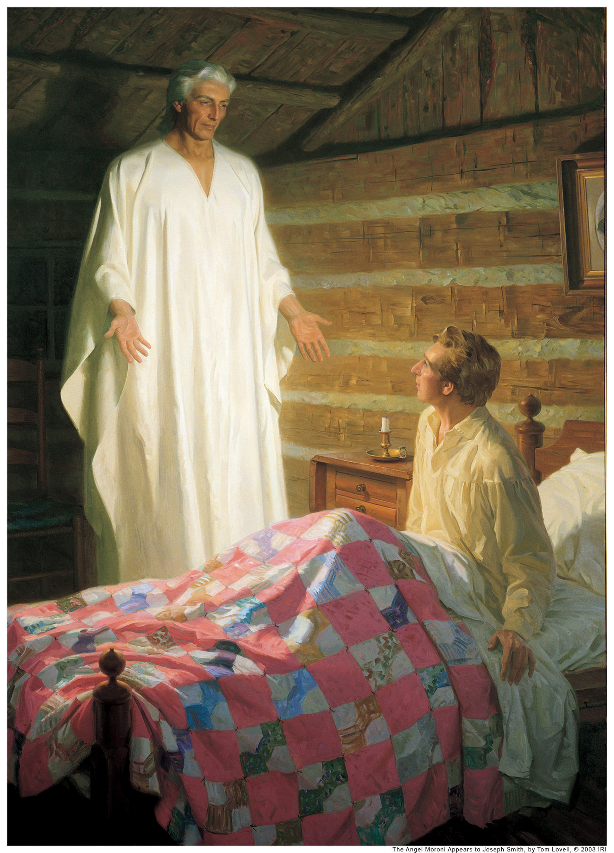
Mormonism – Origin/History
Joseph Smith
Vision of Father and son (1820)
Vision of Angel Moroni (1823)
told him where to find the gold tablets
Urim and Thummin (Stones for translating)
Translated the book of Mormon (1829)
Returned plates to Angel Moroni in Cumorah cave (lost)
Brigham Young
Led pioneer movement of LDS to Utah (1847)
Became separatist society until around 20th century

Slide 31
Mormonism – Origin/History
Joseph Smith
Vision of Father and son (1820)
Vision of Angel Moroni (1823)
told him where to find the gold tablets
Urim and Thummin (Stones for translating)
Translated the book of Mormon (1829)
Returned plates to Angel Moroni in Cumorah cave (lost)
Brigham Young
Led pioneer movement of LDS to Utah (1847)
Became separatist society until around 20th century

Slide 32
Mormonism – Origin/History
Joseph Smith
Vision of Father and son (1820)
Vision of Angel Moroni (1823)
told him where to find the gold tablets
Urim and Thummin (Stones for translating)
Translated the book of Mormon (1829)
Returned plates to Angel Moroni in Cumorah cave (lost)
Brigham Young
Led pioneer movement of LDS to Utah (1847)
Became separatist society until around 20th century

Slide 33
Mormonism – Main Doctrine
13 Articles of Mormon Faith
Words of Wisdom
The Book of Mormon and the King James Bible
Modern day Prophets and Apostles
Priesthood
5 Steps of the Gospel (Faith, Repent, Baptism, Holy Ghost, Enduring until the End)
Bodily resurrection with family

Slide 34
Mormonism – Modern Practice
Tithe
Two year mission
Following the “Words of Wisdom” (abstaining from tobacco, caffeine, alcohol, practicing chastity, etc)
Wearing the temple under garment at all time when possible
Submission to elders and prophets
Temple worship procedures

Slide 35
Mormonism – Modern Practice
Tithe
Two year mission
Following the “Words of Wisdom” (abstaining from tobacco, caffeine, alcohol, practicing chastity, etc)
Wearing the temple under garment at all time when possible
Submission to elders and prophets
Temple worship procedures

Slide 36
Mormonism – Modern Practice
Tithe
Two year mission
Following the “Words of Wisdom” (abstaining from tobacco, caffeine, alcohol, practicing chastity, etc)
Wearing the temple under garment at all time when possible
Submission to elders and prophets
Temple worship procedures

Slide 37
Mormonism – FAQ’s
Are Mormon’s polygamous?
Not anymore. They did until 1890, according to a revelation to Wilford Woodruff
What goes on in a Mormon Temple?
https://www.youtube.com/watch?v=leKK2YAzLWE
https://www.youtube.com/watch?v=VngM80qCOJw
Do Mormon’s believe Jesus is God?
No. Mormons believe the Godhead is “3 beings” with “1 Purpose.” By Christian definitions they are tri-theists.
Mormons believe Jesus is the firstborn son of God. They do not believe he is the same “essence” as God, nor do they believe he existed in eternity past with the Father.

Slide 38
Mormonism – FAQ’s
Do Mormons believe they’ll get their own planet?
Not that I’ve seen. Their official public doctrines state: “There are three kingdoms of glory: the celestial kingdom, the terrestrial kingdom, and the telestial kingdom (see 1 Corinthians 15:40–42). Those who are valiant in the testimony of Jesus and obedient to the principles of the gospel will dwell in the celestial kingdom in the presence of God the Father and His Son, Jesus Christ, and with their righteous family members.”
Mormons do believe they can only be saved by obedience, baptism, and receiving the “gift of the Spirit”
Mormons believe which Kingdom you end up in is a direct result of how well you followed the “the narrow path” in this life

Slide 39
Mormonism – FAQ’s
Do Mormons believe Jesus and Satan were brothers?
Yes. Their mastery of core doctrine states: “Those who followed Heavenly Father and Jesus Christ were permitted to come to the earth to experience mortality and progress toward eternal life. Lucifer, another spirit son of God, rebelled against the plan. He became Satan, and he and his followers were cast out of heaven and denied the privileges of receiving a physical body and experiencing mortality.”

Slide 40
Mormonism – FAQ’s
Will Mormons be saved?
If they knowingly reject the gospel that they are saved by grace through faith, and instead believe a gospel based on works, then no.
It is possible that some Mormons will be saved, though if they have progressed far in the Mormon church, it is highly unlikely.

Slide 41
Mormonism – Christian?
Are Mormons Christians?
Definition of Christian: “Those who have believed the gospel that they are saved by grace alone through faith alone, in the finished work of Christ on the cross, and that by believing have the hope of resurrection, life, in his name.”
By this definition, Mormons are not Christians.
By looser definitions, they are Christians.
Telling Mormons that they aren’t Christians is unhelpful, clarifying the definition of Christian for Mormons from the scriptures, is.

Slide 42
Questions?

Slide 43
Some Shocking Similarities
Both religions began as offshoots of Judeo-Christianity
Both religions began by one man receiving a special revelation from an angel (cf. Gal 1:6-8; 2 Cor 11:3-4)
Both religions have an additional Holy book in addition to affirming parts (or all) of the Old and New Testaments
Both religions place their additional Holy book as equal to scripture
Both religions have only one line of transmission of that Holy Book
Both religions require a list of minimum requirements be met for salvation

