Slide 1
Concerning Jesus
Historicity, Divinity, the Resurrection
By Stephen Curto
For Homegroup
December 2, 2018

Slide 2
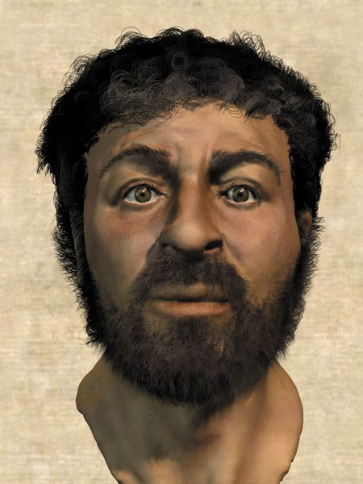
Historicity
Definition
The question of the degree to which current records of Jesus relay the historical facts of the man, if he existed.
i.e. Did Jesus really exist, and how do we know?

Slide 3
Historicity
Historical Records
Christian
Gospels (Mathew, Mark, Luke, John)
Epistolary References (Remaining New Testament)
Church Fathers (Clement, Polycarp, Irenaeus, etc.)
Non-Christian
Gnostic Gospels (Thomas, Peter, Barnabas, etc.)
Historians (Josephus, Thallus, Tacitus, Pliny, etc.)
Philosophers/Writers (Lucian of Samosata, Mara Bar Serapion, etc.)
Religious Texts (Talmuds, Koran, Toledoth Jesus, etc.)

Slide 4
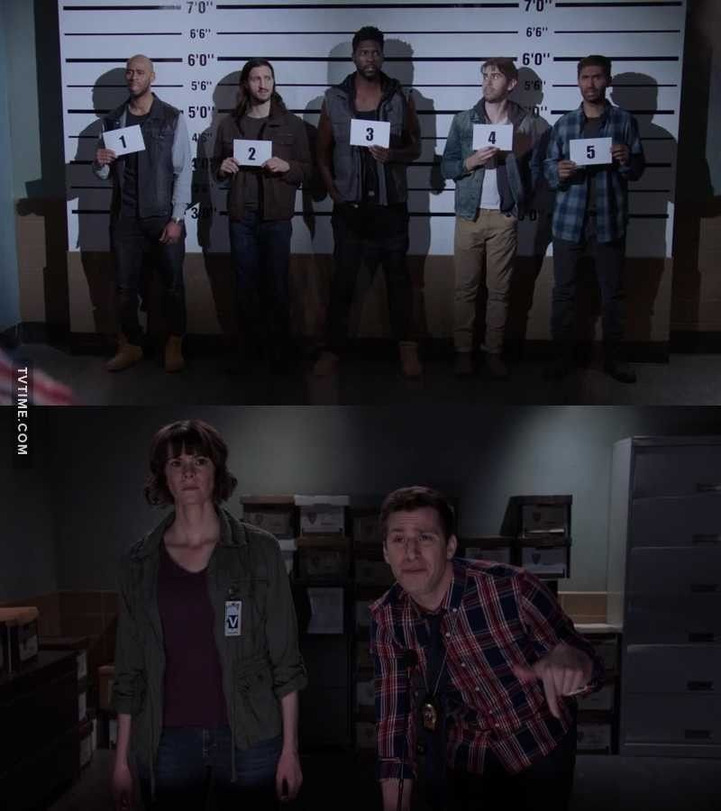
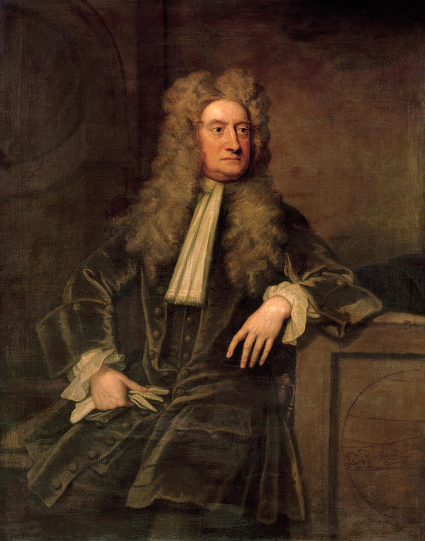
Historicity
Qualities of Christian Sources
Internally consistent/cohesive story between Testaments
and converts thereof
Geographically verifiable
Realistic or fictionalized?
Effect on History
What year is it?
Western Civilization
Science

Slide 5
Divinity
Do Muslims and Christians worship the same God?
Do Jews and Christians worship the same God?
Do you believe Jesus was/is God? Why or why not?

Slide 6
Divinity
Do Muslims and Christians worship the same God?
Do Jews and Christians worship the same God?
Do you believe Jesus was/is God? Why or why not?

Slide 7
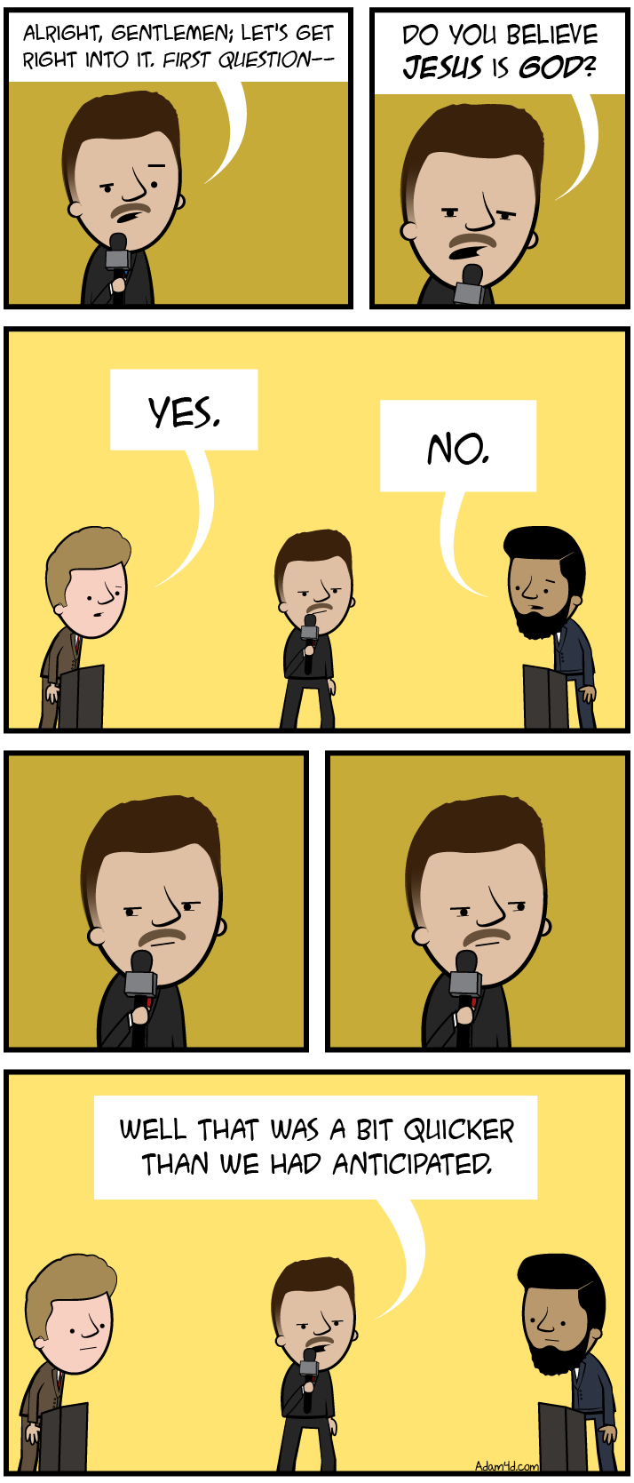
Divinity
Do Muslims and Christians worship the same God?
Do Jews and Christians worship the same God?
Do you believe Jesus was/is God? Why or why not?

Slide 8
Divinity
Do Muslims and Christians worship the same God?
Do Jews and Christians worship the same God?
Do you believe Jesus was/is God? Why or why not?

Slide 9
Divinity
Jesus’s claims about himself
John 5:16-47; 8:58; 10:22-40; Matthew 28:19; Rev 1:17-18
Followers’ claims about Jesus
Ephesians 1:1-14 ;Phil 2:5-11 ; Hebrews 1:1-5
Lewis Trilemma
Mark 2:9
Mere Christianity, Book 2, Chapter 3

Slide 10
What IS Christianity?

Slide 11
The Resurrection
The resurrection is THE central tenant of Christianity. Christ’s resurrection, and thus the hope of our own in the future, IS Christianity.
1 Corinthians 15:1-26

Slide 12
The Resurrection
The final line of defense for the “atheist”
I can’t deny the existence of truth…
…so I can’t deny the existence of God…
…so I can’t deny the Bible’s veracity…
…so I can’t deny the existence of Jesus as a historical figure…
…so I can’t deny that he was from God…
… but I’ll still deny that he came back from the dead!

Slide 13
The Resurrection
Denial of the resurrection is nothing new.
Matthew 28:11-15
Modern Denials of the resurrection:
The Unknown Tomb
The Wrong Tomb Theory
The Hallucination Theory
The Body Was Stolen By the Disciples
Existential Resurrection View
Swoon Theory
Notes:
Existential resurrection (Jesus is in the tomb, but it doesn’t matter, cause Christ was raised in your heart.- Marcus Borg)

