Slide 1
Revelation Pt 8
7 Bowls & Lunch Break #4 (Ch 15-18)
By Stephen Curto
For Homegroup
May 5, 2019

Slide 2
Our Outline
Overview/Outline of Book/"Things That are Seen" (Ch. 1)
"Things that Are" (Ch. 2-3)
After these Things: Heavenly Scene (Ch 4-5)
The Seal Judgments, 1st (((The 144,000 and The Multitude))) (6:1-8:5)
Trumpet Judgments 1-6 (Ch8-9)
2nd (((7 Thunders and Little Book; Two Witnesses))) 7th Trumpet Judgment (10:1-11:14)
3rd (((Israel’s Flight; Two Beasts; 5 scenes of hope))) (Ch. 12-14)
Bowl Judgments; 4th (((Babylon’s Fall))) (15:1-18)
Marriage Supper; 2nd Coming, Millennial Kingdom (Ch 19-20)
Millennial Kingdom (2nd pass) Eternal State (Ch. 21-22)

Slide 3
Context

Slide 4
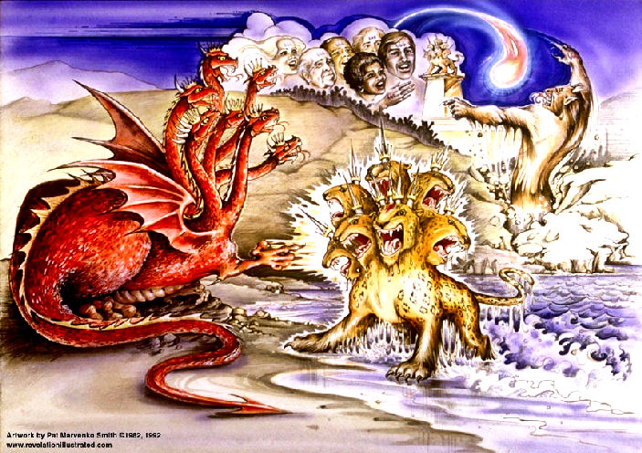
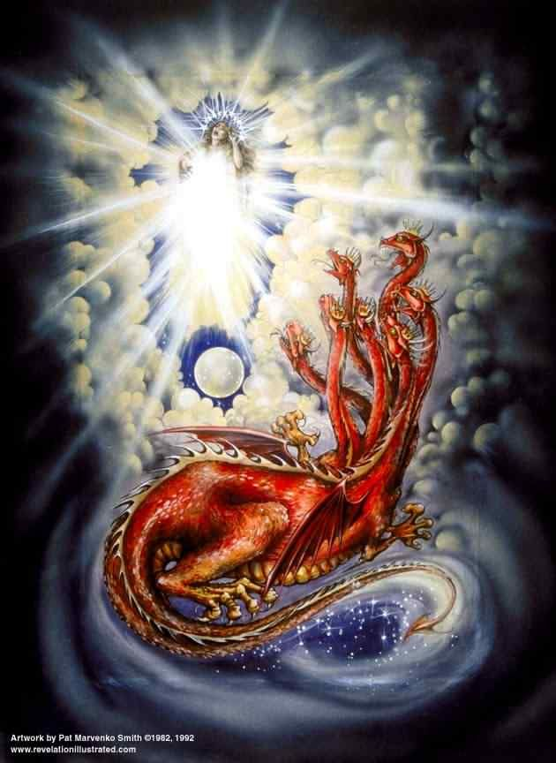
Review

Slide 5
Outline
7 Bowls (Ch 15-16)
Babylon’s Fall (Ch 17-18)

Slide 6
7 Bowls (Ch 15-16)
“7 plagues, the last, because in them the wrath of God is complete.” (15:1)
“those victorious over the beast…” (15:2)
Who are these people and where are they?
“The song of Moses” (cf. Deut 31-32)
“One of the four living creatures gave to the seven angels seven golden bowls full of the wrath of God and from is power” (15:7)

Slide 7
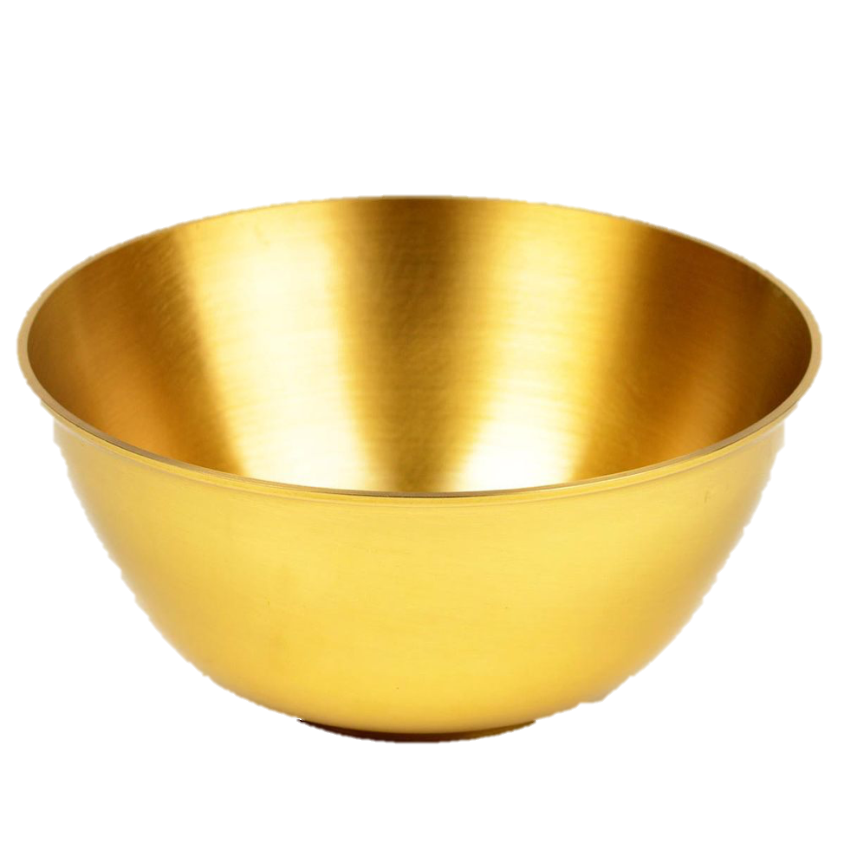
7 Bowls (Ch 15-16)
Beast’s throne and kingdom darkened; more blasphemy
“It has taken place.”; total chaos; hail; more blasphemy
Sores on beast worshippers
Sea like blood; everything in sea dies
Fresh waters like blood; Praise for God in judging
Sun scorches; men blaspheme instead of repent
Euphrates dried for gathering at Meggido

Slide 8
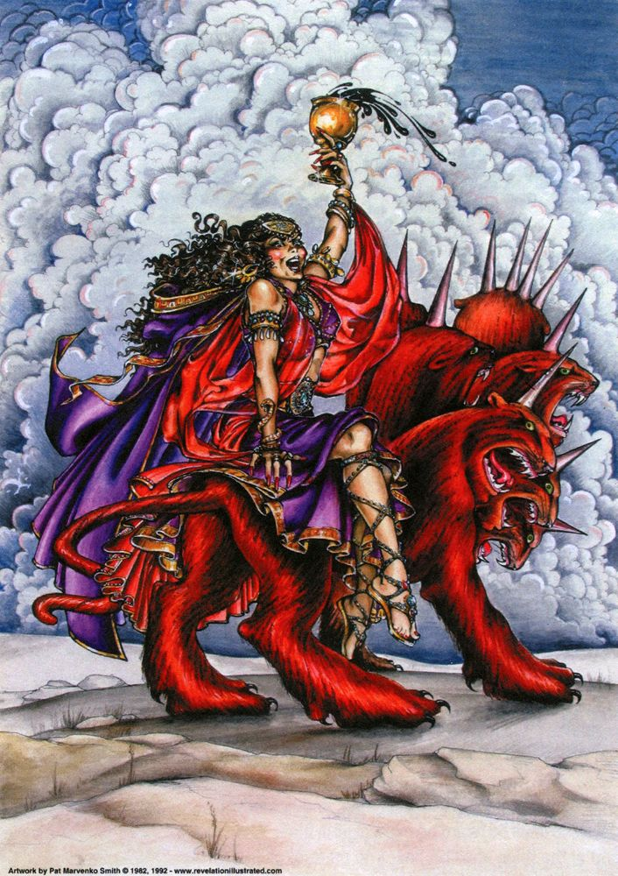
Babylon’s Fall (Ch 17-18)
“The great harlot who sits on many waters with whom the kings of the earth committed immorality, and those who dwell on the earth were made drunk with the wine of her immorality.” (17:1-2)
What facts about this city are given in these verses? Are they literal or figurative?

Slide 9
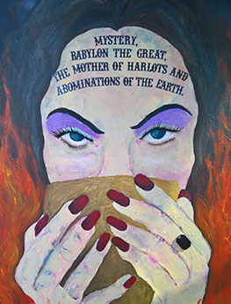
Babylon’s Fall (Ch 17-18)
Woman
Sitting on red beast
Wearing purple, red, gold, gems
Holding cup full of abominations
Sign on her forehead
“Babylon the great…”
Drunk with blood of saints/witnesses of Jesus
Made desolate, naked, eaten and burned by beast’s nations/kings

Slide 10
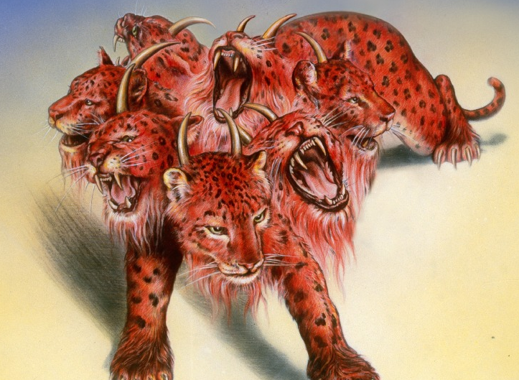
Babylon’s Fall (Ch 17-18)
Beast
Full of blasphemous names (cf. 13:1)
7 heads, 10 horns (cf 12:3; 13:1)
“was and is not, and is about to come up out of the abyss and go to destruction” (cf 9:11; 11:7; 20:1-3)
Will infatuate many
7 heads=7 mountains/kings
Beast is an 8th
10 horns=10 kings not yet with a kingdom
War with the lamb; Desolate/strip/eat/burn the woman

Slide 11
Babylon’s Fall (Ch 17-18)
Major interpretations for “Babylon”:
Literal Babylon (Modern Day Iraq)
Rome (City of the 7 Hills)
World Politico-Religious Systems (That which rides on the back of the world’s governments, and goes after other gods)
Unrepentant Israel (Ezek 16 and contrast with remnant of Rev 12)
Isaiah 46-47

Slide 12
Babylon’s Fall (Ch 17-18)
“After these things I saw another angel coming down from heaven, having great authority, and the earth was illumined with his glory…” (18:1)
Babylon is fallen and this is why (18:2-3)
“Come out of her, my people, so that you will not participate in her sins and receive her plagues… in one day her plagues will come…” (18:4-8)
Isaiah 47:7ff

Slide 13
Babylon’s Fall (Ch 17-18)
Economic destruction of Babylon (18:9-19)
Call to rejoice (18:20)
Cultural destruction of Babylon = millstone (18:21-24)

