Slide 1
Mormonism and Jehovah’s Witnesses
By Stephen Curto
For C3 Apologetics
March 8, 2020

Slide 2
Outline
Preliminary Thoughts
Mormonism
Origin/History
Main Doctrines
Christian?
Jehovah’s Witnesses
Origin/History
Main Doctrines
Christian?
Reaching Both Groups

Slide 3
Preliminary Thoughts
I’m not an expert, I’m still learning
The thought of this presentation
No time for in-depth treatment in class
Broad overview with most important theological differences highlighted
Cultural differences and FAQ’s from the Evangelical perspective are overlooked, but available in second handout
Powerpoint and handout intended as reference material for further study (There’s more here than we have time to cover)

Slide 4
Preliminary Thoughts
What constitutes “Mormonism” and “being a Jehovah’s Witness”?
Is it what their holy books teach, what the majority of their adherents practice, what their founders claimed?
What constitutes “Christianity”?
This presentation will give more credence to what the holy books and/or founders and official church statements of the particular religion has established as doctrine to evaluate claims.

Slide 5
Mormonism – Origin/History
Joseph Smith
Vision of Father and Son (1820)
Vision of Angel Moroni (1823)
Where to find the gold tablets
Urim and Thummin (Stones for translating)
Translated the book of Mormon (1829)
Returned plates to Angel Moroni in Cumorah cave (lost)
Brigham Young
Led pioneer movement of LDS to Utah (1847)
Became separatist society until around 20th century

Slide 6
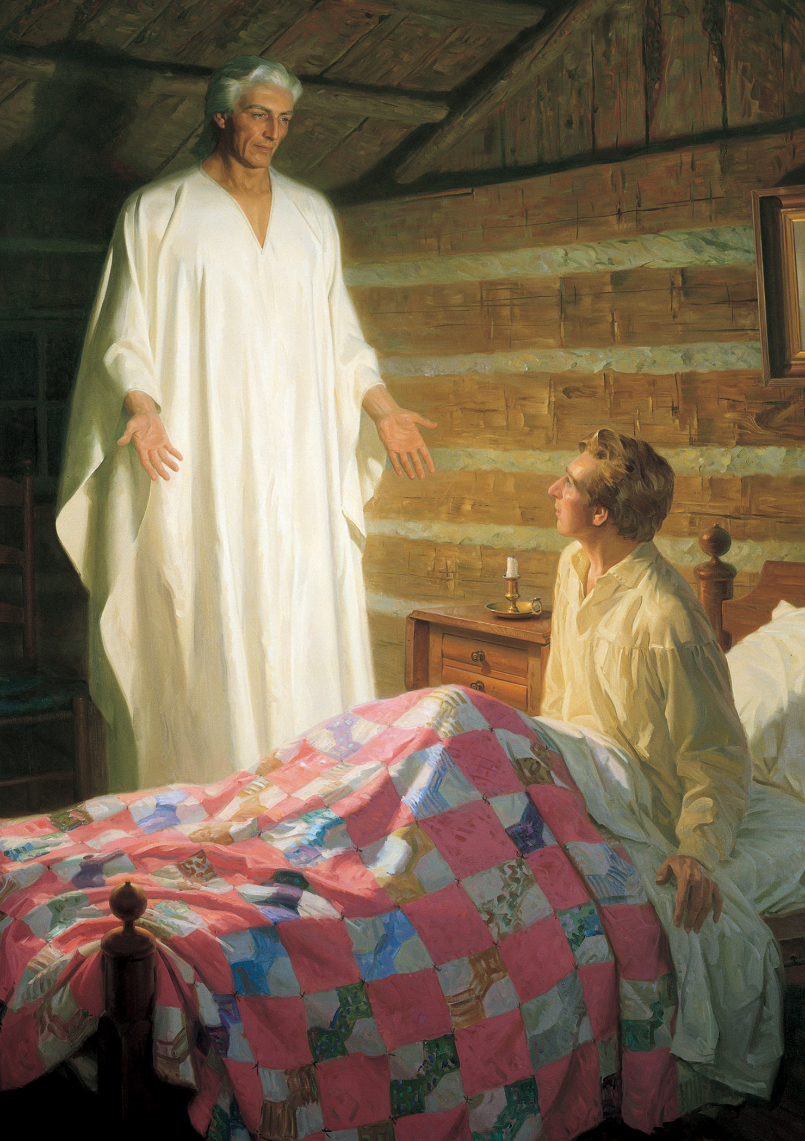
Mormonism – Origin/History
Joseph Smith
Vision of Father and Son (1820)
Vision of Angel Moroni (1823)
Where to find the gold tablets
Urim and Thummin (Stones for translating)
Translated the book of Mormon (1829)
Returned plates to Angel Moroni in Cumorah cave (lost)
Brigham Young
Led pioneer movement of LDS to Utah (1847)
Became separatist society until around 20th century

Slide 7
Mormonism – Origin/History
Joseph Smith
Vision of Father and Son (1820)
Vision of Angel Moroni (1823)
Where to find the gold tablets
Urim and Thummin (Stones for translating)
Translated the book of Mormon (1829)
Returned plates to Angel Moroni in Cumorah cave (lost)
Brigham Young
Led pioneer movement of LDS to Utah (1847)
Became separatist society until around 20th century

Slide 8
Mormonism – Origin/History
Joseph Smith
Vision of Father and Son (1820)
Vision of Angel Moroni (1823)
Where to find the gold tablets
Urim and Thummin (Stones for translating)
Translated the book of Mormon (1829)
Returned plates to Angel Moroni in Cumorah cave (lost)
Brigham Young
Led pioneer movement of LDS to Utah (1847)
Became separatist society until around 20th century

Slide 9
Mormonism – Main Doctrine Summary
13 Articles of Mormon Faith
Doctrinal Mastery Core Document
Texts:
Book of Mormon, King James Bible – Inspired books
Pearl of Great Price, Doctrine and Covenants – Canonized
5 Steps of the Gospel (see Article 4)
Bodily resurrection with family
“Word of Wisdom” (No wine, caffeine, tobacco, etc.)

Slide 10
Mormonism – Main Doctrines
Highlighted Selections of the 13 Articles:
“3. That through Christ’s Atonement, we can be saved by obedience to the laws and ordinances of the gospel.”
“4. That faith in Jesus Christ, repentance, baptism by immersion, confirmation, and receiving the gift of the Holy Ghost are all necessary for salvation.”
“8. That the Bible and Book of Mormon are both divinely revealed scripture.”

Slide 11
Mormonism – Main Doctrines
Highlighted Selections “Doctrinal Mastery Core Doc.”:
“There are three separate personages in the Godhead: God, the Eternal Father; His Son, Jesus Christ; and the Holy Ghost. The Father and the Son have tangible, glorified bodies of flesh and bone, and the Holy Ghost is a personage of spirit (see D&C 130:22–23). They are one in purpose and are perfectly united in bringing to pass Heavenly Father’s plan of salvation.”
“God the Father is the Supreme Being whom we worship.”

Slide 12
Mormonism – Main Doctrines
Highlighted Selections “Doctrinal Mastery Core Doc.”:
“Before we were born on the earth, we lived in the presence of our Heavenly Father as His spirit children. In this premortal existence we participated in a council with Heavenly Father’s other spirit children. During that council Heavenly Father presented His plan and the premortal Jesus Christ covenanted to be the Savior […] Those who followed Heavenly Father and Jesus Christ were permitted to come to the earth to experience mortality and progress toward eternal life. Lucifer, another spirit son of God, rebelled against the plan. He became Satan, and he and his followers were cast out of heaven and denied the privileges of receiving a physical body and experiencing mortality.”

Slide 13
Mormonism – Main Doctrines
Highlighted Selections “Doctrinal Mastery Core Doc.”:
“The Fall is an essential part of Heavenly Father’s plan of salvation. As a result of the Fall, Adam and Eve could have children. They and their posterity could experience joy and sorrow, know good from evil, and progress.”

Slide 14
Mormonism – Main Doctrines
Highlighted Selections “Doctrinal Mastery Core Doc.”:
“There are three kingdoms of glory: the celestial kingdom, the terrestrial kingdom, and the telestial kingdom. Those who are valiant in the testimony of Jesus and obedient to the principles of the gospel will dwell in the celestial kingdom in the presence of God the Father and His Son, Jesus Christ, and with their righteous family members.”

Slide 15
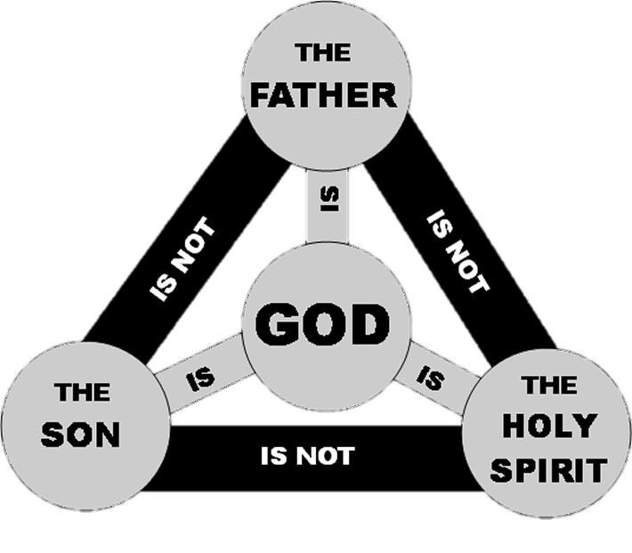
Mormonism – Christian?
Doctrine of Trinity
God is one Being eternally manifest in three Persons.
Key Language:
3 Persons.
1 Essence/Being.
Athanasian Creed
Nicene Creed
Lutheran Satire - “St. Patrick’s Bad Analogies”

Slide 16
Mormonism – Christian?
Doctrine of Trinity
Contributing Passages which help form the doctrine:
One-ness
Deut 6:4; Ex 20:3; Is 45:14; 1 Cor 8:4-6; Eph 4:3-6; Jam 2:19
Three-ness
Deity of “the Father” - Jn 6:27; 1 Pet 1:2; 1 Cor 8:6; Rom 1:7
Deity of “the Son” - Heb 1:3-4; Matt 1:21-23; Jn 1:1; 8:58; 10:30; Col 1:15
Deity of “the Spirit” - Acts 5:3-4; 1 Cor 2:10; 6:19
Other Contributing Passages
Matt 28:19; 3:16-17; 2 Cor 13:14

Slide 17
Mormonism – Christian?
Doctrine of Salvation
Salvation is solely of God and not at all of man.
Salvation is the free gift of God that comes by faith alone in Jesus Christ.
1 Cor 15; Gal 2-3; Rom 1-8; Eph 2:8-10
Grace alone, not Grace plus works.
Lutheran Satire – “Donall and Conall Convince the Mormon Missionaries…”

Slide 18
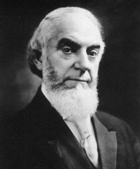
Jehovah’s Witnesses – Origin/History
Charles Taze - “The Pastor”
Born Feb 16, 1852
Started Bible Class in Pittsburgh 1870
Founded magazine The Herald of the Morning 1879 (which later became The Watchtower Announcing Jehovah’s Kingdom)
Incorporated “Zion’s Watchtower Tract Society” 1886
J.F. Rutherford
Led larger faction of a split after Russell’s death 1917
Name “Jehovah’s Witnesses” adopted to distinguish factions

Slide 19
Jehovah’s Witnesses – Origin/History
Charles Taze - “The Pastor”
Born Feb 16, 1852
Started Bible Class in Pittsburgh 1870
Founded magazine The Herald of the Morning 1879 (which later became The Watchtower Announcing Jehovah’s Kingdom)
Incorporated “Zion’s Watchtower Tract Society” 1886
J.F. Rutherford
Led larger faction of a split after Russell’s death 1917
Name “Jehovah’s Witnesses” adopted to distinguish factions

Slide 20
Jehovah’s Witnesses – Origin/History
Charles Taze Personal Issues
The Brooklyn Daily Eagle led fight to expose Taze as a fraud
Ran “Miracle Wheat” advertising scheme to fund Watchtower
Wife divorced and sued him under a claim of mental cruelty
Rev J.J. Ross published anti-Russell pamphlet about which Russell sued for libel and in court committed multiple documented counts of perjury

Slide 21
Jehovah’s Witnesses – Main Doctrine Summary
15 Basic Beliefs of Jehovah’s Witnesses.
There is one God and his name is Jehovah.
Jesus is important, but different from God.
Jesus returned to earth in 1914 as the invisible Logos working to overthrow Satan and establish kingdom.
Texts:
New World Translation of Bible – Authoritative translation
All “Watchtower” Publications – “Helpful Bible Study tools”
Annihilationist view of hell

Slide 22
Jehovah’s Witnesses – Main Doctrines
Jesus is important, but different from God.
Jesus is “God’s Son”
Jesus was one of Jehovah’s “perfect spirit sons”
Jesus was Jehovah’s first creation, but not eternally exiting
Uses Col 1:15 as support
Modern form of ancient heresy “Arianism,” condemned at Nicaea 325 and Constantinople 381

Slide 23
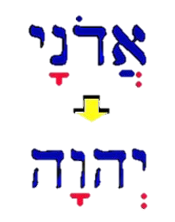
Jehovah’s Witnesses – Main Doctrines
There is one God and his name is Jehovah.
Emphasis on the fact that “Jehovah” is the proper English name of God
Firm belief that God is one personality
Salvation is dependent upon worshipping God “rightly” as one personality whose name is Jehovah

Slide 24
Jehovah’s Witnesses – Christian?
Doctrine of Trinity
God is one Being eternally manifest in three Persons.
Key Language:
3 Persons.
1 Essence/Being.
Athanasian Creed
Nicene Creed
Lutheran Satire – “Donall and Conall Meet the JWs”

Slide 25
Jehovah’s Witnesses – Christian?
Doctrine of Christ
The denial of Jesus Christ in either His humanity or deity is the spirit of antichrist. (1 John 3:23; 4:1-3)
Jesus is “Fully God and fully Man.” (John 8:58; John 1:1ff)
Jesus’s enemies recognized his claims to deity (John 5:18)
Chalcedonian Definition
Lutheran Satire – “Donall and Conall Learn that Jesus isn’t Divine”

Slide 26
Reaching Both Groups
Listen carefully
Define terms
Don’t get distracted
Preach the gospel, emphasizing its trinitarian nature.
Grace alone.
Faith alone.
God-incarnate’s perfect sacrifice

