Slide 1
Worldview: an Introduction
By Stephen Curto
For Homegroup
August 14, 2016

Slide 2
Outline
What is a worldview?
What are the common worldviews?
Why study it/How to use it?

Slide 3
1. What is a worldview?
“A worldview is simply the total of our beliefs about the world, the ‘big picture’ that directs our daily decisions and actions.”-Chuck Colson & Nancy Pearcey, How Now Shall We Live?
“A habituated way of seeing and doing.” -Paul Shockley
core beliefs which determine how we live
Everyone has one. No exceptions.

Slide 4
1. What is a worldview?
A person’s worldview tells you:
What they truly believe
How they live on a daily basis
What sort of pains they’ve had in life
Where you should start in your apologetics

Slide 5
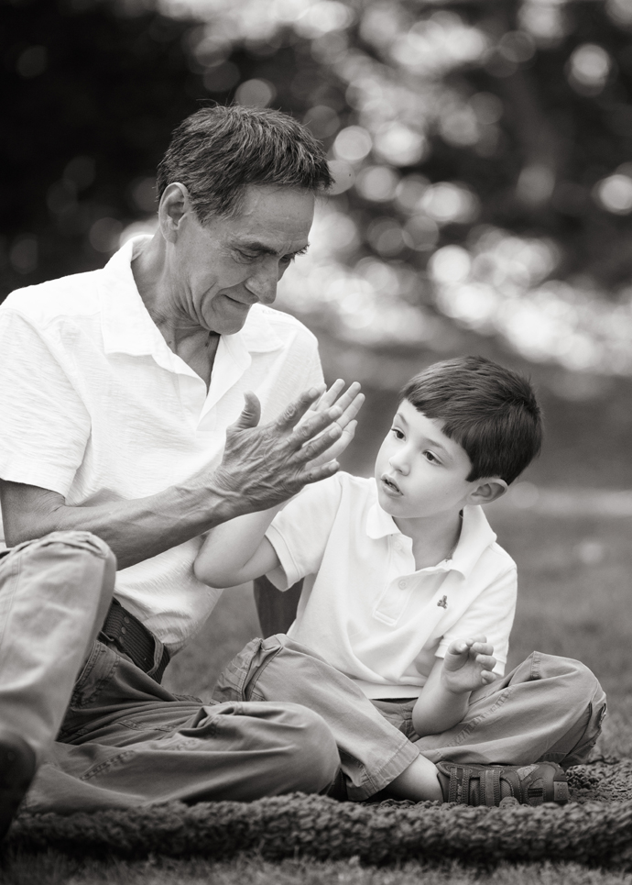
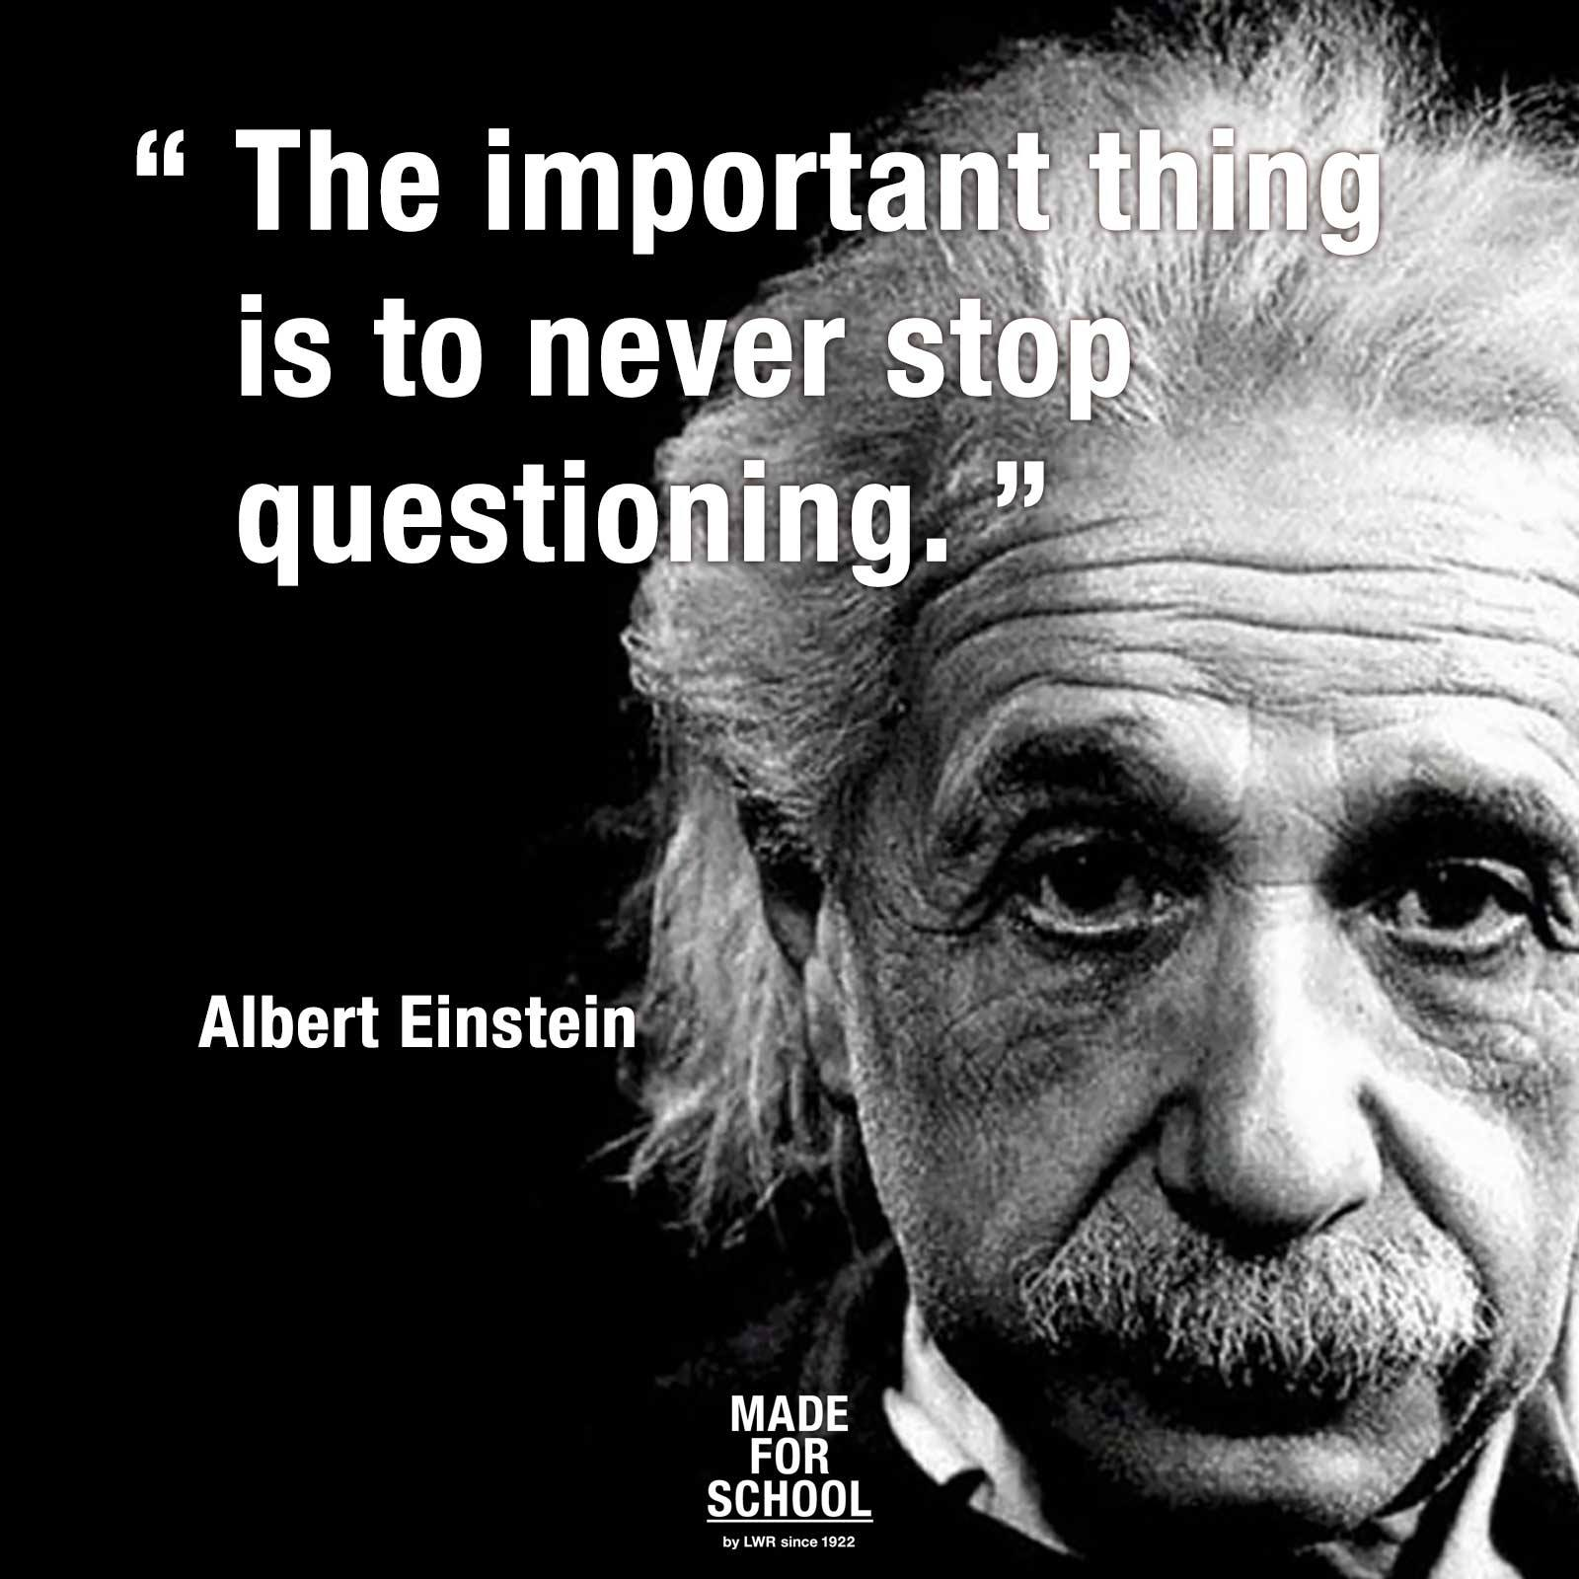
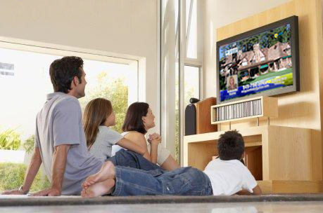
1. What is a worldview?
How are worldviews formed?
Informally
Uncritically
Inter-generationally
By community
Over time
By habit

Slide 6
1. What is a worldview?
The 7 Components of any worldview:
View of God
View of Truth
View of Reality
View of Knowledge
View of Ethics
View of Humanity
View of Evil

Slide 7
1. What is a worldview?
The 7 Components of any worldview:
View of God
View of Truth
View of Reality
View of Knowledge
View of Ethics
View of Humanity
View of Evil

Slide 8
1. What is a worldview?
“People almost invariably arrive at their beliefs not on the basis of proof, but on the basis of what they find attractive.”
–Blaise Pascal, 17th century French Philosopher

Slide 9
2. What are the common worldviews?
Naturalistic
Postmodern
Pantheistic
Polytheistic
Monotheistic
Biblical

Slide 10
2. What are the common worldviews?
Naturalistic
VIEW OF GOD
ATHEISM:
There is no God.
AGNOSTICISM:
There is not enough information to determine whether God exists.
SECULAR EXISTENTIALISM:
God does not exist so humanity must learn to live without Him.
VIEW OF MAN
Chance product of evolution
Entirely material, “biological machine”
Man is finite and will on day become extinct
There is no afterlife
There is no such thing as “sin”
VIEW OF TRUTH
Scientific proof
Knowledge gained by five senses
Only that which can be observed with the five senses is accepted as real
VIEW OF ETHICS
No objective prescriptive values
Morals are individual preferences or products of society
Conscience is a product of evolution

Slide 11
2. What are the common worldviews?
Postmodern
VIEW OF GOD
NEW AGE SPIRITUALISM:
God is all of us.
NON-THEISM:
“I believe there’s a God, but I don’t really at the same time.”
VIEW OF MAN
Humans are pawns in cultural-reality
They are products of their cultural/ social setting
Could be a product of evolution
VIEW OF TRUTH
Truth is what you want it to be
Truth is an illusion and subject to change
There are no universal truths
Truth is what you personally hold as meaningful
VIEW OF ETHICS
No moral objectives
Anti-authoritarian
Values are social constructs and mental organizers with no source
Tolerance is a prized virtue

Slide 12
2. What are the common worldviews?
Biblical
VIEW OF GOD
Doctrines that the church holds universally true.
(Theology, Trinity, Pneumatology, Christology, etc.)
God is a personal being revealed in the Bible
God created everything, reality as we know it.
God is active today and loves His creation.
VIEW OF MAN
Man is made in the image of God
Man was created by God, but is fallen
Evil is something that has entered this world as a result of free will, God did not create it
Man is saved by grace through faith
Man has a spiritual eternal component and a fleshly temporal one
VIEW OF TRUTH
Truth based in reality, knowable, found in the bible and in Jesus the son of God.
Truth is universal and absolute.
Truth is coherent and logical.
Truth is exclusive. (some things are by nature, false, or not true)
VIEW OF ETHICS
Morals are the objective values sourced in the Bible
Natural moral law is written on the hearts of man
Men are stewards of God’s moral judgments

Slide 13
3. Why study it/How to use it?
Reasons to Study Worldviews:
It answers ethical/moral questions
What should I believe about this issue?
How should I respond to this event?
It answers philosophic questions
What is truth and reality?
How do different people answer the big questions of life?
It answers practical questions
What will I do next because of my worldview?
How will so-and-so act because of his worldview?

Slide 14
3. Why study it/How to use it?
Questions for determining someone’s worldview:
“Where do you think we came from?” “What are we humans?”
“What do you think happens when we die?”
“What has gone wrong with this world?” “Can you believe the evil stuff happening?”
“What do you think we should do to fix this world?”

Slide 15
My Worldview
Questions to ask yourself about your worldview:
What is real?
What are the nature and limits of knowledge?
What is good? How do I live a good life?
What is a “good person”?
How does one become a “good person”?
What do I believe about the 7 components of a worldview?

