Slide 1
An Introduction to Theology
Overview
By Stephen Curto
For Homegroup
July 10, 2016

Slide 2
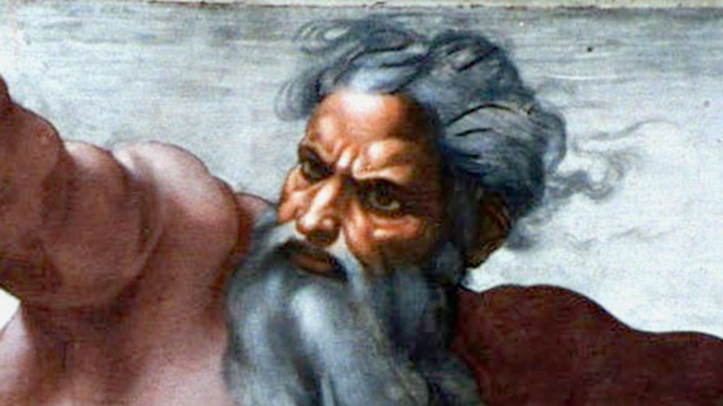
What is Theology?
Theos God
Logos word
Theology is words about (the study of) God
Everyone Does Theology.

Slide 3
Categories In Theology
Prolegomena (Introduction to Theology [“First Things Said”])
Theology Proper (Study of God: Father, Son, and Spirit)
Christology (Study of the Christ)
Pneumatology (Study of the Spirit)
Angelology (Study of Angels)
Demonology (Study of Demons)
Satanology (Study of the Devil)
Anthropology (Study of Mankind)
Hamartiology (Study of Sin)
Soteriology (Study of Salvation)
Ecclesiology (Study of the Church)
Eschatology (Study of Last Things)
Bibliology (Study of the Bible)

Slide 4
How is Theology Done?
Read the Revelation
Interpret the Information
Synthesize the Supposition

Slide 5
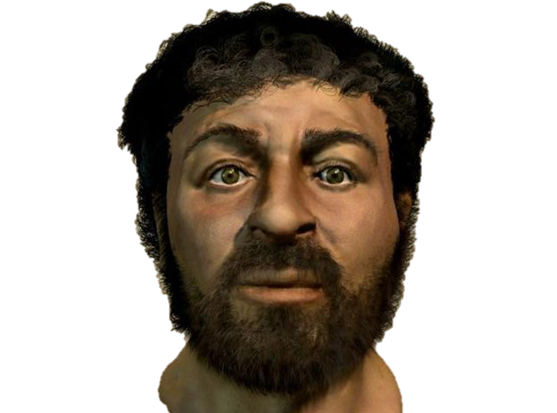
How is Theology Done?
Read the Revelation
3 sources of revelation
Biblical Text
The Person and Work of Jesus
Creation/Created Order
Keep Observations orderly
Do not to add to your observations.
Interpret the Information
Synthesize the Supposition

Slide 6
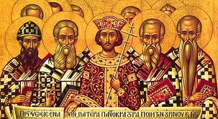
How is Theology Done?
Read the Revelation
Interpret the Information
Consult non-revelation sources
Church fathers writings
Traditions of the church
Creeds
Commentaries
Determine what is meant in each instance
Synthesize the Supposition

Slide 7
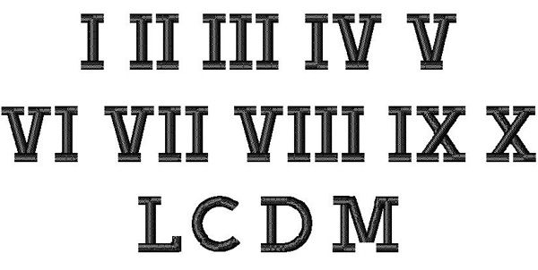
How is Theology Done?
Read the Revelation
Interpret the Information
Synthesize the Supposition
- Identify and enumerate the commonalities

Slide 8
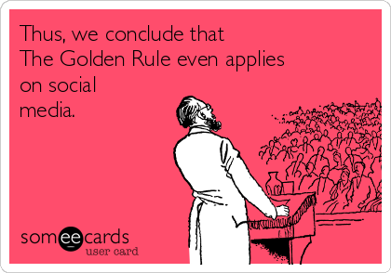
A Note
Systematic Theology is made up entirely of conclusions.

Slide 9
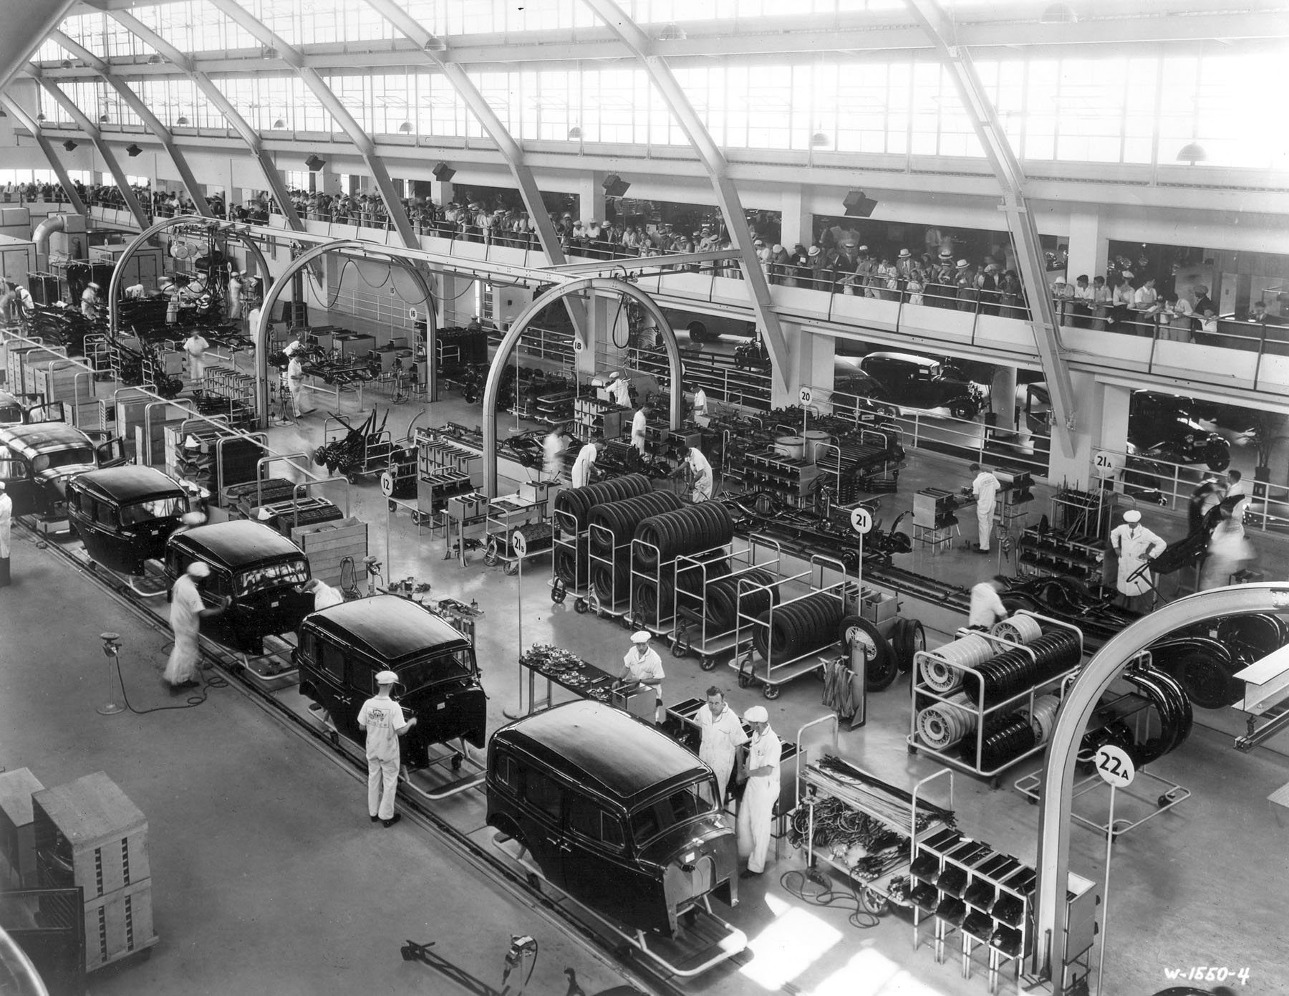
Types of Theology
Systematic Theology: The process of doing theology where any revelation is systematically reviewed, concluded upon, and placed into interpretive categories.

Slide 10
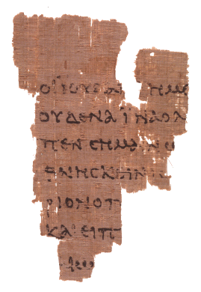
Types of Theology
Biblical Theology: A type of systematic theology that looks primarily to the Bible for revelation.

Slide 11
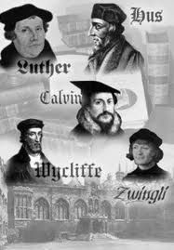
Types of Theology
Historical Theology: A type of systematic theology that looks to historic interpretations as the primary means of constructing interpretive conclusions.

Slide 12
A Question of Authority
When doing theology, where do you look for authority?
The Bible?
Tradition?
Science?
Reasons?
Conscience?
Scholars?
Feelings?
When doing Biblical theology, are you over or under the text?

Slide 13
An Example of Theology Done
Charles Ryrie’s Basic Theology Chapter 31

Slide 14
Recommended Systematic Theologies
Systematic Theology (8 Volumes in 4) by Lewis Sperry Chafer
Systematic Theology (3 Volumes) by Charles Hodge
Systematic Theology (in One Volume) by Norman Geisler
Systematic Theology: An Introduction to Christian Belief by John Frame
Basic Theology by Charles Ryrie
The Moody Handbook of Theology by Paul Enns

