Slide 1
Angelology
“Words About Angels”
By Stephen Curto
For Homegroup
April 9, 2017

Slide 2
Outline
Intro
Creation
Nature
Actions
Satan
Demons

Slide 3
Introduction
Definition:
Angel: heavenly messenger
αγγελος angelos – messenger, angel
מלך malak – messenger, angel
Purpose/Role:
Convey messages from God to humans?
Unknown

Slide 4
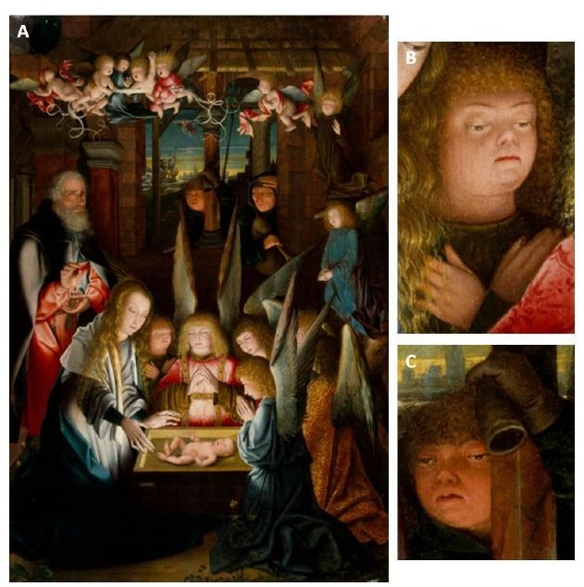
Creation
When were angels created?
Day 4? (Gen 1:15-19)
the “gap”? (Gen 1:1-3)
in “the beginning”? (Gen 1:1)
Between day 6 and 7?
If it’s true that Satan is a fallen angel, then angels must have been created before the events of Genesis 3. (cf. Job 38:4-7)

Slide 5
Nature
Wholly different from humans (Heb 1:14)
They study humans (1 Pet 1:10-12; Eph 3:10-11)
Various “types” or classes (Isaiah 6:2; Gen 3:24)
e.g. seraph, cherub
Archangels? (7 in Catholic Doctrine)
The Angel of the Lord? (Gen 16:7-12; 21:17-18; 22:11-18; Ex 3:2; Judg 2:1-4; 6:11-24; Zech 1:12; 3:1)

Slide 6
Facts
Created by Christ (Ps 148:1-7, Col 1:16)
Do Not Marry (Matt 22:30)
Some rebelled (1/3?) (Matt 25:41; Rev 12:1-9)
Carry messages (Luke 1-2; meaning of word)
Two named in Bible:
Michael (Rev 12; Jude)
Gabriel (Dan 8-9; Lk 1)

Slide 7
Perceived Actions
Worship God (Isaiah 6)
War (Rev 12; Jude 9; Dan 10:13)
Can take human forms (Gen 19; Gen 6?)
Don’t accept worship (Rev 22:8-9) (cf. Josh 5:13-15?)
Take human form? (Gen 18-19; Gen 6?)
Sin? (Jude 6-9)

Slide 8
Satan
satan and devil mean “adversary” or “enemy”
Personal being or impersonal force? (Gen 3; Matt 4:1-11; Luke 4:1-13; Job 1-3; Rev 12:9; 20:2)
Not an equal opposite to God.

Slide 9
Satan
Isaiah 14:(12-17)
Ezekiel 28:(1-15)
When did he fall?
Why did he fall?
Where is he headed? (Matt 25:41; Rev 19-20)

Slide 10
Demons
Genesis 6
Jude 6-9
1 Peter 3:17-20
Seen primarily in Gospels (e.g. Lk 4:33; Mark 5:1-20)

