Slide 1
Anthropology
“Words About Man”
By Stephen Curto
For Homegroup
February 26, 2017

Slide 2
Outline
Imago-Dei
Facets
Fall

Slide 3
Imago-Dei
Genesis 1:26-27
Then God said, “Let Us make man in Our image, according to Our likeness; and let them rule over the fish of the sea and over the birds of the sky and over the cattle and over all the earth, and over every creeping thing that creeps on the earth.” God created man in His own image, in the image of God He created him; male and female He created them.

Slide 4
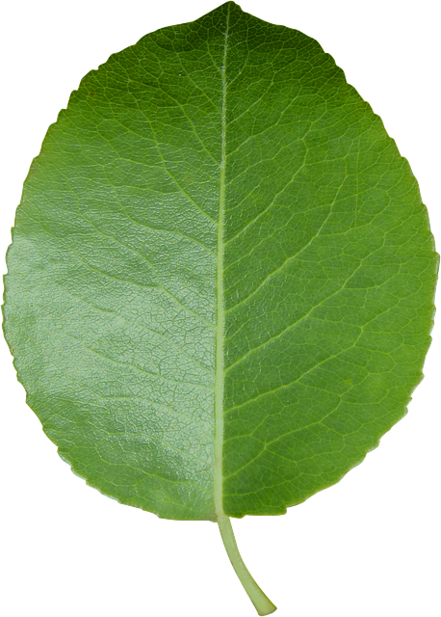
Imago-Dei
“Creation of Adam” by Michelangelo
Is there a difference between “image” and “likeness”?
heb. tselem and demuth, grk. imago and similitudo
What is included in the “image and likeness of God”?

Slide 5
Facets
Material
Current (2 Cor 4:5-12)
Resurrection 1 Cor 15:20-26 (context v1-26)
Immaterial
Soul/Spirit (Gen 2:7; Matt 10:28)
Conscience (Rom 2:14-16)
Mind (Rom 12:2)
Will (Rom 7:15-25)

Slide 6
Facets
Do Humans have free will?
Yes. All creatures are free to act according to their nature.
“The will always chooses according to its strongest inclination at the moment.” Jonathan Edwards
“Man has free will but lacks liberty.” Augustine

Slide 7
Facets
Kitty cat kitty cat where have you been?
I’ve been to England to see the queen.
Kitty cat kitty cat, what saw you there?
I saw a mouse under her chair.

Slide 8
Fall
Genesis 3
What were the causes of the fall?
What were the results of the fall?
“Fall of Man” by Michelangelo

