Slide 1
Back To Basics/Covering Our Bases
An Introductory Lesson to Thinking and Reading

Slide 2
Outline
How to Think
  Logic 101
  What is Truth?
How to Read
  Words 101
  Authorial Intent
What the Bible Assumes
  What we mean by “The Bible says…”
  Gen 1:1
The Story of Scripture
  Green Eggs and Ham
  The Story of the Bible
  Where are you in the Bible?

Slide 3
How to Think
Logic 101
  3 Fundamental Laws of Logic
  Logical fallacies
  Premises and Conclusions
What is Truth?
  100% Assurance?
  What Everyone Agrees on?
  What Corresponds to Reality?

Slide 4
How to Think
Logic 101 – 3 Fundamental Laws of Logic
  The law of identity: P is P.
    An apple is an apple.
  The law of noncontradiction: P is not non-P.
    An apple is not a non-apple fruit.
  The law of the excluded middle: Either P or non-P.
    All fruit is either an apple or not an apple.

Slide 5
How to Think
Logic 101 – Logical Fallacies
  Ad Hominem: “To the man”
  Circular Argument: “Begging the Question”
  Straw Man
  Failing Occam’s Razor
  Non-sequitor
  *Bonus*Moral Equivalency

Slide 6
Ad Hominem
https://www.youtube.com/watch?v=FD50OTR3arY

Slide 7
How to Think
Logic 101 – Logical Fallacies
  Ad Hominem: “To the man”
  Circular Argument: “Begging the Question”
    Eg: “Gay marriage is just plain wrong.”
  Straw Man
  Failing Occam’s Razor
  Non-sequitor
  *Bonus*Moral Equivalency

Slide 8
How to Think
Logic 101 – Logical Fallacies
  Ad Hominem: “To the man”
  Circular Argument: “Begging the Question”
  Straw Man
  Failing Occam’s Razor
  Non-sequitor
  *Bonus*Moral Equivalency

Slide 9
Straw Man
https://www.youtube.com/watch?v=zVRVA3mun3Q&nohtml5=False
Starts at 33:23

Slide 10
How to Think
Logic 101 – Logical Fallacies
  Ad Hominem: “To the man”
  Circular Argument: “Begging the Question”
  Straw Man
  Failing Occam’s Razor
    You don’t keep up on your homework and start a paper the night before it’s due. When it’s returned to you it has a C- grade. You conclude the grade reflects the teacher’s ignorance or personal dislike for you.
    Occam’s Razor: The paper was poorly written.
  Non-sequitor
  *Bonus*Moral Equivalency

Slide 11
How to Think
Logic 101 – Logical Fallacies
  Ad Hominem: “To the man”
  Circular Argument: “Begging the Question”
  Straw Man
  Failing Occam’s Razor
  Non-sequitor
    Eg: “I can’t believe you don’t like Speed; you loved Matrix and Keanu Reaves is in Speed.”
  *Bonus*Moral Equivalency

Slide 12
How to Think
Logic 101 – Logical Fallacies
  Ad Hominem: “To the man”
  Circular Argument: “Begging the Question”
  Straw Man
  Failing Occam’s Razor
  Non-sequitor
  *Bonus*Moral Equivalency
    Eg: Equating the treatment of animals with the treatment of human beings.

Slide 13
How to Think
Logic 101 – Premises and Conclusions
  VALID:
  All humans are selfish.
  Stephen is a human.
  Stephen is selfish.
  INVALID:
  All snakes are cold-blooded.
  All sharks are coldblooded.
  All sharks are snakes.

Slide 14
How to Think
Logic 101 – Premises and Conclusions
  VALID:
  All humans are selfish.
  Stephen is a human.
  Stephen is selfish.
  INVALID:
  All snakes are cold-blooded.
  All sharks are coldblooded.
  All sharks are snakes.
Premise
Premise
Conclusion

Slide 15
How to Think
What is Truth?
  100% Assurance?
  What Everyone Agrees on?
  What Corresponds to Reality?

Slide 16
How to Think
“Truth is that which corresponds with reality, identifies things as they actually are, can never fail diminish change or be extinguished, must be able to be expressed in logical propositions, sourced in the God of the Bible, the author of all truth.”
– Dr. Paul Shockley

Slide 17
How to Read
Words 101
  Words Don’t Mean Thing.
    Every word derives its meaning from its context.
    Eg: trunk
  Words Mean Things.
    Any given word has a given range of valid meanings.
    Eg: trunk
Authorial Intent

Slide 18
How to Read
Words 101
Authorial Intent
  There is only one meaning in a text
  Meaning is not dependent on the reader
  The only way to know what some book REALLY SAYS is to go by what the words ACTUALLY SAY

Slide 19
What the Bible Assumes
What we mean by “The Bible says…”
Eg: Gen 1:1
  What does it assume?
    There is a God.
    There was a beginning.
  What information does it communicate?
    God created.
    He created two places.
    It names the two places.

Slide 20
The Story of Scripture
Green Eggs and Ham
  Characters
  Conflict
  Rising Action
  Climax
  Resolution
The Story of the Bible
Where are you in the Bible?

Slide 21
The Story of Scripture
Green Eggs and Ham
  Characters: “I” and “Sam”
  Conflict: “I” doesn’t like Sam.
  Rising Action: “I” refuses to eat Green Eggs and Ham in various places
  Climax: “I” eats green eggs and ham.
  Resolution “I” thanks Sam (showing that he does now like Sam)
The Story of the Bible
Where are you in the Bible?

Slide 22
The Story of Scripture
Green Eggs and Ham
The Story of the Bible
  Characters: (Gen 1&2) God, Adam, Eve, Serpent
  Conflict: (Gen 3) Man sins. Death enters.
  Rising Action: (Gen 3:15) Prediction of a “seed.” Looking for that seed.
  Climax (x2?): (Gospels) The “Seed” is crucified. (And second coming?)
  Resolution: death gets killed.
Where are you in the Bible?

Slide 23
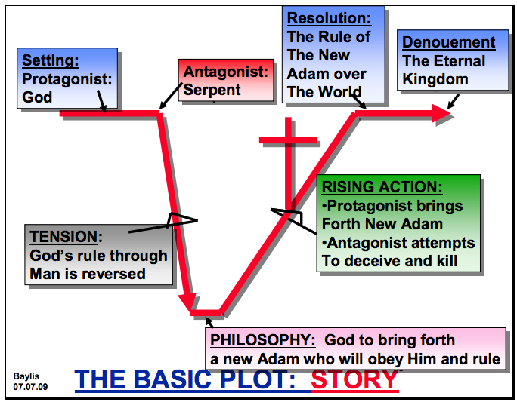

Slide 25
