Slide 1
Church History
Catholic Christianity
by Stephen Curto
for Home Church
January 17, 2016

Slide 2
Lesson Outline
Characteristics of the Age
Major Players
Doctrines

Slide 3
Characteristics of the Age
persecution from Rome
massive expansion and evangelism
rumors in the republic
two schools

Slide 4
Characteristics of the Age
persecution from Rome
Polycarp: “86 years I have served him and he has done me no wrong. How can I blaspheme my king and my savior?”
Ignatius: “Bring on your beasts.”
Origen: endured 3 years of torture
Justin: “That is our desire, to be tortured for Our Lord, Jesus Christ, and so to be saved”
Different from Judaism... and everyone
Refusal to hail Caesar (249 made compulsory)

Slide 5
Characteristics of the Age
persecution from Rome
massive expansion and evangelism
Christian love “Not a beggar among them”
God-fearers
Witness of martyrs (Rev. 12:11)

Slide 6
Characteristics of the Age
persecution from Rome
massive expansion and evangelism
rumors in the republic
orgies “The love feast” and “holy kiss”
cannibalism “this is my body... my blood”
they recruit only the worthless

Slide 7
Characteristics of the Age
persecution from Rome
massive expansion and evangelism
rumors in the republic
two schools
Alexandria
(Clement and Origen)
More philosophical
Antioch
(Irenaeus)
Emphasis on literal historical approach to scriptures

Slide 8
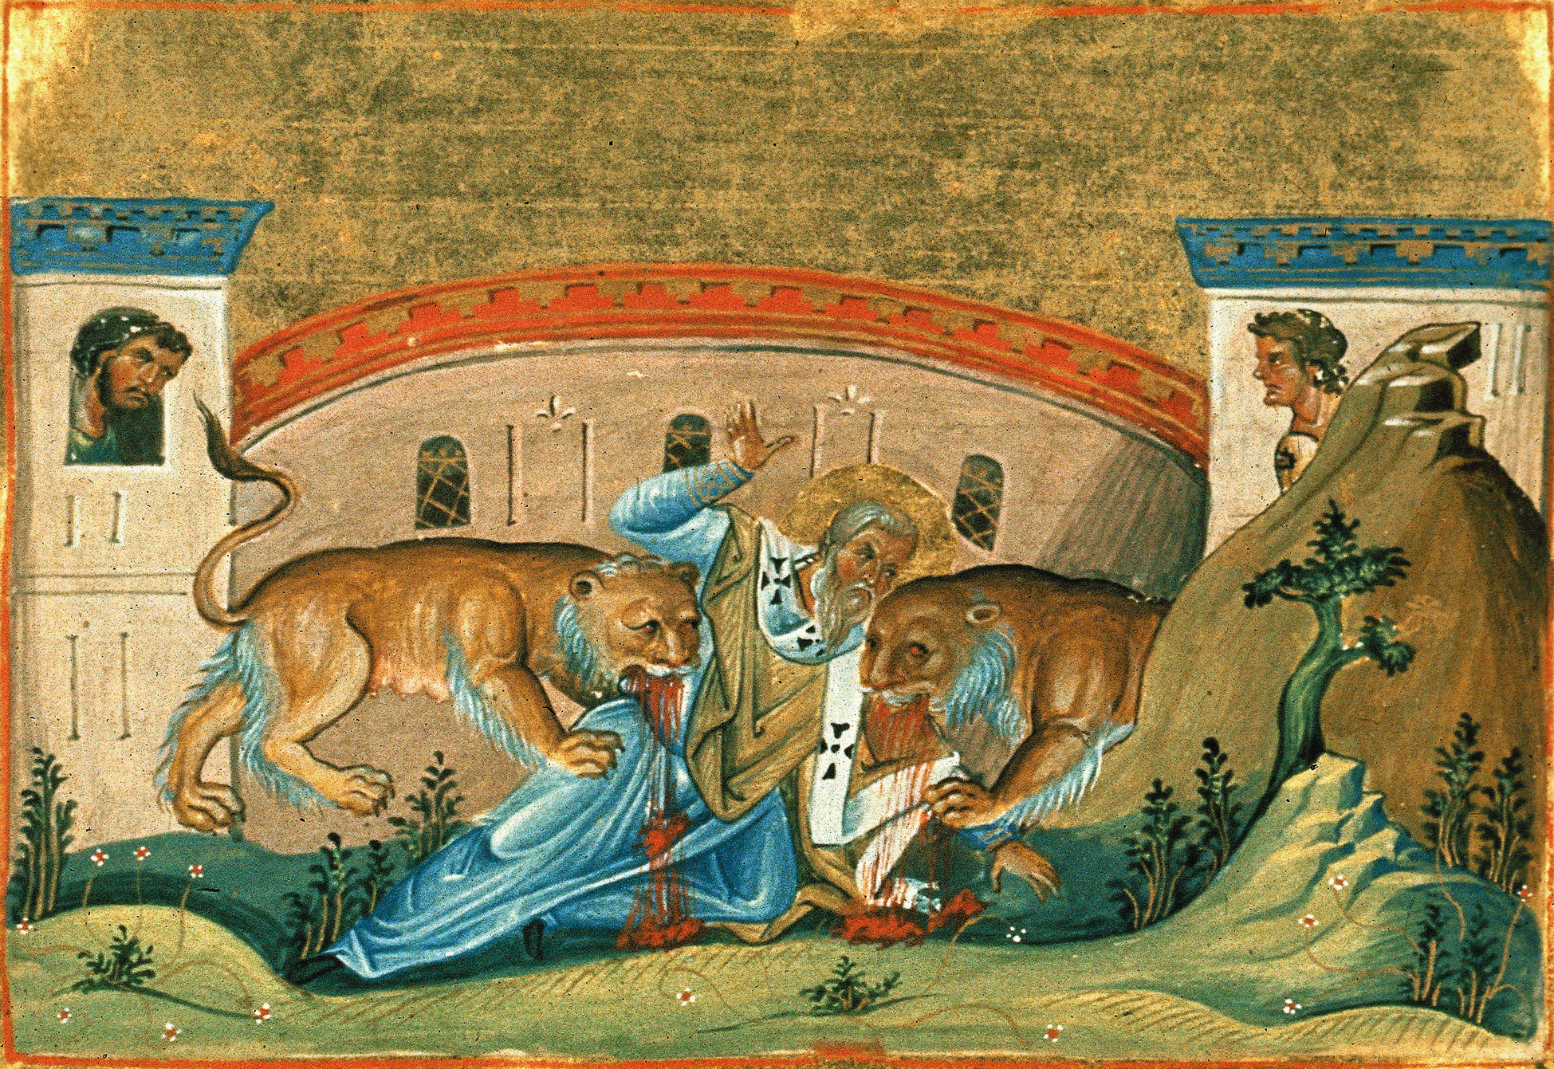
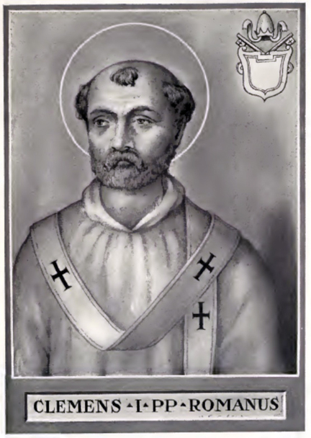
Major Players
Clement of Rome
(?-AD 99)
first bishop of Rome
Apostolic succession
Epistle
of Clement
Ignatius of Antioch
(AD 35-98)
Martyred being fed to wild beasts
Monarchial bishops
Student of Apostle John

Slide 9
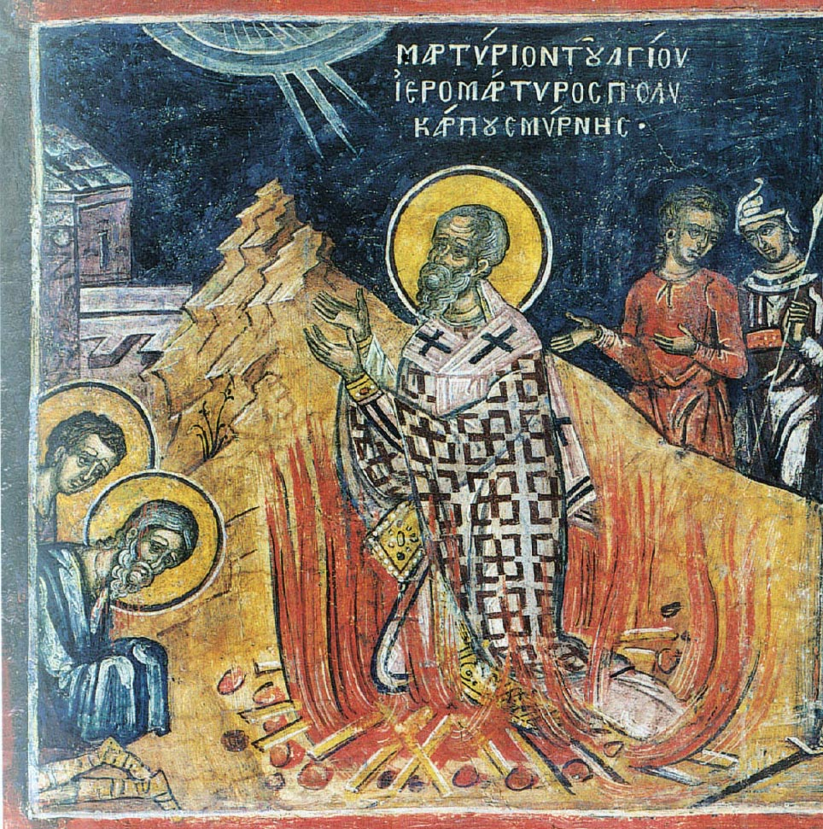
Major Players
Polycarp
(AD 69-155)
Disciple of John the Apostle
The Letter to the Philippians
Likely heavily involved in compiling the New Testament
Burned at the stake

Slide 10
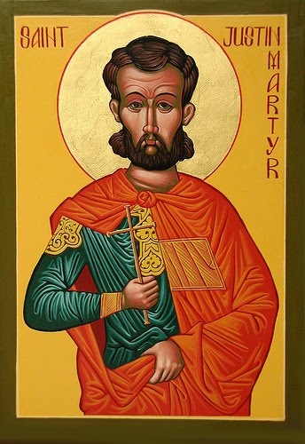
Major Players
Justin Martyr
(100-165)
The apologist
Apology
Beheaded with 6 of his students

Slide 11
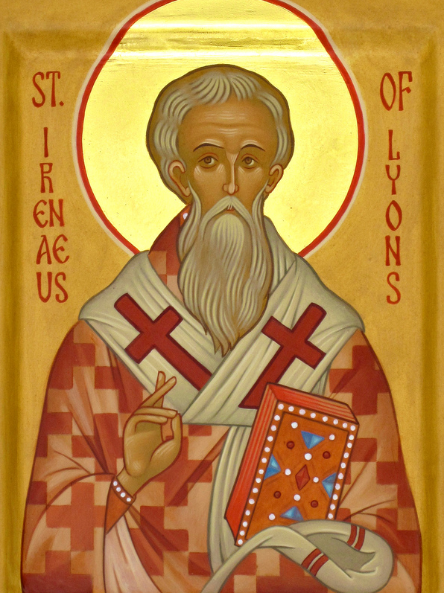
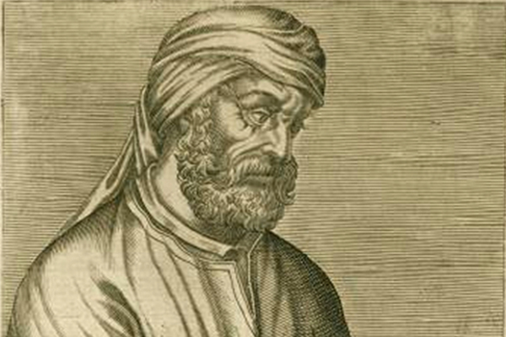
Major Players
Tertullian
(155-240)
The Latin Father
First father to use “Trinity”
Became a Montanist
Unforgiving in later years
Irenaeus
(130-202)
Disciple of Polycarp
Against Heresies
The Theologian Apologist

Slide 12
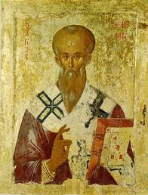
Major Players
Clement of Alexandria
(150-215)
“A messenger of Christianity in Philosopher’s garb.”
Taught with Origen
Exhortation to the Heathen, The Instructor, Miscellanies

Slide 13
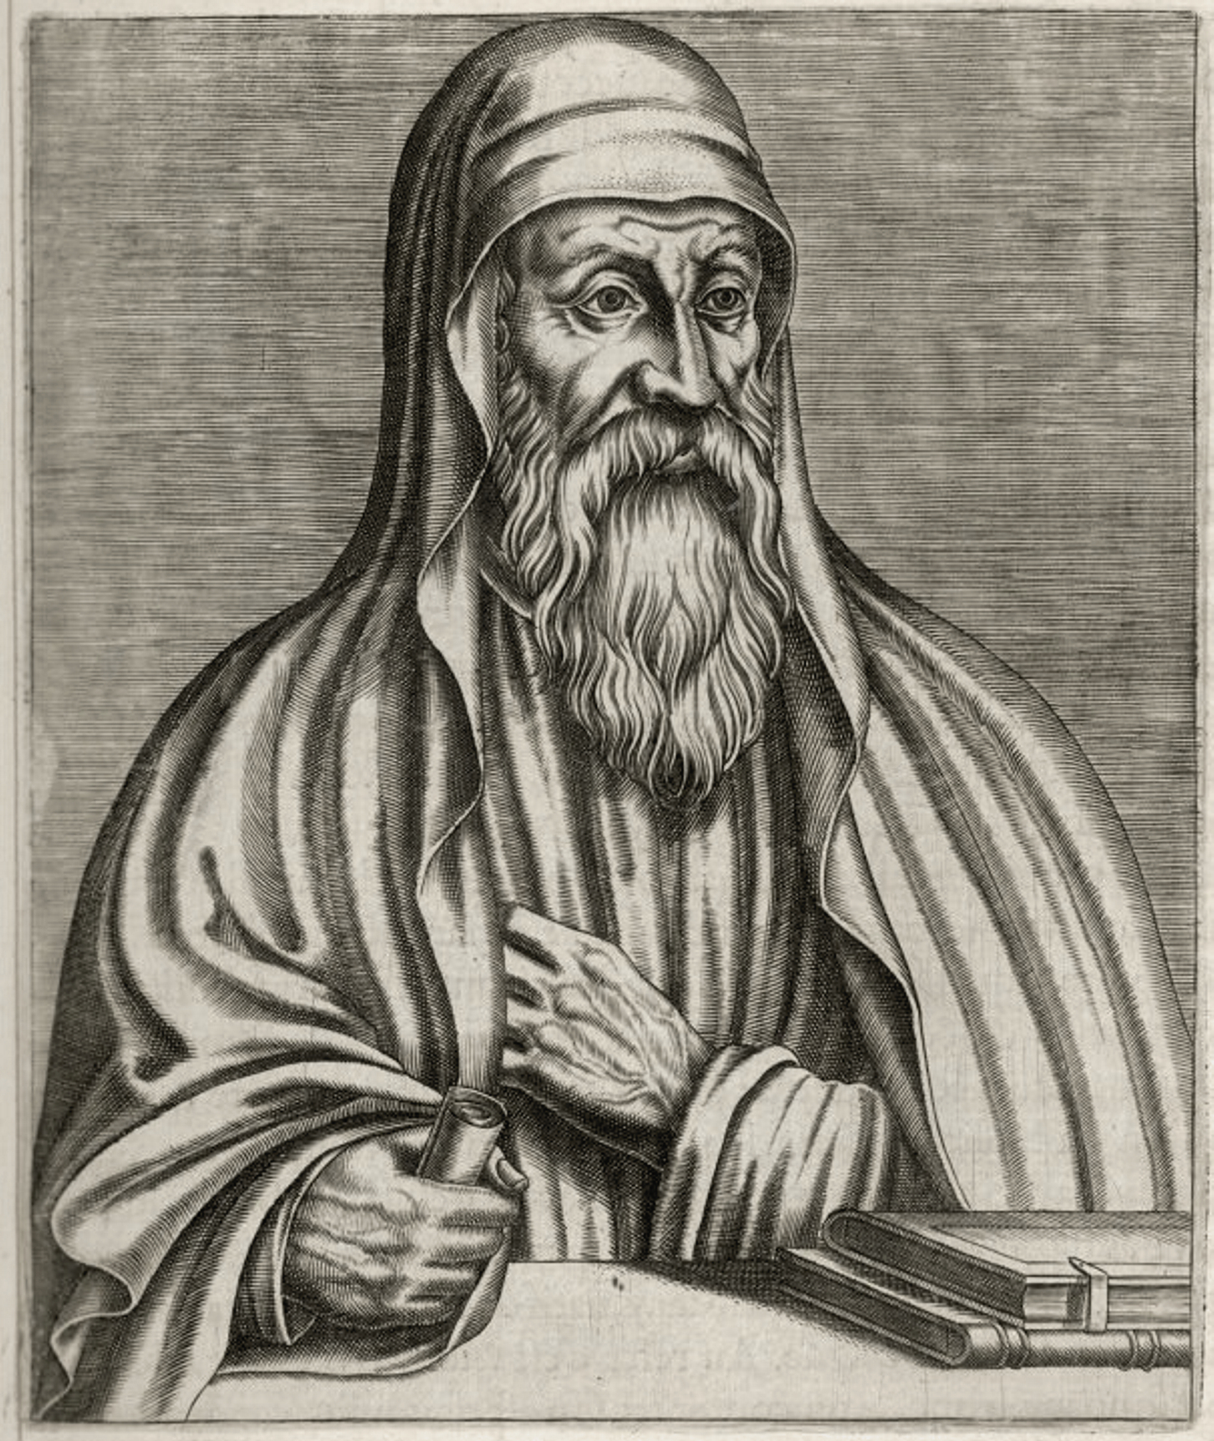
Major Players
Origen
(180-253)
Took over Alexandrian school at 18.
Followed Clement’s teaching
Most prolific & influential writer from 100-300
Popularized the Allegorical approach
Main concern was to exposit the scriptures

Slide 14
http://www.ccel.org/

Slide 15
Doctrines
Gospel
Gnostics (gnosis= knowledge)
special knowledge
dualistic
matter=bad, energy/light=good
Platonic Philosophy on steroids
Judaizers
Law + gospel
Circumcision a must
Montanus
New prophecy + gospel
Spoke in tongues

Slide 16
Doctrines
Jesus
Ebionites: Jesus was a man who became God
Docetism: Jesus only appeared to be a man, but was just God
Scriptures
various church fathers put forth proposed canons
What counts as “Bible”? What would you die for?

Slide 17
Doctrines
Apostles Creed (2nd Century)
“I believe in God almighty
And in Christ Jesus, his only Son, our Lord
Who was born of the Holy Spirit and the Virgin Mary
Who was Crucified under Pontius Pilate and was buried
And the third day rose from the dead
Who ascended into heaven
And sits on the right hand of the Father
Whence he comes to judge the living and the dead
And in the Holy Ghost
The holy church
The remission of sins
The resurrection of the flesh
The life everlasting.”

Slide 18
Rich Mullins Creed

