Slide 1
Church History
Christian Roman Empire: Constantine, Christ, and Canon
by Stephen Curto
for Home Church
January 24, 2016

Slide 2
Lesson Outline
Context
Constantine
Christ
Canon

Slide 3
Context
Rome in Disarray
Diocletian persecution
Galerius persecution
Edict of Toleration (310/311)

Slide 4
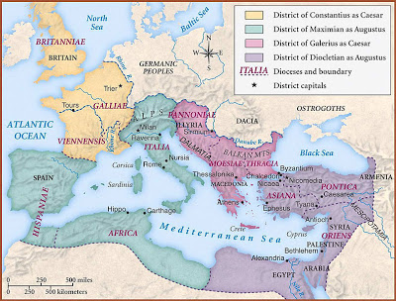

Slide 5
Edict of Toleration Excerpt
“[…]for in some way such arrogance had seized them [Christians] and such stupidity had overtaken them, that they did not follow the ancient institutions which possibly their own ancestors had formerly established […] but a great many being harassed endured all kinds of death. And since many continue in the same folly […] we have determined that we ought most cheerfully to extend our indulgence in this matter also; that they may again be Christians, and may rebuild the conventicles in which they were accustomed to assemble.”

Slide 6
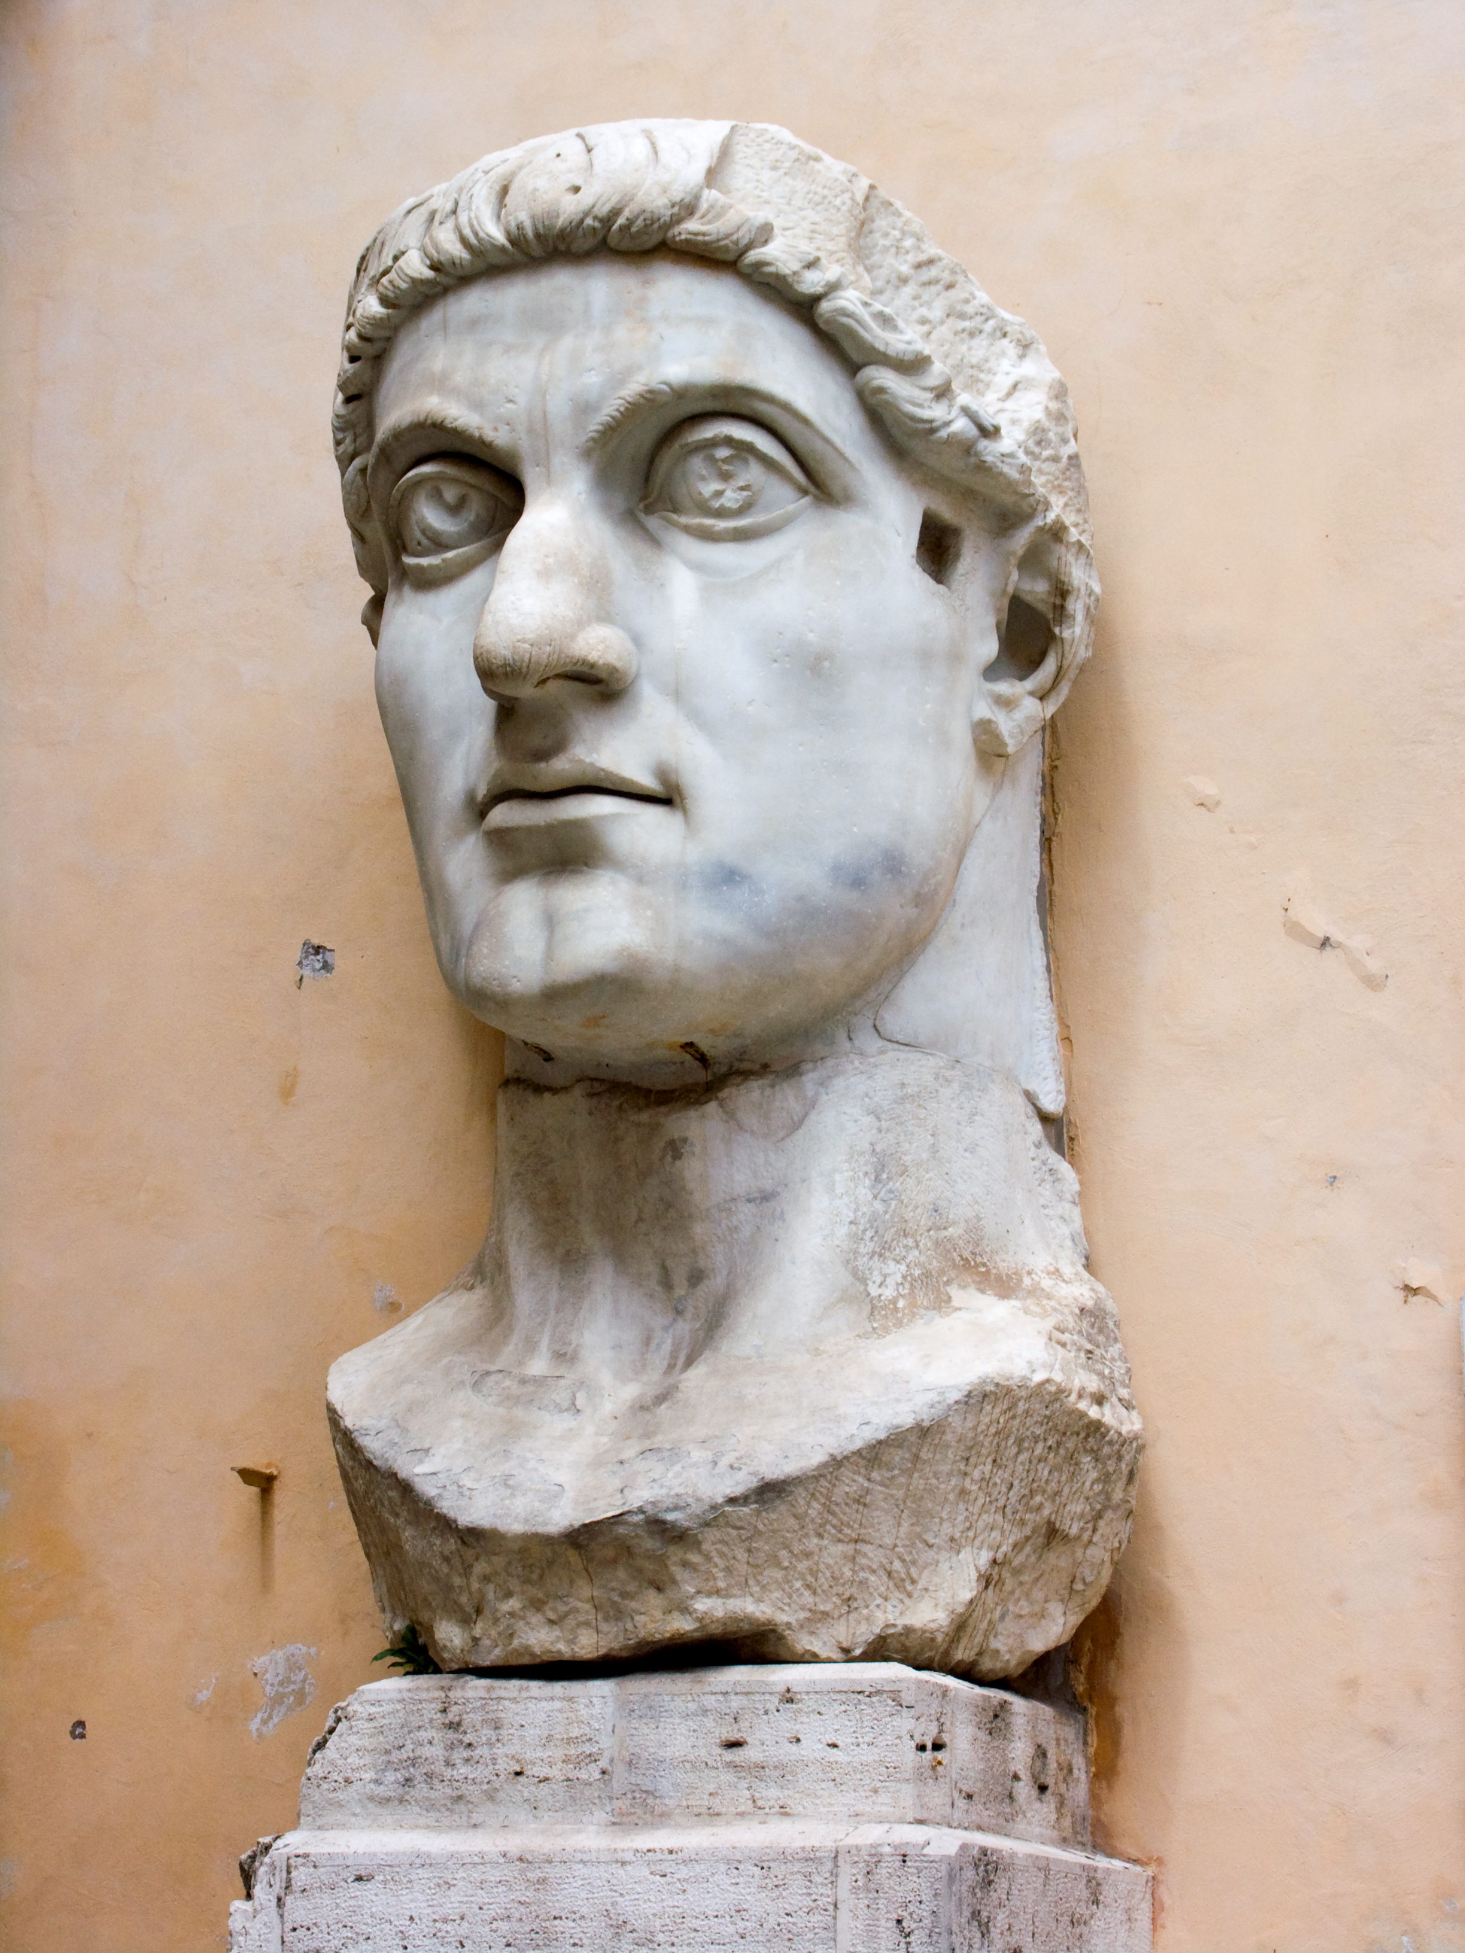
Constantine
Who was he?
What did he do?
What were the effects?

Slide 7
Constantine
Who was he?
Roman General
Milvian Bridge with Maxentius
“In this sign conquer”
conversion
What did he do?
What were the effects?

Slide 8
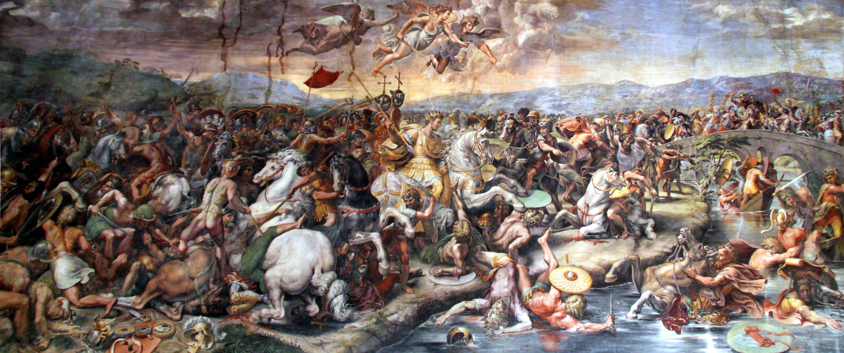

Slide 10
Constantine
Who was he?
What did he do?
Edict of Milan (312/313)
Threw support behind church
Built churches
Moved capital of Rome
called Council of Nicaea
What were the effects?

Slide 11
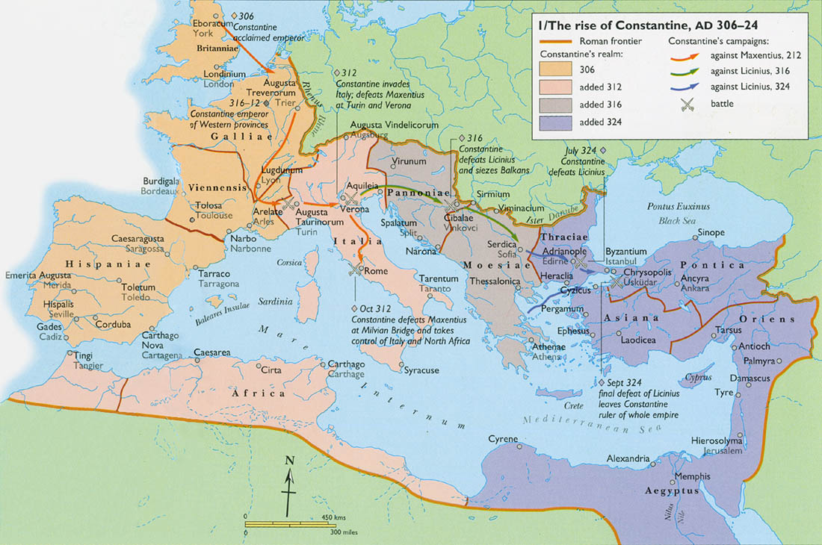
Constantinople

Slide 12
Constantine
Who was he?
What did he do?
What were the effects?
“Christians” added to the Church
Mo money mo problems
Mandatory religion by 380
More on this next week…

Slide 13
Christ
Answering Heresy
Major Councils
Creeds for Clarity

Slide 14
Subordinationism
TRINITY
(Tri-Unity)
Unity
Diversity
Modalism
Tritheism
Equality

Slide 15
Christ
Answering Heresy
Arius (d.336) – Jesus was a created being. God like, but not the same essence as God.
Apollonarius (310-390) – Jesus wasn’t fully human, just fully God.
Nestorius (370’s-452) – Jesus had two warring natures, and the divine overpowered the human.
Eutyches (378-454) – Jesus wasn’t fully God or fully man. He was 50-50. He had a mixed nature. (Modern equivalent: Mormons)
Major Councils
Creeds for Clarity

Slide 16
Major Church Councils
1
Nicaea
325
Arianism
2
Constantinople
381
Arianism
Apollinarianism
3
Ephesus
431
Nestorianism
Pelagianism
4
Chalcedon
451
Eutychianism
5
Constantinople II
553
Neo-Nestorianism
6
Constantinople III
680-681
Monotheletism
7
Nicaea II
787
Iconoclasm

Slide 17
Christ
Answering Heresy
Major Councils
Creeds for Clarity
Athanasius Creed – Clarify Trinity in face of Arianism
Nicene Creed – Clarify Christ in face of Arianism
Definition of Chalcedon – Clarified Christ in face of Eutychian heresy
Creed of Constantinople – Further clarify the Nicene Creed

Slide 18
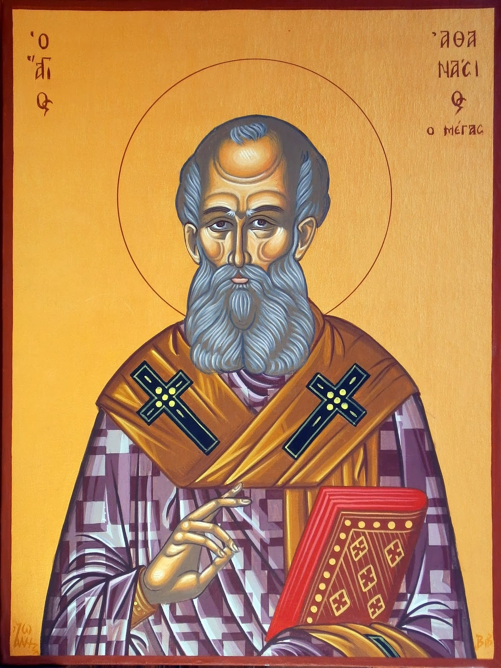
Athanasius
(297-373)
Athanasian Creed
Very influential against Arianism and defending Trinity
Bishop of Alexandria (reluctantly)
“Athanasius against the world”

Slide 19
Athanasian Creed Excerpt
Whoever desires to be saved should above all hold to the catholic faith.
Anyone who does not keep it whole and unbroken will doubtless perish eternally.
Now this is the catholic faith:
That we worship one God in trinity and the trinity in unity,
neither blending their persons
nor dividing their essence.
For the person of the Father is a distinct person,
the person of the Son is another,
and that of the Holy Spirit still another.
But the divinity of the Father, Son, and Holy Spirit is one,
their glory equal, their majesty coeternal.

Slide 20
What quality the Father has, the Son has, and the Holy Spirit has.
The Father is uncreated,
the Son is uncreated,
the Holy Spirit is uncreated.
The Father is immeasurable,
the Son is immeasurable,
the Holy Spirit is immeasurable.
The Father is eternal,
the Son is eternal,
the Holy Spirit is eternal.
And yet there are not three eternal beings;
there is but one eternal being.
So too there are not three uncreated or immeasurable beings;
there is but one uncreated and immeasurable being.

Slide 21
The Creed of Nicaea-Constantinople
We believe in one God,
the Father almighty,
maker of heaven and earth,
of all things visible and invisible.
And in one Lord Jesus Christ,
the only Son of God,
begotten from the Father before all ages,
God from God,
Light from Light,
true God from true God,
begotten, not made;
of the same essence as the Father.
Through him all things were made.
For us and for our salvation
he came down from heaven;
he became incarnate by the Holy Spirit and the virgin Mary,
and was made human.
He was crucified for us under Pontius Pilate;
he suffered and was buried.
The third day he rose again, according to the Scriptures.

Slide 22
He ascended to heaven
and is seated at the right hand of the Father.
He will come again with glory
to judge the living and the dead.
His kingdom will never end.
And we believe in the Holy Spirit,
the Lord, the giver of life.
He proceeds from the Father and the Son,
and with the Father and the Son is worshiped and glorified.
He spoke through the prophets.
We believe in one holy catholic and apostolic church.
We affirm one baptism for the forgiveness of sins.
We look forward to the resurrection of the dead,
and to life in the world to come. Amen.

Slide 23
Definition of Chalcedon
Therefore, following the holy fathers, we all with one accord teach men to acknowledge one and the same Son, our Lord Jesus Christ, at once complete in Godhead and complete in manhood, truly God and truly man, consisting also of a reasonable soul and body; of one substance with the Father as regards his Godhead, and at the same time of one substance with us as regards his manhood; like us in all respects, apart from sin; as regards his Godhead, begotten of the Father before the ages, but yet as regards his manhood begotten, for us men and for our salvation, of Mary the Virgin, the God-bearer; one and the same Christ, Son, Lord,

Slide 24
Only-begotten, recognized in two natures, without confusion, without change, without division, without separation; the distinction of natures being in no way annulled by the union, but rather the characteristics of each nature being preserved and coming together to form one person and subsistence, not as parted or separated into two persons, but one and the same Son and Only-begotten God the Word, Lord Jesus Christ; even as the prophets from earliest times spoke of him, and our Lord Jesus Christ himself taught us, and the creed of the fathers has handed down to us.

Slide 25
Canon
Why “pick”?
What were they “picking”?
How did they “pick” it?
What did the “pick”?

Slide 26
Canon
Why “pick”?
Heresy
Standard of revelation
Marcion’s Canon (140)
What were they “picking”?
How did they “pick” it?
What did the “pick”?

Slide 27
Canon
Why “pick”?
What were they “picking”?
Not really picking, more like recognizing
Scripture was already accepted as authoritative, the question was, “What counts as ‘scripture’?”
Focus on New Testament. OT was unresolved for centuries.
2 Pet 3:15
How did they “pick” it?
What did the “pick”?

Slide 28
Canon
Why “pick”?
What were they “picking”?
How did they “pick” it?
Acceptance: how widely did people agree?
Authority: does it have any demonstrated errors?
Authorship: did it come from the apostolic age?
What did the “pick”?

Slide 29
What did they pick?

Slide 30
What did they pick?

Slide 31
What did they pick?

Slide 32
Canon: The unfinished decision
Jerome (345-420)
Translated the Bible into Latin.
Included the Apocrypha in the Appendix
Judith, Tobit, the Maccabees, Susanna, Bel and the Dragon: “these writing, though recognized as useful, were perceived as inferior in quality”¹
Athanasius in 367: “other books besides these not indeed included in the canon...” Wisdom of Solomon, Ben Sirach, Esther, Judith Tobit, Didache, the Shepherd of Hermas.
1. Our Legacy by John Hannah

Slide 33
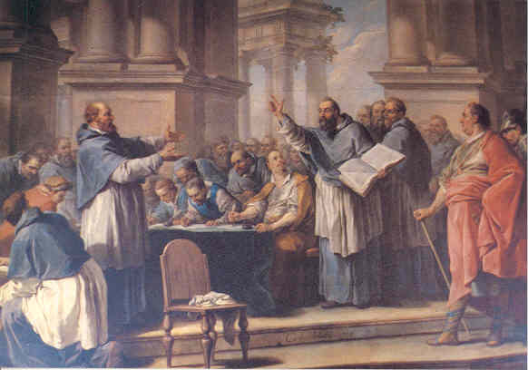
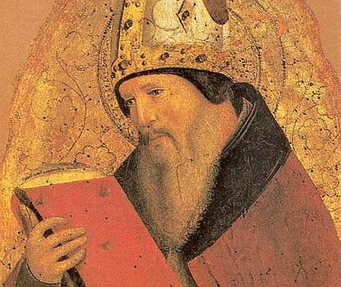
Canon
Council of Carthage (397)
Augustine (354-430)
Confirmed current NT canon
Council of Carthage (418-419)
Reaffirmed first council’s canon

Slide 34
Canon
Further study on canonicity
The Canon of Scripture by F. F. Bruce
Our Legacy by John Hannah
The Canon of the New Testament by Bruce Metzger
Turning Points by Mark Noll

Slide 35
Canon
How do we know they got it right?
We don’t... technically.
Do you have good reasons?
The question of canon wasn’t yet settled... More on that in the reformation

