Slide 1
David Through Exile
A Survey of the Kings and Prophets of Israel
By Stephen Curto
For Home Group
May 22, 2016

Slide 2
A Look Ahead
May 22 - Kings and Prophets
May 29 - VBS day
June 5 - Ezra Nehemiah
June 12 – Intertestamental Period

Slide 3
Review
Genesis
God created things good, but they went bad.
3:15 - the “seed”
Abraham, Isaac, Jacob - > Egypt
Exodus
Moses and the Law
Joshua
Conquering the land
Judges
Living in the land
“Everyone did what was right in their own eyes.”
Samuel

Slide 4
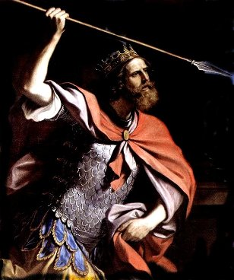
Saul, David, and Solomon
Saul (1 Samuel 9-31; 1 Chron 8; 10)
Chosen by God, anointed by Samuel (1 Sam 9-10)
Successful Leader (1 Sam 11-13)
Unsuccessful Leader (1 Sam 13-31)

Slide 5
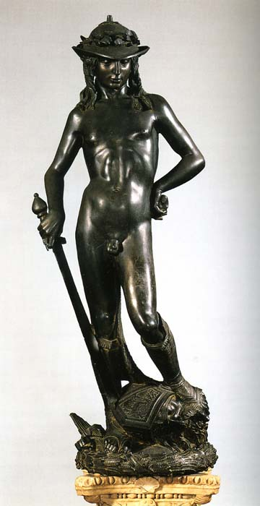
Saul, David, and Solomon
David (1 Sam 16 – 1 Kings 2; 1 Chron 11-29)
Chosen by God, anointed by Samuel (1 Sam 16)
Saul’s servant and constant conflict with Saul (1 Sam 16-31)
Transition from Saul to David (2 Sam 1-4)
Successful leader (2 Sam 5-10)
Unsuccessful father (2 Sam 11-24)
Davidic Covenant (2 Sam 7)

Slide 6
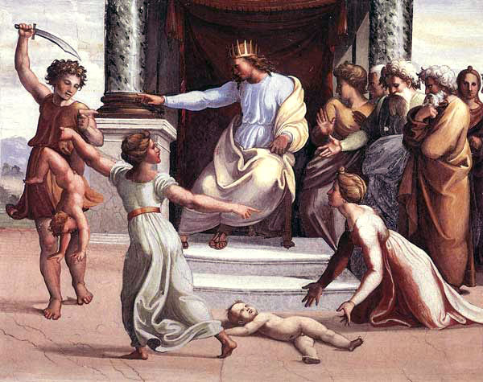
Saul, David, and Solomon
Solomon (1 Kings 1-11; 2 Chron 1-9)
Wise king, foolish lover (1 Kings 1-11)
Builder of the temple (1 Kings 5-8)
Last ruler of the United Kingdom

Slide 7
Divided Kingdom (1 Kings 12 - 2 Kings 25; 2 Chron 10-36)
Rehoboam (Judah/South) and Jeroboam (Israel/North) Conflict
All the kings of Israel and Judah

Slide 8
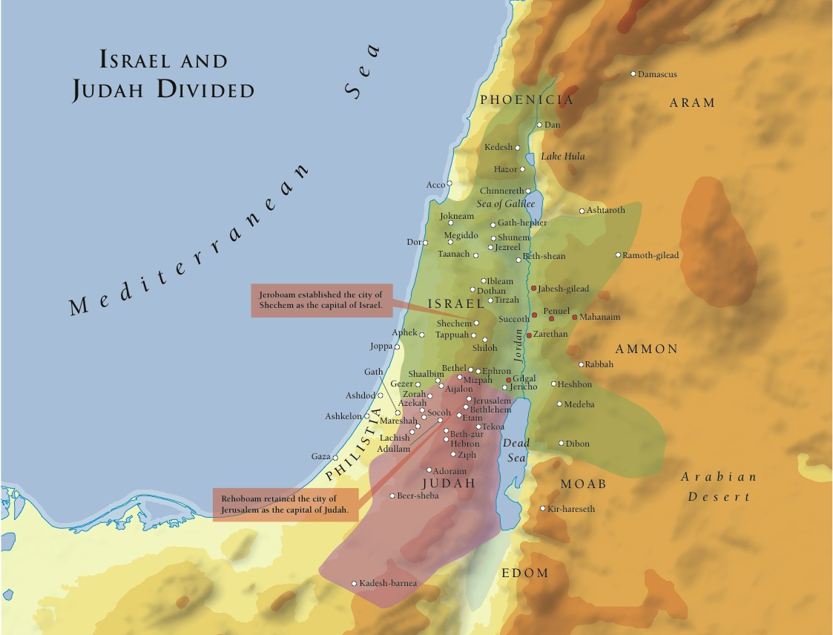

Slide 9
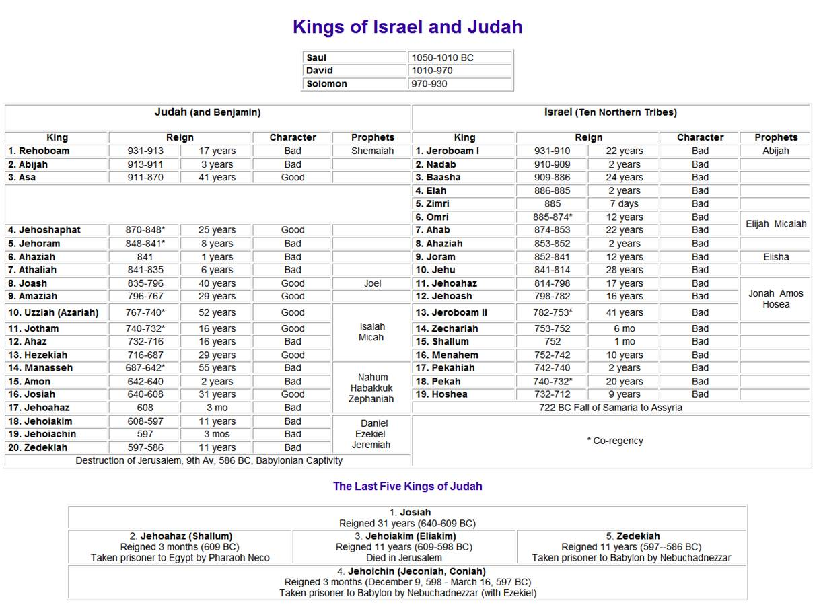

Slide 12
Kings Chart Online
https://www.vtaide.com/gleanings/Kings-of-Israel/kings.html

Slide 13
Prophets (Isaiah-Malachi)
ministered during the reigns of the kings
Writings Prophets vs Non-Writing Prophets
Common themes in Prophets Writings
God’s judgment
God’s sovereignty
God’s steadfast love for Israel
God’s graceful restoration of Israel after judgment

Slide 15
Prophet | Purpose of Book
Isaiah | A plea to Judah and Jerusalem to Trust Yahweh as his Servant nation, in the face of a gentile-run world.
Jeremiah | A call for Judah to repent and then to submit to punishment for refusing to repent.
Ezekiel | A reminder of God's faithfulness to Israel even when they were unfaithful, and predictions of his continued faithfulness.
Daniel | A show of God's sovereignty over all nations and all history.
Hosea | A call for Israel to repent, and a reminder of God's love for Israel, even when they were unfaithful.
Joel | A warning to Jerusalem of judgment day: the Day of the Lord.
Amos | A stern warning of judgment for Israel's idolatry.
Obadiah | A message of judgment on Edom.
Jonah | A message of judgment on Nineveh, and God's mercy.
Micah | A message to the people of Judah to repent.
Nahum | The announcing of Nineveh's fall.
Habakkuk | A cry to God for justice, and submission to his sovereignty.
Zephaniah | A call to be silent and fear Yahweh.
Haggai | An encouragement to the remnant to rebuild the temple.
Zachariah | A call for the remnant to hope in the messiah and his kingdom.
Malachi | a call for the remnant to pursue holiness.

Slide 16
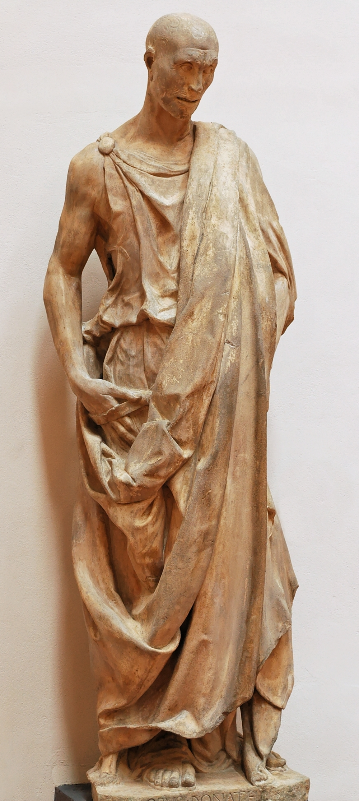
Habakkuk
Outline
Cry for Just Judgment on Wicked in Israel (1:2-4)
God’s Promise of Judgment on All in Israel (1:5-11)
Habakkuk’s Question of God’s Judgment (1:12-2:1)
God’s Response to Habakkuk’s Question (2:2-20)
Habakkuk’s Resolve to Trust God (3:1-19)
Message
God is sovereign and merciful, and the righteous (those who have faith in him) will be resurrected in the end.

Slide 17
Review
(1 America = 240yrs)
Exodus – 1446 BC
Law/Wandering – 1446-1406 BC (40 yrs)
Conquest – ~1406-1399 BC (~5-7 yrs)
Judges – ~1390-1050 BC (340yrs)
Saul – 1050-1010 BC (40 yrs) [Ish-Bosheth reigned 2 yrs]
David – 1010-970 BC (40 yrs)
Solomon – 970-930 BC (40 yrs)
Divided Kingdom – 930-722 BC (Israel, 208 yrs) 930-586 BC (Judah, 344 yrs)
The Kings

