Slide 1
Ecclesiology
“Words About the Gathering”
By Stephen Curto
For Homegroup
March 26, 2017

Slide 2
Outline
Purpose, Beginning, End
Universal
Local

Slide 3
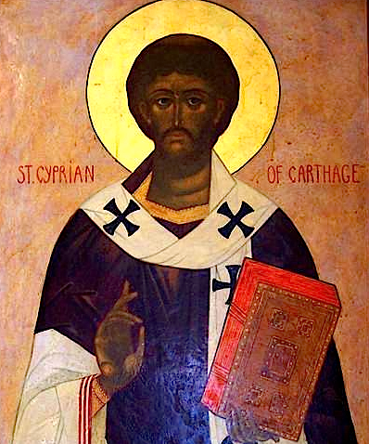
A Question and History
“Is the Church a pure assembly of believers, or a mixed assembly?” Cyprian of Carthage
Novatian vs Cyprian/Cornelius Controversy

Slide 4
Purpose, Beginning, End
4-Fold Purpose of the Church
Edify/strengthen the Saints. (Eph 4:11-16)
Observe the Ordinances. (Eph 2:15)
Preach the Gospel. (Matt 28:18-20)
Glorify God. (Eph 3:21)

Slide 5
Purpose, Beginning, End
Beginning
Acts 2
Acts 11:15
End
Rev 19-21

Slide 6
Purpose, Beginning, End
Beginning
Acts 2
Acts 11:15
End
Rev 19-21

Slide 7
Universal
Membership
Distinctives
Biblical Terminology

Slide 8
Universal
Membership
What makes you a member of the Universal Church?
John 20:31
Distinctives
Biblical Terminology

Slide 9
Universal
Membership
Distinctives
Is the Church a unique entity? Is it part of Israel? Did it replace Israel?
Eph 2:11-3:12
Biblical Terminology

Slide 10
Universal
Membership
Distinctives
Biblical Terminology
εκκλησια ecclesia “assembly, gathering”

Slide 11
Local
Difference
Government
Leadership

Slide 12
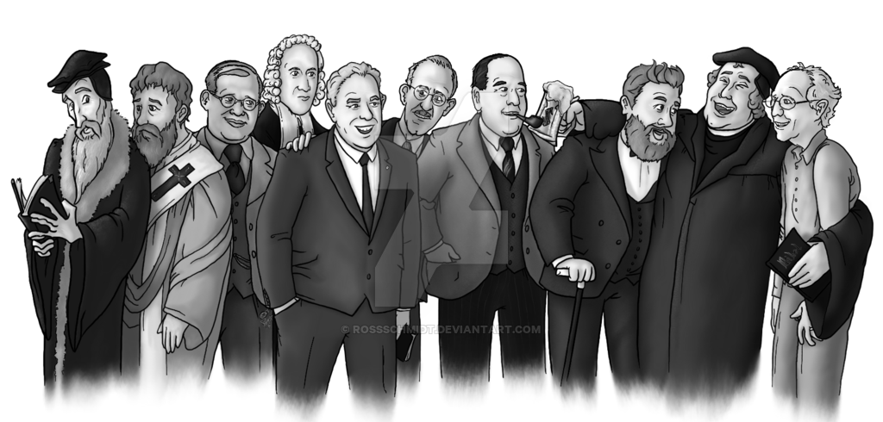
Local
Difference
How is the local church different from the universal church?
What is the “membership” of a local church?
What did the local church look like through history?
What about the reformation?
Government
Leadership

Slide 13
Local
Difference
Government
National (e.g. Church of England)
Hierarchical (e.g. Bishops of Catholicism)
Federal (e.g. Presbytery of Presbyterianism)
Congregational (e.g. Baptist)
Mix?
Leadership

Slide 14
Local
Difference
Government
Leadership
Role of Elders (Titus 1:5-9; 1 Tim 3:1-7)
Role of Deacons – Service (Acts 6; 1 Tim 3:8-13)
Elder/bishop distinction?
Female elders? (1 Tim 2:9-15)
Female deacons?

Slide 15
Other Helpful Ecclesiology Passages
1 Timothy
2 Timothy
Titus
Ephesians 1-3
1 Corinthians 5
1 Thessalonians 4
2 Thessalonians 3
Acts?

