Slide 1
Galatians
Introduction and 1:1-12
By Stephen Curto
For Homegroup
May 7, 2017

Slide 2
Outline
Introductory Matters
Background
Outline
Galatians 1:1-12

Slide 3
Introductory Matters
Author: Paul
Date: Northern or Southern View? *
Purpose: To Rebuke Christians who had been tricked by Judaizers into thinking they must follow the Mosaic Law in order to be saved.

Slide 4
Introductory Matters
Message: We are saved by grace alone through faith alone and not by works.
Key Verse: 2:16b “…we have believed in Christ Jesus, so that we may be justified by faith in Christ and not by the works of the Law; since by the works of the Law no flesh will be justified.”

Slide 5
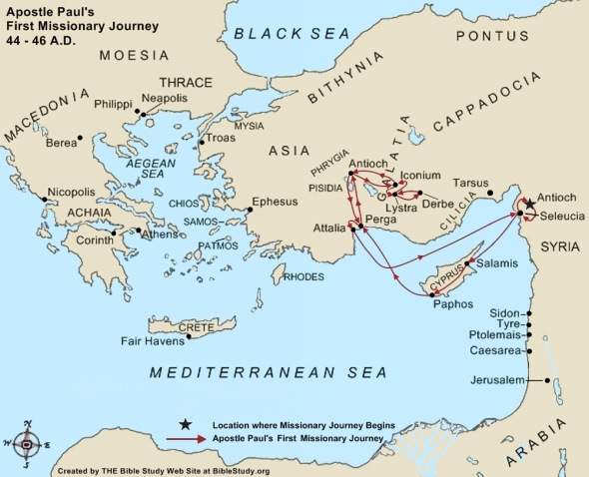
Introductory Matters - Date
Southern View:
Written to the southern region known as Galatia after Paul’s First Missionary Journey, just before the Jerusalem Council in approx 48AD

Slide 6
Introductory Matters - Date
Northern View:
written to the northern region known as Galatia after Paul’s Second Missionary Journey in approx 53AD

Slide 7
Background
Acts 10: First Gentiles are saved (Cornelius and Peter’s Visions)
Acts 11: Peter Defends his Actions against the circumcision party (11:1-18)
Acts 12: Peter’s Arrest, Miraculous Release, and Herod’s Death
Acts 13: First Missionary Journey, Paul Preaching at Antioch, Paul Turns to Gentiles (13:42-51)
Acts 14: Paul Heals a Cripple, Mistaken for a Pagan God
Acts 15: The Jerusalem Council (14:24-15:21)

Slide 8
Outline
Intro and 1:1-12 (May 7)
1:13-2:10 (May 14)
2:11-2:21 AND VBS Prep (May 21)
3:1-29 (June 4)
4:1-5:1 (June 11)
VBS Prep (June 18)
5:2-14 (June 25)
5:15-26 (July 2)
6:1-18 (July 9)
VBS Final Touches (July 16)

Slide 9
Galatians 1:1-12 Outline
Greeting (v1-5)
The Purpose for Writing: the Gospel (v6-9)
The Source of “Paul’s” The Gospel (v10-12)

Slide 10
Greeting (v1-5)
“Paul, an apostle – not from men nor through man, but through Jesus Christ and God the father who raised him from the dead – …” (v1)
Unique opening for a unique letter
This aside is the summary of his argument: this gospel is from God! (cf. v10-12)

Slide 11
Greeting (v1-5)
“…who gave himself for our sins to deliver us from the present evil age...” (v4)
What is this a summary of?
(cf. 1 Cor 15:1-14)
what is “the present evil age”?

Slide 12
Greeting (v1-5)
“…according to the will of our God and Father…” (v4)
Who’s will was it that Christ would die?
Does it seem contrary that God would “will” such evil?
“… to whom be the glory forever and ever.”
Dispensationalism rears its ugly head.

Slide 13
The Purpose for Writing: The Gospel (v6-9)
“I’m astonished that you are so quickly deserting him who called… and are turning to a different gospel” (v6)
“so quickly” support for Southern view
What different gospel are they turning to?
How do you know?
“…in the grace of Christ...” (v6)
Paul is setting up his rant for later. How are we ACTUALLY saved?

Slide 14
The Purpose for Writing: The Gospel (v6-9)
“not that there is another gospel…” (v7)
Truth doesn’t change by popular opinion.
“Even if we or an angel from heaven should preach to you a gospel contrary… let him be accursed” (v8, x2 v9)
“accursed” anathema : i.e. condemned to hell.
What question should immediately be of importance to the reader?

Slide 15
The Source of “Paul’s” Gospel (v10-12)
“For now do I persuade men or God? Or do I desire to please men? If I still desire men, I would not be a slave of Christ.”
What specifically is he saying?
I have no idea.
What’s his point?
see verses 11-12

Slide 16
The Source of “Paul’s” Gospel (v10-12)
“The gospel that was preached by me is not according to man.” (v11)
“I received it through a revelation of Jesus Christ.” (v12)
This statement serves 2 purposes:
Sums up the point of the preceding section: This is a unique gospel.
Transitions to his supporting argument: Paul’s testimony.

