Slide 1
How to Watch a Movie
By Stephen Curto
For Homegroup
October 8, 2017

Slide 2
Outline
Worldview Overview
Components of a Movie
Questions to Ask of Any Movie
Practice
Final Thoughts

Slide 3
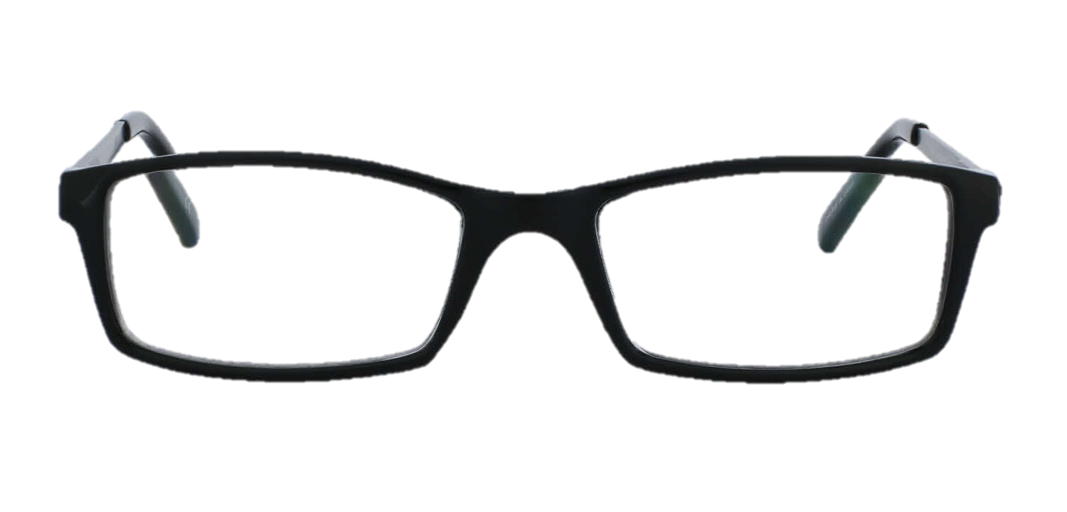
Worldview Overview
Definition: A worldview is the set of beliefs by which each person subconsciously observes and interprets the world.
Components of a Worldview:
View of God
View of Ethics
View of Morality
View of Evil
View of Reality
View of Knowledge
View of Truth

Slide 4
Components of a Movie
Ways to organize the components of a movie:
Creators and What is Created
Pieces and the Whole
Pre-production, Production, Post Production
Active Components and Passive Components

Slide 5
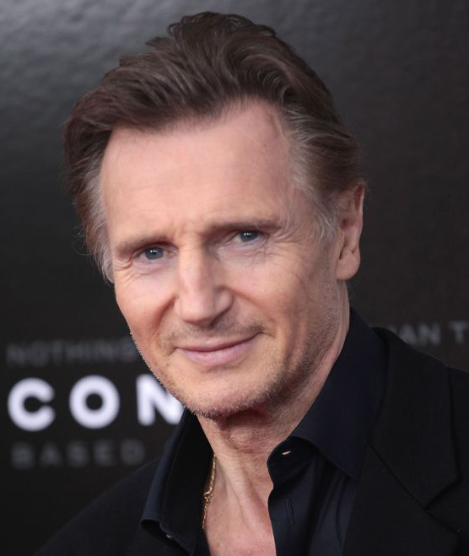
Components of a Movie
Ways to organize the components of a movie:
Creators and What is Created
Writers, directors, producers, actors, musicians…
Story/script, music, characters, plot, music, sound…
Pieces and the Whole
Pre-production, Production, Post Production
Active Components and Passive Components

Slide 6
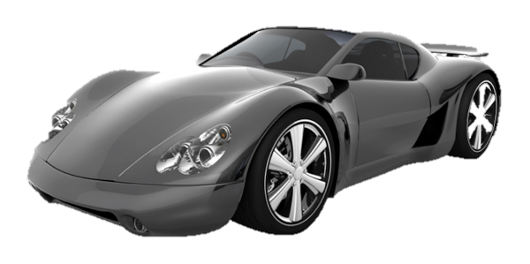
Components of a Movie
Ways to organize the components of a movie:
Creators and What is Created
Pieces and the Whole
actors, lights, script, characters, climax, cameras…
Meaning/message/lesson, plot, tone, genre…
Pre-production, Production, Post Production
Active Components and Passive Components

Slide 7
Components of a Movie
Ways to organize the components of a movie:
Creators and What is Created
Pieces and the Whole
Pre-production, Production, Post Production
script, story, genre, writers, producers, message…
directors, actors, cameras, lights...
CGI, editors, story, tone...
Active Components and Passive Components

Slide 8
Components of a Movie
Ways to organize the components of a movie:
Creators and What is Created
Pieces and the Whole
Pre-production, Production, Post Production
Active Components and Passive Components
Actors, writers, directors, story (?)…
lights, cameras, props, CGI...

Slide 9
Components of a Movie
Ways to organize the components of a movie:
Creators and What is Created
Pieces and the Whole
Pre-production, Production, Post Production
Active Components and Passive Components

Slide 10
Components of a Movie
Certain components are always present
writer, director, cameras, message/meaning
A thinking Christian takes note of the components of a movie he/she watches

Slide 11
Questions to Ask of Any Movie
What is the point/main idea/message of this movie?
State the point in one single sentence.
Try to be objective and put yourself in the place of the creator.
Further questions to help you answer that…

Slide 12
Questions to Ask of Any Movie
Why was this movie made?
What is this movie saying about the world, morality, reality…?
Does this movie match form and function?
Does this movie reflect reality? (And should it?)

Slide 13
Questions to Ask of Any Movie
Why was this movie made?
To inform? To inspire? To entertain? To lament?
What is this movie saying about the world, morality, reality…?
Does this movie match form and function?
Does this movie reflect reality? (And should it?)

Slide 14
Questions to Ask of Any Movie
Why was this movie made?
What is this movie saying about the world, morality, reality…?
What is the worldview of the makers?
Is its statement/message true?
Does this movie match form and function?
Does this movie reflect reality? (And should it?)

Slide 15
Questions to Ask of Any Movie
Why was this movie made?
What is this movie saying about the world, morality, reality…?
Does this movie match form and function?
Do its components facilitate its message?
e.g. a horror movie making a statement about the nature of evil vs. a pixar movie about the Holocaust
Does this movie reflect reality? (And should it?)

Slide 16
Questions to Ask of Any Movie
Why was this movie made?
What is this movie saying about the world, morality, reality…?
Does this movie match form and function?
Does this movie reflect reality? (And should it?)
Are these characters true to real life?
Are these characters unrealistic for a purpose (e.g.Avengers)?

Slide 17
Questions to Ask of Any Movie
What methods do the makers use to argue their case?
Pathos, Ethos, Logos
music, pictures, characters
lighting, sound, camera angles

Slide 18
Practice
Two short films. Answer the following questions for each:
In one sentence, what is the creator’s message/point?
In a few sentences, what is the creator’s worldview?
Does the form match the function?
What is the biblical analysis/response to this film?

Slide 19
“The Present” a short film produced by Jacob Frey

Slide 20
Click the link below to watch the film on youtube
https://www.youtube.com/watch?v=WjqiU5FgsYc

Slide 21
Discussion
In one sentence, what is the creator’s message/point?
In a few sentences, what is the creator’s worldview?
Does the form match the function?
What is the biblical analysis/response to this film?

Slide 22
“In a Heartbeat” a short film by Beth Davis and Esteban Bravo

Slide 23
Click the link below to watch the film on youtube
https://www.youtube.com/watch?v=2REkk9SCRn0

Slide 24
Discussion
In one sentence, what is the creator’s message/point?
In a few sentences, what is the creator’s worldview?
Does the form match the function?
What is the biblical analysis/response to this film?

Slide 25
A Scene from Season 2, Episode 4 of Frasier “Flour Child”
cue - 5:36
https://www.netflix.com/watch/70207020?trackId=14170289&tctx=0%2C3%2C1cea89c3-61ec-46cf-9eb7-03f34972de52-134656207

Slide 26
Discussion
What worldview claims did this scene make?
Are they correct?

Slide 27
Final Thoughts
Should Christians watch or support R-rated movies containing violence, foul language, and sex?
What is the difference between a good movie and an effective movie?
How should Christians talk about the movies they watch?

Slide 28
Final Thoughts
Q: Should I watch this movie?
A: Does this movie …
… weaken my reason.
… Impair the tenderness of my conscience.
… Obscure my sight of God.
… Diminish my thirst for spiritual things.
… Increase the authority of my body over my mind.
If you answer yes to any of them, it's probably a bad idea.

