Slide 1
Intro to Hinduism, Buddhism, and Atheism
By Stephen Curto
For Homegroup
December 4, 2016

Slide 2
Outline
Hinduism
History
Basic Doctrines
Common Practices
Buddhism
History
Basic Doctrines
Atheism
History
Basic Doctrines

Slide 3
Hinduism - History
No clear starting event/date.
Various Periods
Vedic Period (1900 – 800 BC)
Epic Period (200 BC – 500 AD)
Classical Period (650 – 1100 AD)
Islamic Period (1200 – 1750 AD)
Eclectic Period (1750 – Present)

Slide 4
Hinduism – Basic Doctrine
Vaguely Polytheistic
Brahma, Vishnu, Shiva
Thousands of gods
Holy Books (writings of sages)
Vedas
Upanishads
Rig Veda
Bhagavad Gita
Thousands of writings

Slide 5
Hinduism – Basic Doctrine
Main Beliefs
Dharma (ethics/duties)
Samsara (reincarnation, cycle of death and rebirth)
Karma (action/reaction/intent)
Moksha (freedom from reincarnation cycle)
Yogas (paths/practices)

Slide 6
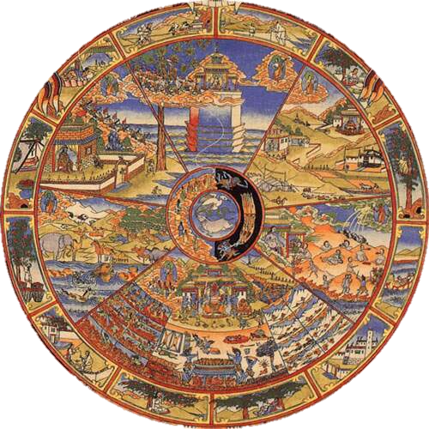
Hinduism – Basic Doctrine
Main Beliefs
Dharma (ethics/duties)
Samsara (reincarnation, cycle of death and rebirth)
Karma (action/reaction/intent)
Moksha (freedom from reincarnation cycle)
Yogas (paths/practices)

Slide 7
Hinduism – Basic Doctrine
Main Beliefs
Dharma (ethics/duties)
Samsara (reincarnation, cycle of death and rebirth)
Karma (action/reaction/intent)
Moksha (freedom from reincarnation cycle)
Yogas (paths/practices)

Slide 8
Hinduism – Basic Doctrine
Main Beliefs
Dharma (ethics/duties)
Samsara (reincarnation, cycle of death and rebirth)
Karma (action/reaction/intent)
Moksha (freedom from reincarnation cycle)
Yogas (paths/practices)

Slide 9
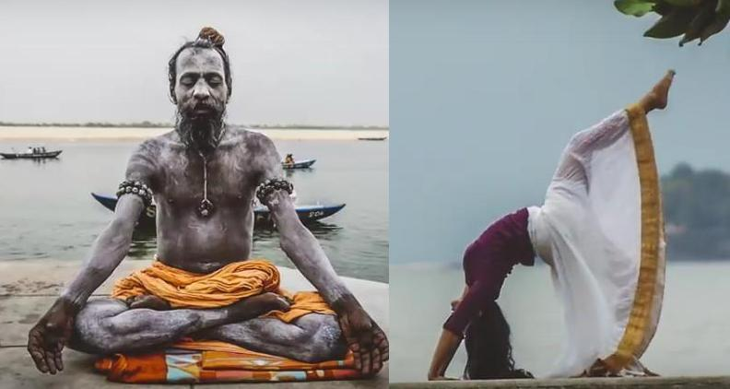
Hinduism – Basic Doctrine
Main Beliefs
Dharma (ethics/duties)
Samsara (reincarnation, cycle of death and rebirth)
Karma (action/reaction/intent)
Moksha (freedom from reincarnation cycle)
Yogas (paths/practices)

Slide 10
Hinduism – Common Practices
Rituals (home practice)
meditation, yoga, chanting mantras, recitation of scriptures
Following one’s individual path to moksha (release from reincarnation cycle)
Pilgrimage
trekking to one of various ancient holy cities
Diwali and Thaipusam

Slide 11
Hinduism – Common Practices
Rituals (home practice)
meditation, yoga, chanting mantras, recitation of scriptures
Following one’s individual path to moksha (release from reincarnation cycle)
Pilgrimage
trekking to one of various ancient holy cities
Diwali and Thaipusam

Slide 12
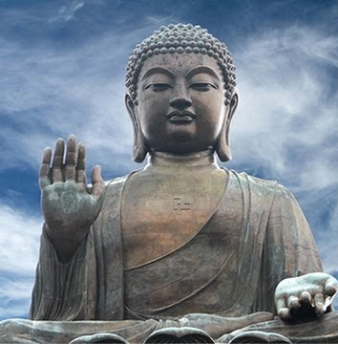
Buddhism - History
Sidhartha Gautama (approx 500’s BC)
The Buddha “Awakened One” or “Enlightened One”
Born into Hinduism as a prince
Tried asceticism but nearly died
gained enlightenment under the Bodhi tree

Slide 13
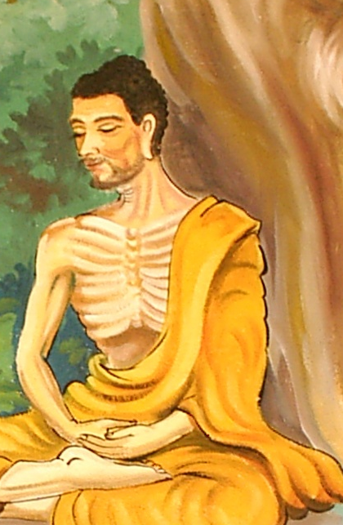
Buddhism - History
Sidhartha Gautama (approx 500’s BC)
The Buddha “Awakened One” or “Enlightened One”
Born into Hinduism as a prince
Tried asceticism but nearly died
gained enlightenment under the Bodhi tree

Slide 14
Buddhism – Basic Doctrine
The Four Noble Truths
Dukkha – “incapable of satisfying” “painful” the innate painfulness and impermanence of life
Samudaya – the cause or source of dukkha: longing, “thirst” “clinging”
Nirhodha – “liberation” the end of dukkha, achieving nirvana through enlightenment
Magga – the method of achieving enlightenment, practicing the eight-fold path

Slide 15
Buddhism – Basic Doctrine
The Eight Fold Path (The Middle Path)
Proper Vision (understanding, recognizing the four noble truth)
Proper Intention (Avoid anger, resentment, greed)
Proper Speech (avoiding slander, lying, gossip, abusive speech)
Proper Action (avoid violence, stealing, sexual impurity)
Proper Livelihood (make your living honestly, without harming others)
Proper Effort (trying hard to follow this path wholeheartedly)
Proper Awareness (having a clear mental state and bodily health)
Proper Meditation (meditation to achieve enlightenment)

Slide 16
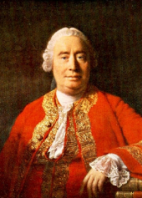
Atheism - History
Old Atheism (Renaissance and Reformation)
Voltaire (1600’s), Spinoza (1600’s), David Hume (1700’s)
Began questioning the existence of God and necessity of God for the existence of the universe
Still entrenched in a distinctly theistic world
“God doesn’t exist, but belief in God is good for society.”

Slide 17
Atheism - History
New Atheism (Modern Day)
Richard Dawkins, Sam Harris, Christopher Hitchens
“God doesn’t exist, and belief in God is bad for society.”

Slide 18
Atheism – Basic Doctrine
God doesn’t exist.
The chief end of man is to seek pleasure and create meaning for himself.
There are few other universal doctrines of Atheism.

