Slide 1
Church History
Introduction
by Stephen Curto
for Home Church
January 10, 2016

Slide 2
Lesson Outline
Why Study it?
Introductory Overview
Resources for Further Study
Apostolic Christianity (33-70AD)

Slide 4
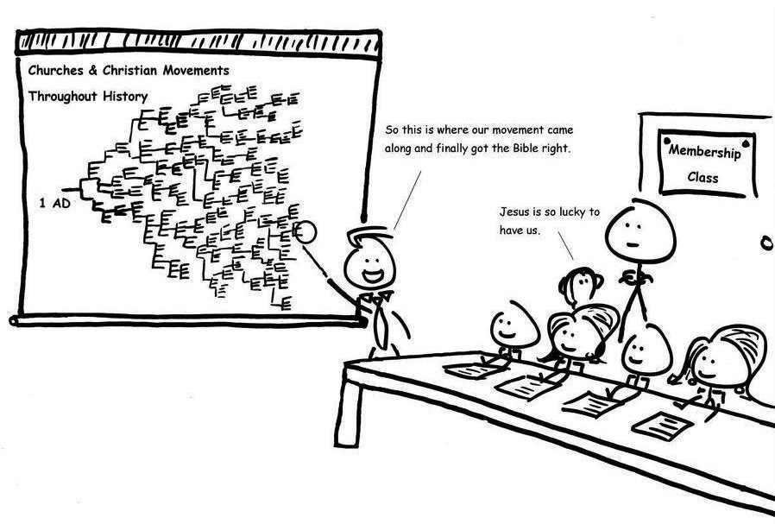

Slide 5
Why Study it?
Answers some big questions. (Josh 4:6-7)
It keeps you humble. (Acts 7)
There is nothing new under the sun. (Ecc. 1:9)

Slide 6
Why Study it?
Answers some big questions. (Josh 4:6-7)
Who is Jesus?
How did we get the Bible?
Who has the authority?
Where did Rome go?
Where did monks come from?
Why are there denominations?
Why aren’t we Roman Catholic?
How did Christianity get so big?
What happened to the political Israel?
It keeps you humble. (Acts 7)
There is nothing new under the sun. (Ecc. 1:9)

Slide 7
Why Study it?
Answers some big questions. (Josh 4:6-7)
It keeps you humble. (Acts 7)
People have died for this.
We know less about this than they did.
We are just as prone to error as they were.
There is nothing new under the sun. (Ecc. 1:9)

Slide 8
Why Study it?
Answers some big questions. (Josh 4:6-7)
It keeps you humble. (Acts 7)
There is nothing new under the sun. (Ecc. 1:9)
Heresies are being recycled
Most issues in the current church have been dealt with before
We’re not special, and that’s a good thing.

Slide 9
Introductory Overview
Apostolic Christianity (32-70AD)
Catholic Christianity (70-312AD)
Christian Roman Empire (312-590AD)
Middle Ages (590-1517AD)
Reformation (1517-1648AD)
Roots of Current Christianity (1648-20th Century)

Slide 10
Resources for Further Study
Our Legacy by John Hannah
Church History in Plain Language by Bruce Shelley
A Pocket History of the Church by Jeffrey Bingham
A Week in the Life of Corinth by Ben Witherington III
A History of Christianity (2 Volume set) by Kenneth Scott Latourette
History of the Church by Eusebius
Church history sermon series by Tommy Nelson https://archive.org/details/ChurchHistory

Slide 11
Apostolic Christianity (32-70AD)
From Death of Christ to Destruction of Jerusalem
Period of the writing of the New Testament
Characterized by persecution from Rome
Paul’s 3 Missionary Journeys

Slide 12
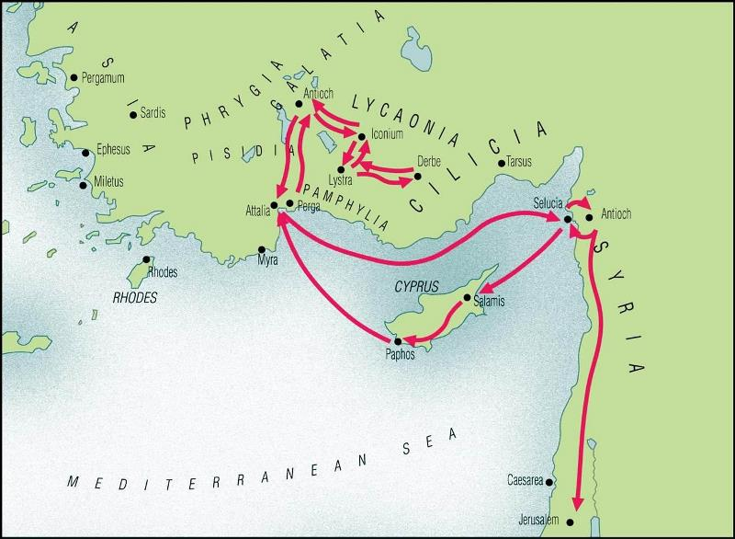
Paul’s Journeys: #1

Slide 13
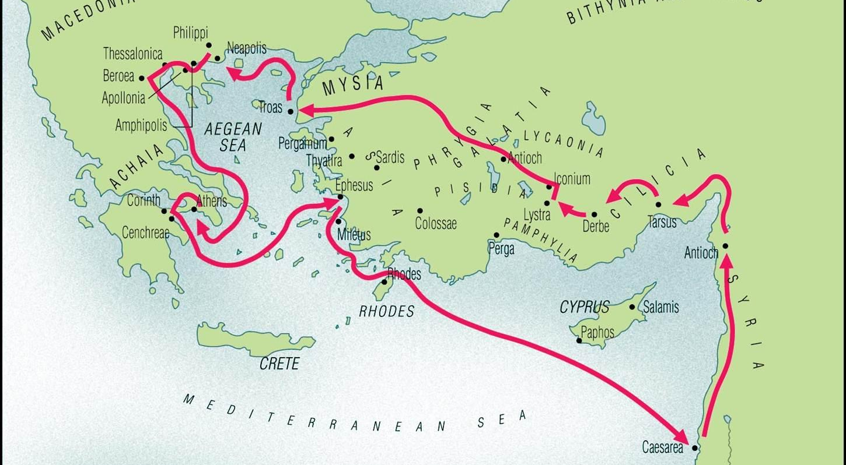
Paul’s Journeys: #2

Slide 14
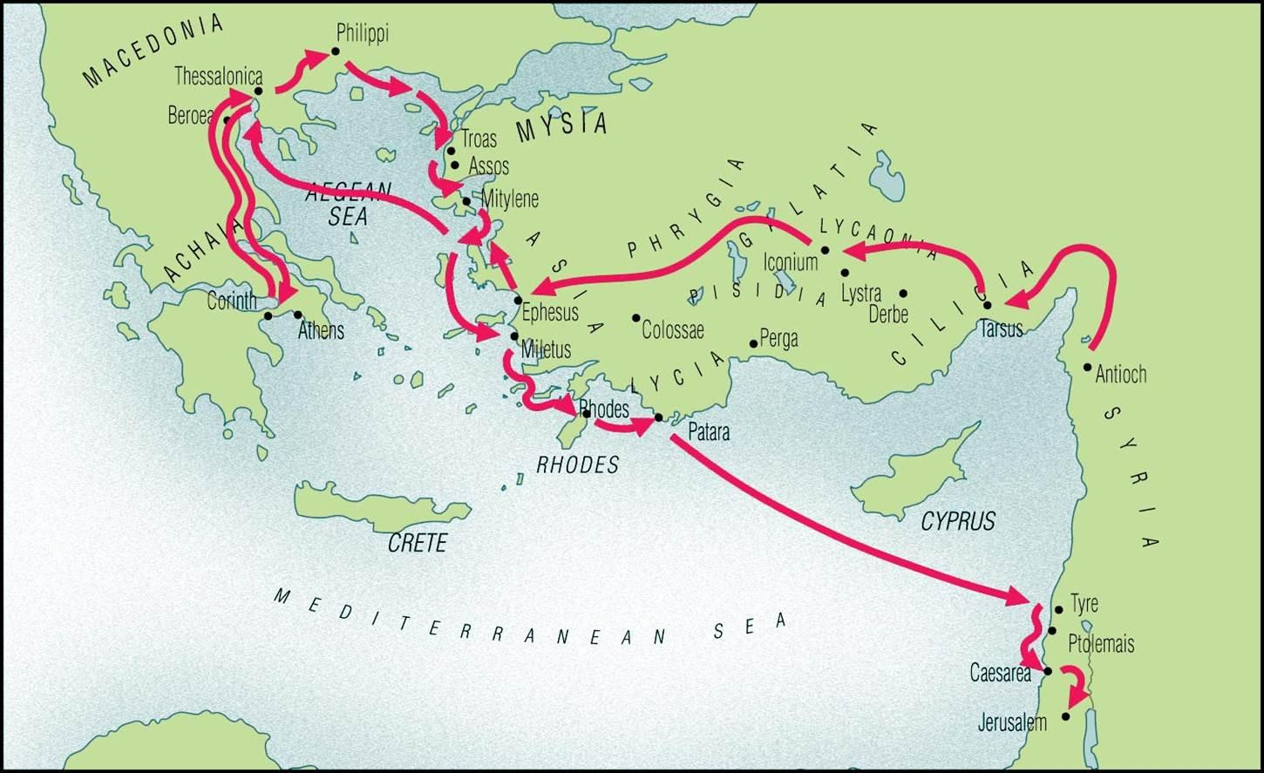
Paul’s Journeys: #3

Slide 15
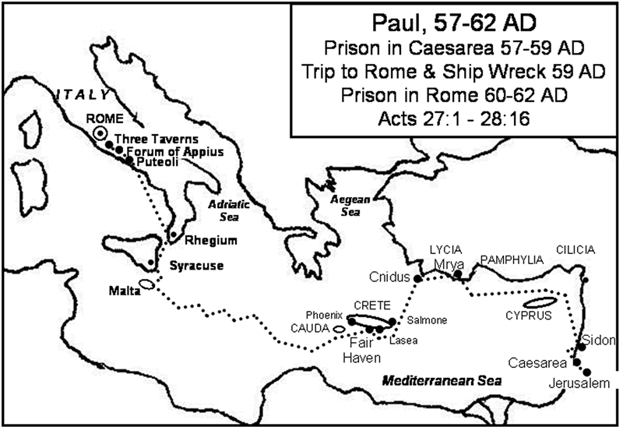
Paul’s Journey to Rome

