Slide 1
Joel
By Stephen Curto
For Homegroup
October 22, 2017

Slide 2
Lesson Outline
Introductory Issues
Background
Text

Slide 3
Introductory Issues
Author: Joel (1:1)
Date: Either very early (835 BC) or very late (420’s BC)
Audience: Judah (2:32; 3:1, 6)
Purpose: To explain the coming “Day of the Lord” and cause Judah (and Israel) to Repent.

Slide 4
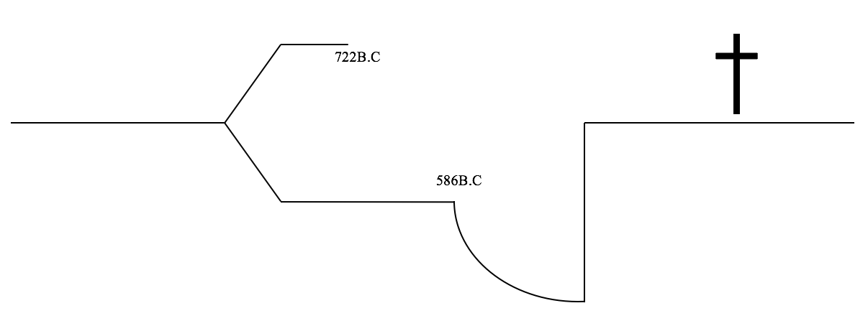
Introductory Issues
Author: Joel (1:1)
Date: Either very early (835 BC) or very late (420’s BC)
Audience: Judah (2:32; 3:1, 6)
Purpose: To explain the coming “Day of the Lord” and cause Judah (and Israel) to Repent.

Slide 5
Background
Kings in Judah and Israel at the Time: (2 Kings 10-14)
Ahab and Jezebel’s Wickedness
Servants of Baal
Elijah and the fire from heaven
Elisha anoints Jehu King of Israel (2 Kings 9)
Jehu comes in and kills Joram (KoI), Ahaziah (KoJ), and Jezebel (Ahab’s wife, Baal worshipper)
Jehu kills all 70 of all of Ahab’s relatives in Judah and Israel
Jehu kills all of the Baal priests
Jehu does not depart from sins of Jeroboam

Slide 6
Background
Kings in Judah and Israel at the Time: (2 Kings 10-14)
Athaliah (Ahaziah’s Mother) is Queen in Judah 6 years
kills all other children to try and reunite kingdoms
Joash hidden from her for 6 years
Joash crowned king at age 7 and Athaliah killed
Joash (Jehoash) reigns and does right in the eyes of the Lord
Joash repairs the temple
Joash pays off the Arameans from the temple treasuries
His servants conspire and kill him, and Amaziah, his son reigns

Slide 7
Joel Outline
The Locust Plague (Ch. 1)
The Day of the Lord (2:1-11)
A Call for Repentance (2:12-17)
Promises for the Remnant (2:18-3:21)

Slide 8
I. The Locust Plague (1:1-20)
“Has anything like this happened in your days?” (v2)
Anything like what? cf. v4-7
LAMENT! (v8-13)
“Gather the elders… and cry out to the Lord... For the Day of the Lord is near...” (v14-15)
“… and it will come as destruction from the Almighty” (v15)
What is Joel telling the nation to do and why?

Slide 9
II. The Day of The Lord (2:1-11)
“Let all the inhabitants of the land tremble” (v1)
“As the dawn is spread over the mountains, so there is a great and mighty people” (v2)
What is the image and what does this “Great and mighty people” do? (cf. v2-10)
“The Lord utters His voice before His army…strong is he who carries out His word.”(v11)
“The day of the Lord is indeed great and very awesome, And who can endure it?” (v11)

Slide 10
What is “the Day of the Lord”?
Is this different from “the Great and Terrible Day of the Lord” (Mal 4:5) or “the Great and Awesome Day of the Lord” (Joel 2:31, Acts 2:20)?
Has the Day of the Lord begun?
If it has, has it finished?
Zeph 1:1-18; Isa 13:6-13; 1 Cor 5:5; 1 Thess 5:1-6; 2 Thess 2:1-14
II. The Day of The Lord (2:1-11)

Slide 11
III. A Call for Repentance (2:12-17)
“Return to me with all your heart… rend your heart and not your garment” (12-13)
“For he is gracious and compassionate, slow to anger, abounding in lovingkindness and relenting of evil” (v13)
cf. Ex. 34:6
“Call a solemn assembly... let the priests and ministers weep and say, ‘Spare your people’” (v15, 17)

Slide 12
IV. Promises for the Remnant (2:18-3:21)
“Then the Lord will become jealous for his land and will have pity on his people” (v18)
“Fear not… for the Lord has done great things” (v21)
“The threshing floor shall be full of grain; the vats shall overflow with wine and oil” (v24)
“My people shall never again be put to shame” (v26 & 27)
Is “never again” literal or hyperbole?
“You shall know that I am in the midst of Israel” (v27)

Slide 13
IV. Promises for the Remnant (2:18-3:21)
“…afterward, I will pour out my Spirit on all flesh” (v28)
After what? cf. Acts 2:20ff
“I will show wonders... blood and fire and columns of smoke, the sun shall be darkened and the moon turned to blood, in the face of the coming of the great and terrible day of the Lord.” (v30-31)
What is verse 32 describing?

Slide 14
“For behold, in those days and at that time, when I restore the fortunes of Judah and Jerusalem...” (v1)
What time period is being spoken of?
What will God do and why? (v2-3)
What judgment does God pronounce of Tyre and Sidon and why? (v4-8)
God calls the nation to war. (v9-16) What time period does he do this?
IV. Promises for the Remnant (2:18-3:21)

Slide 15
“in that day the mountains shall drip sweet wine…” (v18)
“Egypt shall become a desolation and Edom a desolate wilderness” (v19)
“But Judah will be inhabited forever, and Jerusalem to all generations” (v20)
“I will acquit their bloodguilt that I have not acquitted for the Lord lives in Zion.” (v21)
What is this talking about?
IV. Promises for the Remnant (2:18-3:21)

Slide 16
Why does any of this matter?

