Slide 1
Church History
Medieval Christianity Part 1
by Stephen Curto
for Home Church
February 21, 2016

Slide 2
Middle Ages 590-1517
Part 1)
590-1077 (Gregory the Great – Gregory VII vs. Henry IV)
Part 2)
1077-1517 (Gregory and Henry – Martin Luther’s 95 Theses)

Slide 3
Recap
Constantine makes Empire Christian and moves capital to Constantinople
Western Empire falls by 460
Pope Leo the Great faces down Atilla the Hun in 457
Church is now the stabilizing force in West, Byzantine Empire still limping along in the east

Slide 4
The Middle Ages
Our Perception
Complete moral and Religious breakdown
Death and Destruction everywhere
The church killing people willy-nilly
More Accurate Picture
Rejection of sacred/secular split
Belief in impermanency of life and a future world
Gradual growth of Papal authority
A general acceptance of trading freedom for safety

Slide 5
An analogy of this time period...

Slide 6
America has existed for 240 years.
This period is >1000 years.
The history of the Middle Ages is more than 4x longer than America has existed.

Slide 8
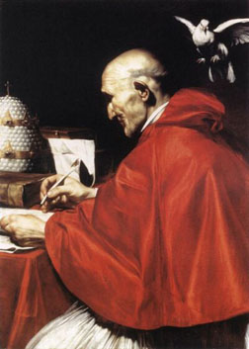
Gregory the Great
Brought stability in an unstable time
Organized food and sanitation in the city
Rebuilt aqueducts and city defenses
Negotiated peace with Lombards
Humanitarian and Missionary
Converted Visigoth king to Nicene Christianity
Instigated missions to the barbarians
Inventor of Gregorian Chants

Slide 9
Gregory the Great – on the Atonement
“Guilt can only be extinguished by a penal offering to justice, but would contradict the idea of justice if, for the sin of a rational being like man the death of an irrational animal should be accepted as a sufficient atonement. Hence a man must be offered as a sacrifice for man, so that a rational victim may be slain for a rational criminal. But how could a man, himself stained with sin, be an offering for sin? Hence a sinless man must be offered.

Slide 10
Gregory the Great – on the Atonement
But what man, descending in the ordinary course would be free from sin? Hence, the son of man must be born of a virgin, become a man for us. He assumed our nature without our corruption. He made himself a sacrifice for us and set forth for sinners his own body, a victim without sin, and able to die by virtue of his humanity, and to cleanse the guilty upon the grounds of justice.” Why? Because of his deity.

Slide 11
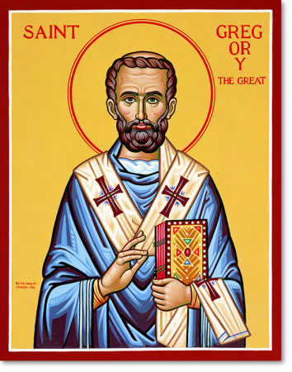
Gregory the Great
"Illiterate men can contemplate in the lines of a picture what they cannot learn by means of the written word.”
https://www.youtube.com/watch?v=RaECiix7kJ8

Slide 12
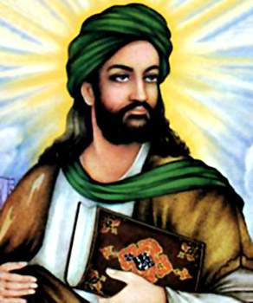
Mohammad (570-632)
Founder of Islam
Claimed to receive revelation from angel Gabriel in a cave (approx. AD 610)
Gathered army of 10,000 converts to take Mecca (630)
Fell ill and died 632
The question of successors led to factions
Muslim conquest for 100 years

Slide 14
Merovingians and Carolingians (France) – 680-800
Frankish kingdoms that came out of Clovis’s dynasty
Charles Martel (Charles the Hammer) (680-741)
Defended western Europe against Arab conquest
Pepin the Short (714-761)
Charlemagne (Charles the Great) (741-814)

Slide 15
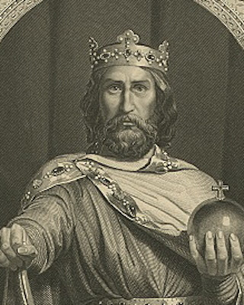
Charlemagne (741-814)
named Emperor of “Holy Roman Empire” by Leo III on Christmas Day, AD 800
“Charles most pious, crowned Augustus by God.”
Went on military conquest of Europe
Became the Church’s muscle
Executed the Pope’s rule
Established moral and political order
Invented escole … schools!
After his death, feudal system takes over western Europe

Slide 16
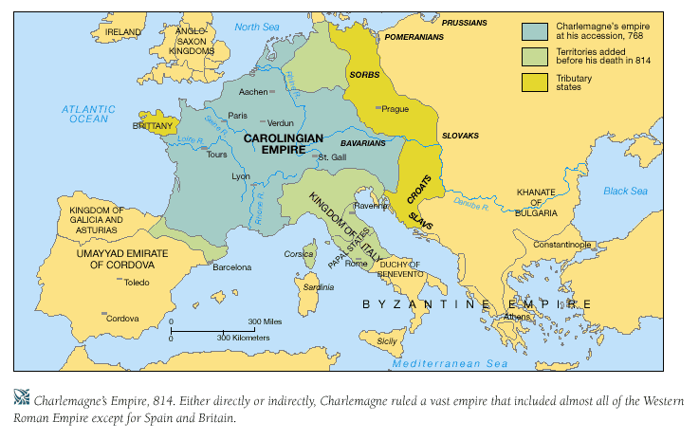

Slide 17
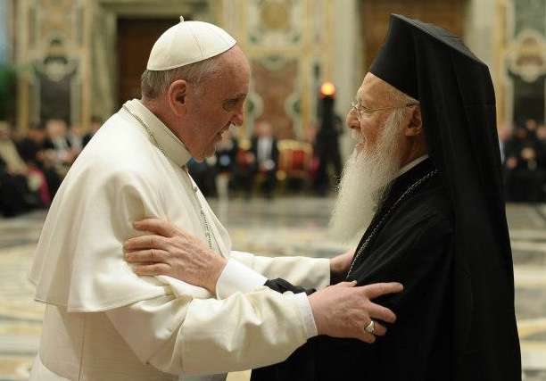
The Great Schism (1054)
The East/West Church division has finally come to a head
Eastern Orthodox
Iconography
Spiritual Mysticism
Pope of Constantinople
Greek language
Western Catholic Church
Doctrine
Papal authority
Pope of Rome
Latin language
Mutual excommunication

Slide 18
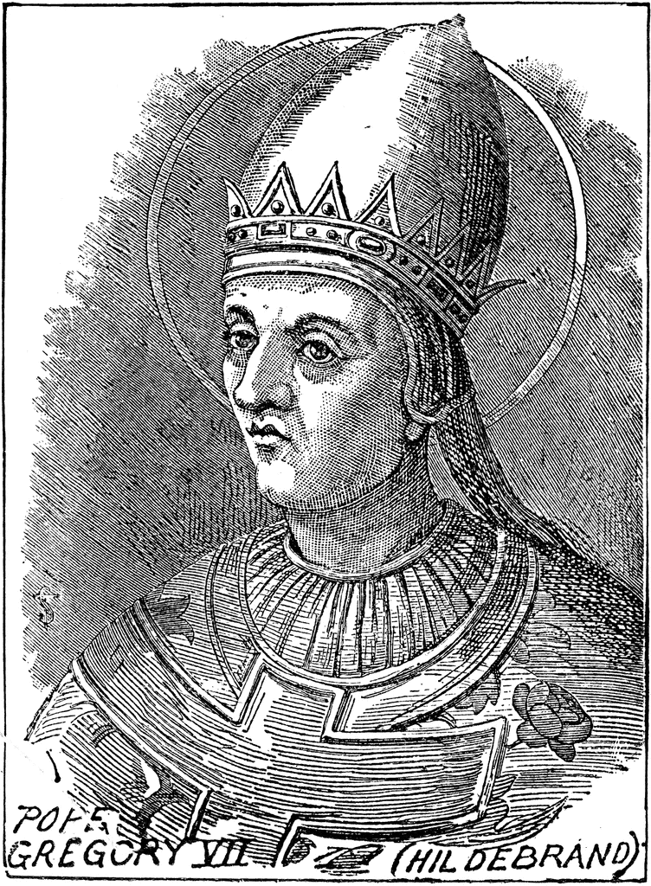
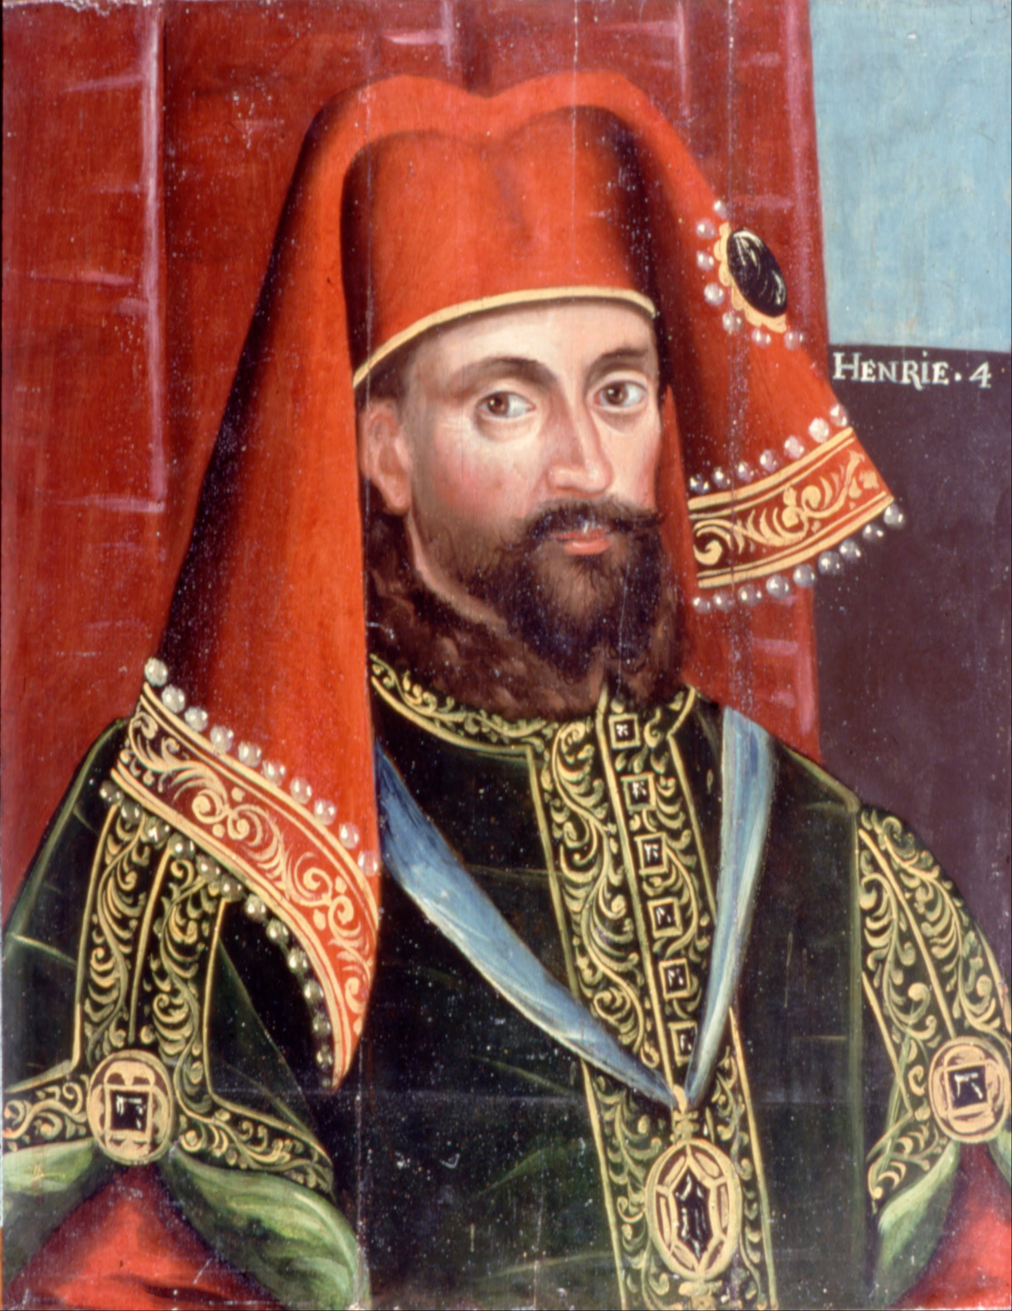
Walk to Canossa (1077)
The Players
Gregory VII (Hildebrand)
Took Papal infallibility for himself
Declared simony (selling church offices to the highest bidder) illegal
Attempted to exert church authority over Western Empire
Henry IV
Western Emperor
Butted heads with Gregory VII

Slide 19
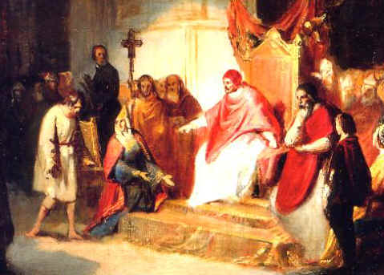
Walk to Canossa (1077)
The Story
Gregory VII accused Henry IV of Simony
Henry IV excommunicated Gregory
Gregory declared an Interdiction on All of Europe under Henry IV’s rule
Interdiction: withhold communion and in so doing withhold grace/salvation.

Slide 20
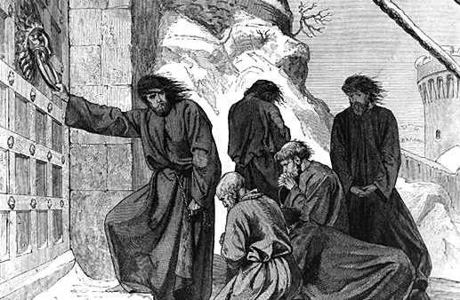
Walk to Canossa (1077)
Henry walked to Canossa and waited outside the Pope’s gates for 3 days doing penance
Gregory forgave Henry
The church now had its ace in the hole

