Slide 1
Church History
Medieval Christianity Part 2
by Stephen Curto
for Home Church
March 6, 2016

Slide 2
Middle Ages 590-1517
Part 1)
590-1077 (Gregory the Great – Gregory VII vs. Henry IV)
Part 2)
1077-1517 (Gregory and Henry – Martin Luther’s 95 Theses)

Slide 3
Recap
Barbarian tribes in West
Church is stabilizing force in Europe
Islam and Arab conquest
Stopped by Charles Martel
Charlemagne
The Walk to Canossa
https://www.youtube.com/watch?v=l53bmKYXliA
Start at 1:20

Slide 4
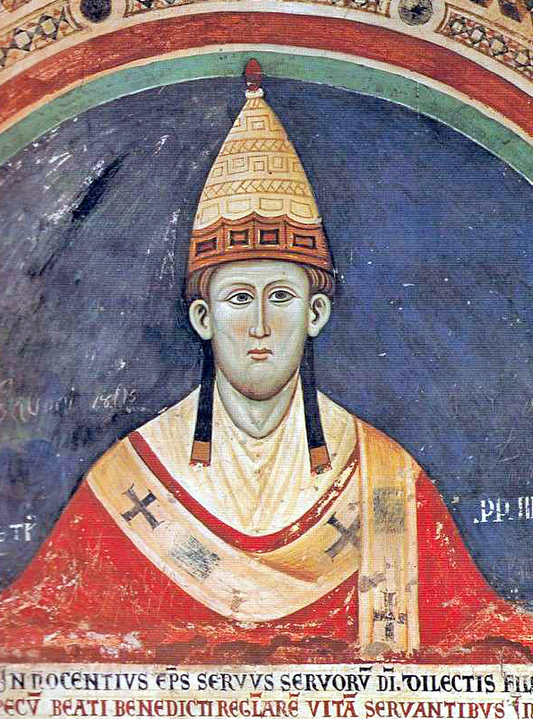
Innocent III (1160-1216)
Most powerful pope of medieval period
“The most powerful man on earth.”
Called 4th Lateran Council
Dogmatize transubstantiation
Dogmatize confession to priests
Dogmatize papal primacy
Dogmatize the tithe
70 canons
“A good roman catholic at 7:30 every working day would attend mass every day for resolving the sins of the previous day.” – John Hannah

Slide 5
The Crusades 1095-1480’s
An attempt by the west to:
re-conquer holy land
reunite east and west empires
1095- Council of Clermont – Pope Urban II
“Deus vult” God wills it!
July 15 1099 crusaders take Jerusalem.
The following Crusades were not as clear cut, but they continued until aprrox 1480’s

Slide 6
The Crusades 1095-1480’s

Slide 7
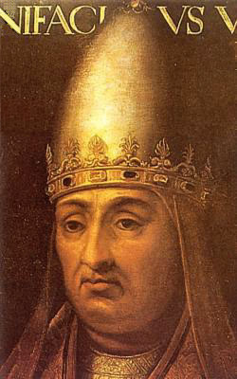
Boniface VIII (1235-1303)
sought to reform church through political power
promised indulgences to all who visited Peter’s tomb (1300)
Unam Sanctam a papal bull reflecting the high point of papal claims to universal power (in church and in state)

Slide 8
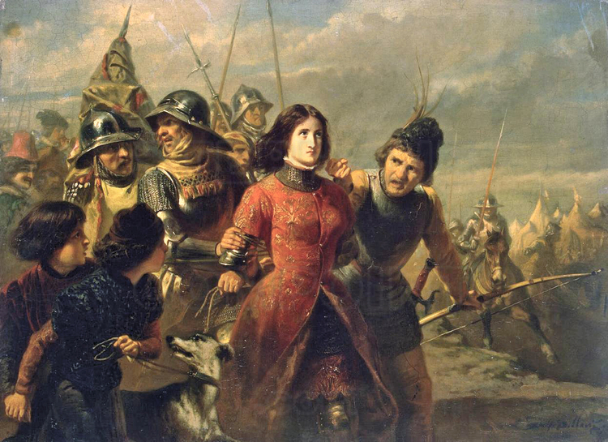
100 Years War (1337-1475)
Mainly between France and England
Joan of Arc (d. 1431)
Fought for France
Captured by English and accused of heresy
Burned alive
War pilfered out due to civil unrest/general malaise

Slide 9
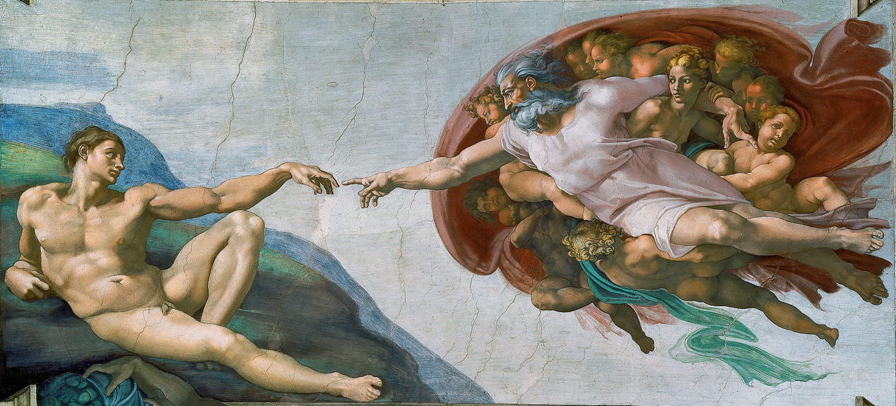
Renaissance (1300’s-1600’s)
“re-birth” or science, art, humanistic culture
Aristotelian ideas of reality
Groundwork for the enlightenment

Slide 10
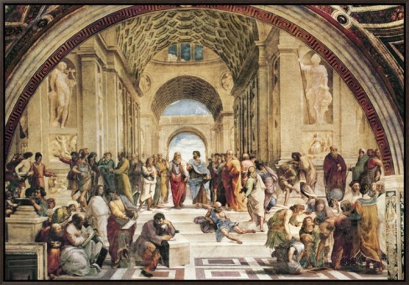
The School of Athens (Raphael)

Slide 11
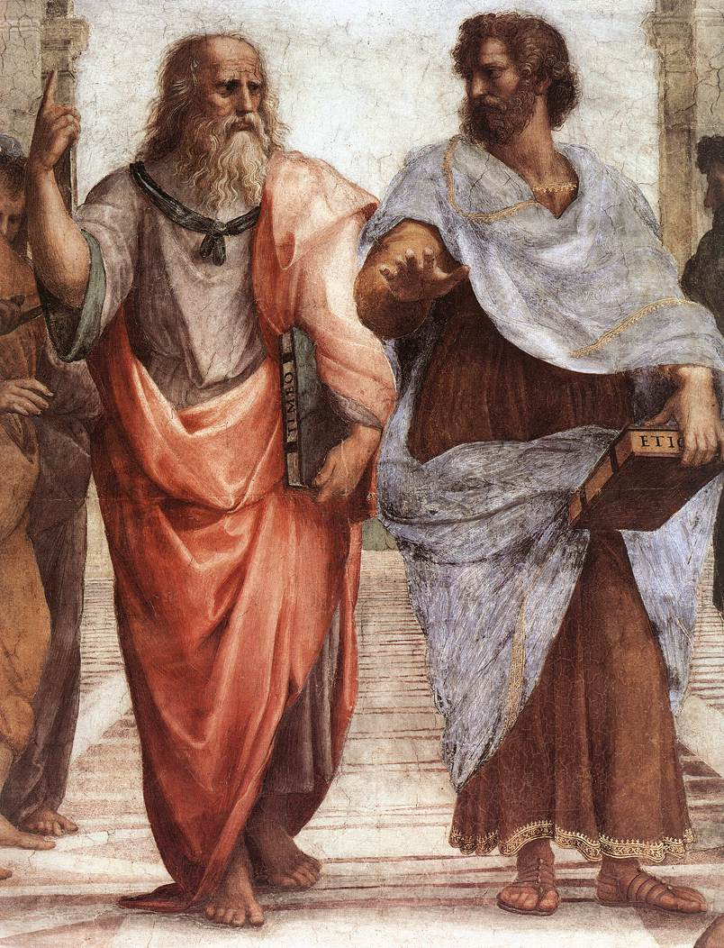

Slide 12
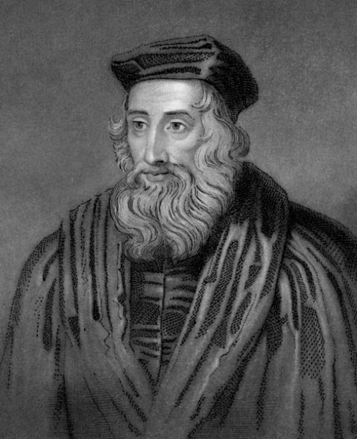
John Wycliffe (1331-1384)
opposed dominance of church
rallied against the pope(s)
argued for Bibles in possession people
opposed transubstantiation in favor of a “mystery” view
died of a stroke
later condemned as a heretic by the church
his followers promoted his views
wrote prolifically

Slide 13
Things Going on...
The Black Plague (1347-53)
The Great Western Schism (1378-1417)
Fall of Constantinople (May 29, 1453)
Spanish Inquisition (1478)

Slide 14
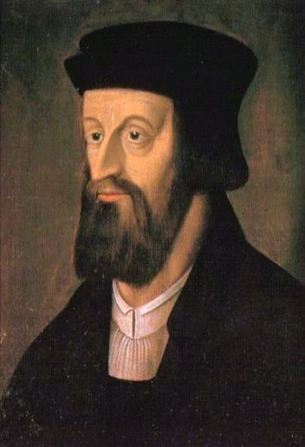
Jan Huss (1369-1415)
born and raised in Bohemia (current day Czechoslovakia)
Beliefs
held to transubstantiation
“an unworthy pope is not to be obeyed”
Bible is final authority
Accused of heresies by several popes
Burned alive for heresy
“I appeal to Jesus Christ, the only judge who is almighty and completely just.”

Slide 15
https://www.youtube.com/watch?v=l53bmKYXliA
Watch for:
Split of Rome
Charlemagne’s conquest for Franks
Holy Roman Empire
Fall of Constantinople to Ottomans

