Slide 1
The Minor Prophets
Introduction

Slide 2
Why Study the Prophets
Make up approx. 29% of the OT and 22% of the bible. (the whole NT is 23% of the bible)
Teach us about God and how He interacts with Israel

Slide 3
Law
Genesis
Exodus
Leviticus
Numbers
Deuteronomy
Poetry
Job
Psalms
Proverbs
Ecclesiastes
Song of Solomon
Minor Prophets
Hosea
Joel
Amos
Obadiah
Jonah
Micah
Nahum
Habakkuk
Zephaniah
Haggai
Zachariah
Malachi
History
Matthew
Mark
Luke
John
Acts
Pauline Epistles
Romans
1 Corinthians
2 Corinthians
Galatians
Ephesians
Philippians
Colossians
1 Thessalonians
2 Thessalonians
1 Timothy
2 Timothy
Titus
Philemon
General Epistles
Hebrews
James
1 Peter
2 Peter
1 John
2 John
3 John
Jude
Major Prophets
Isaiah
Jeremiah & Lamentations
Ezekiel
Daniel
History
Joshua
Judges & Ruth
1 & 2 Samuel
1 & 2 Kings
1 & 2 Chronicles
Ezra & Nehemiah
Esther
Prophecy
Revelation

Slide 4
Why Study the Prophets
Often timeless messages:
Hosea’s appeal for purity and God’s indestructible love
Amos’ call for justice in his society
Obadiah’s condemnation of pride
Micah’ rebuke of ungodly leadership
Habakkuk’s quest for divine retribution and reconciling God’s sovereignty
Haggai’s discourse on misplaced priorities
Malachi’s censure of religious orthodoxy

Slide 5
Why Study the Prophets
Tell us much about the Messiah
Teach us more about the future than the NT. (If you don’t know a little eschatology you won’t get the prophets)
They serve as our examples. (Hebrews 11:32-38)
Stress the judgment and mercy of God who always does what he says he will.

Slide 6
Why We Often Neglect the Prophets
Difficult to understand
Some think they are “Out of date” and “irrelevant"
Requires effort and skill to exegete them
Some believe they are already fulfilled or will never be fulfilled so why bother with them?
Modern church doesn’t like the message of the prophets: A sovereign God whose righteous judgment and holy discipline is presented.

Slide 7
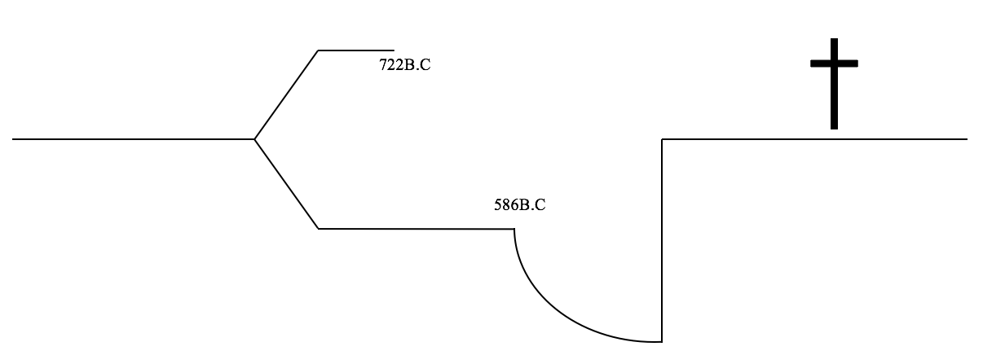
History
Can you fill in the timeline?

Slide 8
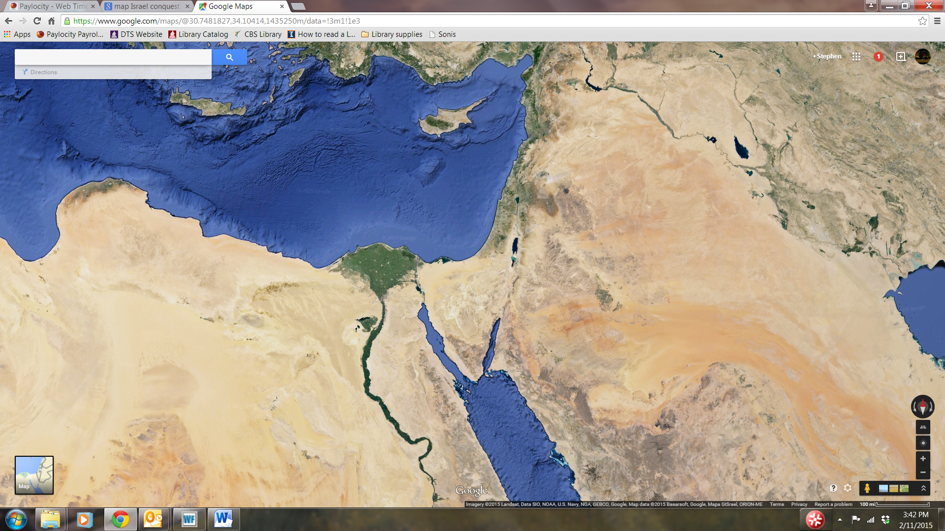
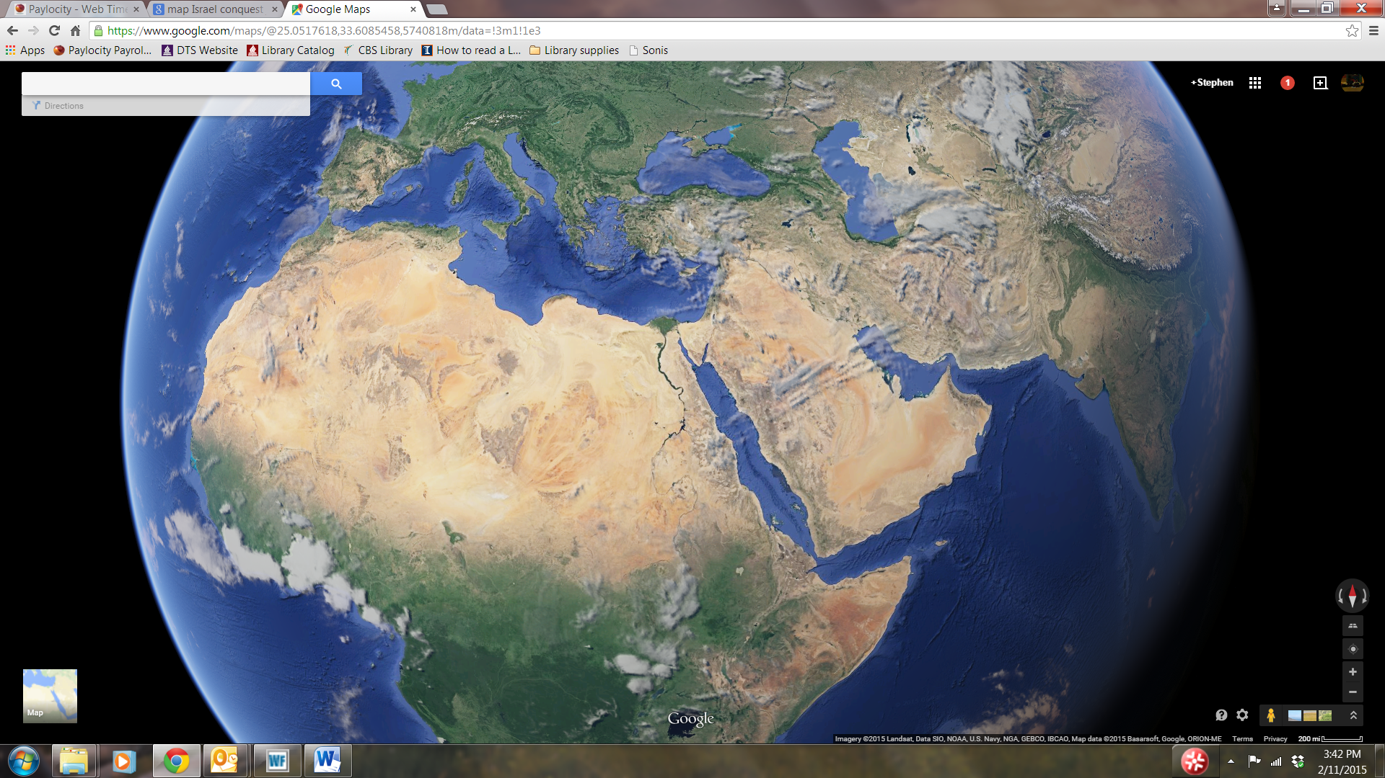
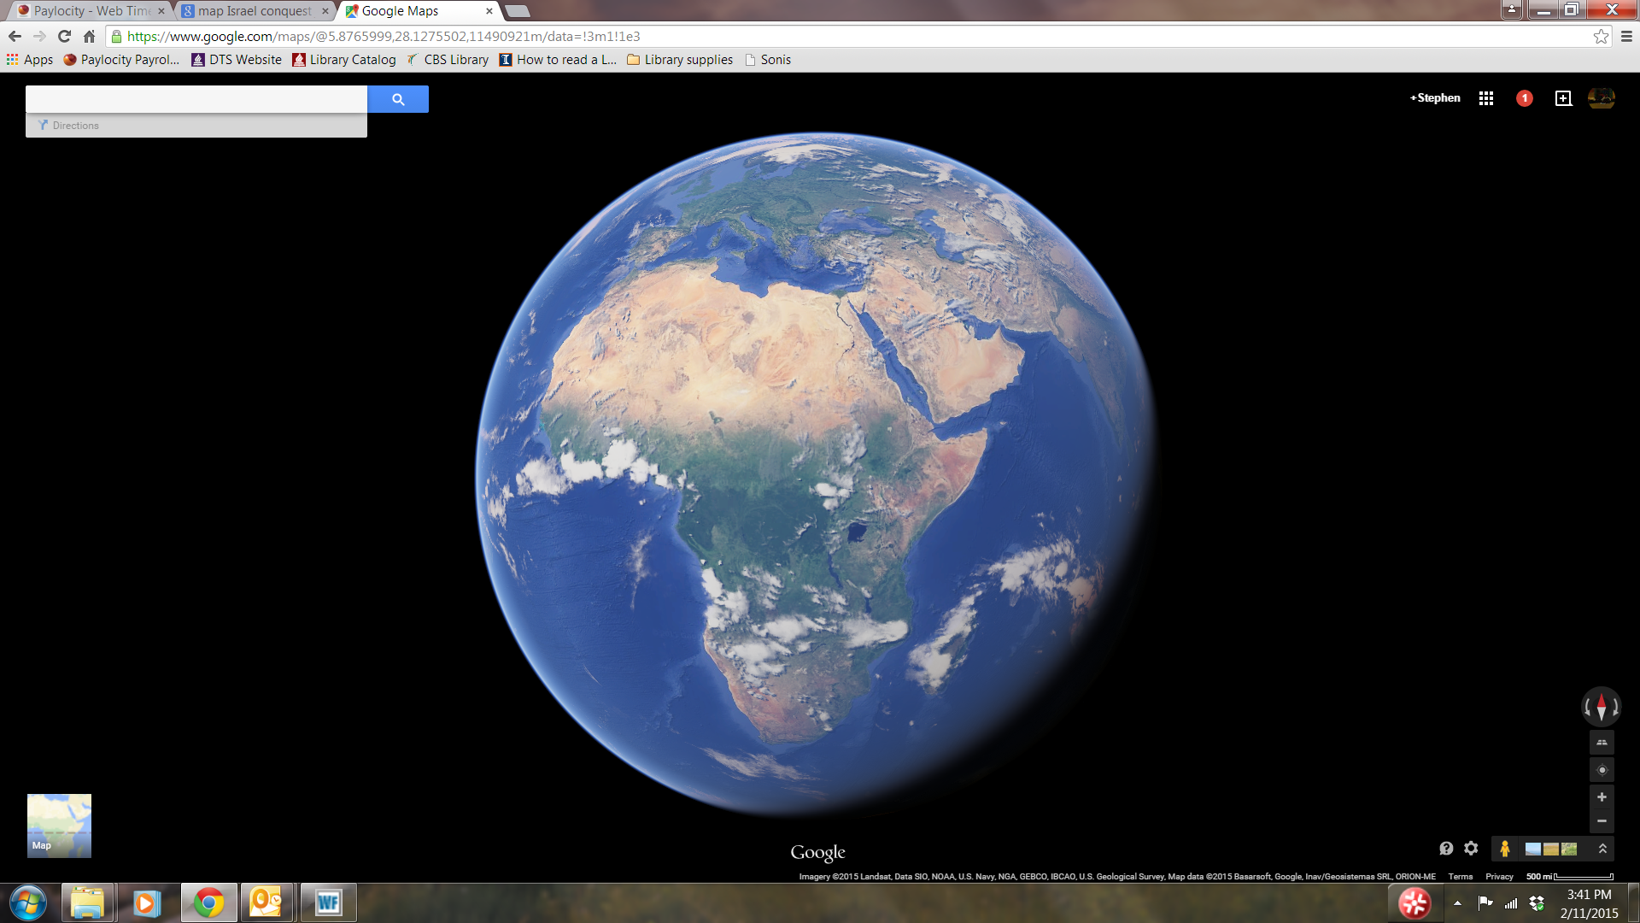

Slide 12
History
Genesis
Abraham, Isaac, Jacob - > Egypt
Exodus
Moses and the Law
Joshua
Conquering the land
Judges
“Everyone did what was right in their own eyes.”

Slide 13
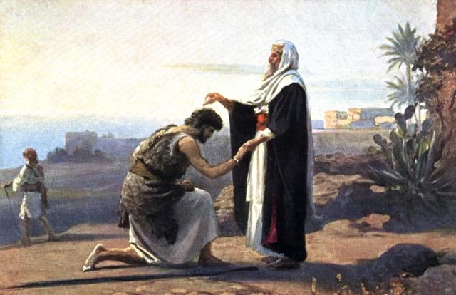
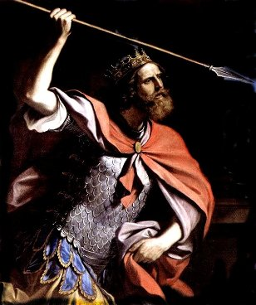
History
Samuel
the last judge, the first prophet since Moses (Joshua?)
Saul
David
Solomon

Slide 14
History
Divided Kingdom
Rehoboam (Judah/South) and Jeroboam (Israel/North) Conflict
All the kings of Israel and Judah

Slide 15
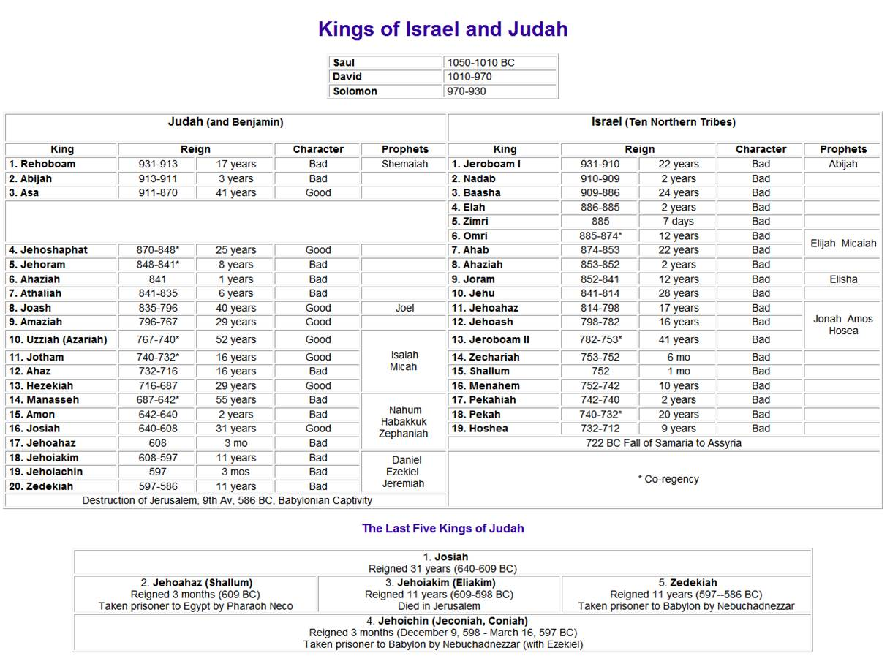

Slide 19
Prophet | Purpose of Book
Isaiah | A plea to Judah and Jerusalem to Trust Yahweh as his Servant nation, in the face of a gentile-run world.
Jeremiah | A call for Judah to repent and then to submit to punishment for refusing to repent.
Ezekiel | A reminder of God's faithfulness to Israel even when they were unfaithful, and predictions of his continued faithfulness.
Daniel | A show of God's sovereignty over all nations and all history.
Hosea | A call for Israel to repent, and a reminder of God's love for Israel, even when they were unfaithful.
Joel | A warning to Jerusalem of judgment day: the Day of the Lord.
Amos | A stern warning of judgment for Israel's idolatry.
Obadiah | A message of judgment on Edom.
Jonah | A message of judgment on Nineveh, and God's mercy.
Micah | A message to the people of Judah to repent.
Nahum | The announcing of Nineveh's fall.
Habakkuk | A cry to God for justice, and submission to his sovereignty.
Zephaniah | A call to be silent and fear Yahweh.
Haggai | An encouragement to the remnant to rebuild the temple.
Zachariah | A call for the remnant to hope in the messiah and his kingdom.
Malachi | a call for the remnant to pursue holiness.

