Slide 1
Moses Through David
A Survey of Exodus Through 1 Samuel

Slide 2
A Look at the Weeks Ahead
May 1 - Moses Through David
May 8 - BEACH WEEKEND
May 15 - Kings and Prophets
May 22 - Ezra-Nehemiah
May 29 - VBS day

Slide 3
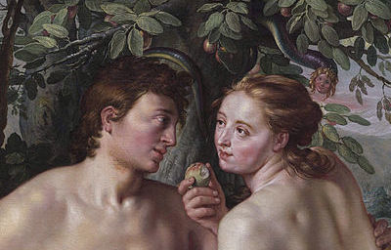
Review
Seed Promised (Gen 3:15)
Noah
Babel
Abraham
Isaac
Abrahamic Covenant reiterated to Isaac (26:3-5)
Jacob
Abrahamic Covenant reiterated to Jacob (28:13-15)

Slide 4
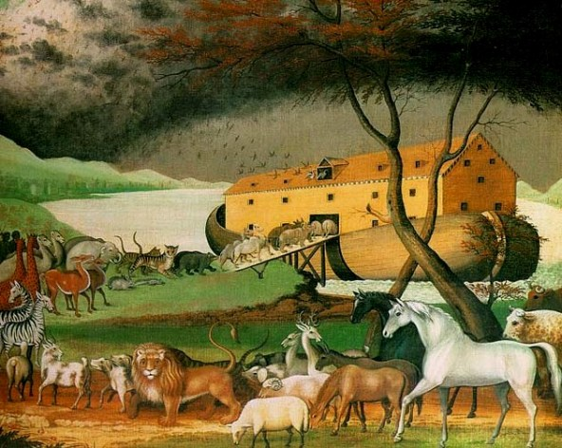
Review
Seed Promised (Gen 3:15)
Noah
Babel
Abraham
Isaac
Abrahamic Covenant reiterated to Isaac (26:3-5)
Jacob
Abrahamic Covenant reiterated to Jacob (28:13-15)

Slide 5
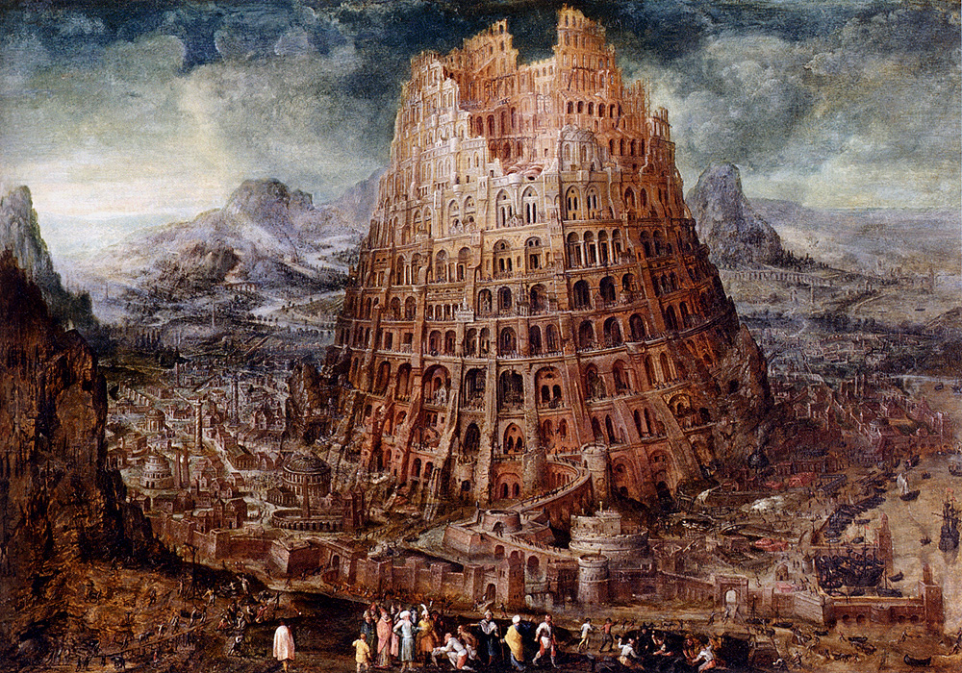
Review
Seed Promised (Gen 3:15)
Noah
Babel
Abraham
Isaac
Abrahamic Covenant reiterated to Isaac (26:3-5)
Jacob
Abrahamic Covenant reiterated to Jacob (28:13-15)

Slide 6
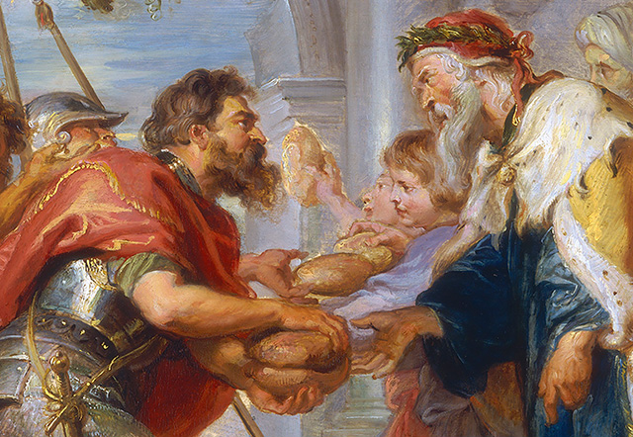
Review
Seed Promised (Gen 3:15)
Noah
Babel
Abraham
Isaac
Abrahamic Covenant reiterated to Isaac (26:3-5)
Jacob
Abrahamic Covenant reiterated to Jacob (28:13-15)

Slide 7
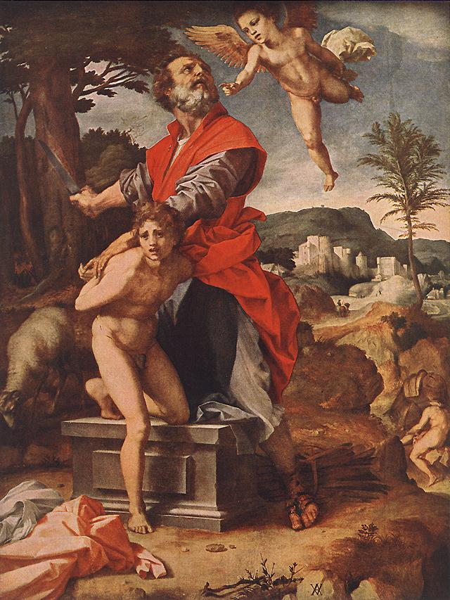
Review
Seed Promised (Gen 3:15)
Noah
Babel
Abraham
Isaac
Abrahamic Covenant reiterated to Isaac (26:3-5)
Jacob
Abrahamic Covenant reiterated to Jacob (28:13-15)

Slide 8
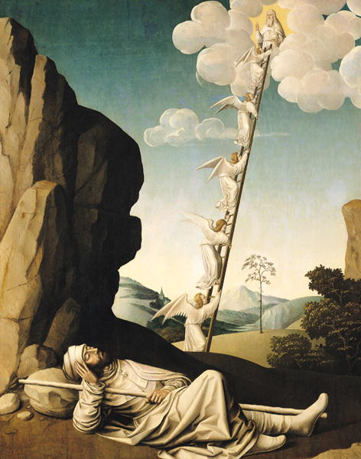
Review
Seed Promised (Gen 3:15)
Noah
Babel
Abraham
Isaac
Abrahamic Covenant reiterated to Isaac (26:3-5)
Jacob
Abrahamic Covenant reiterated to Jacob (28:13-15)

Slide 9
Abrahamic Covenant
(Gen 12, 13, 15) UNCONDITIONAL
Land – “To your offspring I will give this land” (12:7) “From the Nile to the Euphrates” (15:18-20)
Seed – “Make you a great nation” (12:2) numerous as “dust” (13:16) and “stars” (15:5)
Blessing – “Bless those who bless you… in you, all the families of the earth shall be blessed.” (12:3)

Slide 10
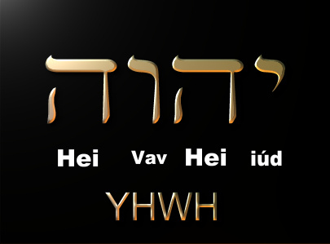
Moses
Burning bush (Ex 3:6, 13-15)(ref Gen 32:22-32) The Name of God!
Return to Egypt and the ten Plagues (Ex 4-12)
The 10 Plagues

Slide 12
Moses
The Passover (Ex 12)
Take a lamb and keep it four days
Congregation kills their lambs together at twilight
Blood on doorpost
Roast and eat lamb, quickly
The Lord will see the blood and pass over you.

Slide 13
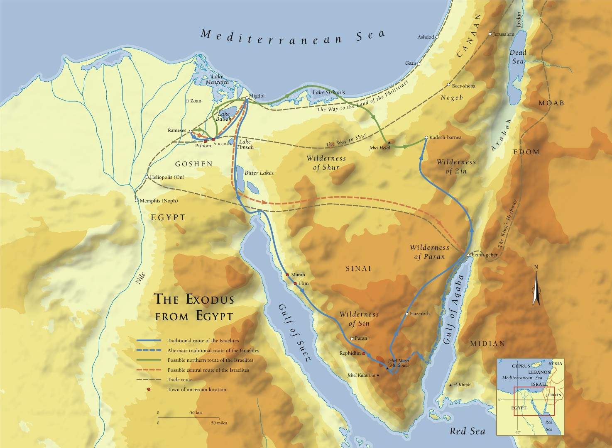
Moses – The Exodus

Slide 14
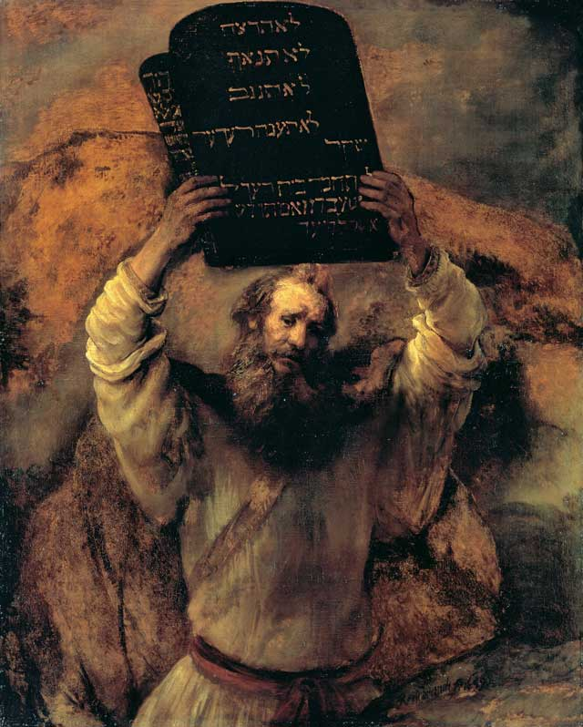
Moses
Giving the Law and the Law (Ex 19-31, Leviticus)
10 Commandments (Ex 20)
613 Commandments (Exodus-Deuteronomy)
Theme/point of the law?
Lev 19:2 “Be ye holy for I the Lord your God am Holy.”

Slide 15
Mosaic Covenant
(Ex 19-Deut 34) CONDITIONAL
Exodus 19:5-6
“IF you will… keep my covenant…”
“A kingdom of priests and a holy nation”
Exodus 24:7-18
“All that YHWH has spoken we will do, and we will be obedient”
Compare Galatians and Hebrews…

Slide 16
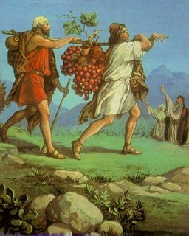
Moses
Rebellion at Kadesh Barnea (Num 13-14)
12 spies go in
2 spies come out optimistic (Caleb and Joshua)
The people rebel
“How long will this people despise me?” (Num 14:11)
Moses intercedes (Num 14:13-19)
God’s Judgment (Num 14:20-45)
14:28-35

Slide 17
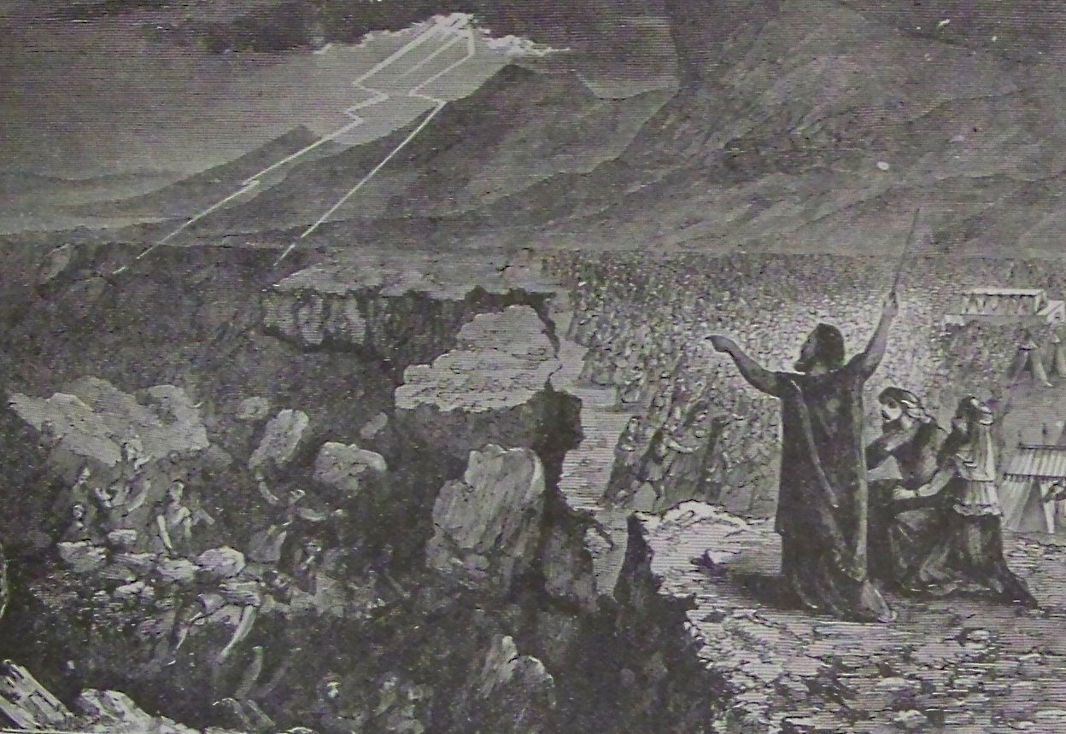
Moses
40 Years Wandering (Num 15-36)
Korah’s Rebellion (Num 16)
Aaron’s staff buds (Num 17)
Moses Strikes Rock (Num 20)
Bronze Serpent (Num 21)
Balaam’s oracles (22-24)

Slide 18
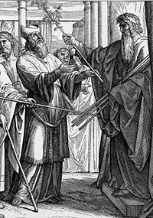
Moses
40 Years Wandering (Num 15-36)
Korah’s Rebellion (Num 16)
Aaron’s staff buds (Num 17)
Moses Strikes Rock (Num 20)
Bronze Serpent (Num 21)
Balaam’s oracles (22-24)

Slide 19
Moses
40 Years Wandering (Num 15-36)
Korah’s Rebellion (Num 16)
Aaron’s staff buds (Num 17)
Moses Strikes Rock (Num 20)
Bronze Serpent (Num 21)
Balaam’s oracles (22-24)

Slide 20
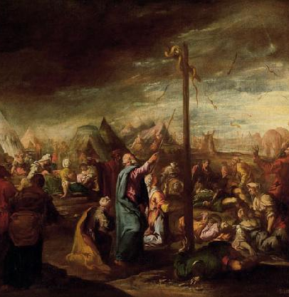
Moses
40 Years Wandering (Num 15-36)
Korah’s Rebellion (Num 16)
Aaron’s staff buds (Num 17)
Moses Strikes Rock (Num 20)
Bronze Serpent (Num 21)
Balaam’s oracles (22-24)

Slide 21
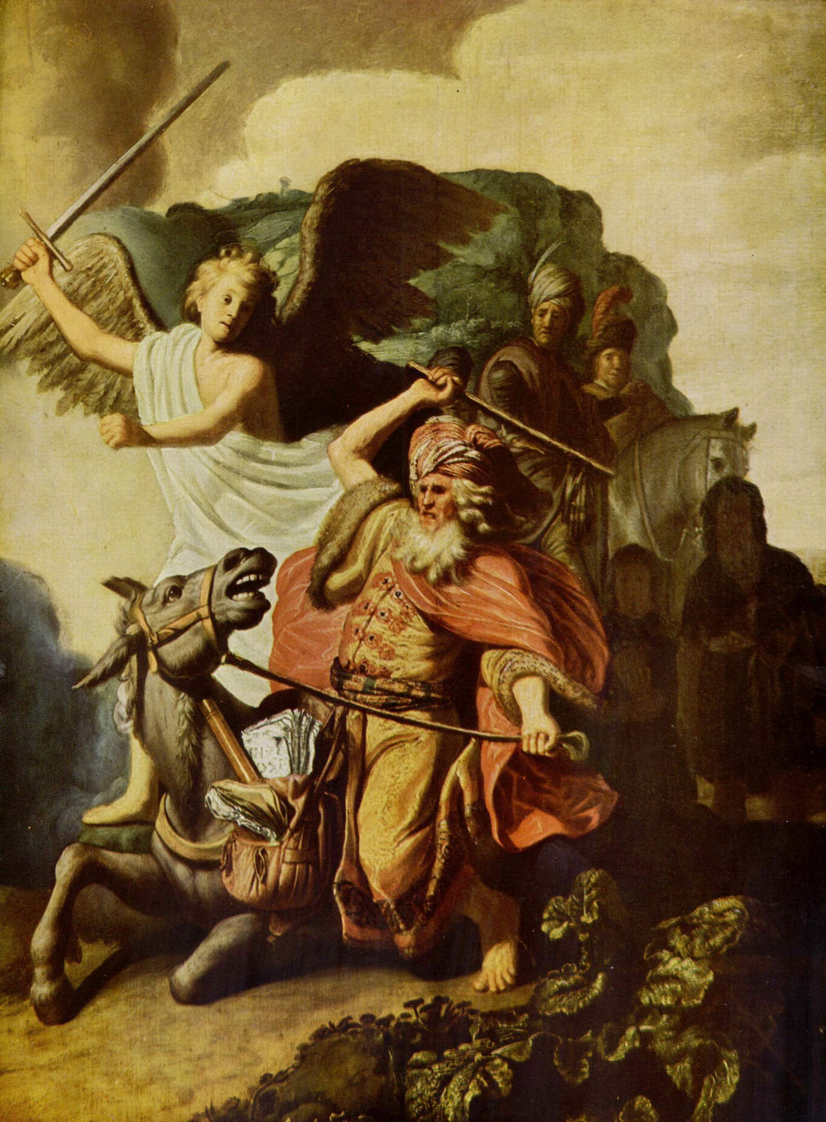
Moses
40 Years Wandering (Num 15-36)
Korah’s Rebellion (Num 16)
Aaron’s staff buds (Num 17)
Moses Strikes Rock (Num 20)
Bronze Serpent (Num 21)
Balaam’s oracles (22-24)

Slide 22
Moses
Deuteronomy (Second Law)
Recounts History
Recounts laws
Predicts future
Deut 17:14-20 (“When you have a king…” ????)
Deut 28 (Blessings AND Curses)
Deut 30:2-6 (land and circumcision)
Deut 32 (The whole story)

Slide 23
Major Shifts in the Story
From single characters to nation
From Abrahamic Covenant to Mosaic Covenant
From broad rule to specific law
Why?

Slide 24
Joshua
Joshua begins conquering land (starting with Jericho) (1-6)
Rahab and the spies (2)
Josh 8:30-35 (Covenant renewal)
Josh 13 (Lands not conquered)
“You are old and there remains very much land to possess.)
Josh 24:14-28 (Covenant renewal)

Slide 25
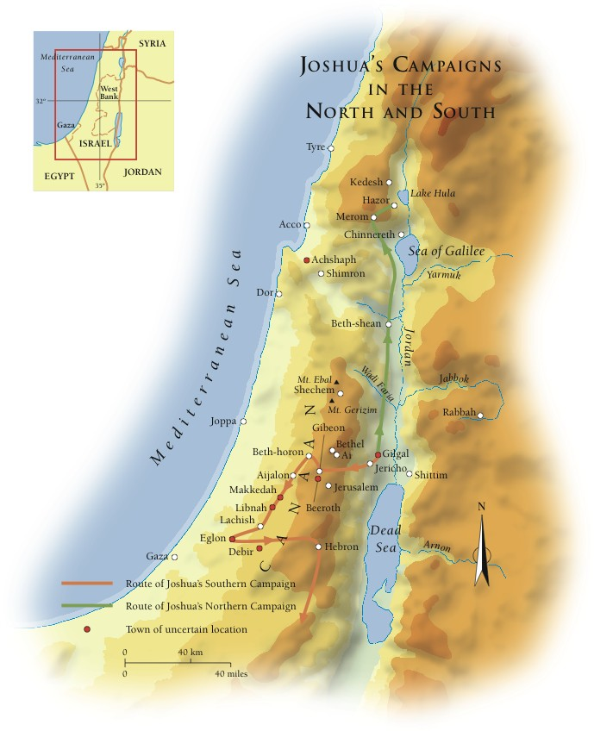

Slide 26
Judges
Judges 2:11 (It takes 2 chapters for them to forget their promises)
Theme of Judges: 21:25 “In those days there was no king in Israel. Everyone did what was right in his own eyes.”
The cycle of the judges
The Judges

Slide 27
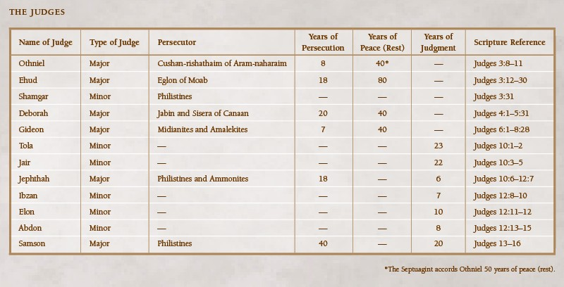

Slide 28
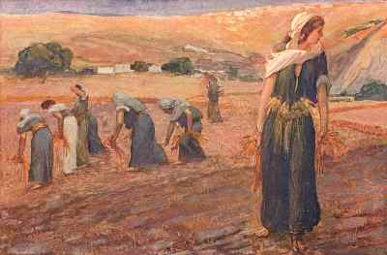
Ruth
during the period of the judges
a Moabite
grafted into Israel
mother of Obed, father of Jesse, Father of David…

Slide 29
Samuel
during the period of the judges
Hannah prays for son (1 Sam 2)
The Lord Calls Samuel (1 Sam 3)
Samuel Judges Israel (1 Sam 7)
Israel Demands a king (1 Sam 8)
Refer to Deut 17:14-20
8:4-9 (Israel rejects God)
8:19-22 “That we may be like all the other nations” (Refer to theme of the law)

Slide 30
Saul
Chosen and anointed by Samuel (1 Sam 9-10)
Saul as a successful leader (1 Sam 11-13)
Saul as an unsuccessful leader (1 Sam 13-31)
1 Sam 13:14 “the Lord has sought out a man after his own heart…”

Slide 31
Major Shifts?

