Slide 1
The New Testament
A Survey
By Stephen Curto
For Home Group
July 3, 2016

Slide 2
Overview
Historical Books
The Four Gospels and Acts
Pauline Epistles
Romans-Philemon
General Epistles
Hebrews-Jude
Prophetic Book
Revelation

Slide 3
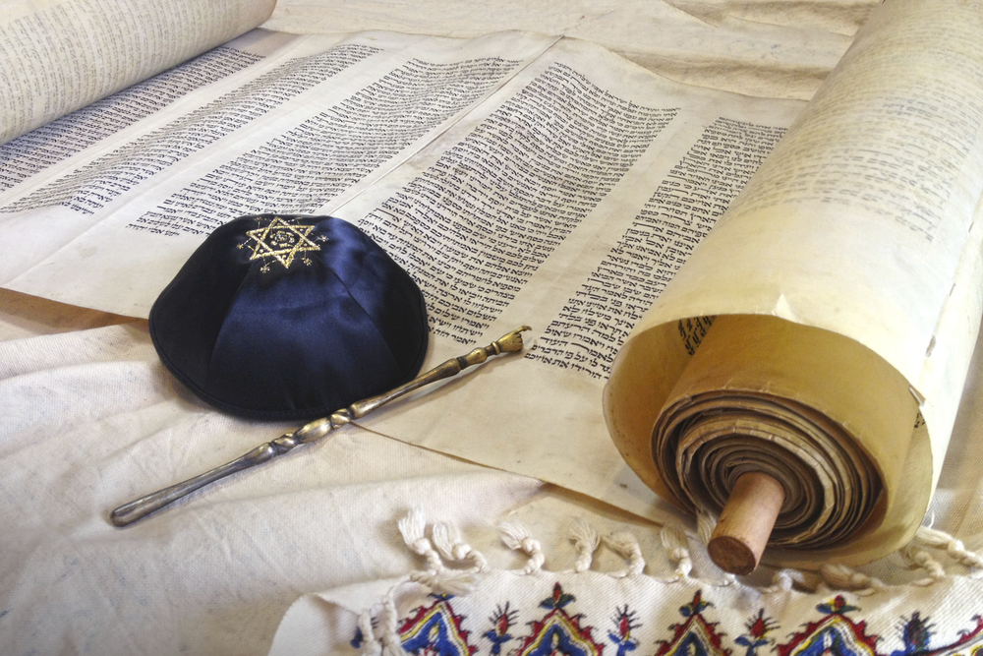
Historical Books - Gospels
Forget not…
Their Context
Their Jewishness
Their Time (1st Century)
Their genre (history)
Their Point
to record the first coming
Not to tell the whole story

Slide 4
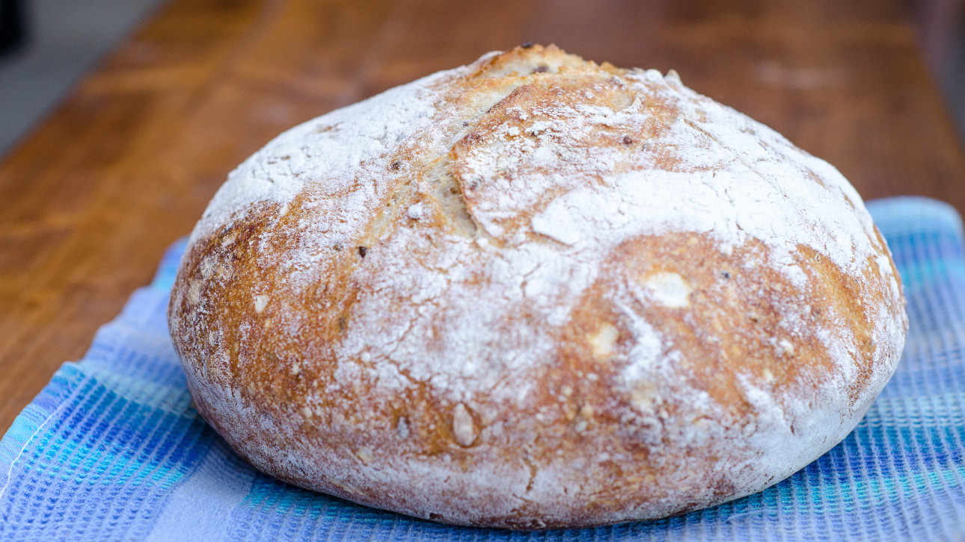
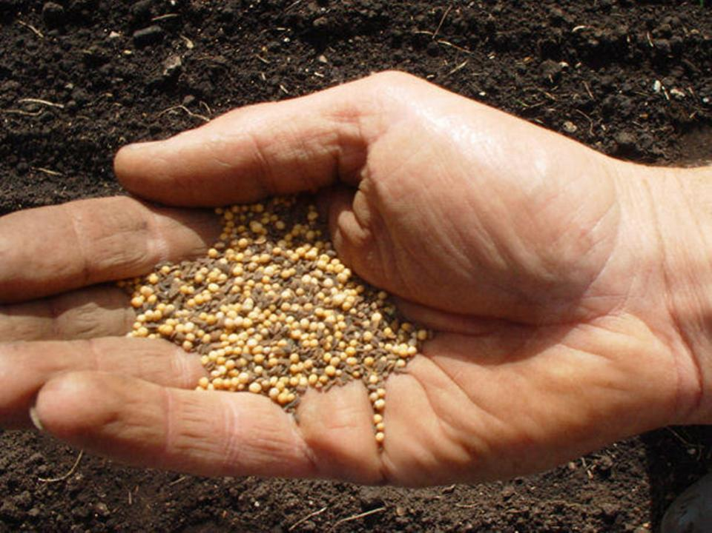
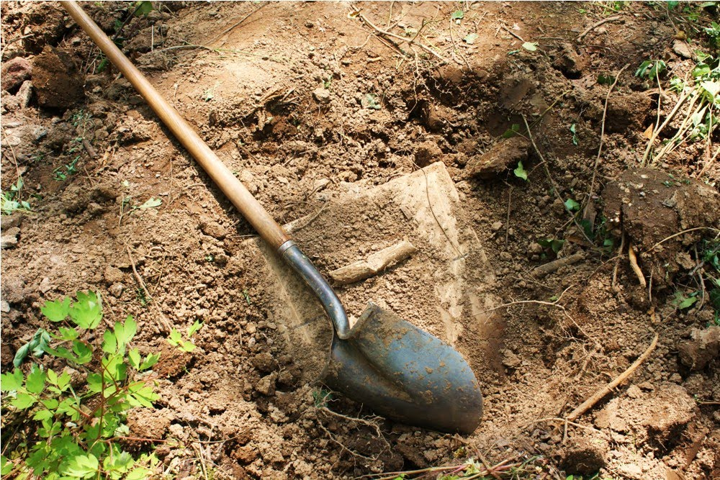
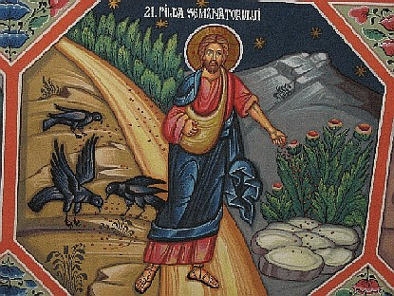
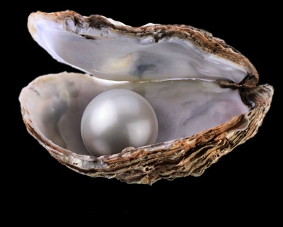
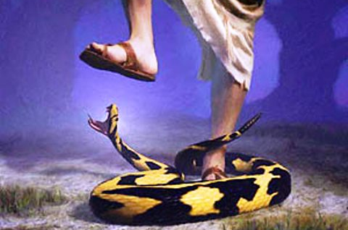
Historical Books - Gospels
Major Themes
The Kingdom of God
The rejection of the Messiah
The striking of the heel (Gen 3:15)

Slide 5
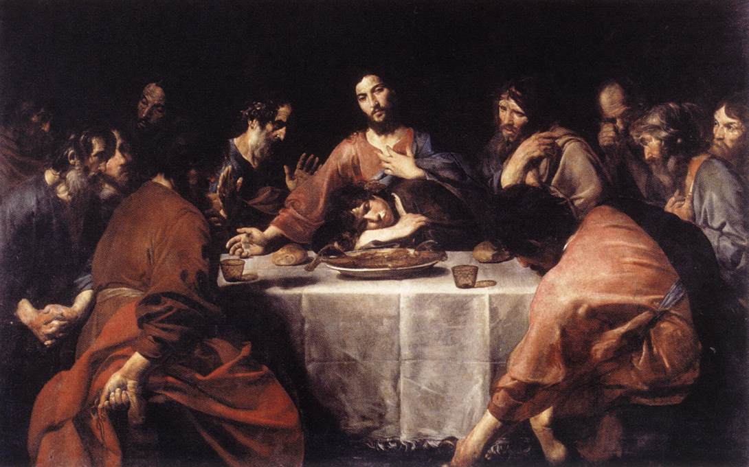
Historical Books - Gospels
Major Characters
Jesus
The Twelve
Priests and Elders
John the Baptist

Slide 6
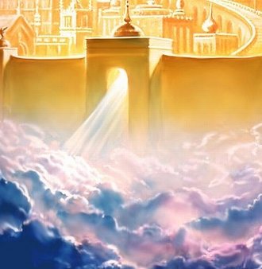
Historical Books - Gospels
Matthew: The gospel of the kingdom and the king.
Records more teachings about the kingdom of heaven than any other
Likely written to a Jewish audience
Key emphasis on showing the proofs from the OT of Jesus’s claim to be Messiah

Slide 7
Historical Books - Gospels
Mark: The gospel of action.
Punchy writing style (ευθυς euthus immediately)
The shortest
Records Jesus’s actions without much interpretation of the meaning

Slide 8
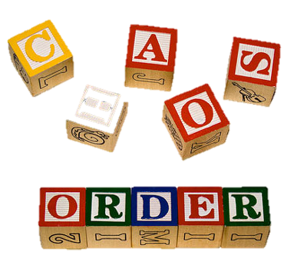
Historical Books - Gospels
Luke: The gospel of order.
Likely written to a largely Hellenistic audience
High-level Greek vocabulary
Was written “to present an orderly account”

Slide 9
Historical Books - Gospels
John: The gospel of love.
The most unique material/stories.
Written to get you to “believe that Jesus is the Christ, the Son of God, and that by believing you may have life in his name.”
Records 7 major miracles

Slide 10
Historical Books - Acts
(The Acts of the Apostles)
Written as a second volume to Luke’s Gospel to record the events after the resurrection.
Shows the going out of the gospel to Judea, and Samaria, and the ends of the earth.
1st half: The Apostles in Jerusalem
2nd Half: Paul travelling the world

Slide 11
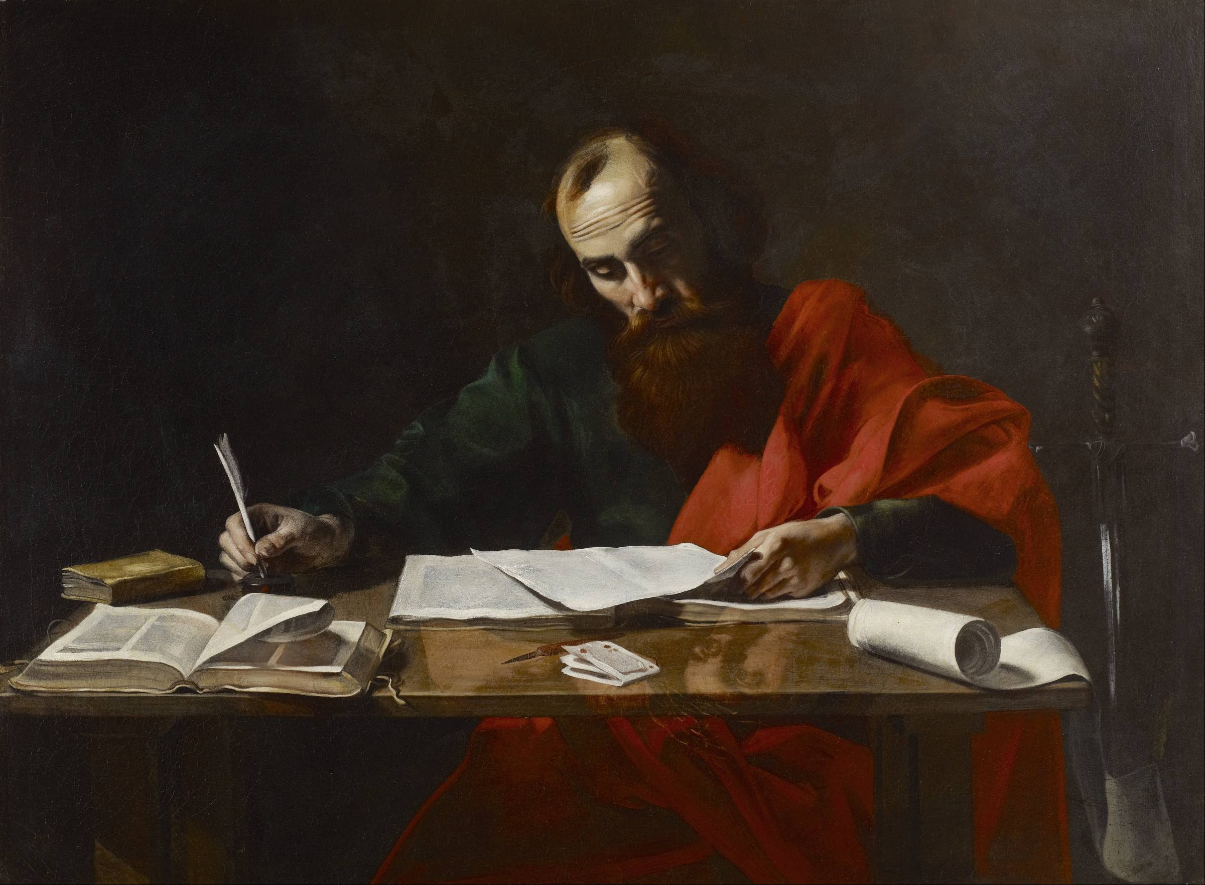
Pauline Epistles

Slide 12
Book | Year Written | Written From | Theme
Romans | 57 | Corinth (3rd Journey) | The Gospel of righteousness from God.
1 Corinthians | 56 | Ephesus (3rd Journey) | The Spirit of God working in a worldly local Church.
2 Corinthians | 56 | Macedonia (3rd Journey) | A personal appeal from Paul to reject false teachers.
Galatians | 40-49 | Antioch of Syria (After 1st Journey) | The grace of God which is better than the law.
Ephesians | 60 | Rome (Captivity) | The church of God, a mystery.
Philippians | 60-61 | Rome (Captivity) | A letter of encouragement and thanks.
Colossians | 60-61 | Rome (Captivity) | A defense of the deity of Christ in the face of heresy.
1 Thessalonians | 50-54 | Corinth (2nd Journey) | A letter of encouragement in the face of persecution.
2 Thessalonians | 50-54 | Corinth (2nd Journey) | a commendation of growth and instruction on "the Day of the Lord."
1 Timothy | 63-66 | Macedonia? (Before 2nd captivity?) | An encouragement to a young pastor on how to lead his church.
2 Timothy | 67 | Rome (2nd Captivity) | An encouragement to a young pastor to persevere in the face of hardship.
Titus | 63-66 | Macedonia? (Before 2nd captivity?) | An encouragement to a young pastor on how grace promotes good works.
Philemon | 60-62 | Rome (Captivity) | An appeal to view Christian slaves as brothers and forgive those who wrong you.

Slide 13
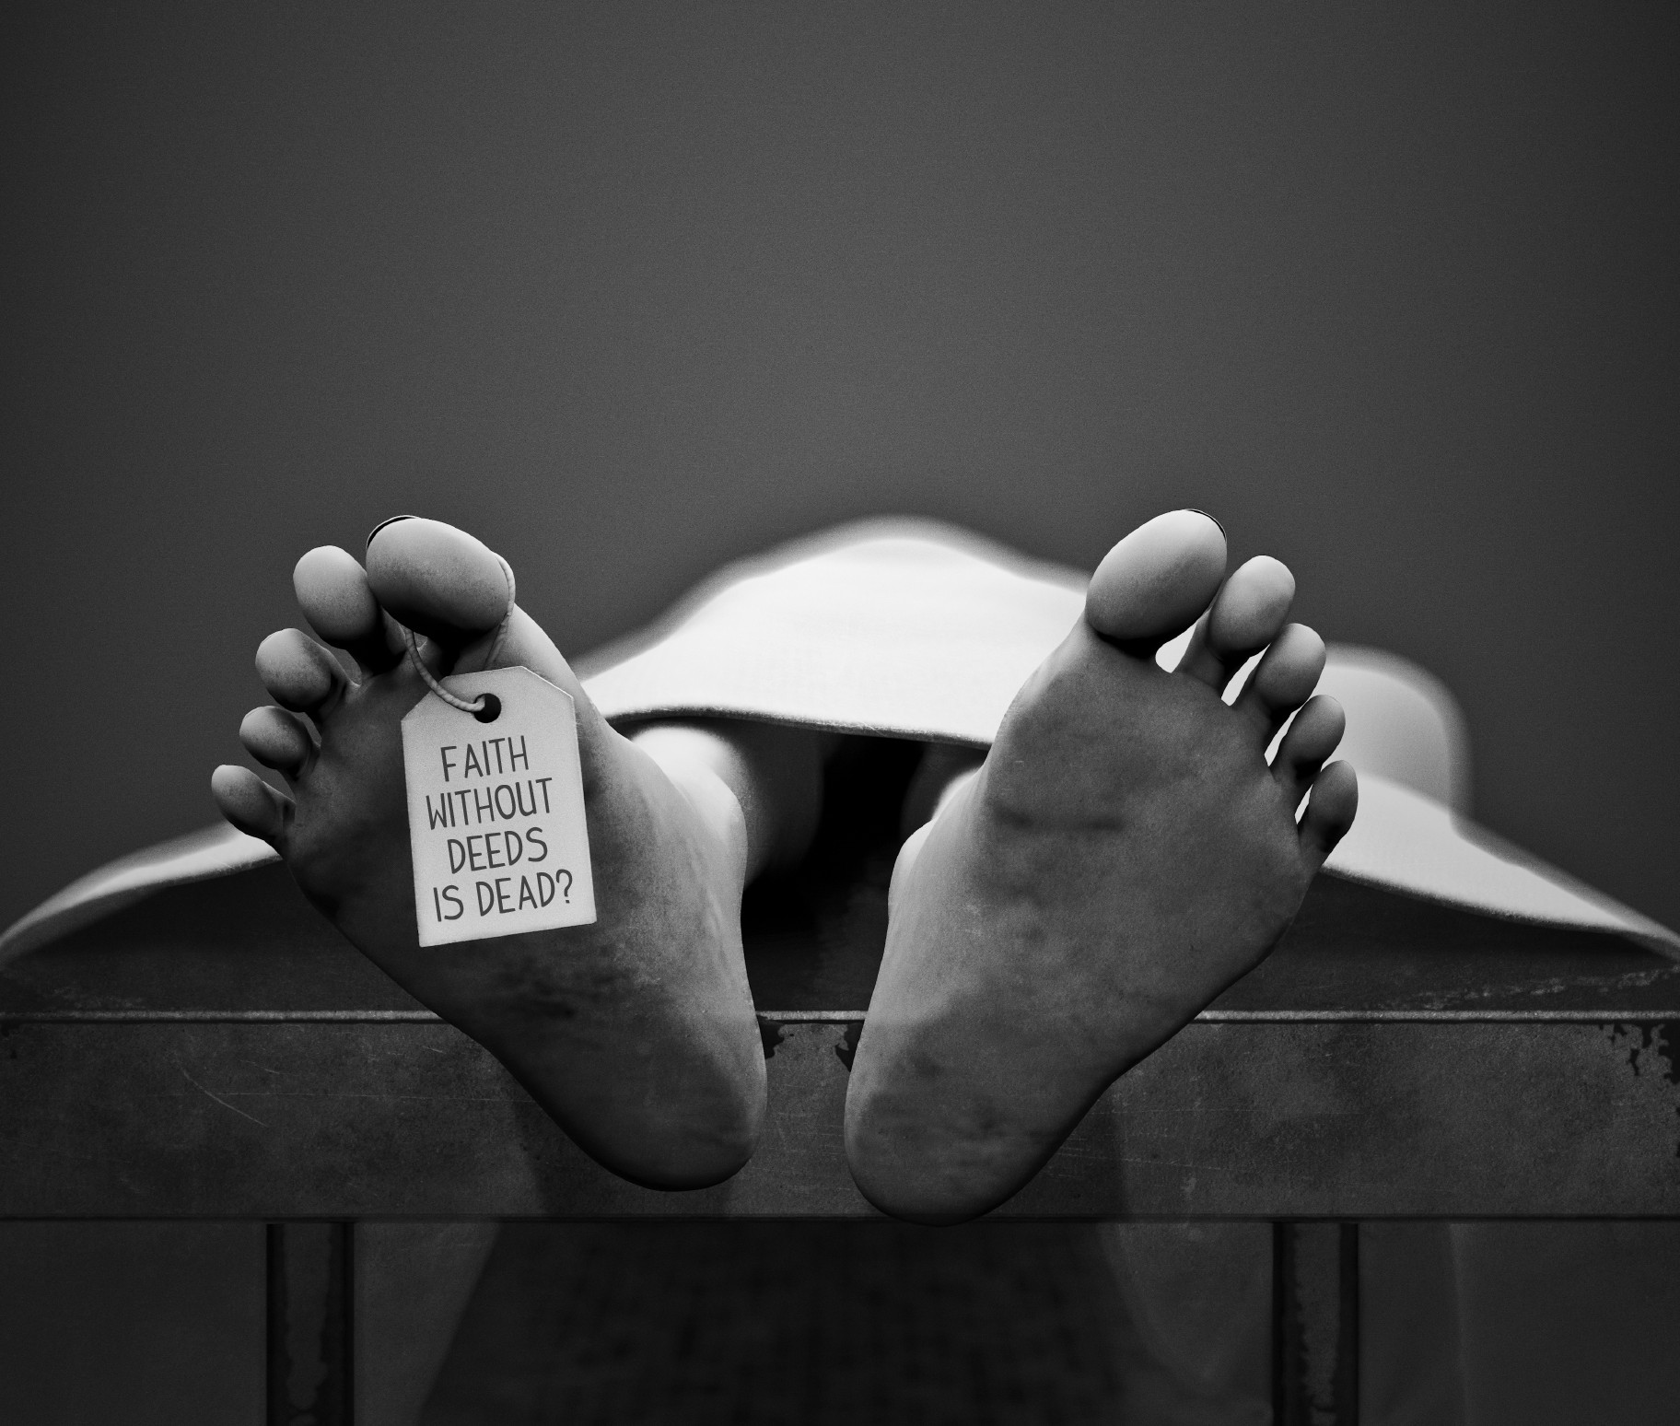
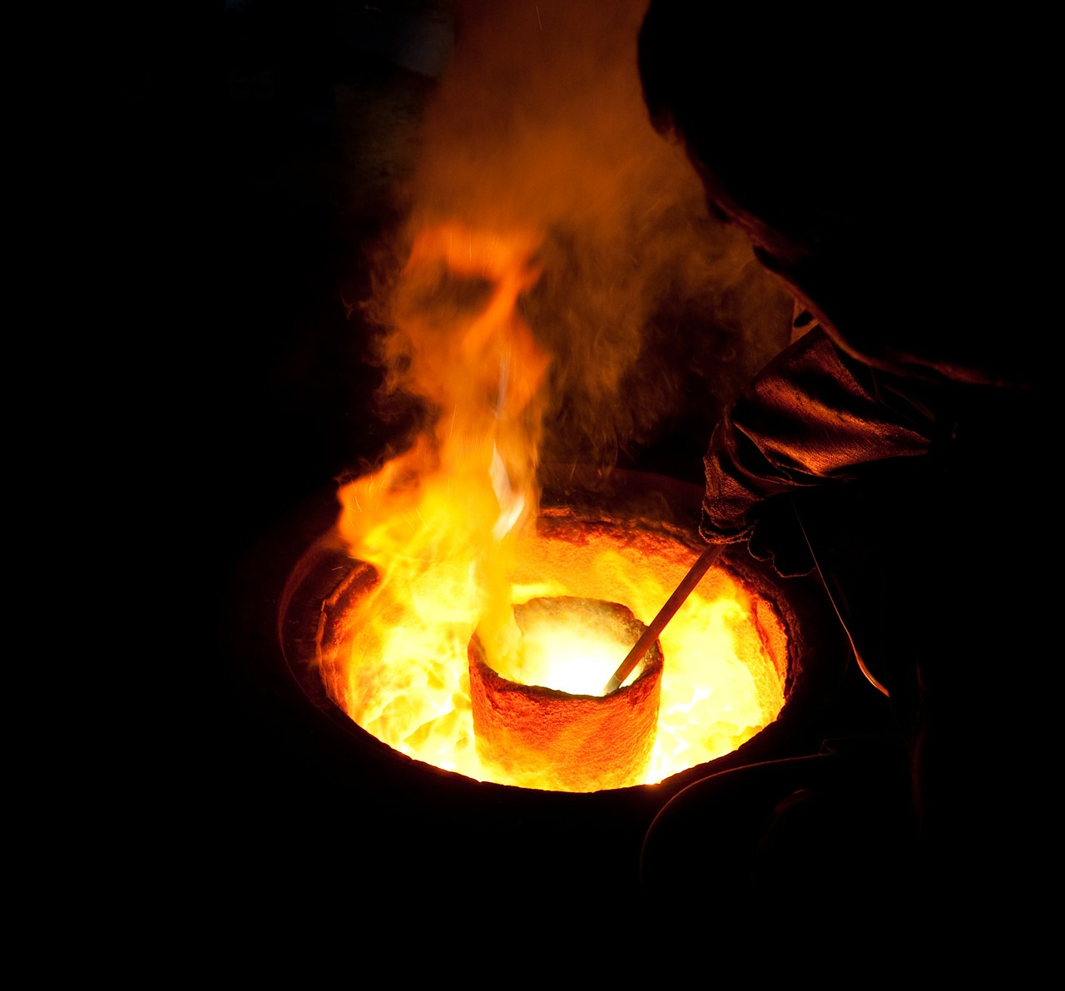
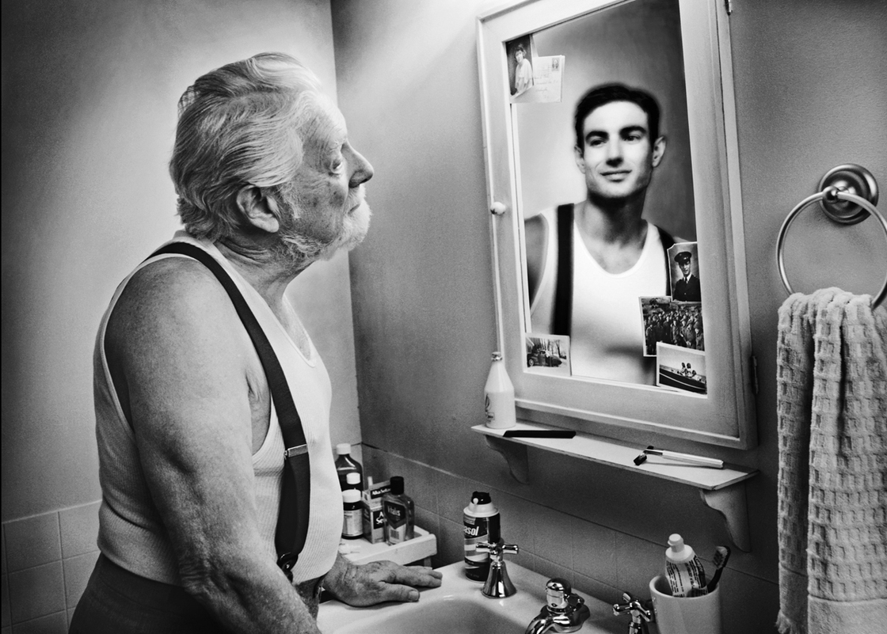
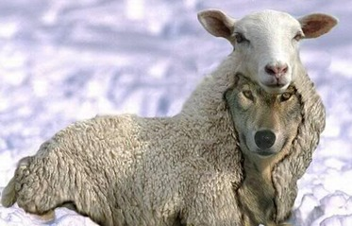
General Epistles

Slide 14
Book | Year Written | Author | Theme
Hebrews | ? | Paul? Luke? Apollos? Barnabas? | The superiority of Christ to all previous revelation.
James | 45-48 | James (Brother of Jesus) | The practical holiness brought by the Spirit.
1 Peter | 64 | Peter | Daily living as an alien in a foreign land.
2 Peter | 68 | Peter | A warning against false teachers.
1 John | 60-65 | John | How to love each other while rejecting false teachers.
2 John | 60-65 | John | a short encouragement to right belief and practice.
3 John | 60-65 | John | a short note on resolving church quarrels.
Jude | ? | Jude (Brother of Jesus) | A warning against false teachers.

Slide 15
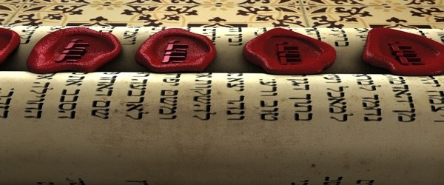
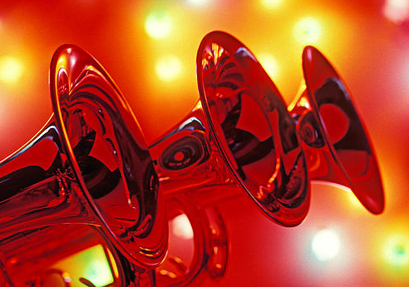
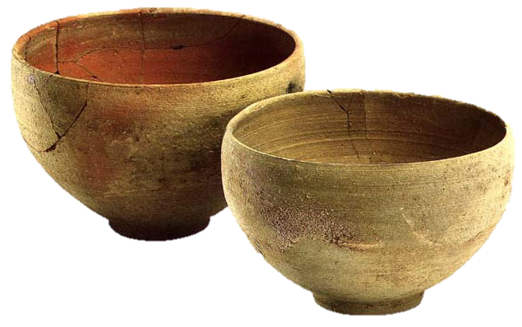
Prophetic Book
Revelation
Tells the end of the story that began in Genesis 3
Major theme: the worship of God for his holiness and justice.

Slide 16
