Slide 1
Church History
Reformation
by Stephen Curto
for Home Church
March 13, 2016

Slide 2
Recap
Crusades
100 Years War
Renaissance
John Wycliffe
Fall of Eastern Empire to Ottomans
Black death
The Spanish Inquisition
Jan Hus

Slide 3
Reformation
1515-1648 (Luther’s Theses- Peace of Westphalia)
The Reformers
The Reforms
The Effects

Slide 4
The Reformers

Slide 5
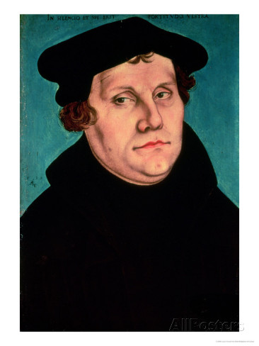
Martin Luther (1483-1546)
German monk
A monk of monks
A moment of clarity
“Who am I, that I should lift up mine eyes or raise my hands to the Divine Majesty? . . . For I am dust and ashes and full of sin and I am speaking to the living, eternal and true God.’”

Slide 6
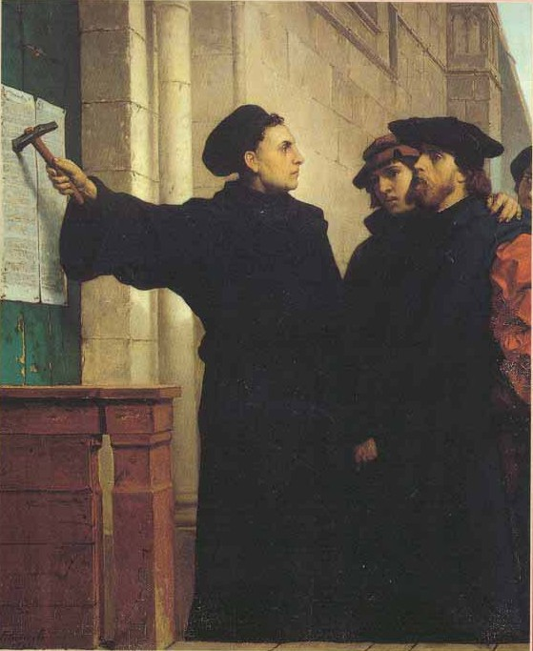
Martin Luther (1483-1546)
Johann Tetzel and selling of indulgences
95 Theses
http://www.luther.de/en/95thesen.html

Slide 7
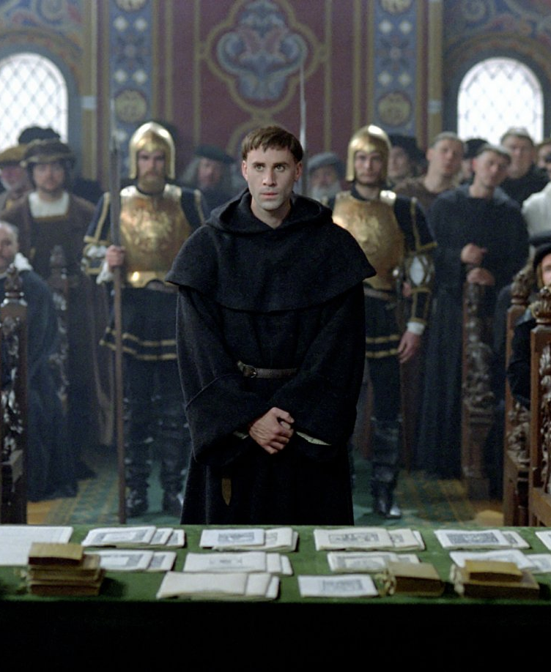
Martin Luther (1483-1546)
Diet of Worms (1521)
“Unless I am convinced by the testimony of the Holy Scriptures or by evident reason-for I can believe neither pope nor councils alone, as it is clear that they have erred repeatedly and contradicted themselves-I consider myself convicted by the testimony of Holy Scripture, which is my basis; my conscience is captive to the Word of God. Thus I cannot and will not recant, because acting against one's conscience is neither safe nor sound. God help me. Amen.”

Slide 8
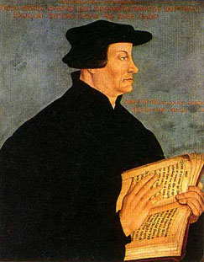
Ulrich Zwingli (1484-1531)
leader of reformation in Switzerland
Zwingli Confession
Opposed transubstantiation, took memorial view
Lot’s of influence on and from Martin Luther
Killed in battle

Slide 9
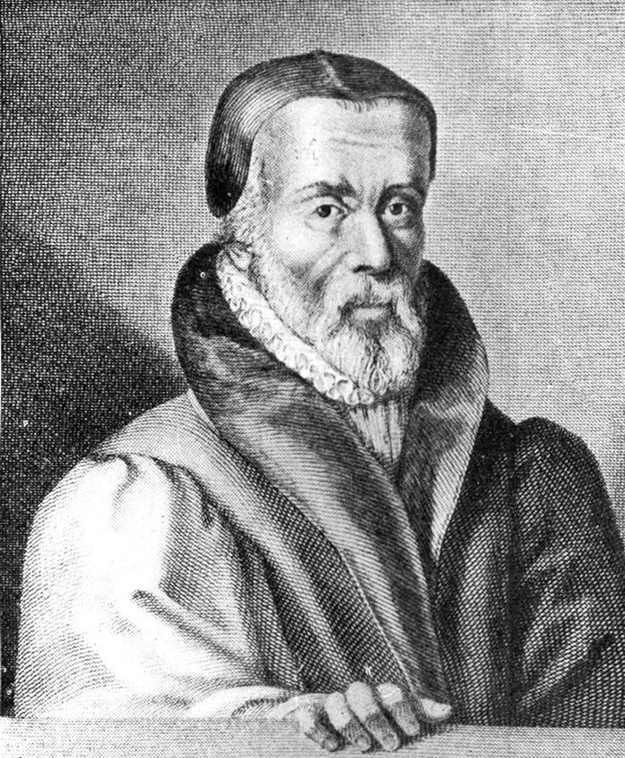
William Tyndale (1494-1536)
translated Bible into English
used Greek and Hebrew texts
used printing press
arrested and executed for heresy
“Open the King of England’s eyes!”

Slide 10
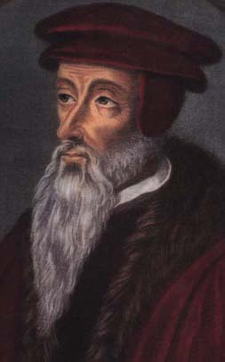
John Calvin (1509-1564)
French humanist lawyer
Fled to Switzerland during protestant uprising in France
Institutes
Geneva reformations

Slide 11
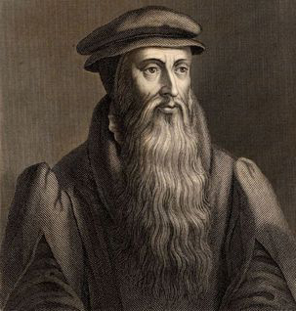
John Knox (1513-1572)
Leader of reformation in Scotland
Father of Presbyterianism in Scotland
Book of Common Prayer

Slide 12
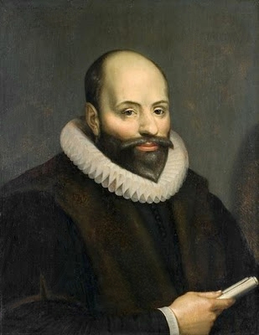
Jacobus Arminius (1560-1609)
father of Arminianism
Professor of Theology
Prevenient Grace
Rejected at Synod of Dort
1618
FACTS vs TULIP
http://evangelicalarminians.org/an-outline-of-the-facts-of-arminianism-vs-the-tulip-of-calvinism/

Slide 13
Reforms

Slide 14
5 Solas

Slide 15
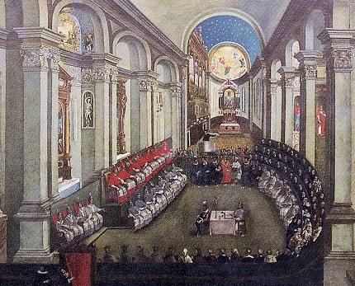
Council of Trent (1545-1563)
the counter-Reformation
25 sessions between 1545 and 1563
Established RC canon
Addressed issues brought up by reformation

Slide 16
The Effects

Slide 17
Edict of Nantes (1598)
edict by Henry IV of France
Pardon for Protestants (Particularly Calvinists in France “Huguenots”)
Revoked in 1685 by Louis XIV

Slide 18
30 Years War (1618-1648)
Series of wars between Protestants and Catholics
Mostly took place in what was left of Holy Roman Empire
A war to try and re-establish a universal religion
Peace of Westphalia (1648) ended the war (154 meetings in 2 years)
National self-determination becomes order of the day

Slide 19
