Slide 1
In-Depth Study of Trinity: A Review of Past Lessons
By Stephen Curto
For Homegroup
August 20, 2017

Slide 2
Outline
History and Heresies
Creeds and Councils for Clarity
Coming to Conclusions

Slide 3
History and Heresies
The Major Heresies about Jesus – An Overview:
Arius (d.336) – Jesus was a created being. God like, but not the same essence as God.
Apollonarius (310-390) – Jesus wasn’t fully human, just fully God.
Nestorius (370’s-452) – Jesus had two warring natures, and the divine overpowered the human.
Eutyches (378-454) – Jesus wasn’t fully God or fully man. He was 50-50. He had a mixed nature. (Modern equivalent: Mormons)

Slide 4
History and Heresies
Early Church Fathers (100-150AD)
Weren’t concerned with defining trinity
Fighting Gnosticism
Affirmed “Jesus is Lord.”
Followed Apostles Creed
“Creed” credo (lat) “I believe”

Slide 5
History and Heresies
Gnosticism
Secret knowledge
Matter is evil, spirit is good
Dualistic philosophy
Jesus wasn’t really a historical human

Slide 6
History and Heresies
Early Church Fathers (100-150AD)
Weren’t concerned with defining trinity
Fighting Gnosticism
Affirmed “Jesus is Lord.”
Followed Apostles Creed
“Creed” credo (lat) “I believe”

Slide 7
History and Heresies
The Apologists (150-300AD)
Development of language, but not concepts
Tertullian coins “trinity” “person” “substance”
Fighting Modalism
Setting the stage for the theologians

Slide 8
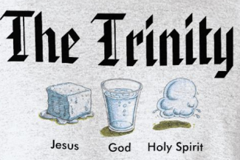
History and Heresies
Modalism
God is only one person
The one person of god appears in three forms
When God is the Father, he’s not the son or the Spirit, etc.
Babylon Bee Article

Slide 9
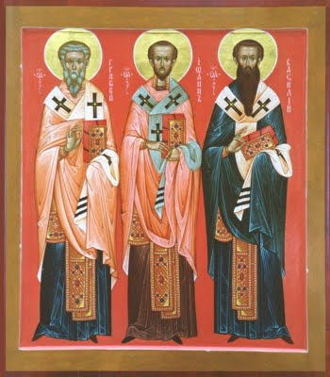
History and Heresies
The Theologians (300-600AD)
Nailing down concepts
Fighting Arianism and Tri-theism
Council of Nicaea (325AD)
Nicene Creed

Slide 10
History and Heresies
Arianism
Jesus wasn’t always the son of God
Jesus didn’t have full divinity
Jesus was “God-like”
Jesus was the first thing God created (Col 1:15)

Slide 11
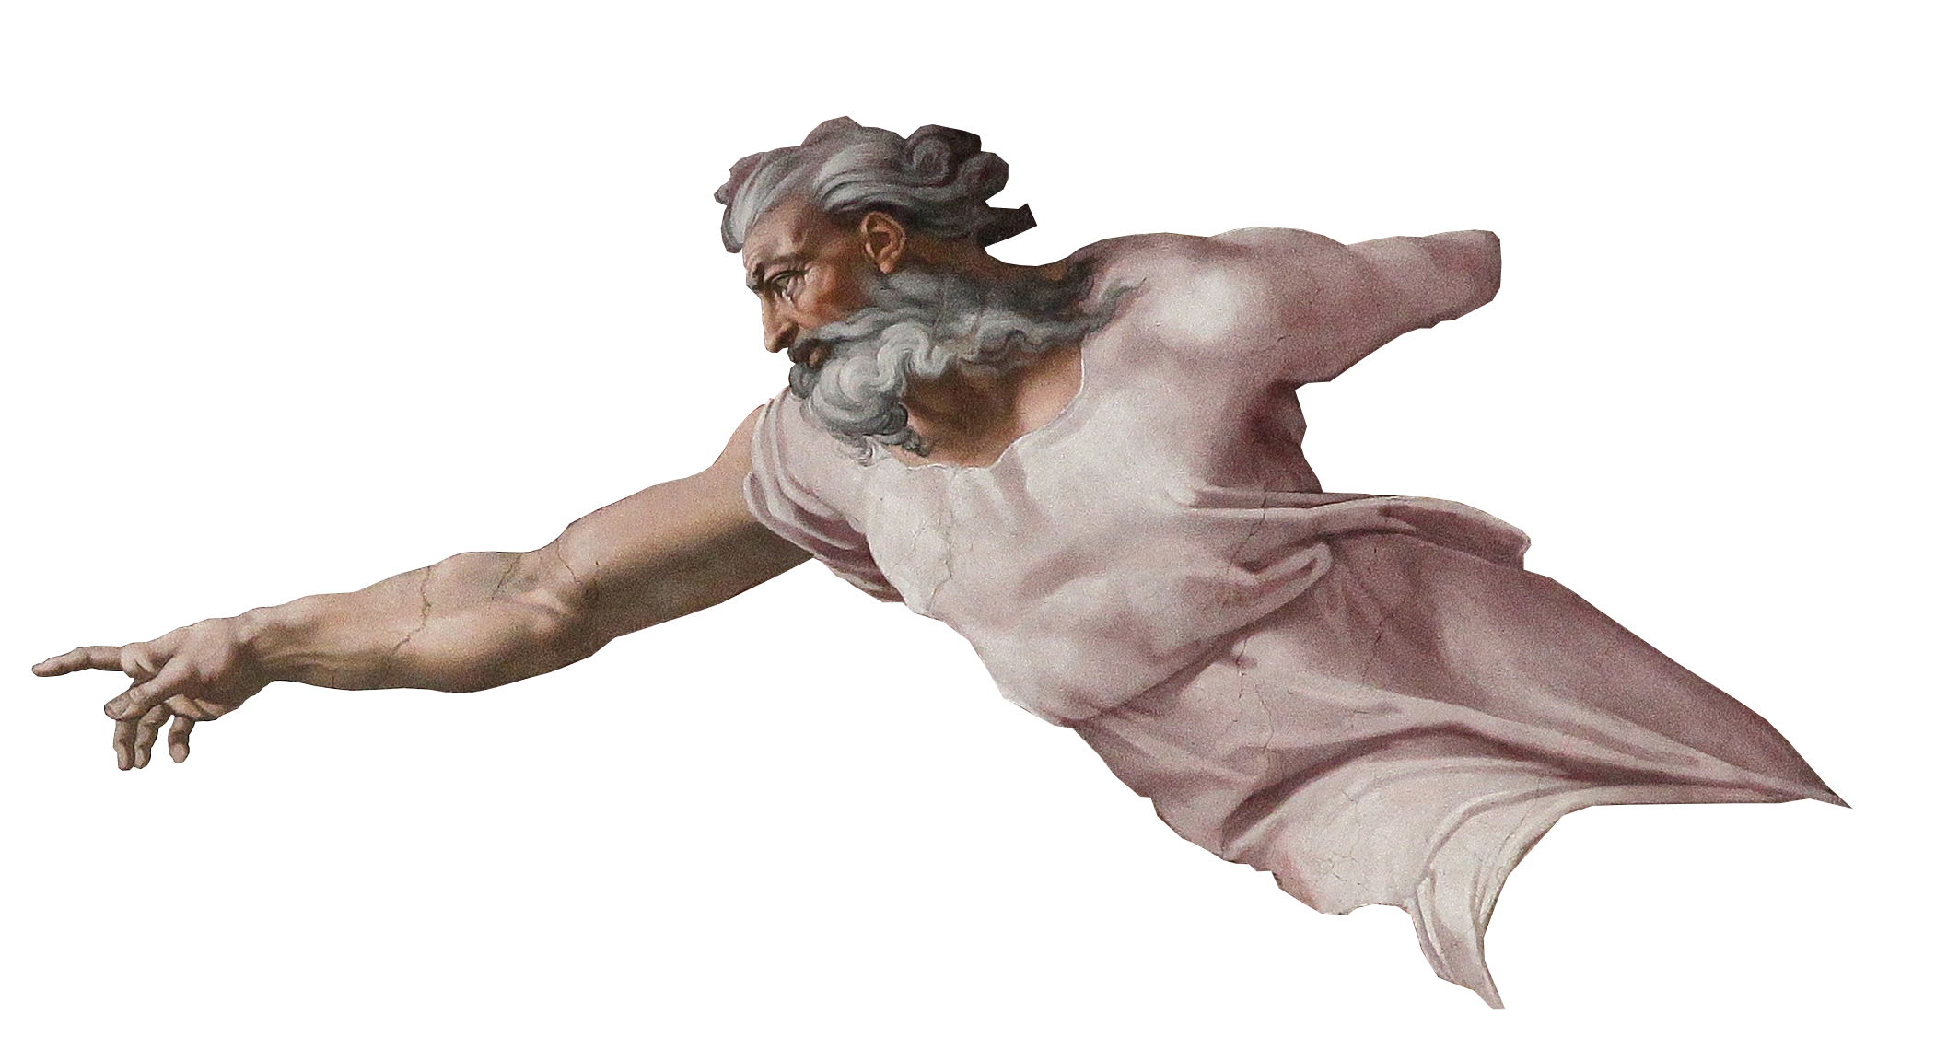
History and Heresies
Tri-theism
There are three different Gods, with three different essences

Slide 12
History and Heresies
The Theologians cont’d(300-600AD)
Weaknesses of Nicene council
Creed of Constantinople (381AD)
The three Cappadocians work on definitions
Athansius’s Creed

Slide 13
Creeds and Councils for Clarity
Athanasius (297-373)
Athanasian Creed
Very influential against Arianism and defending Trinity
Bishop of Alexandria (reluctantly)
“Athanasius against the world”

Slide 14
Creeds and Councils for Clarity
1
Nicaea
325
Arianism
2
Constantinople
381
Arianism
Apollinarianism
3
Ephesus
431
Nestorianism
Pelagianism
4
Chalcedon
451
Eutychianism
5
Constantinople II
553
Neo-Nestorianism
6
Constantinople III
680-681
Monotheletism
7
Nicaea II
787
Iconoclasm

Slide 15
Creeds and Councils for Clarity
Nicene Creed (325AD)
Nicene Constantinople Creed (381AD)
Athanasius Creed
*See Handout “Creeds Appendix”

Slide 16
Coming to Conclusions
Subordinationism
Conclusion 1
3 qualities to affirm
3 heresies to deny
TRINITY
(Tri-Unity)
Unity
Diversity
Modalism
Tritheism
Equality

Slide 17
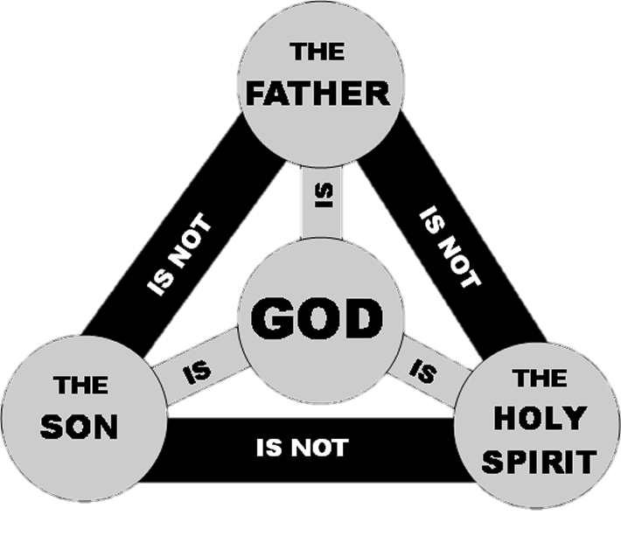
Coming to Conclusions
Conclusion 2
3 persons
1 essence

