Slide 1
The Intertestamental Period
A Survey
By Stephen Curto
For Home Group
June 19, 2016

Slide 2
Outline
Intertestamental Period Intro
The History (Brief Overview)
The Texts (Biblical and Extra-Biblical)
The History
Persian Era
Greek Era
Hasmonean/Maccabean Era
Roman Era

Slide 3
Intertestamental Period Intro
Some New Testament Questions the IP Answers:
How did we go from Persia in charge, to Rome?
Where did the Pharisees, Sadducees, and zealots come from?
Why is Greek the main language now?
Where did Herod come from?

Slide 4
Intertestamental Period Intro
Definition: The historical period between the end of the Old Testament and the beginning of the New Testament.
Most of it prophesied by Daniel in chapters 2, 7, 8, and 11
Time covered: 400’s-5 BC
NOTE: There’s always war going on somewhere.

Slide 5
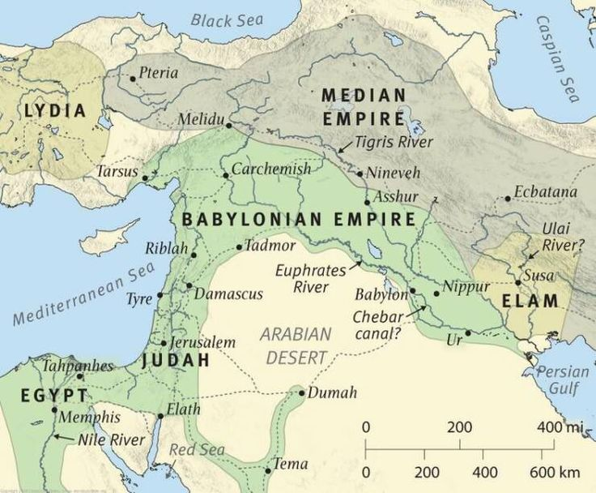
The History (Brief Overview)
Babylon
Persia
Greece
Divided
Greece
Rome
About 600BC

Slide 6
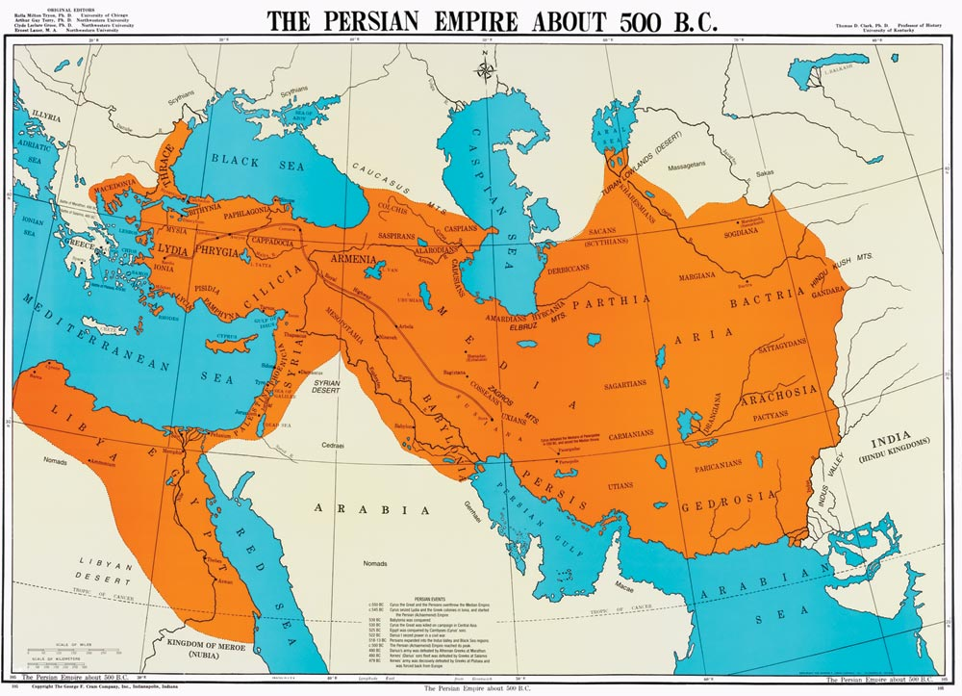
The History (Brief Overview)
Babylon
Persia
Greece
Divided
Greece
Rome
About 500BC

Slide 7
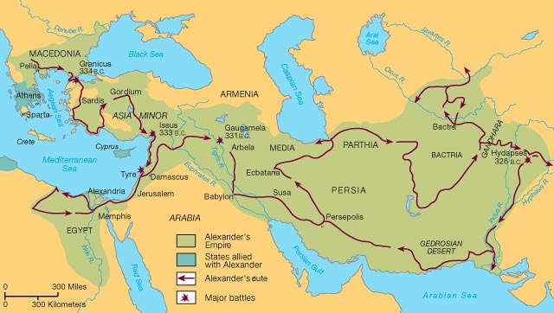
The History (Brief Overview)
Babylon
Persia
Greece
Divided
Greece
Rome
About 330BC

Slide 8
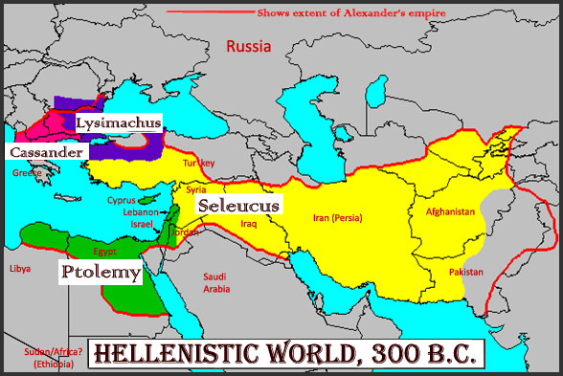
The History (Brief Overview)
Babylon
Persia
Greece
Divided
Greece
Rome
About 300BC

Slide 9
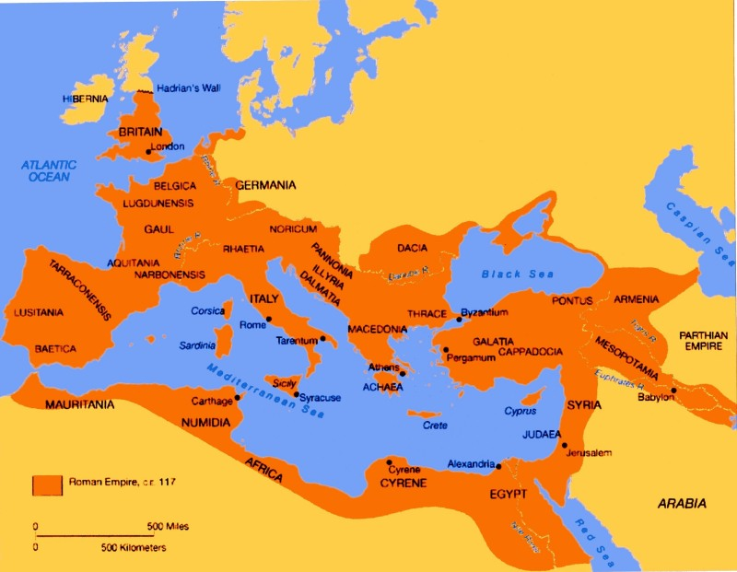
The History (Brief Overview)
Babylon
Persia
Greece
Divided
Greece
Rome
About 100AD

Slide 10
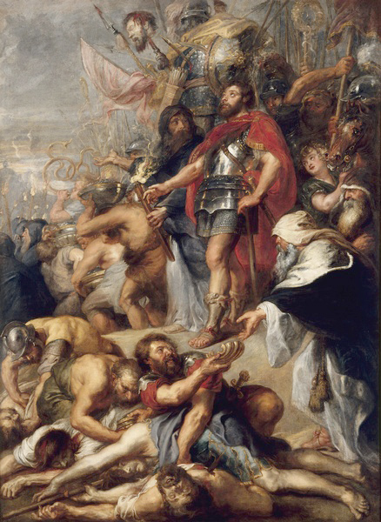
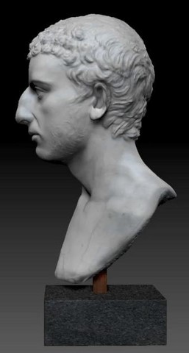
The Texts
Extra Biblical:
1 & 2 Maccabees (in apocrypha)
Josephus Antiquities and Wars of the Jews
The major Persian and Roman historians

Slide 11
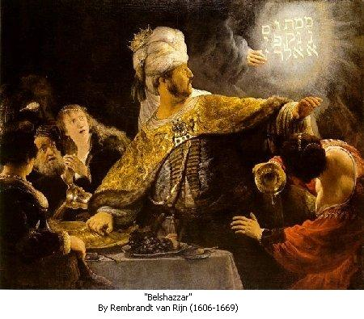
The Texts
Biblical:
Daniel 2
Daniel 7
Daniel 8
Daniel 11

Slide 12
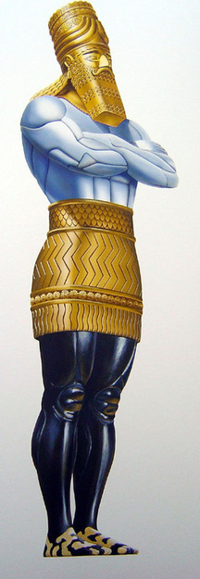
The Texts
Babylon
Medo-Persia
Greece
Rome
Daniel 2:
Nebuchadnezzar’s dream of a statue
Head of Gold (Babylon), Chest of Silver (Persia), Belly of Bronze (Greece), Legs Iron (Rome) Feet Mixed Iron and Clay (Revived Roman Empire), Rock (Christ’s Kingdom)

Slide 13
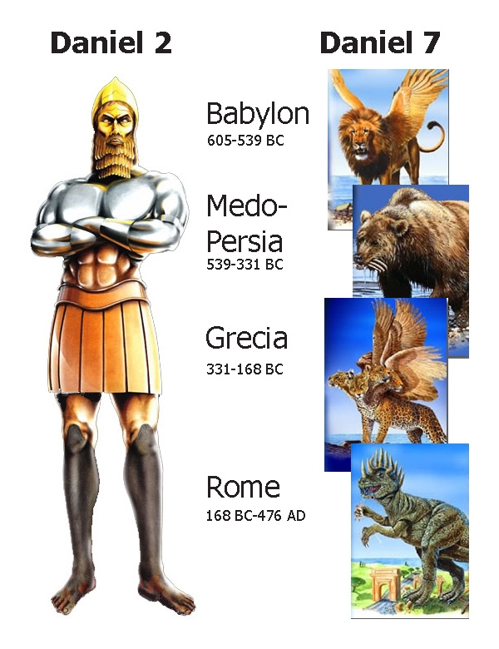
The Texts
Daniel 2:
Nebuchadnezzar’s dream of a statue
Head of Gold (Babylon), Chest of Silver (Persia), Belly of Bronze (Greece), Legs Iron (Rome) Feet Mixed Iron and Clay (Revived Roman Empire), Rock (Christ’s Kingdom)

Slide 14
The Texts
Daniel 7:
Daniel’s dream of four beasts
Lion with wings (Babylon), Lopsided Bear (Persia), Four-headed-four-winged Leopard (Greece), Beast with 10 horns (Rome)

Slide 15
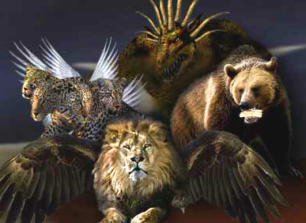
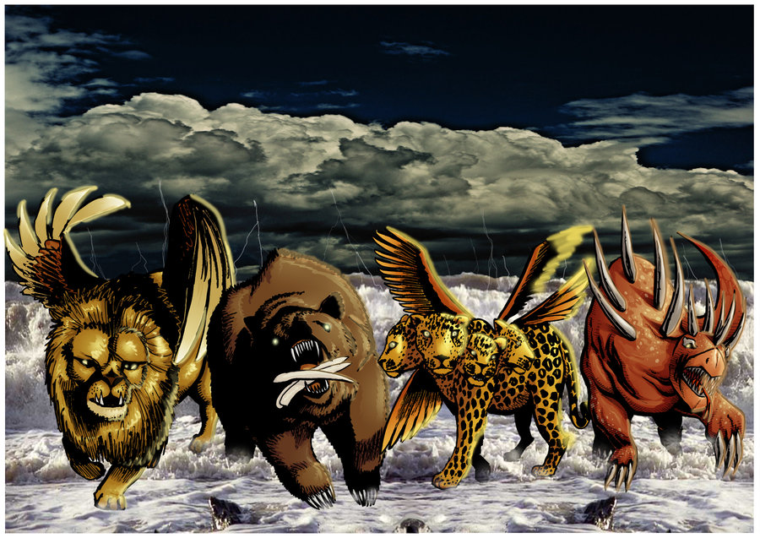
The Texts
Daniel 7:
Daniel’s dream of four beasts
Lion with wings (Babylon), Lopsided Bear (Persia), Four-headed-four-winged Leopard (Greece), Beast with 10 horns (Rome)

Slide 16
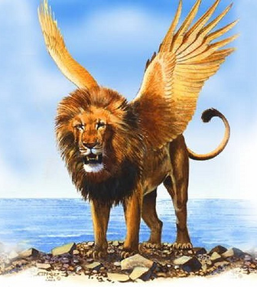
The Texts
Daniel 7:
Daniel’s dream of four beasts
Lion with wings (Babylon), Lopsided Bear (Persia), Four-headed-four-winged Leopard (Greece), Beast with 10 horns (Rome)

Slide 17
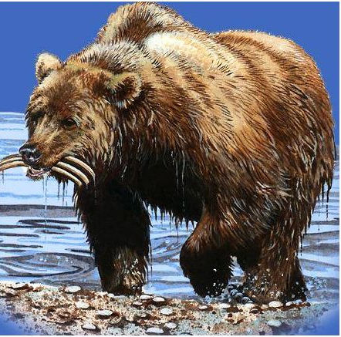
The Texts
Daniel 7:
Daniel’s dream of four beasts
Lion with wings (Babylon), Lopsided Bear (Persia), Four-headed-four-winged Leopard (Greece), Beast with 10 horns (Rome)

Slide 18
The Texts
Daniel 7:
Daniel’s dream of four beasts
Lion with wings (Babylon), Lopsided Bear (Persia), Four-headed-four-winged Leopard (Greece), Beast with 10 horns (Rome)

Slide 19
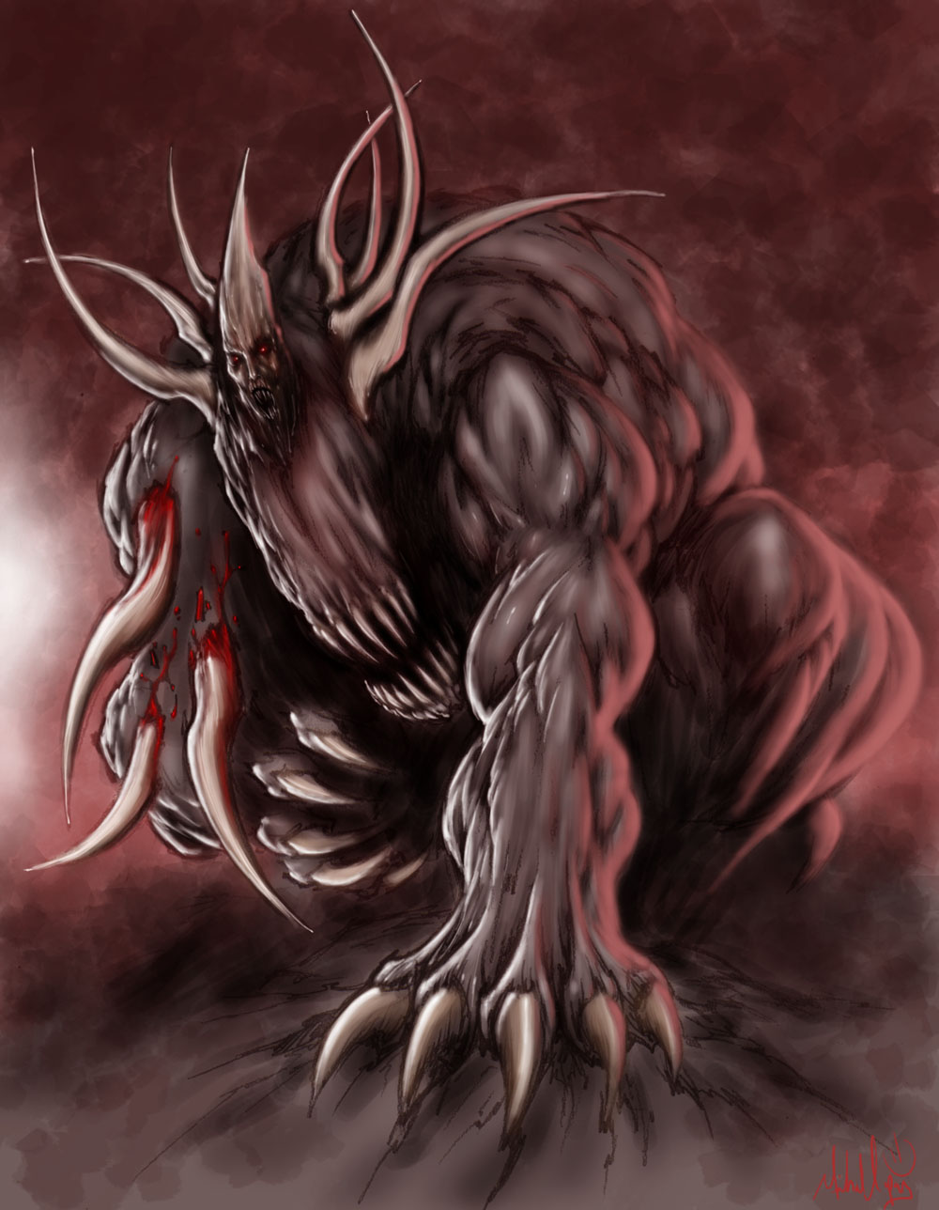
The Texts
Daniel 7:
Daniel’s dream of four beasts
Lion with wings (Babylon), Lopsided Bear (Persia), Four-headed-four-winged Leopard (Greece), Beast with 10 horns (Rome)

Slide 20
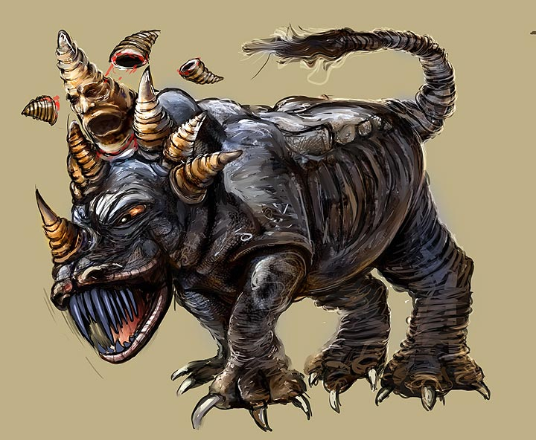
The Texts
Daniel 7:
Daniel’s dream of four beasts
Lion with wings (Babylon), Lopsided Bear (Persia), Four-headed-four-winged Leopard (Greece), Beast with 10 horns (Rome)

Slide 21
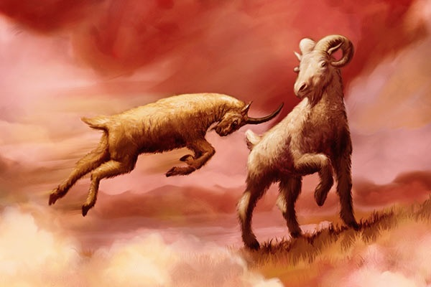
The Texts
Daniel 8:
Daniel’s dream of the goat and ram
Ram with uneven horns (Persia), Goat with one horn (Greece under AtG), four horns replace one horn (Divided Greece)

Slide 22
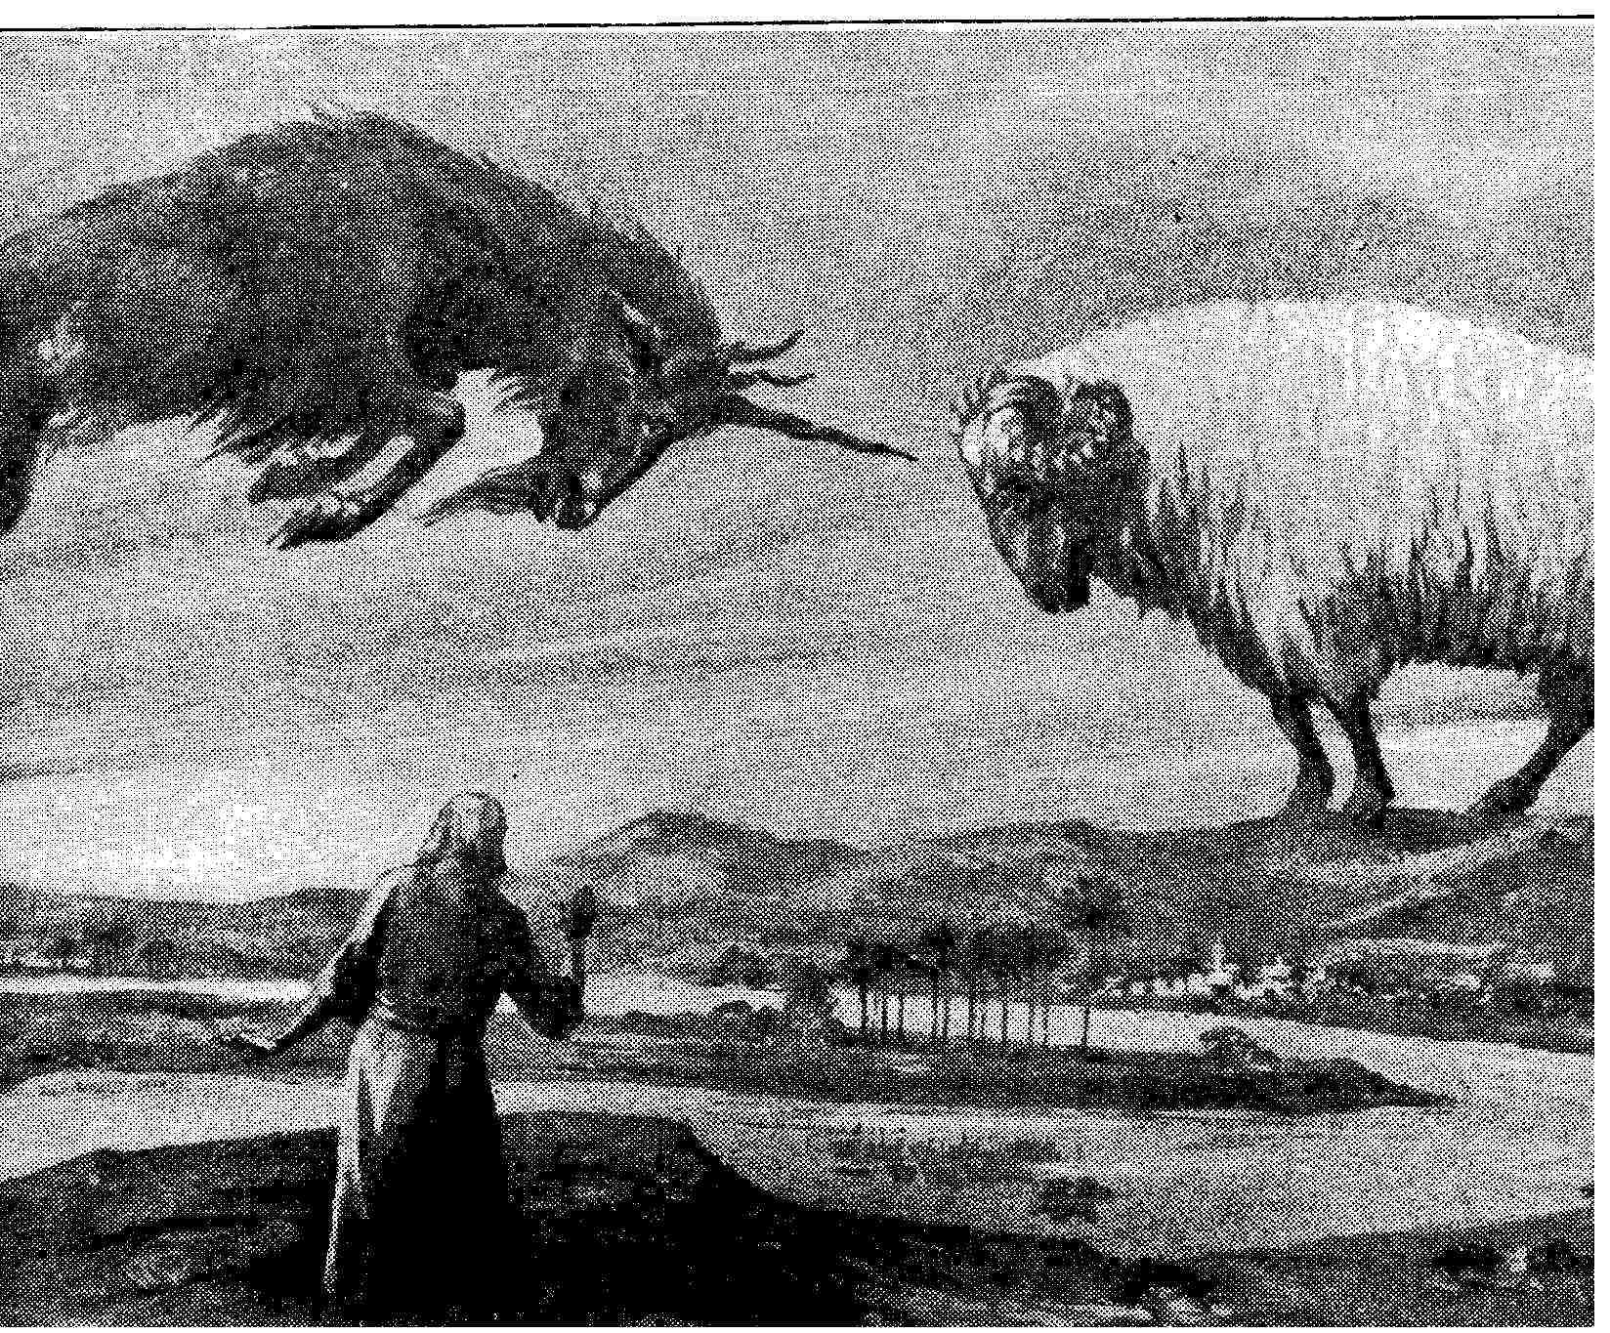
The Texts
Daniel 8:
Daniel’s dream of the goat and ram
Ram with uneven horns (Persia), Goat with one horn (Greece under AtG), four horns replace one horn (Divided Greece)

Slide 23
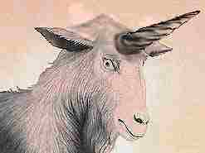
The Texts
Daniel 8:
Daniel’s dream of the goat and ram
Ram with uneven horns (Persia), Goat with one horn (Greece under AtG), four horns replace one horn (Divided Greece)

Slide 24
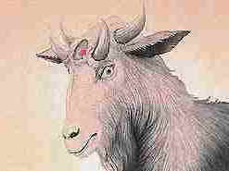
The Texts
Daniel 8:
Daniel’s dream of the goat and ram
Ram with uneven horns (Persia), Goat with one horn (Greece under AtG), four horns replace one horn (Divided Greece)

Slide 25
The Texts
Daniel 11:
Gabriel’s explanation of intertestamental history
Mighty king who rules with great dominion rises (AtG) and his kingdom is broken toward the four winds (AtG’s Generals, Divided Greece, tetrarchs) alliances and wars (Ptolemies and Seleucids fighting) and one profanes the temple and sets up an abomination that makes desolate (Antiochus IV)

Slide 26
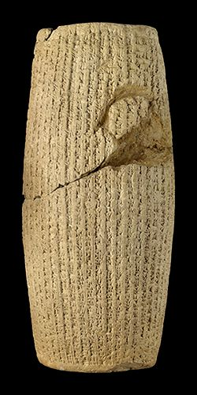
The History
Persian Era: (560-330 BC)
Cyrus the Great – 559-530BC
Let Israel go back to Jerusalem
Darius I – 522-486BC
Daniel and the Lion’s den
Xerxes (Ahasuerus) – 486-465BC
Esther’s Husband
Artaxerxes – 464-424BC
Sent Nehemiah to build wall
Darius III – 336-330BC

Slide 27
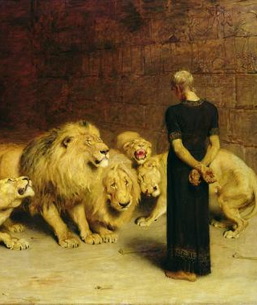
The History
Persian Era: (560-330 BC)
Cyrus the Great – 559-530BC
Let Israel go back to Jerusalem
Darius I – 522-486BC
Daniel and the Lion’s den
Xerxes (Ahasuerus) – 486-465BC
Esther’s Husband
Artaxerxes – 464-424BC
Sent Nehemiah to build wall
Darius III – 336-330BC

Slide 28
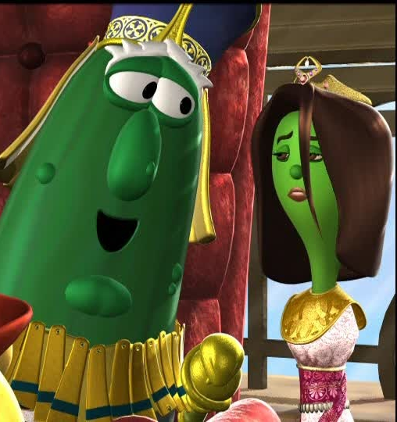
The History
Persian Era: (560-330 BC)
Cyrus the Great – 559-530BC
Let Israel go back to Jerusalem
Darius I – 522-486BC
Daniel and the Lion’s den
Xerxes (Ahasuerus) – 486-465BC
Esther’s Husband
Artaxerxes – 464-424BC
Sent Nehemiah to build wall
Darius III – 336-330BC

Slide 29
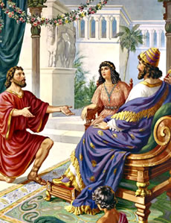
The History
Persian Era: (560-330 BC)
Cyrus the Great – 559-530BC
Let Israel go back to Jerusalem
Darius I – 522-486BC
Daniel and the Lion’s den
Xerxes (Ahasuerus) – 486-465BC
Esther’s Husband
Artaxerxes – 464-424BC
Sent Nehemiah to build wall
Darius III – 336-330BC

Slide 30
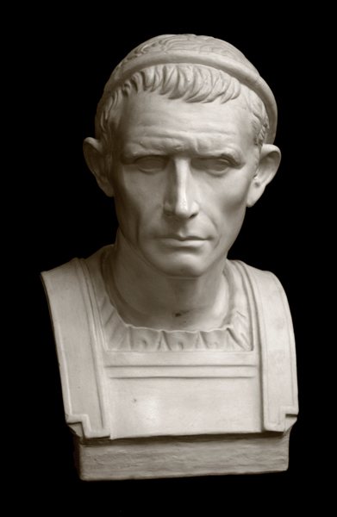
The History
Greek Era: (330-130’s BC)
Alexander the Great (330-326 BC)
Divided Kingdom of AtG
Cassander
Lysimachus
Ptolemy
Seleucus
Antiochus IV Epiphanes

Slide 31
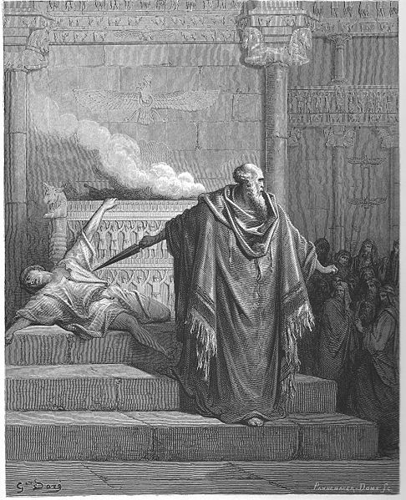
The History
Hasmonean/Maccabean Era: (166-63 BC)
Mattathias Maccabeus
Kills a Jew who tried to sacrifice a pig at Modin, starts revolt
Judas Maccabeus
Mattathias’s first son. Leads the revolt
Jonathan Maccabeus
Mattathias’s second son. Takes command when Judas dies
Simon Maccabeus
Mattathias’s third son. Takes command when Jonathan dies.
John Hyrcanus

Slide 32
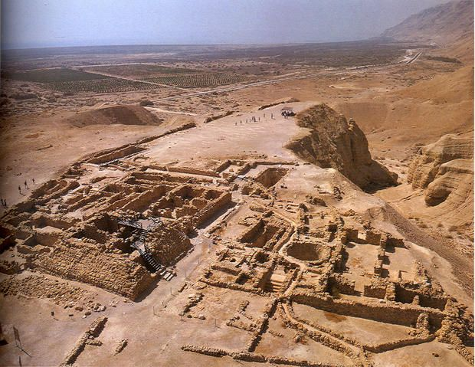
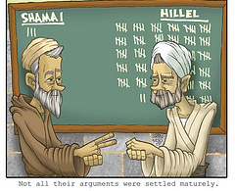
The History
Jewish Culture
Pharisees, Sadducees, Essenes Developing…
Hillel vs Shamai (110BC-70AD)

Slide 33
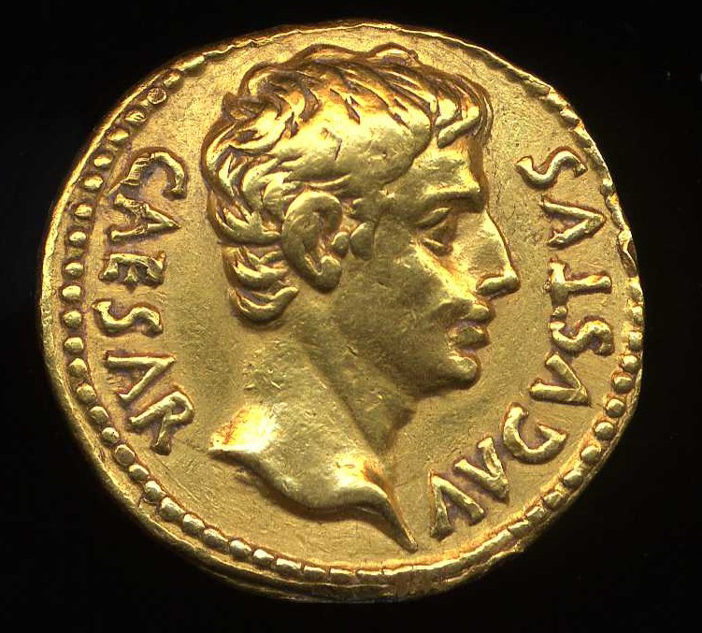
The History
Roman Era: (146-330 AD)
Pompey
Antipater
Herod
Octavian (Augustus)

