Slide 1
Theology Proper
“Words About God”
By Stephen Curto
For Homegroup
January 29, 2017

Slide 2
Outline
Attributes of God
Triunity of God

Slide 3
Attributes of God
What is God like?

Slide 4
Attributes of God
Definitions of God(?):
“Spirit, infinite, eternal, unchangeable, in His being, power, holiness, justice, goodness, and truth.” – Westminster Shorter Catechism
“God is the sum total of his infinite perfections.” – Dr. Paul Shockley

Slide 5
Attributes of God
Definitions of God(?):
“He is ens perfectissimum… the word ens designates Him as a being, not an idea, but as that which has real, objective existence; and absolute perfection distinguishes Him from all other beings.” - Charles Hodge

Slide 6
Attributes of God
Defining God:
Ultimately fruitless
sub-ultimately helpful
defining by description is best

Slide 7
Attributes of God
Communicable Attributes
Attributes which God shares
In-communicable Attributes
Attributes which God does not share

Slide 8
Attributes of God
In-Communicable Attributes
Aseity (Self-existence)
Infinity/Eternity
Immutability
The Three Omnis
Sovereignty/Autonomy

Slide 9
Attributes of God – In-communicable
Aseity (Self-existence)
“From Self” (lat.)
God is the un-caused causer.
Name: Yahweh “I am” יהוה
Genesis 1:1

Slide 10
Attributes of God – In-communicable
Infinity/Eternity
God is not limited by anything but Himself (including time).
Name: El Olam “God Everlasting” אל עולמ
1 Kings 8:27

Slide 11
Attributes of God – In-communicable
Immutability
God doesn’t change.
Name: Yahweh “I am” יהוה
Malachi 3:6
Can God change his mind?
(Gen 6:6; Jonah 3:10)
Anthropomorphisms

Slide 12
Attributes of God – In-communicable
The Three Omnis
Omnipotence
God is all powerful.
Name: El Shaddai “God Almighty” אל שדי
Genesis 17:1
Omniscience
Omnipresence (?)

Slide 13
Attributes of God – In-communicable
The Three Omnis
Omnipotence
Omniscience
God knows everything.
Name: El Roi “God who sees” אל ראי
Psalm 139:16
Omnipresence (?)

Slide 14
Attributes of God – In-communicable
The Three Omnis
Omnipotence
Omniscience
Omnipresence (?)
God is not excluded from anywhere in his creation.
Name: none
Psalm 139:7-11

Slide 15
Attributes of God – In-communicable
Sovereignty/Autonomy
God is in control.
Name: Adonia “Lord/Master” אדני
Psalm 135:5-6

Slide 16
Attributes of God – In-communicable
Non-exhaustive list
other possible In-communicable attributes
Simplicity
Spirituality
Perfection
Unity

Slide 17
Attributes of God
Communicable Attributes
Attributes which God shares
Primarily shared with humans
Primarily shared through “Imago Dei”
All seen lessened/imperfect in humans

Slide 18
Attributes of God
Communicable Attributes
Justice
Goodness/Holiness
Love
Grace

Slide 19
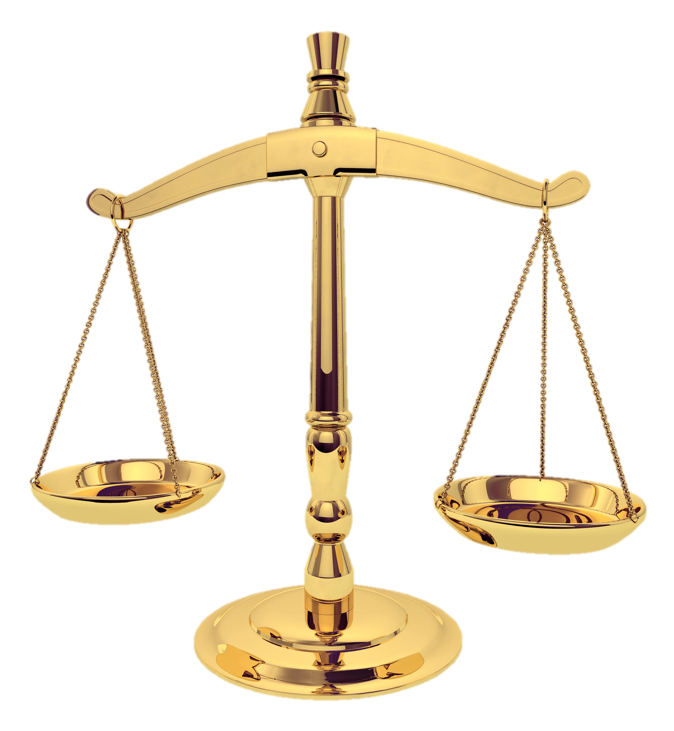
Attributes of God - Communicable
Justice
God always does what is right.
“justify”
Name: Yahweh Tsidkenu “The Lord is our Righteousness” יהוה צדקנו
1 John 1:9
“At no point is divine justice more observable than in the plan of redemption.” – Chafer, 1:203

Slide 20
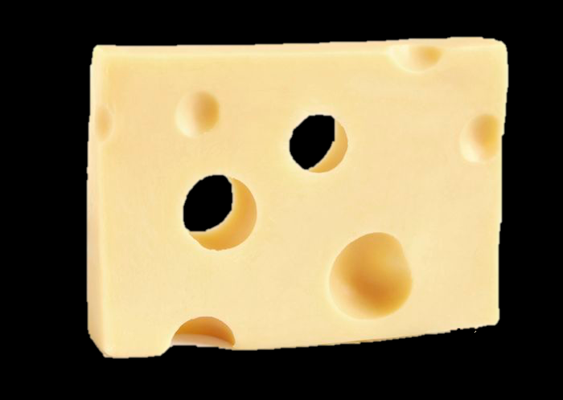
Attributes of God - Communicable
Goodness/Holiness
God always does what is good.
Name: Yahweh Shalom “GOD is Peace” יהוה שלום
Leviticus 19:1-2; Romans 8:28

Slide 21
Attributes of God - Communicable
Love
God always “commits his will to the true good of another.”
Name: Yahweh Roi “God is my Shepherd” יהוה ראי
1 John 4:7-8

Slide 22
Attributes of God - Communicable
Grace
God always provides beyond what is required/expected.
Name: Yahweh Jireh “God will Provide” יהוה יראה
Ephesians 2:8

Slide 23
Attributes of God - Communicable
other possible communicable attributes
Truth
Righteousness
Knowledge
Will

Slide 24
Triunity of God
One-ness
Deuteronomy 6:4
Exodus 20:3
Isaiah 45:14
1 Corinthians 8:4-6
Ephesians 4:3-6
James 2:19

Slide 25
Triunity of God
One-ness
Deuteronomy 6:4
"Hear Israel, the Lord our God, the Lord is one.”
“one” – echad “only, alone”

Slide 26
Triunity of God
One-ness
Isaiah 45:14
“Surely, God is with you, and there is none else, No other God.”
alternatively “nothing is beside God.”
comment on God’s singularity in existence

Slide 27
Triunity of God
One-ness
1 Corinthians 8:4-6
”There is no other God but one.”
Allusion to Deut 6:4

Slide 28
Triunity of God
One-ness
1 Corinthians 8:4-6
“yet for us there is but one God, the Father, from whom are all things and we exist for Him; and one Lord, Jesus Christ, by whom are all things, and we exist through Him.”
Early hymn
Is this a contrast or a complement?

Slide 29
Triunity of God
Three-ness
Deity of “the Father”
Jhn 6:27; 1 Pet 1:2; 1 Cor 8:6
Deity of “the Son”
Heb 1:3-4; Matt 1:21-23; Jhn 1:1; 8:58; 10:30; Col 1:15
Deity of “the Spirit”
Acts 5:3-4; 1 Cor 2:10; 6:19

Slide 30
Triunity of God
Other Contributing Passages
Matthew 28:19
Matthew 3:16-17
2 Corinthians 13:14
***1 John 5:7***

Slide 31
Triunity of God
History
Early Fathers (100-150AD)
The Apologists (150-300AD)
The Theologians (300-600AD)

Slide 32
Triunity of God - History
Early Church Fathers (100-150AD)
Weren’t concerned with the doctrine
Fighting Gnosticism
Affirmed “Jesus is Lord.”
Followed Apostles Creed
“Creed” credo (lat) “I believe”

Slide 33
Triunity of God - History
Gnosticism
Secret knowledge
Matter is evil, spirit is good
Dualistic philosophy
Jesus wasn’t really a historical human

Slide 34
Triunity of God - History
Early Church Fathers (100-150AD)
Weren’t concerned with defining trinity
Fighting Gnosticism
Affirmed “Jesus is Lord.”
Followed Apostles Creed
“Creed” credo (lat) “I believe”

Slide 35
Triunity of God - History
Early Church Fathers (100-150AD)
I believe in God, the Father almighty,
creator of heaven and earth.
I believe in Jesus Christ, his only Son, our Lord,

Slide 36
Triunity of God - History
Early Church Fathers (100-150AD)
who was conceived by the Holy Spirit
and born of the virgin Mary.
He suffered under Pontius Pilate,
was crucified, died, and was buried;
he descended to hell.

Slide 37
Triunity of God - History
Early Church Fathers (100-150AD)
The third day he rose again from the dead.
He ascended to heaven
and is seated at the right hand of God the Father almighty.
From there he will come to judge the living and the dead.

Slide 38
Triunity of God - History
Early Church Fathers (100-150AD)
I believe in the Holy Spirit,
the holy catholic (universal) church,
the communion of saints,
the forgiveness of sins,
the resurrection of the body,
and the life everlasting. Amen.

Slide 39
Triunity of God - History
The Apologists (150-300AD)
Development of language, but not concepts
Tertullian coins “trinity” “person” “substance”
Fighting Modalism
Setting the stage for the theologians

Slide 40
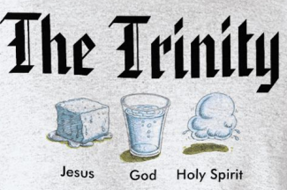
Triunity of God - History
Modalism
God is only one person
The one person of god appears in three forms
When God is the Father, he’s not the son or the Spirit, etc.
Babylon Bee Article

Slide 41
Triunity of God - History
The Theologians (300-600AD)
Nailing down concepts
Fighting Arianism and Tri-theism
Council of Nicaea (325AD)
Nicene Creed

Slide 42
Triunity of God - History
Arianism
Jesus wasn’t always the son of God
Jesus didn’t have full divinity
Jesus was “God-like”
Jesus was the first thing God created (Col 1:15)

Slide 43
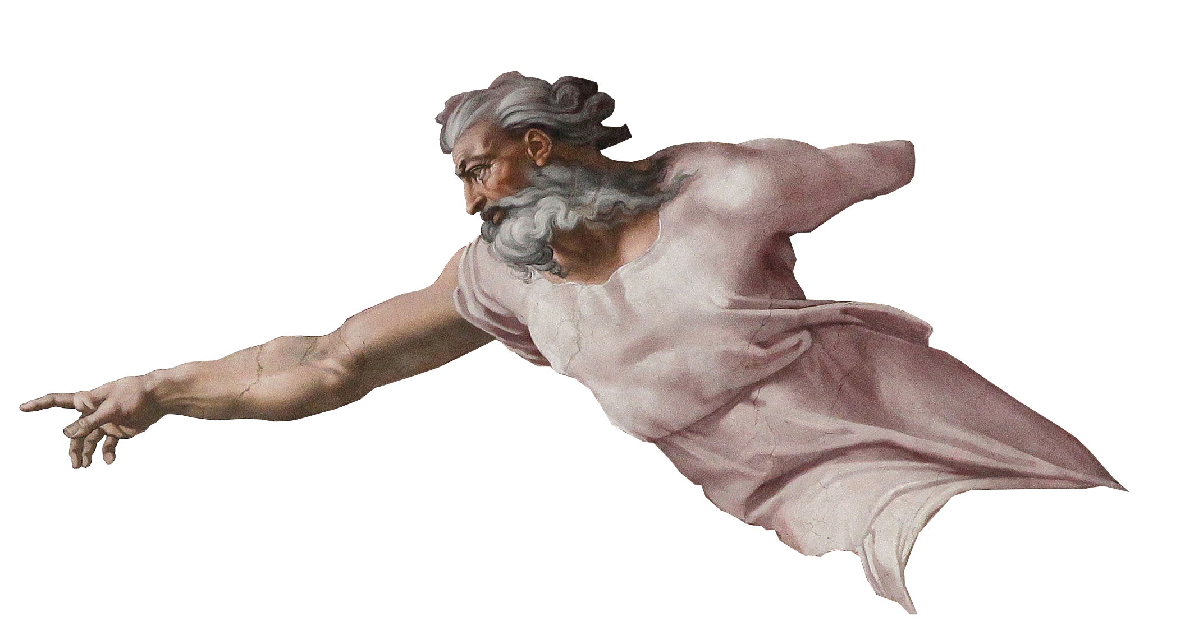
Triunity of God - History
Tri-theism
There are three different Gods, with three different essences

Slide 44
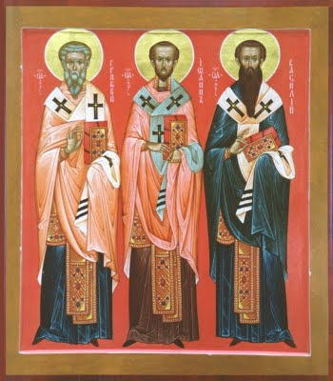
Triunity of God - History
The Theologians (300-600AD)
Weaknesses of Nicene council
Creed of Constantinople (381AD)
The three Cappadocians work on definitions
Athansius’s Creed

Slide 45
Triunity of God
Subordinationism
Conclusion
3 qualities to affirm
3 heresies to deny
TRINITY
(Tri-Unity)
Unity
Diversity
Modalism
Tritheism
Equality

Slide 46
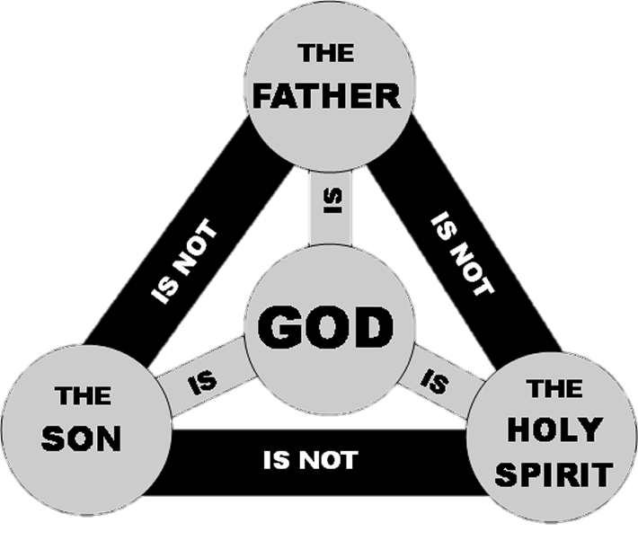
Triunity of God
Conclusion
3 persons
1 essence

Slide 47
Triunity of God
Conclusion
Compare Creed of Constantinople and Creed of Nicaea
Look at Creed of Athanasius

