Slide 1
Creation Views
How the Genesis Account
Interplays with Modern Science

Slide 2
Introductory Matters
a. Genesis 1-2
- Two successive accounts
b. To be scientifically proven…
Observable
Testable
Repeatable
c. “Historical Science” vs “Science” (*see Bill Nye/Ken Ham debate) (18:48-21:15)
d. “Macro” vs “Micro” Evolution

Slide 3
The Views
Evolution
Creative Evolution
Literary Approach
Day-Age
2 Phase
Gap Theory (aka. Prior Creation)
Literal Six-Day

Slide 4
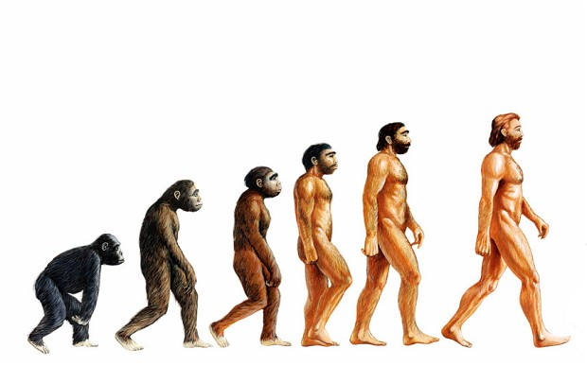
Evolution
Basics:
- Says that earth randomly evolved over an enormous period of time to create life
- Earth is however old Modern Scientists now claim (currently 5 Billion yrs)
- Uses Radiometric dating of meteoric material and volumetric/luminosity of sun compared to other stars. Oldest material=minimum age of earth, age of sun=maximum age of earth (because no sun means no solar system)

Slide 5
Evolution
Pros/Arguments For:
Explains calculated age of earth
Cons/Arguments Against:
Radiometric dating inaccurate after 2,000 years
Assumes unchanging conditions throughout earth’s existence
Is not scientifically proven
Contradicts two scientific Laws: (1) Biogenesis (i.e. life comes from life) (2) 2nd Law of Thermodynamics (i.e. things, if left to themselves, progress toward chaos, not order)
Assumes death prior to sin
Ignores God’s involvement

Slide 6
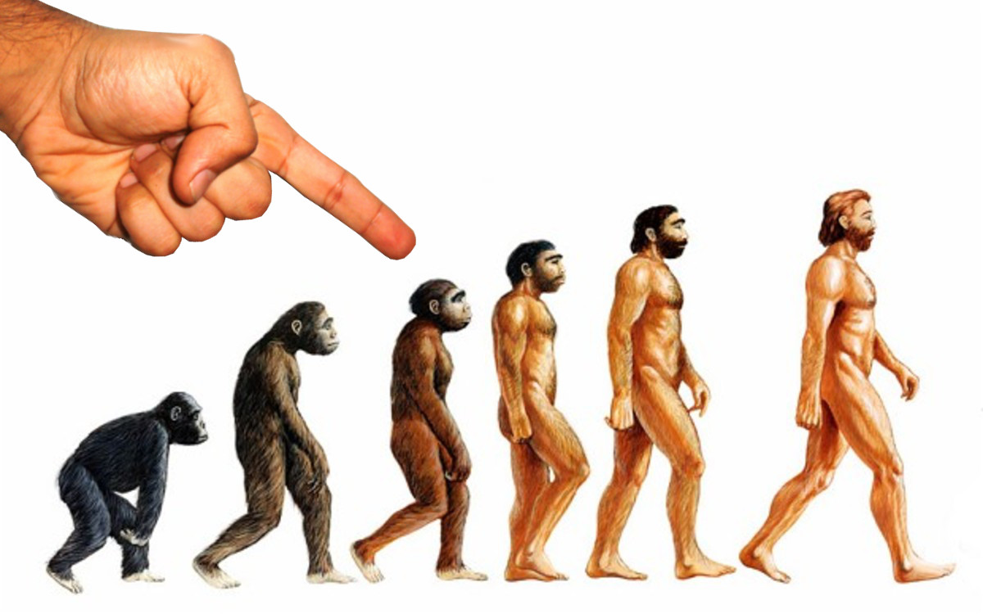
Creative Evolution
Basics:
- Says that God used the evolutionary process to create earth
- *see Basics of Evolution

Slide 7
Creative Evolution
Pros/Arguments For:
Tries to account for God’s involvement
Explains calculated age of earth
Cons/Arguments Against
*see arguments a-d on Evolution
Evolution and Genesis have different orders of creation (evolution puts light and stars before the earth, and the land before the ocean)
Assumes uniformitarianism (i.e. everything is the same as it always was)

Slide 8
Literary Approach
Basics:
- God created, but the Genesis account is purely poetic/literary
- Most who take literary approach adhere to Creative Evolution

Slide 9
Literary Approach
Pros/Arguments For:
Attempts to explain the differences between biblical texts and Evolutionary theory
Explains calculated age of earth
Usually adheres to Mosaic Authorship
Cons/Arguments Against:
*see arguments a-c on Creative Evolution
Does not use literal hermeneutic
Assumes higher view of science than the Bible

Slide 10
Day-Age Theory
Basics:
- God created in six phases of history but they weren’t literal days. A “day” in Genesis is a much longer period of time.
- May or may not have followed evolutionary process

Slide 11
Day-Age Theory
Pros/Arguments For:
Attempts to hold higher view of Biblical texts
Explains calculated age of earth
Adheres to mosaic Authorship
Some linguistic support for yom as “time” instead of “day”
Cons/Arguments Against:
Abandons literal Hermeneutic
Uses verses out of context to support theory
Fossil record does not support gradual creation
Assumes death prior to sin

Slide 12
2 Phase
Basics:
- God created the earth in two phases, one recorded in Genesis 1, the other in Genesis 2 with a great length of time in between
- Often uses pieces of other views in the first phase.

Slide 13
2 Phase
Pros/Arguments For:
*See arguments a-c on Day-Age
Explains the repeat account in Genesis 2
Can be held while holding to a literal hermeneutic
Explains calculated age of earth
Cons/Arguments Against:
no evidence for break of time between 2:3 and 2:4
Unnecessary to explain biblical text
Assumes death prior to sin

Slide 14
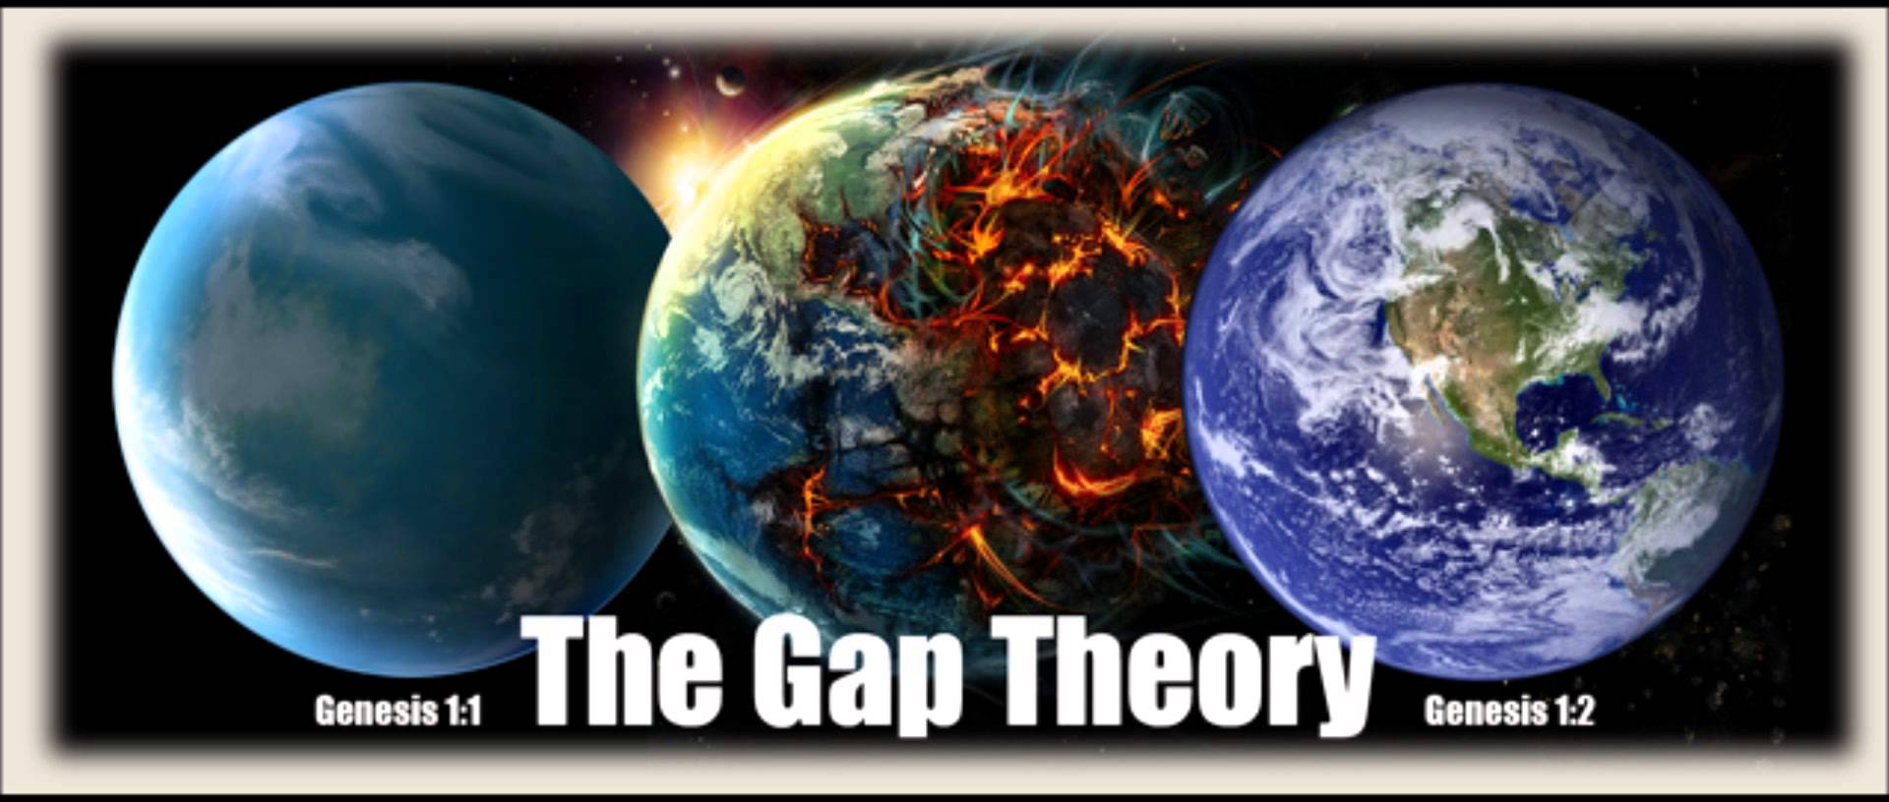
Gap Theory
Basics:
- God created everything in 1:1 and began refashioning it in verse 2 with a large gap of time in between
- Uses mostly linguistic theological necessity arguments for support.
- Age of earth is indeterminate, but age since refashioning is identical to LSD

Slide 15
Gap Theory
Pros/Arguments For:
Accounts for change in word “made.” Bara- v.1 Asa-v.7ff
Explains calculated age of earth
Can be held while holding literal hermeneutic
Explains when Satan fell
Attempts to Hold Higher-view of Biblical text
Cons/Arguments Against:
Hyper-literal interpretation of Hebrew words
Unnecessary to explain biblical text
Assumes death prior to sin (reasonable counter-arguments available)
Adds a lot to the text that isn’t explicit

Slide 16
Literal Six Day
Basics:
- God created everything in 6 literal days just as the Bible describes.
- The Chapter 2 retelling is a more detailed/particularized account
- Holds that the earth is between 6 and 10,000 years old

Slide 17
Literal Six Day
Pros/Arguments For:
Best use of literal hermeneutic
Holds Biblical text as highest standard of truth
Explains Genesis 2 account
Adheres to Mosaic authorship
No death prior to sin
Does not add to or take away from the text
Cons/Arguments Against:
Does not explain calculated age of earth
“Apparent Age” argument
Minority View
Overly Simplistic

