Slide 1

Eschatology
“Words About the End”
By Stephen Curto
For Homegroup
April 23, 2017

Slide 2
Outline
Introduction and Terms
Millennial Views
Rapture Views
Eternal State
Timeline of Premil. Pretrib. Dispensational Eschatology

Slide 3
Introduction and Terms
The Non-Negotiable Eschatological Truths
  Bodily Resurrection (1 Cor 15; Rev 20)
  Physical Return of Christ (Acts 1:11; 1 Thess 4; Matt 24; Rev 19)
  Not Everyone Will be Saved (Rev 21:8; John 3:17-18; Matt 25:46; Ps 145:20)

Slide 4
Introduction and Terms
Terms:
Millennium - 1,000 year reign of Christ described in Rev 20
2nd Coming - return of Christ to earth described in Rev 19
Rapture - catching up of Church into air with Christ described in 1 Thess 4
Great White Throne Judgment – Final judgment of all who have ever lived described in Rev 20
Tribulation – 7 year period of great and terrible judgment on the whole earth. (Dan 9; Revelation, Matt 24:22; 1 Thess 5)

Slide 5
Introduction and Terms
Terms:
Hell – Final place of torment, termed “Lake of Fire” in Revelation 19-20. 3 Greek words translated hell: hades (Matt 11:23; Rev 20:13) gehenna (Matt 5:29-30) lake of fire (OT: sheol “grave” or “death”)
Heaven – The residing place of God and angels, not the final destination of Christians. (Matt 5:16, Rev 19-22)
New Earth/New Jerusalem – The final destination of Christians. (Rev 21-22)

Slide 6
Millennial Views and the Millennium
Revelation 20
  1,000 years (repeated x6)
  Christ ruling on earth with others
  Satan bound
  those reigning with Christ were alive during the mark of the beast episode
Premillennialism
Postmillennialism
Amillennialism

Slide 7
Millennial Views and the Millennium
Revelation 20
Premillennialism
  Christ will return before the millennium
  Millennium will be literal 1,000 year reign on earth
Postmillennialism
Amillennialism

Slide 8
RAPTURE (various views)
SECOND COMING
GREAT WHITE THRONE JUDGMENT
PREMILLENNIALISM
7 YEAR TRIBULATION
Literal 1000 year Millennium
Church Age
We are living Here
SECOND COMING & GWTJ
POSTMILLENNIALISM
Millennium (may be 1,000 years prior to Christ’s return, or may be entire period; Church is reforming world to usher in Christ’s return)
ETERNITY
TRIBULATION
We are living Here
SECOND COMING & GWTJ
AMILLENNIALISM
Millennium (not 1,000 literal years)
TRIBULATION
We are living Here
Not all Amillennialists believe the tribulation has already happened in AD 70. Some would put it just before the 2nd Coming.

Slide 9
Millennial Views and the Millennium
Revelation 20
Premillennialism
Postmillennialism
  Christ will return after the Millennium
  Millennium may or may not be a literal 1,000 years
  Christ’s reign is mediated through the Church
  The Church will gradually improve and reform the world
  Christ will return and usher in the eternal state
Amillennialism

Slide 10
RAPTURE (various views)
SECOND COMING
GREAT WHITE THRONE JUDGMENT
PREMILLENNIALISM
7 YEAR TRIBULATION
Literal 1000 year Millennium
Church Age
We are living Here
SECOND COMING & GWTJ
POSTMILLENNIALISM
Millennium (may be 1,000 years prior to Christ’s return, or may be entire period; Church is reforming world to usher in Christ’s return)
ETERNITY
TRIBULATION
We are living Here
SECOND COMING & GWTJ
AMILLENNIALISM
Millennium (not 1,000 literal years)
TRIBULATION
We are living Here
Not all Amillennialists believe the tribulation has already happened in AD 70. Some would put it just before the 2nd Coming.

Slide 11
Millennial Views and the Millennium
Revelation 20
Premillennialism
Postmillennialism
Amillennialism
  There is no literal Millennium
  The church is the “Millennial Kingdom” described in Revelation 20
  Christ will return and usher in the eternal state

Slide 12
RAPTURE (various views)
SECOND COMING
GREAT WHITE THRONE JUDGMENT
PREMILLENNIALISM
7 YEAR TRIBULATION
Literal 1000 year Millennium
Church Age
We are living Here
SECOND COMING & GWTJ
POSTMILLENNIALISM
Millennium (may be 1,000 years prior to Christ’s return, or may be entire period; Church is reforming world to usher in Christ’s return)
ETERNITY
TRIBULATION
We are living Here
SECOND COMING & GWTJ
AMILLENNIALISM
Millennium (not 1,000 literal years)
TRIBULATION
We are living Here
Not all Amillennialists believe the tribulation has already happened in AD 70. Some would put it just before the 2nd Coming.

Slide 13
Abrahamic Covenant
Unconditional covenant with a conditional blessing (Deut. 28; Lev. 26)

Slide 14
Millennial Views and the Millennium
Promises of the Kingdom to Israel:
Joel 3:18-21
Amos 9:11-15
Zech 8; 14?

Slide 15
Rapture Views
Pre-trib
  The rapture will occur before the tribulation
Mid-trib
  The rapture will happen at the half-way point of the tribulation
Post-trib
  The rapture will happen after the tribulation (at the same time as the second coming
Pre-wrath
  The rapture will happen before the bowl judgments

Slide 16
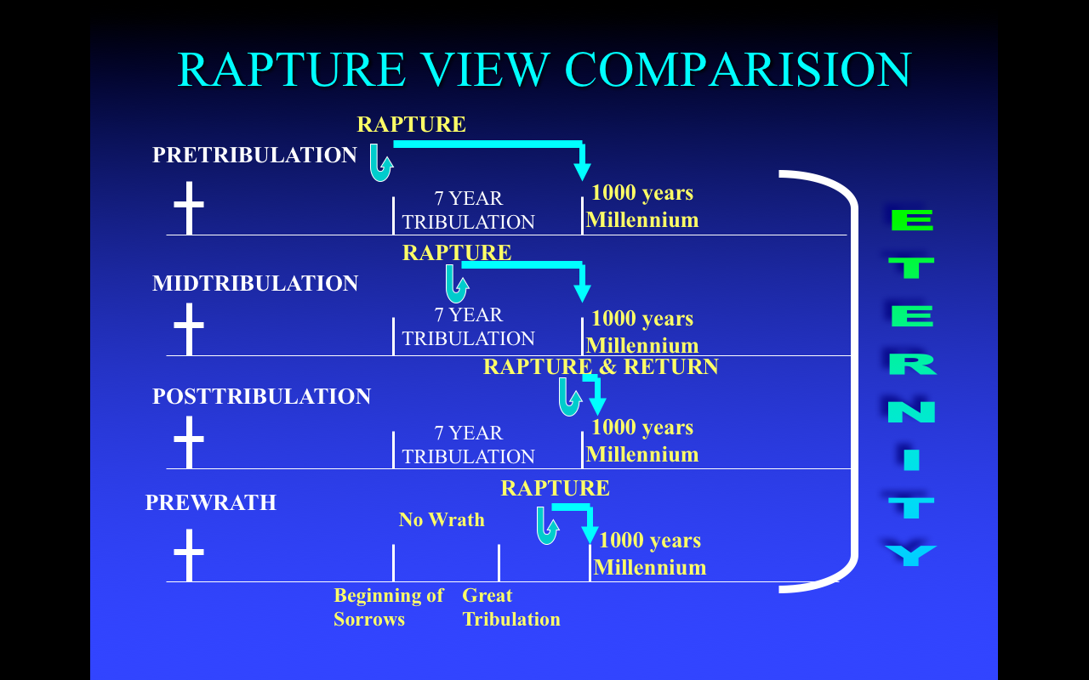

Slide 17
Eternal State
Revelation 21-22
What There Will Be:
GOD (21:3; 22:5)
A city [new Jerusalem] (21:10)
Tree of life (22:2)
River of life (22:1)
What There Won’t Be:
night, sun, moon (21:22, 25)
temple (21:22)
sea (21:1)
death, pain, mourning (21:4)
sinners (21:8, 27)

Slide 18
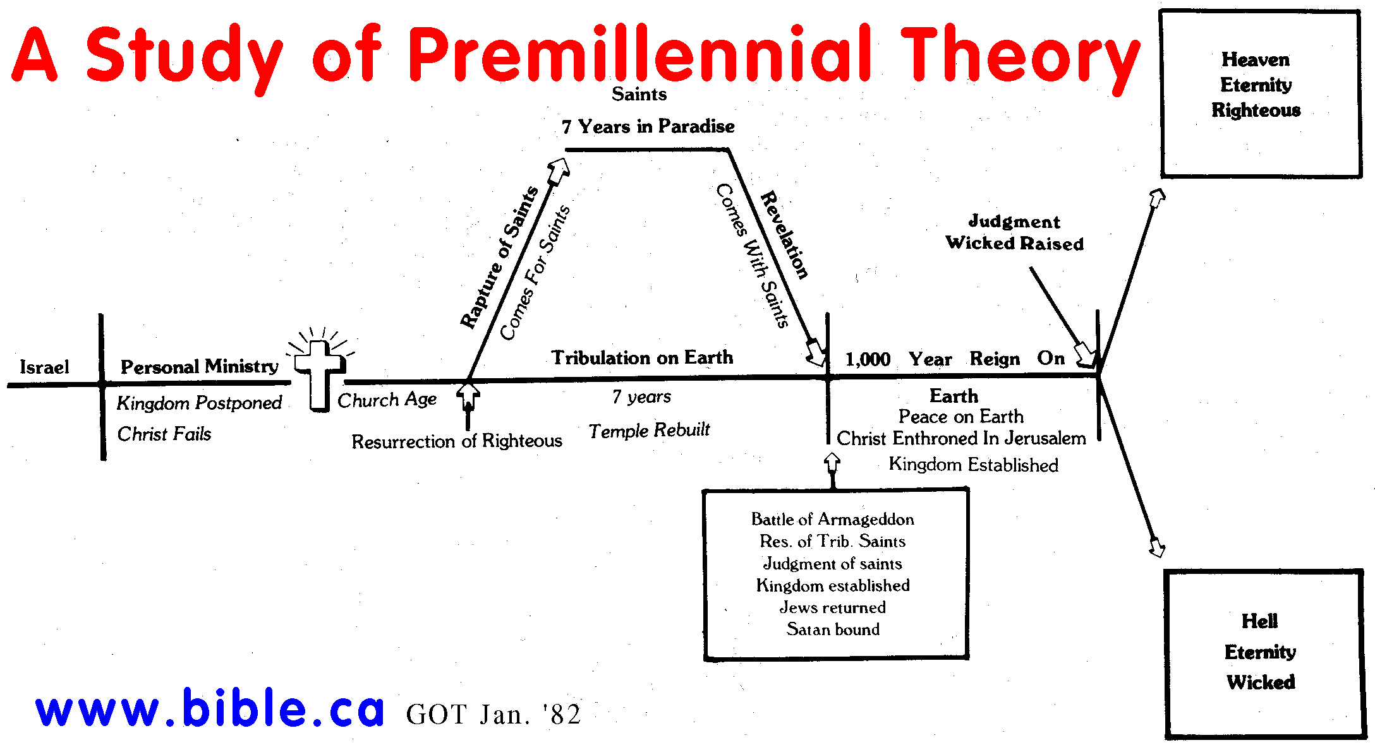
Timeline of Premil. Pretrib. Dispensational Eschatology

Slide 19
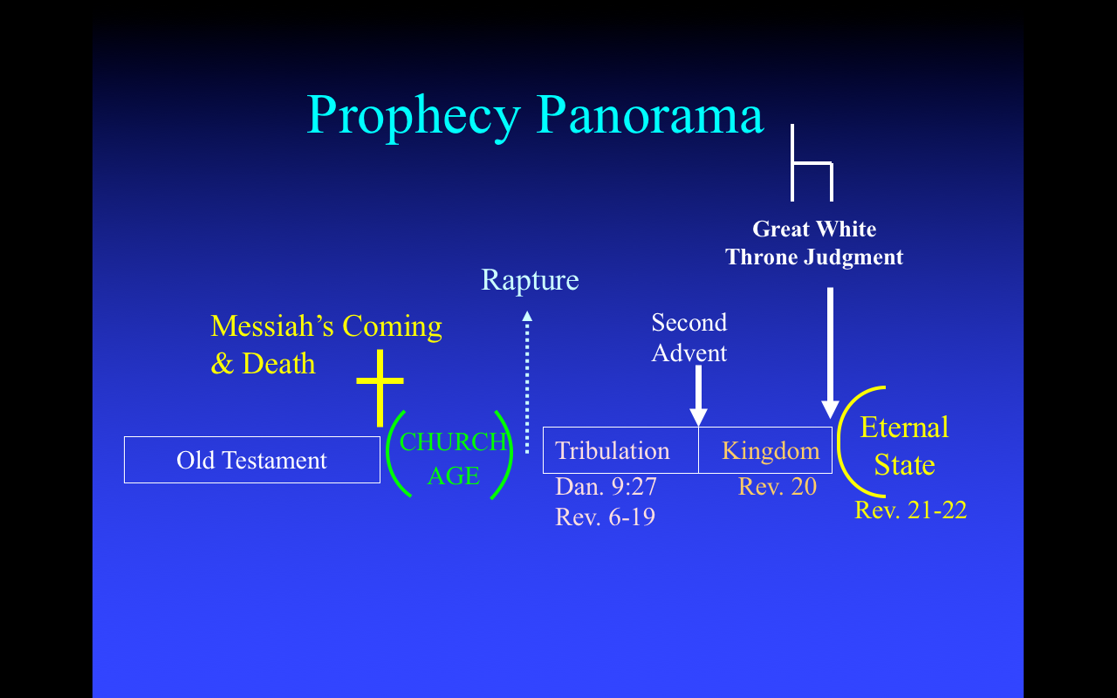
Timeline of Premil. Pretrib. Dispensational Eschatology

Slide 20
`

