Slide 1
The Oracle Habakkuk the Prophet Saw

Slide 2
Introductory Matters
Authorship
Date
Background
Message
Key Verse

Slide 3
Introductory Matters
Authorship
Habakkuk (1:1) meaning “embrace”
a prophet (1:1)
The poetic/musician prophet (3:19)
Date
7th century
Likely in reign of Josiah (about 630BC)
“Lo Zuccone” (statue of the prophet Habakkuk) by Donatello 1423-1425

Slide 4
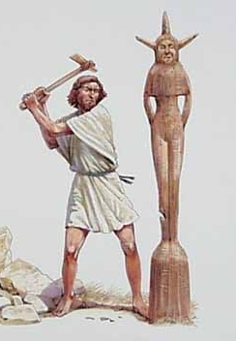
Introductory Matters
Background
Wickedness of Israel
Reign of Manasseh (696-642BC)
Baal worship and spirit mediums
Image of Asherah In the temple (2 Kngs 21:7)
Babylon
At this time, Babylon was not yet a fearsome nation
Nineveh overrun (612BC)
Battle of Carchemish (605BC)

Slide 5
Introductory Matters
Message
God is sovereign and just, even when it feels like he is absent and allowing evil to reign. God will resurrect those who have faith in Him.
Key Verse
2:4 “The righteous will live by faith.”

Slide 6
Outline
Habakkuk’s Plea for Justice (1:1-4)
God’s First Answer Promising Justice (1:5-11)
Habakkuk’s Response to God’s Answer (1:12-2:1)
God’s Resolve to Judgement (2:2-20)
Habakkuk’s Resolve to Faith (3:1-19)

Slide 7
Habakkuk’s Plea for Justice (1:1-4)
“Oracle” (v1)
A pronouncement from God. A message communicating direct revelation usually concerning blessing or judgment on a nation.
How long will you wait to judge the wicked? (v2-4)
“Why do you make me see iniquity?” (v3)
“the law is ignored” (v4)
“the wicked surround the righteous” (v4)

Slide 8
God’s First Answer Promising Justice (1:5-11)
Question: How long? Answer: Not long. (v5)
“I am doing something in your days” (v5)
I am raising up the Chaldeans (v6-11)

Slide 9
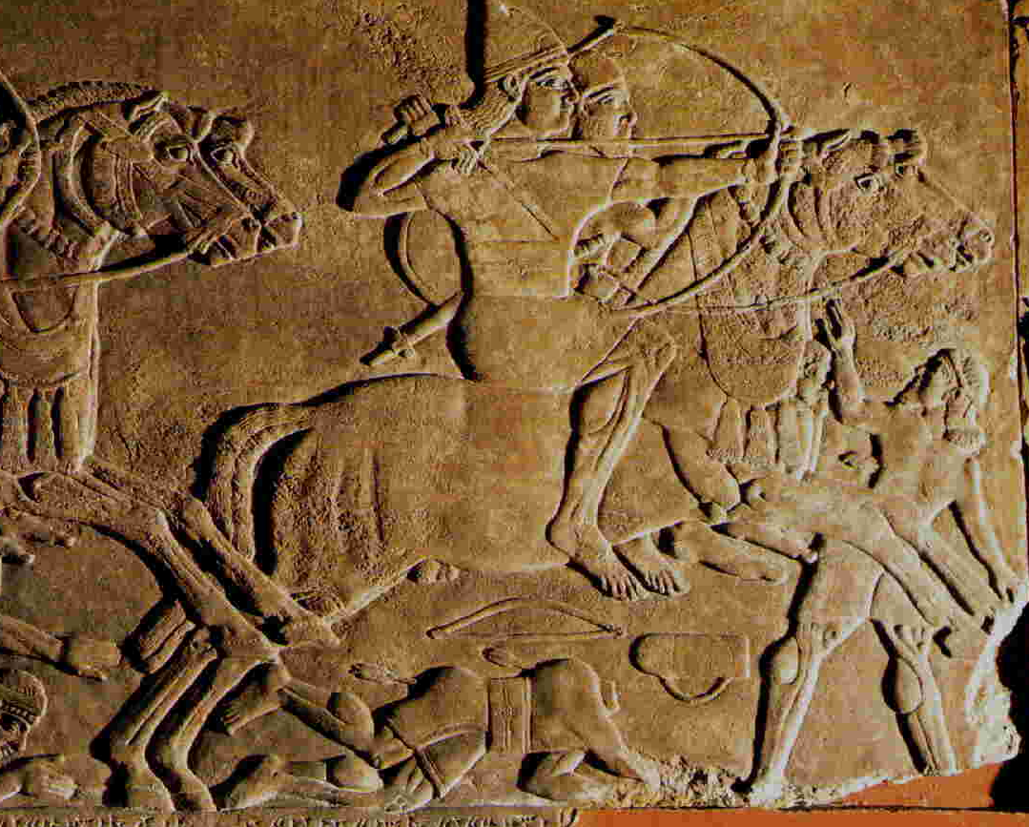
I am Raising up the Chaldeans (1:6-11)
Chaldeans – Ancient name for Babylon area peoples
“Fierce and impetuous nation” (v6)
“It’s justice and authority proceeds from itself.” (v7)
Powerful cavalry (v8)
A swift conquering nation (v9-11a)
“But it will be held guilty, whose might is its god.” (v11b)

Slide 10
Habakkuk’s Response to God’s Answer (1:12-2:1)
Far be it from you to do this, God! (1:12-13a)
“Are you not from everlasting?” (v12)
“Your eyes are too pure to approve evil” (v13)
Will the idolatrous/wicked persevere and Will the righteous be destroyed with the wicked? (1:13b-17)
“Why do you look with favor on those who deal treacherously?” (v13)
“he offers sacrifices to his net... Is he then to keep on emptying his net and mercilessly killing nations forever?” (v16-17)
…Well? (2:1)

Slide 11
God’s Resolute Judgement (2:2-20)
The vision should be clear and convicting (2:2-5)
“inscribe it on tablets that the one who reads it may run” (v2)
“It hastens toward the goal and it will not fail”(v3)
“See, as for the proud, His soul is not right within him; but the righteous will live by his faith.” (v4)

Slide 12
“The righteous will live by his faith” (2:4b)
What is the sense?
1) Righteous people will go about their day in a state of faith.
2) Righteous people will be resurrected because of their faith.
3) Righteous people will be spared when the Chaldeans come because of their faith.
What are the citations?
Romans 1:17
Hebrews 10:38
Galatians 3:11

Slide 13
God’s Resolute Judgement (2:2-20)
Five Woe Pronouncements (2:6-20)
Woe to the Debtor (v6-8)
Woe to the Covetous (v9-11)
Woe to the Conquerors (v12-14)
Woe to the Licentious (v15-17)
Woe to the Idolatrous (v18-20)
Who is speaking these woes? (cf. v5-6)

Slide 14
Habakkuk’s Resolute Faith (3:1-19)
I’m afraid but I trust You. (v2-3)
“I heard the report about You and I fear.” (v2)
“In wrath remember mercy.” (v2)
Your powerful wrath has been shown before. (v4-15)
I’m afraid, but I trust You. (v16-19)
“I tremble” (v16)
“I must wait quietly for the day of distress” (v16)
“though _________ … yet I will exult in the Lord.” (v17-18)

