Slide 1
Galatians
Introduction and 1:1-12
By Stephen Curto
for College of Biblical Studies
June 29, 2017

Slide 2
Introductory Matters
Author: Paul
Purpose: To Rebuke Christians who had been tricked by Judaizers into thinking they must follow the Mosaic Law in order to be saved.

Slide 3
Introductory Matters
Message: We are saved by grace alone through faith alone and not by works of the law.
Key Verse: 2:16b “…we have believed in Christ Jesus, so that we may be justified by faith in Christ and not by the works of the Law; since by the works of the Law no flesh will be justified.”

Slide 4
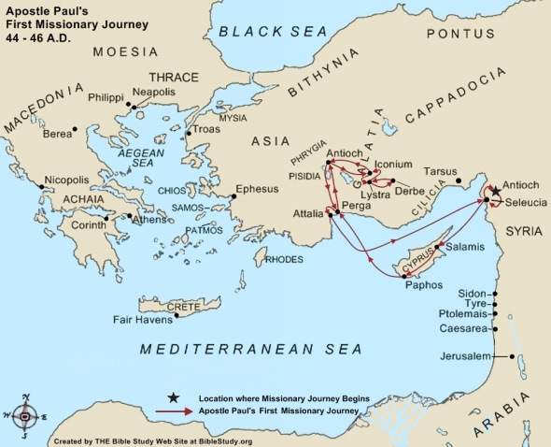
Introductory Matters - Date
Southern View:
Written to the southern region known as Galatia after Paul’s First Missionary Journey, just before the Jerusalem Council in approx 48AD

Slide 5
Introductory Matters - Date
Northern View:
Written to the northern region known as Galatia after Paul’s Second Missionary Journey in approx 53AD

Slide 6
Background
Acts 10: First Gentiles are saved (Cornelius and Peter’s Visions)
Acts 11: Peter Defends his Actions against the circumcision party (11:1-18)
Acts 12: Peter’s Arrest, Miraculous Release, and Herod’s Death
Acts 13: First Missionary Journey, Paul Preaching at Antioch, Paul Turns to Gentiles (13:42-51)
Acts 14: Paul Heals a Cripple, Mistaken for a Pagan God
Acts 15: The Jerusalem Council (14:24-15:21)

Slide 7
Outline
Greeting and Purpose for Writing: The Gospel (1:1-9)
The Gospel (1:10-5:15)
The Gospel is Not from Man (1:10- 2:10)
This is the Gospel (2:11-21)
The Law And the Gospel (3:1-5:1)
The Gospel as Seen in the Law (3:1-18)
The Point of the Law in Light of the Gospel (3:19-4:11)
Paul’s Personal Appeal for the Gospel (4:12-20)
An Old Testament Allegory About the Gospel (4:21-5:1)
Points of Application (5:2-26)
Applying the Law has Changed with the Gospel (5:2-15)
Flesh and Law vs Spirit and Gospel (5:16-26)
Final Defense (6:1-18)

Slide 9
Greeting and Purpose for Writing: The Gospel (1:1-9)
“Paul, an apostle – not from men nor through man, but through Jesus Christ and God the father who raised him from the dead – …” (v1)

Slide 10
Greeting and Purpose for Writing: The Gospel (1:1-9)
“…who gave himself for our sins to deliver us from the present evil age...” (v4)
what is “the present evil age”?
“…according to the will of our God and Father…” (v4)
Who’s will was it that Christ would die?
“… to whom be the glory forever and ever.”

Slide 11
Greeting and Purpose for Writing: The Gospel (1:1-9)
“I’m astonished that you are so quickly deserting him who called… and are turning to a different gospel” (v6)
“so quickly” support for Southern view.
“not that there is another gospel…” (v7)
Truth doesn’t change by popular opinion.

Slide 12
I. Greeting and Purpose for Writing: The Gospel (1:1-9)
“Even if we or an angel from heaven should preach to you a gospel contrary… let him be accursed” (v8, x2 v9)
“accursed” anathema : i.e. condemned to hell.
What question should immediately be of importance to the reader?

Slide 14
II. The Gospel (1:10-5:15)
The Gospel is Not from Man (1:10- 2:10)
This is the Gospel (2:11-21)

Slide 15
II. A. The Gospel is Not from Man (1:10- 2:10)
“The gospel that was preached by me is not according to man.” (v11)
“I received it through a revelation of Jesus Christ.” (v12)

Slide 16
II. A. The Gospel is Not from Man (1:10- 2:10)
Paul’s Travels According to Paul
1:13-14 Former Life in Judaism (Acts 7-9)
1:15-17 Arabia/Damascus (Acts 9:23)
1:18-19 Jerusalem With Barnabas (Acts 9:26-28)
1:20-24 Syria and Cilicia and surrounding region (Acts 9:30; 11:25-26)
2:1-10 Mission to Jerusalem During the Famine Prophesied by Agabus (Acts 11:28-30)

Slide 18
II. A. The Gospel is Not from Man (1:10- 2:10)
Theological Notes:
“who had set me apart from my mother’s womb” (v15)
“called me through his grace” (v15)
“was pleased to reveal his son” (v15-16)
What was the cause of God revealing His Son?

Slide 19
II. A. The Gospel is Not from Man (1:10- 2:10)
“I did not immediately consult with flesh and blood” (v16)
“Then after” meta (v18) vs “then through” dia (2:1)
“But I did not see any other of the apostles…” (v19)
“I was still unknown in person to the churches of Judea” (v22)

Slide 20
II. A. The Gospel is Not from Man (1:10- 2:10)
“It was because of a revelation (apokalupsis) that I went up” (v2)
What revelation caused his trip to Jerusalem? (cf. Acts 11:28-30)
“I submitted the gospel I preach among the Gentiles” (v2)
“...in private...” (v2)

Slide 21
II. A. The Gospel is Not from Man (1:10- 2:10)
“we did not yield in subjection to [false brethren] for even an hour so that the truth of the gospel would remain with you.” (v5)
“Those who were of high reputation contributed nothing to me.” (v6)
The summary of his point.
“God shows no partiality” (v6) (lit: “God does not receive a face”)
Is this true? What does he mean in context?

Slide 22
II. A. The Gospel is Not from Man (1:10- 2:10)
“They only asked us to remember the poor – the very thing I also was eager to do.” (v10)
What did they ask at the Jerusalem council? (cf. Acts 15-16)

Slide 24
II. B. This is the Gospel (2:11-21)
“I opposed him to his face, because he was being condemned” (v11)
What gave Paul the confidence to do this?
“When I saw that they were not walking rightly about the truth of the gospel” (v14)
orthopodeo (ortho = “right” “correct”; podos = “foot”)

Slide 25
II. B. This is the Gospel (2:11-21)
List all of the assertions in Verse 16:

Slide 26
II. B. This is the Gospel (2:11-21)
List all of the assertions in Verse 16:
Man is not justified by works of the Law.
Man is justified by faith in Christ Jesus.
We (Peter and Paul) have believed in Jesus.
So that we may be justified by faith in Christ Jesus (and not works of the Law).
By the works of the Law no flesh will be justified.

Slide 27
II. B. This is the Gospel (2:11-21)
“But if while seeking to be justified in Christ, we ourselves have also been found sinners, is Christ then a minister of sin?... for if I rebuild what I have destroyed I prove myself a transgressor.” (v17-18)
What does he mean by “have been found sinners”?
What is the definition of “justified” in this context (same word in verse 16)?
To what is he referring with “if I rebuild what I have destroyed”? What had he destroyed? (cf. v19)

Slide 29
III. The Law And the Gospel (3:1-5:1)
The Gospel as Seen in the Law (3:1-18)
The Point of the Law in Light of the Gospel (3:19-4:11)
Paul’s Personal Appeal for the Gospel (4:12-20)
An Old Testament Allegory About the Gospel (4:21-5:1)

Slide 30
III. A. The Gospel as Seen in the Law (3:1-18)
“Having begun by the spirit, are you now finishing by the flesh?” (v3)
To what “beginning” and “finishing” is he referring?
“Does he who provides the spirit…do it by works of law or by hearing of faith?” (v5)
”Just as Abraham faithed God and it was counted to him as righteousness.” (v6)
What did Abraham receive by faith?
What has Paul been saying Christians receive by faith?

Slide 31
III. A. The Gospel as Seen in the Law (3:1-18)
Abrahamic Covenant:
Gen 12 (Promise Made)
Gen 15:1-6 (Promise Believed)
Gen 15:7ff (Covenant Made)
Gen 17 (Sign of Covenant made)
Gen 22 (Promise and Belief Confirmed)

Slide 32
III. A. The Gospel as Seen in the Law (3:1-18)
“The Scriptures, seeing that God would justify the Gentiles by faith, preached the gospel beforehand to Abraham” (v8)
Gen 12:3, 22:18
“Those of faith are blessed, along with the faithing Abraham.” (v9)

Slide 33
III. A. The Gospel as Seen in the Law (3:1-18)
“As many as are of the works of law are under a curse” (v10)
“cursed is everyone who does not abide by all things written in the book of the law, to do them.” (v10)
Deut 27:26. In what part of Deuteronomy does this verse come?

Slide 34
III. A. The Gospel as Seen in the Law (3:1-18)
“No one is justified before God by the law for the righteous by faith will live.” (v11)
Habakkuk 2:4
What kind of “living” is he talking about? (cf. 5:25)
“But law is not of faith, but the one who does them will live by them.” (v12)

Slide 35
III. A. The Gospel as Seen in the Law (3:1-18)
“So that in Christ Jesus the blessing of Abraham might come to the Gentiles, so that we might receive the promised spirit through faith.” (v14)
“Even with a man-made covenant, no one annuls it or adds to it once it has been ratified.” (v15)
“He does not say ‘and to seeds.’” (v16)

Slide 36
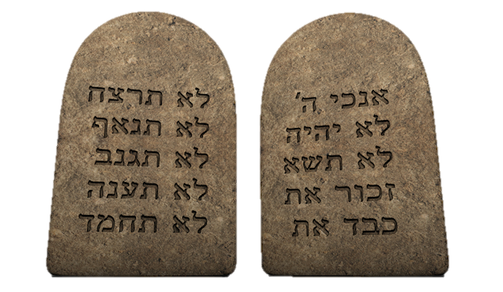
III. A. The Gospel as Seen in the Law (3:1-18)
“The law… does not invalidate a covenant previously ratified by God” (v17)
To what covenant is he referring?
“For if inheritance is based on the law, it is no longer based on a promise” (v18)

Slide 38
III. B. The Point of the Law in Light of the Gospel (3:19-4:11)
“Why then the law?” (v19)
“It was added because of transgressions” (v19)
“Is the law contrary to the promises of God?” (v21)
This is a possible conclusion based on his case.
He’s built up a distinction between “Law” and “Promise” and so he has to clarify, just because the law doesn’t save you, it doesn’t mean it’s bad! (cf. v21)

Slide 39
III. B. The Point of the Law in Light of the Gospel (3:19-4:11)
“If a law had been given that could give life, then righteousness would indeed be by the law.” (v21)
What does this tell us about the Mosaic law?
“The law was our guardian unto Christ” (v24)
What does he mean? (read various translations)
“So that we might be made righteous by faith.” (v24)
who is the we in verses 23 and 24?

Slide 40
III. B. The Point of the Law in Light of the Gospel (3:19-4:11)
“There is neither Jew nor Greek, there is neither slave nor free, there is no male and female, for you are all one in Christ Jesus.” (v28)
What does he mean by saying “there is neither” in this verse?
Does this mean women should be able to pastor?
What does the phrase “you are all one” mean?

Slide 41
III. B. The Point of the Law in Light of the Gospel (3:19-4:11)
“And if you are Christ’s then you are Abraham’s offspring, heirs according to promise.” (v29)
Of what are the Galatians (and also us) heirs?

Slide 42
III. B. The Point of the Law in Light of the Gospel (3:19-4:11)
“As long as the heir is a child, he does not differ at all from a slave though he is lord of everything, but he is under guardians and manager until the date set by his father.” (v1-2)

Slide 43
III. B. The Point of the Law in Light of the Gospel (3:19-4:11)
Summarize the argument made in verses 4-7.

Slide 45
III. C. Paul’s Personal Appeal for the Gospel (4:12-20)
“Become as I am, for I also have become as you are.” (v12)
“It was because of a bodily ailment that I preached the gospel to you the first time” (v13)
“Bodily ailment” lit. “weakness of flesh” (cf. v14-15)
What might he be referring to?

Slide 46
III. C. Paul’s Personal Appeal for the Gospel (4:12-20)
“and the temptation (or trial) of you in my flesh, you didn’t despise or loathe, but as an angel of God, you received me as Christ Jesus.” (v14)
How are we to respond to the temptations/trials of others? cf. 6:2

Slide 47
III. C. Paul’s Personal Appeal for the Gospel (4:12-20)
“Have I become your enemy by telling you the truth? They eagerly seek you, not commendably, but they wish to shut you out so that you will seek them.” (v16-17)
Note the personal tone of verses 18-20.

Slide 49
III. D. An Old Testament Allegory About the Gospel (4:21-5:1)
Abraham’s two sons:
Ishmael
from Hagar, a slave
Born according to the flesh
Isaac
from Sarah, a free woman
Born through the promise

Slide 50
III. D. An Old Testament Allegory About the Gospel (4:21-5:1)
The allegorical Interpretation:
Ishmael (Mosaic Covenant)
Mt. Sinai
Children are slaves
Mother of Present Jerusalem
Isaac (Abrahamic Covenant)
Jerusalem Above
Children are free
Mother of the Church
“And you, brethren are like Isaac, the children of promise” (v18)

Slide 51
III. D. An Old Testament Allegory About the Gospel (4:21-5:1)
“As he who was born according to the flesh (Ishmael) persecuted him of the the spirit (Isaac) so it is also now.” (v19)
What historical event is he talking about? cf. Gen 21:5-14
What is he saying about The Jews of the day?

Slide 52
III. D. An Old Testament Allegory About the Gospel (4:21-5:1)
“So then, brothers, we are not children of a bondwoman but of the free woman. In freedom Christ set us free, therefore keep standing firm and do not be subject again to a yoke of slavery.” (v31-5:1)

Slide 54
IV. Points of Application (5:2-26)
Applying the Law has Changed with the Gospel (5:2-15)
Flesh and Law vs Spirit and Gospel (5:16-26)

Slide 55
IV. A. Applying the Law has Changed with the Gospel (5:2-15)
“If you receive circumcision, Christ will be of no benefit to you” (v2)
How does this square with Paul’s actions regarding Timothy’s circumcision?
“You have been severed from Christ, you who are seeking to be justified by law” (v4)
“In Christ Jesus neither circumcision nor uncircumcision means anything, but faith working through love.” (v6)

Slide 56
IV. A. Applying the Law has Changed with the Gospel (5:2-15)
“If I still preach circumcision, why am I still persecuted?” (v11)
“I wish that those who are troubling you would cut themselves off.” (v12)

Slide 57
IV. A. Applying the Law has Changed with the Gospel (5:2-15)
“Do not turn your freedom into an opportunity for the flesh.” (v13)
“… through love serve one another.” (v13)
“The whole law is fulfilled in one word, “You shall love your neighbor as yourself.” (v14)

Slide 59
IV. B. Flesh and Law vs Spirit and Gospel (5:16-26)
“Walk by the Spirit, and you will not carry out the desire of the flesh” (v16)
What does it mean to “Walk by the Spirit”?
What are the ”desires of the flesh”?
“those who practice such things will not inherit the kingdom of God.” (v21)
“Those who belong to Christ have crucified the flesh…” (v24)

Slide 60
IV. B. Flesh and Law vs Spirit and Gospel (5:16-26)
“If we live by the Spirit, let us also walk by the Spirit.” (v25)
What does “live” mean in this context?

Slide 62
V. Final Defense (6:1-18)
“If anyone thinks he is something when he is nothing, he deceives himself.” (v3)
“for the one who sows to his own flesh will from the flesh reap corruption” (v8)
“The one who sows to the Spirit will from the Spirit reap eternal life.” (v8)

Slide 63
V. Final Defense (6:1-18)
“Let us do good to all people” (v10)
“See with what large letters I am writing to you with my own hand.” (v11)
“... compel you to be circumcised simply so that they will not be persecuted for the cross of Christ.” (v12)

Slide 64
V. Final Defense (6:1-18)
“May it never be that I would boast except in the cross of our Lord Jesus Christ” (v14)
“Those who will walk by this rule, peace and mercy be upon them” (v16)
What rule? cf. v15
“…and upon the Israel of God.” (v16)
“let no one trouble me, for I bear on my body the brand-marks of Jesus.” (v17)

