Slide 1
mygiveonthings.com/james

Slide 2
Special Issues in James
By Stephen Curto
for College of Biblical Studies
August 3, 2017

Slide 3
Outline
Introductory Matters
Outline of Book
Special Issues
Tests, Trials, or Temptations? …and the Nature of Sin (1:2-18)
Faith and Works (2:14-26)
Quoting scripture? (4:5)
Save a sinner’s soul from death? (5:19-20)

Slide 4
Introductory Matters
Authorship: James (Jacob)
Which James?
James, brother of John, son of Zebedee
James the son of Alpheus
James the father of Judas (Thaddeus)
James the brother of Jesus & Jude
Date: 46-48AD
Message
Audience

Slide 5
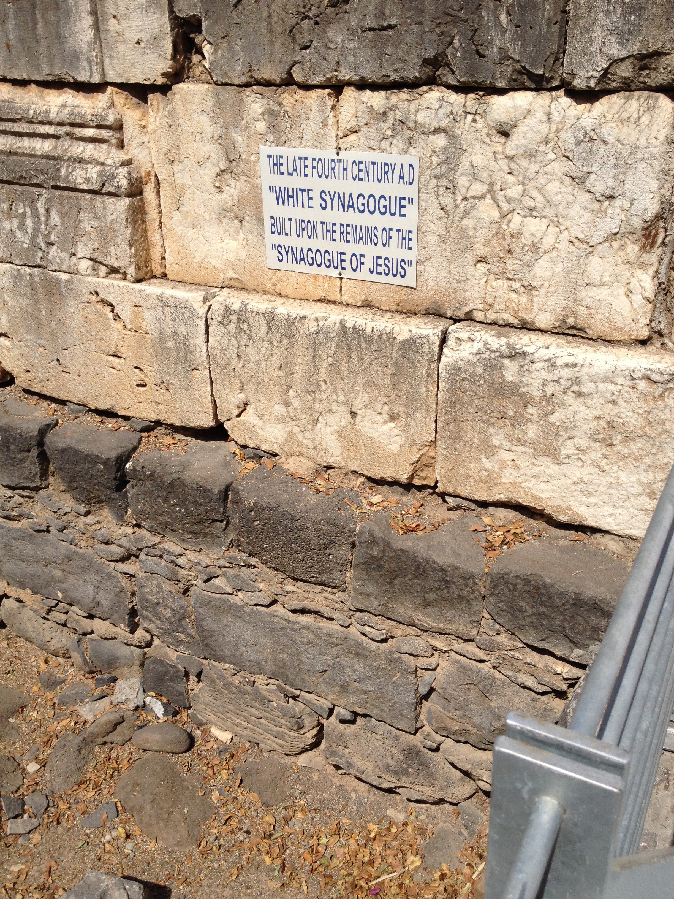
Introductory Matters
Authorship: James (Jacob)
Date: 46-48AD
James’s death (70AD at latest)
Addressed to Jewish Diaspora
No mention of Jerusalem Council
Jewish terminology
(e.g. “synagogue”)
Message
Audience

Slide 6
Introductory Matters
Authorship: James (Jacob)
Date: 46-48AD
Message
Practical righteousness is attainable when believers live out an active faith and walk by wisdom (the Spirit).
Audience

Slide 7
Introductory Matters
Authorship: James (Jacob)
Date: 46-48AD
Message
Audience
Jewish Christians who were (1) Under Roman persecution and (2) had become hardened and unmerciful/unloving.

Slide 8
Outline of Book
Tests of Faith (1:1-5:6)
Tests Themselves (1:1-18)
Tests of Obedience (1:19-27)
Tests of Favoritism (2:1-26)
Tests of the Tongue (3:1-12)
Tests of Temper (4:1-12)
Tests of Commerce(4:13-5:6)
Future for Faithful (5:7-20)

Slide 9
Special Issues
Tests, Trials, or Temptations? …and the Nature of Sin (1:2-18)
The word:
πειράζω (peirazo) : “to test, tempt, try”
vv.2, 3, 12 versus vv.13-14
What is meant by this word? Is it different in the two contexts?
the concept of sin:
tempted > carried away by lust > lust conceives > Gives birth to sin
Is lust a sin?
What is meant by this progression?
cf. Genesis 4:1-7ff

Slide 10
Special Issues
Faith and Works (2:14-26)
2:1 : Do not have faith with partiality (Deut 10:17-18)
What is meant by “works”? (cf. 2:11-12)
Answer: mercy (חסד hesed) “works” actions that show no partiality; selflessness; Self-sacrifice.
They’re not just “stuff you do for God.”
What is meant by “justified”?
Made righteous or made perfect. A good synonym: “Finished”

Slide 11
Special Issues
Faith and Works (2:14-26)

Slide 12
Special Issues
Quoting Scripture? (4:5)
James specifically says he’s quoting scripture, but we do not have this “scripture” that he quotes.
Is our scripture incomplete?

Slide 13
Special Issues
Save a Sinner’s Soul from Death? (5:19-20)
Define the important terms:
“strays from the truth”
Turns
soul
death
Whose soul is being “saved from death”?
How does “covering a multitude of sins” relate to “saving a soul from death”?
Does this mean a Christian can lose their salvation?

