Slide 1
Amos
By Stephen Curto
For Homegroup
November 26, 2017

Slide 2
Outline
Introductory Issues
Background
Text

Slide 3
Introductory Issues
Author: Amos (1:1)
Date: 782-753 BC (Uzziah and Jeroboam II)
Audience: Israel and surrounding Nations (1:3, 6, 9, 13; 2:1, 4, 6)
Purpose/Message: To rebuke Israel for their self-idolatry and predict a coming judgment in the hopes of eliciting repentance.
“The Prophet Amos” by Gustav Doré 1865

Slide 6
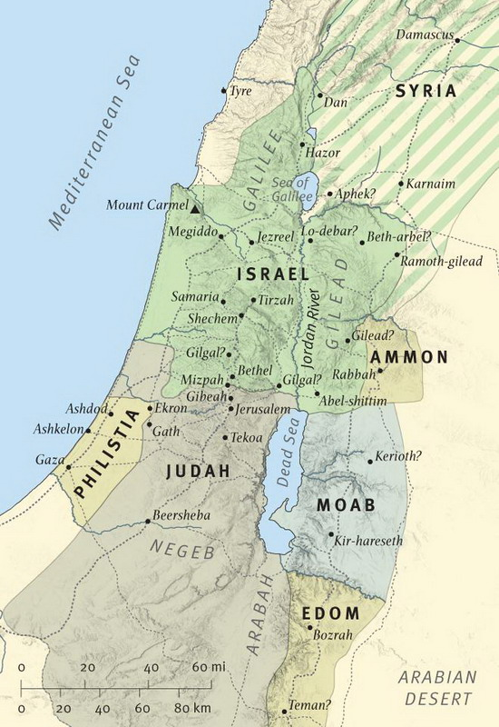
Background
Prosperity under Jeroboam II in Israel
Fourth king in the line of Jehu
Largest borders since Solomon
Uzziah Reigning well in Judah

Slide 7
Outline
Judgment For Nations Surrounding Israel (Chs. 1-2)
Three Big Sins for Israel (Chs. 3-6)
Five Visions of Coming Judgment (7:1-9:10)
Promise of Restoration for Israel (9:11-15)

Slide 8
I. Judgment For Nations Surrounding Israel (Chs. 1-2)
Each judgment surrounds and gets closer to Israel
Each judgment follows a pattern:
”For three sins of ______ and for four I will not revoke punishment” e.g. 1:3
Nation, Indictment, Punishment, Elaboration

Slide 9
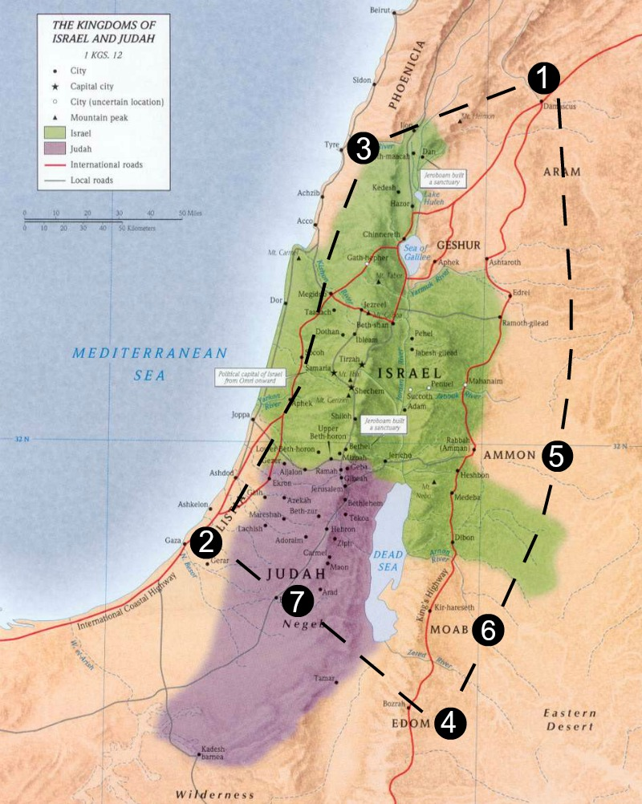

Slide 10
I. Judgment For Nations Surrounding Israel (Chs. 1-2)
Nation | Indictment | Judgment | Elaboration
Damascus | “threshed Gilead with iron” – brutal evil war with Israel | Fire on Hazael’s House | fire will devour Benhadad’s strongholds; gate-bar of Damascus broken; cut off descendants; exile the people
Philistines | slave trade | Fire on wall of Gaza | cut off descendants in Ashdod; end ruler in Ashkelon; turn hand against Ekron; destroy Philistines
Tyre | slave trade; broken treaty | Fire on wall of Tyre | fire will devour strongholds
Edom | brutal war against brother (Israel?); perpetual anger; | Fire upon Teman | fire will devour strongholds of Bozrah
Ammon | abortion/murders in war | Kindle a fire in wall of Rabbah | fire will devour strongholds with greater devastation; noble court taken to exile
Moab | destruction of Edom | fire on Moab | fire will devour strongholds of Kerioth; destruction of Moab
Judah | rejected the law of the Lord; led astray by own lies | fire on Judah | fire will devour strongholds of Jerusalem

Slide 11
I. Judgment For Nations Surrounding Israel (Chs. 1-2)
Israel’s Judgment
Breaks usual literary form: Series of judgments, contrast with blessing
Indictment:
selling poor into slavery (2:6)
perverting justice, and sexual immorality (2:7)
abusing power and wealth (2:8)

Slide 12
I. Judgment For Nations Surrounding Israel (Chs. 1-2)
Israel’s Judgment
Recounting Israel’s History (2:9-12)
Assurance of Judgment (2:13-16)

Slide 13
II. Three Big Sins for Israel (Ch 3-6)
Sins of Presumption (3:1-15)
Sins of Religion (4:1-13)
Sins of Morality (5:1-6:14)

Slide 14
II. Three Big Sins for Israel (Ch 3-6)
Sins of Presumption (3:1-15)
Who is the judgment for? (v1-2)
read verses 9-15
Sins of Religion (4:1-13)
Sins of Morality (5:1-6:14)

Slide 15
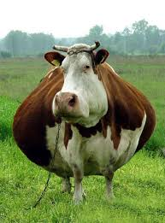
II. Three Big Sins for Israel (Ch 3-6)
Sins of Presumption (3:1-15)
Sins of Religion (4:1-13) (read 1-5, 12-13)
Judgment on “Cows of Bashan” (v1-3)
Sarcastic instruction (v4-5)
Previous, ignored, corrective judgments sent (6-11)
hunger, drought, pests, lost battles, death
prepare to meat your maker (v12-13)
Sins of Morality (5:1-6:14)

Slide 16
II. Three Big Sins for Israel (Ch 3-6)
Sins of Presumption (3:1-15)
Sins of Religion (4:1-13)
Sins of Morality (5:1-6:14)
Call for repentance (5:1-15) (read v14-15)
Clarifying the Day of the Lord (5:16-27) (read all)
Woe to Israel: promise of judgment (6:1-14) (read v8)

Slide 17
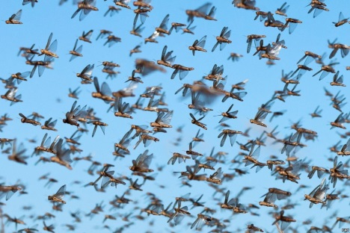
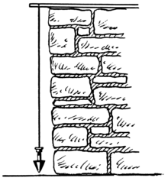
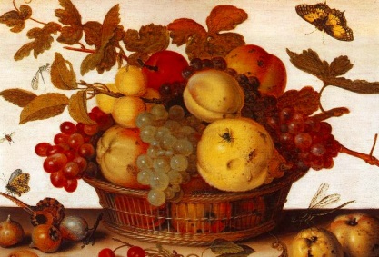
III. Five Visions of Coming Judgment (7:1-9:10)
Vision of locusts (7:1-3) (read all)
Vision of fire (7:4-6) (read all)
Vision of plumbline (7:7-9) (read all)
Historical interlude (7:10-17) (read all)
Vision of fruit basket (8:1-14) (read v1-3, 9-11)
Vision of God at the Altar (9:1-10) (read v8-10)

Slide 18
IV. Promise of Restoration for Israel (9:11-15)
“I will raise up the fallen booth of David” (v11)
What time is being spoken of?
“That they may possess the remnant of Edom…” (v12)
cf. Obadiah 19; Acts 15:13ff
“The plowman will overtake the reaper...” (v13ff)
What does this mean?

Slide 19
IV. Promise of Restoration for Israel (9:11-15)
Read verses 14-15
What time period is being described? How do you know?

