Slide 1
Jonah
By Stephen Curto
For Homegroup
December 3, 2017

Slide 2
Outline
Introductory Issues
Background
Text

Slide 3
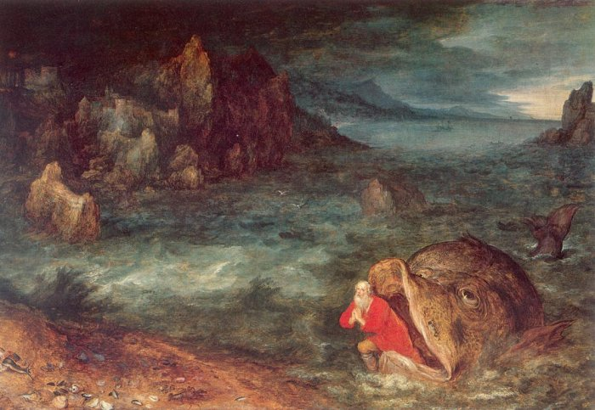
Introductory Issues
Author: Jonah? (v1)
Jonah = “Dove”
Date: approx 765 BC
(end of Jeroboam II’s Reign)
Audience: Israel
Purpose/Message: A call to Israel to repent of their wickedness to avoid coming judgment.
“Jonah Leaving the Whale” by Jan Brueghel the Elder 1600

Slide 4
Background
Jeroboam II’s reign in Israel
Most prosperous materially since Solomon
Hosea and Amos ministering in Israel at this time
Rampant idolatry mixed with self-reliance
Similarities between Jonah, Hosea, Amos
ministering under same king (Jeroboam II)
all instructed to “go” and perform specific tasks (Hos 1:2; Am 7:15; Jon 1:2)
Hosea characterizes Israel as a yonah twice (Hos 7:11; 11:11)

Slide 5
Text
Jonah Flees God (Ch 1)
Jonah Pray to God (Ch 2)
Jonah “Obeys” God (Ch 3)
Jonah Refuses God (Ch 4)

Slide 6
I. Jonah Flees God (ch 1)
“Their wickedness has come up before me” (v2)
“wickedness” - raah “calamity” “destruction” “wickedness”
“The sailors became afraid and every man cried to his god” (v5)
“Let us cast lots so that we may learn on who’s account this raah has come upon us” (v7)
“Then they called on YHWH” (14)
“For you YHWH have done as you pleased” (v14)

Slide 7
II. Jonah Prays to God (ch 2)
“I cried for help from the depth of sheol” (v2)
“And I said, ’I am driven from your sight. Yet I will again look to your Holy Temple” (v4)
“Water surrounded me to my throat… weeds surrounded me... I descended to the root of the mountain...” (v5-6)
“But you have brought my life up from the pit” (v6)
“Those who regard vain idols foresake their mercy” (v8)

Slide 8
III. Jonah “Obeys” God (ch 3)
“Yet forty days and Nineveh will be overthrown” (v4)
“Who knows? God may relent and turn from his fierce anger so that we will not perish” (v9)
“God relented of the raah that he had said he would do, and he did not do it.” (v10)

Slide 9
IV. Jonah Refuses God (Ch 4)
“But it raah’ed Jonah and he became angry” (v1)
“For I knew that you are a gracious God and merciful, slow to anger and abounding in mercy (hesed) and relenting from raah.” (v2)
“Therefore now YHWH, take my life from me for it is better for me to die than to live.” (v3)
“Do you do well to be angry?” (v4)

Slide 10
IV. Jonah Refuses God (Ch 4)
“Now the YHWH Elohim appointed a plant and made it come up over Jonah… so Jonah was exceedingly glad because of the plant.” (v6)
“But when dawn came Elohim appointed a worm that attacked the plant so that it withered.” (v7)
“God appointed a scorching east wind” (v8)
“He asked that he might die and said “It is better for me to die than to live” (v8)

Slide 11
IV. Jonah Refuses God (Ch 4)
“But Elohim said to Jonah, ‘Do you well to be angry for the plant?’ and he said, “Yes I do well to be angry, angry enough to die.” (v9)
“You pity the plant, for which you did not labor, nor did you make it grow, which came into being in a night and perished in a night. And should I not pity Nineveh…?” (v10-11)

Slide 12
Ordering the Prophets

Slide 13
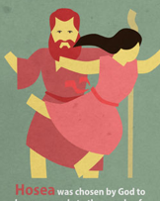
Ordering the Prophets

Slide 14
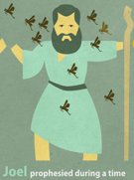
Ordering the Prophets

Slide 15
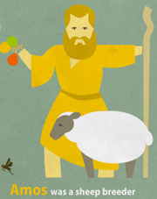
Ordering the Prophets

Slide 16
Ordering the Prophets

Slide 17
Ordering the Prophets

