Slide 1
Obadiah
By Stephen Curto
For Homegroup
December 3, 2017

Slide 2
Outline
Introductory Issues
Background
Text

Slide 3
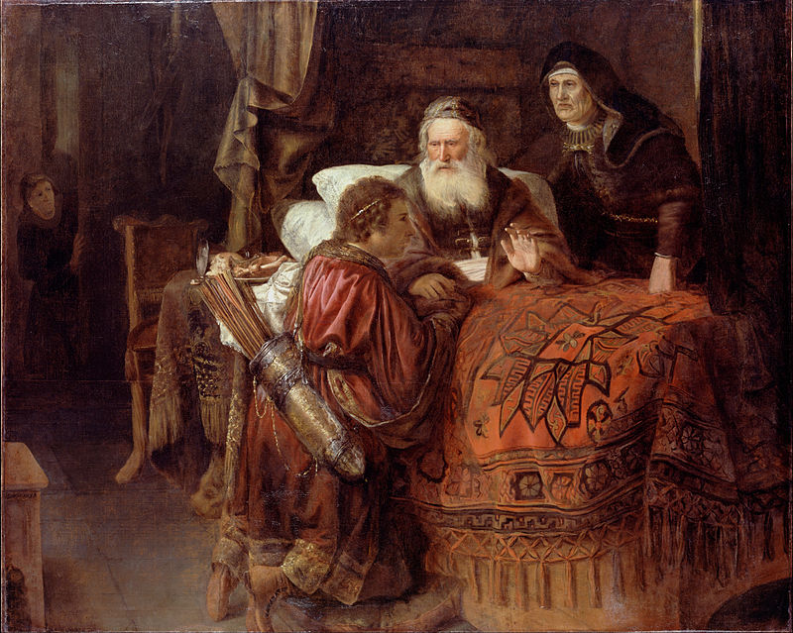
Introductory Issues
Author: Obadiah (v1)
Theophoric name “servant of Yahweh”
common name in OT
1 Kings 18:3-6?
Date: approx 845 BC (Reign of Jehoram)
Audience: Edom (v1)
Purpose/Message: To contrast the eternal states of Judah and Edom, and pronounce judgment on those who oppose the Lord.
“Isaac Blessing Jacob” by Gerrit Willemsz Horst (1612 - 1652)

Slide 4
Background
2 Kings 8:16-22, 2 Chronicles 21
Jehoram (Son of Good King Jehosaphat)
King at 32, reigns 8 years
Kills all his younger brothers, married to Athaliah (Ahab’s daughter)
“Walks in the ways of the kings of Israel” (2 Chron 21:6)
warred with Edom, but did not subdue them
Allowed Philistines and Arabs to ransack Jerusalem (2 Chron 21:16-17)
Had Ahaziah (his youngest son) when he was 18
died by a prophecy of Elijah, intestinal sickness

Slide 5
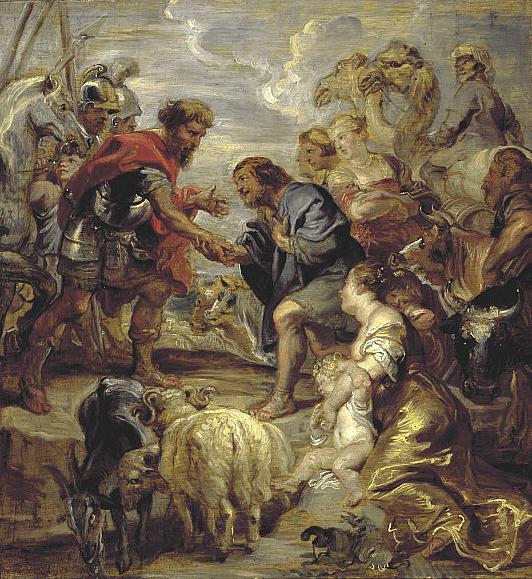
Background
History of Edom
Descendants of Esau (Isaac’s first-born son)
“Edom” means “Red” Famous for their geographic region with red-colored sand, and their pater’s red hair
Warred with Israel and Judah repeatedly (Num 20:14-21; 1 Sam 14:47; 2 Sam 8:14; 1 Kings 11:14; 2 Chron 21:8-10)
“The Reconciliation of Jacob and Esau” by Peter Paul Rubens, 1624.

Slide 7
Text
Outline:
Edom’s Doom (1-14)
The coming destruction (1-9)
The sins that brought it (10-14)
The Day of the Lord (15-21)
Judgment on the nations (15-16)
Restoration of Israel (17-21)

Slide 8
I. Edom’s Doom (1-14)
A. The Coming Destruction (1-9)
“I will make you small
among the nations” (v2)
“The pride of your heart
deceives you” (v3)
“Will I not on that day destroy
the wise men out of Edom and understanding out of
Mount Esau?” (v8)

Slide 9
I. Edom’s Doom (1-14)
B. The sins that brought it (v10-14)
“Because of the violence you have done to your brother Jacob…” (v10)
“On the day that you stood aloof... and strangers carried off his wealth...” (v11)
What day is being described? (cf. 2 Chron 21:16-17)
Do not gloat/rejoice/loot... (v12-14)

Slide 10
II. The Day of the Lord (15-21)
Judgment on the nations (15-16)
“The Day of the Lord is coming on all the nations, as you have done it will be done to you” (v15)
“Just as you drank on the holy mountain, all the nations will drink continually…” (v16)
What is meant by this metaphor/pun?

Slide 11
II. The Day of the Lord (15-21)
B. Restoration of Israel (17-21)
“But on Mount Zion there will be those who escape and it will be Holy.” (v17)
Jacob a fire… Esau a stubble? (v18)
What all does he promise will happen in vs. 19-21?
Have those things happened?
What period of time is being described?

