Slide 1
Habakkuk
By Stephen Curto
For Homegroup
January 21, 2018

Slide 2
Outline
Introductory Issues
Background
Text

Slide 3
Introductory Issues
Authorship
Habakkuk (1:1) meaning “embrace”
The poetic/musician prophet (3:19)
Date
7th century
Likely in reign of Josiah (about 630BC)
“Lo Zuccone” (statue of the prophet Habakkuk) by Donatello 1423-1425

Slide 4
Introductory Issues
Message
God is sovereign and just, even when it feels like he is absent and allowing evil to reign. God will resurrect those who have faith in Him.
Key Verse
2:4 “The righteous will live by faith.”

Slide 5
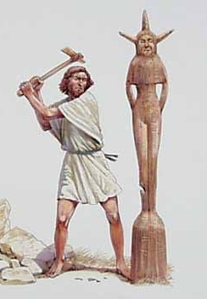
Background
Kings of Judah (2 Kings 2-22; 2 Chron 33-34)
Manasseh: (696-642 BC)
Manasseh succeeds Hezekiah and does evil in the sight of the lord (Probably most evil king of Judah)
rebuilds all temples and high-places to Baal, consults spiritists and mediums, sacrificed his son to pagan gods
Deported to Babylon by Ashurbanipal 647BC. “on hooks and bound with bronze”
in Babylon, repented, and God returned him to Jerusalem.
Tore down his idols and places of worship and died in God’s favor

Slide 6
Background
Kings of Judah (2 Kings 2-22; 2 Chron 33-34)
Amon: (642-640 BC)
succeeds his father Manasseh and reverses his repentance.
establishes high places of idolatry
assassinated by his servants who were executed by the people
Josiah: (640-609 BC)
Good king, though reforms didn’t begin until 12th year of reign.

Slide 7
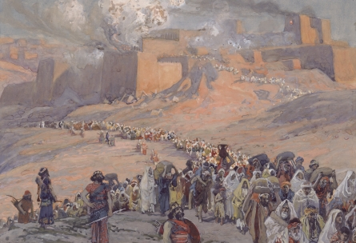
Background
Babylon
During Habakkuk’s time Babylon is a Vassal of Assyria and the Chaldeans exist as a tribal group within other nations
Nabopolassar leads Babylonian revolt and gains Babylonian independence (627-616 BC)
Fall of Nineveh (612 BC) by both Medians and Babylonians
Nebuchadnezzar Finishes Assyria Overthrow at Meggido & 1st Deportation Occurs (605 BC)
Subjugation and Second Deportation (596 BC)
Destruction of Temple & Final Deportation (586 BC)

Slide 8
Outline
Habakkuk’s Plea for Justice (1:1-4)
God’s First Answer Promising Justice (1:5-11)
Habakkuk’s Response to God’s Answer (1:12-2:1)
God’s Resolve to Judgement (2:2-20)
Habakkuk’s Resolve to Faith (3:1-19)

Slide 9
Habakkuk’s Plea for Justice (1:1-4)
“Oracle” (v1)
A pronouncement from God. A message communicating direct revelation usually concerning blessing or judgment on a nation.
How long will you wait to judge the wicked? (v2-4)
“Why do you make me see iniquity?” (v3)
“the law is ignored” (v4)
“the wicked surround the righteous” (v4)

Slide 10
God’s First Answer Promising Justice (1:5-11)
Question: How long? Answer: Not long. (v5)
“I am doing something in your days” (v5)
I am raising up the Chaldeans (v6-11)…

Slide 11
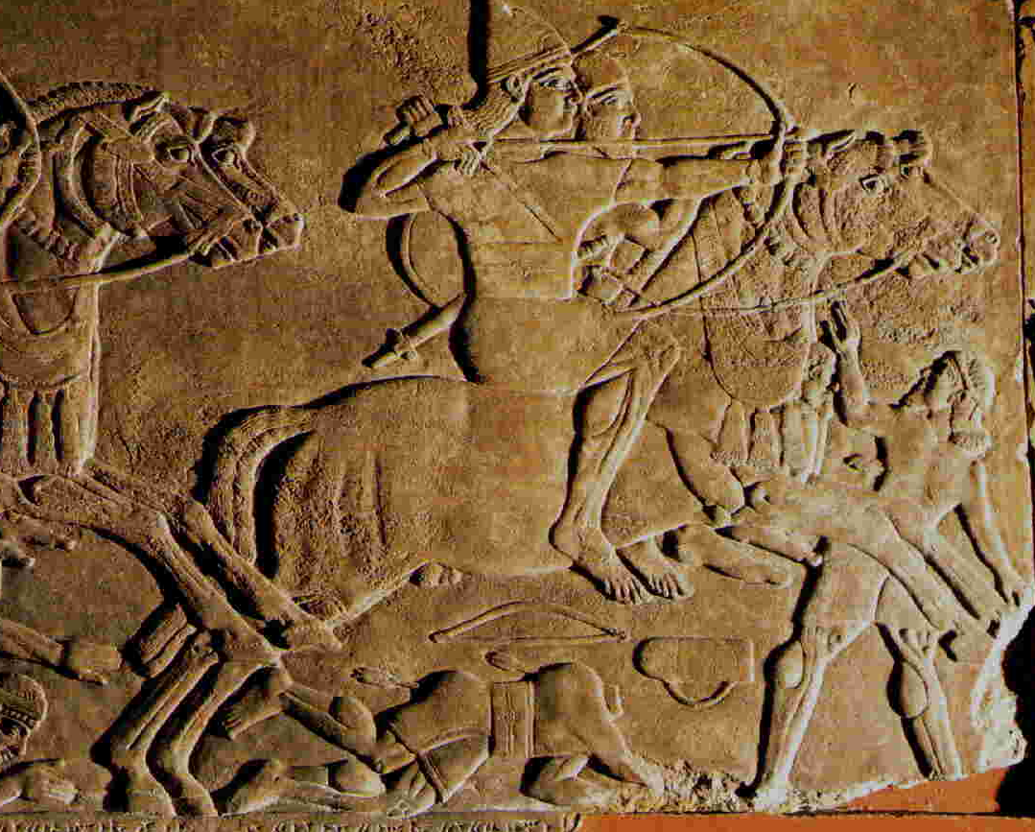
I am Raising up the Chaldeans (1:6-11)
Chaldeans – Ancient name for Babylon area peoples
“Fierce and impetuous nation” (v6)
“It’s justice and authority proceeds from itself.” (v7)
Powerful cavalry (v8)
A swift conquering nation (v9-11a)
“But it will be held guilty, whose might is its god.” (v11b)

Slide 12
Habakkuk’s Response to God’s Answer (1:12-2:1)
Far be it from you to do this, God! (1:12-13a)
“Are you not from everlasting?” (v12)
“Your eyes are too pure to approve evil” (v13)
Will the idolatrous/wicked persevere and Will the righteous be destroyed with the wicked? (1:13b-17)
“Why do you look with favor on those who deal treacherously?” (v13)
“he offers sacrifices to his net... Is he then to keep on emptying his net and mercilessly killing nations forever?” (v16-17)
…Well? (2:1)

Slide 13
God’s Resolute Judgement (2:2-20)
The vision should be clear and convicting (2:2-5)
“inscribe it on tablets that the one who reads it may run” (v2)
“It hastens toward the goal and it will not fail”(v3)
“See, as for the proud, His soul is not right within him; but the righteous will live by his faith.” (v4)

Slide 14
“The righteous will live by his faith” (2:4b)
What is the sense?
1) Righteous people will go about their day in a state of faith.
2) Righteous people will be resurrected because of their faith.
3) Righteous people will be spared when the Chaldeans come because of their faith.
What are the citations?
Romans 1:17
Hebrews 10:38
Galatians 3:11

Slide 15
God’s Resolute Judgement (2:2-20)
Five Woe Pronouncements (2:6-20)
Woe to the Debtor (v6-8)
Woe to the Covetous (v9-11)
Woe to the Conquerors (v12-14)
Woe to the Licentious (v15-17)
Woe to the Idolatrous (v18-20)
Who is speaking these woes? (cf. v5-6)

Slide 16
Habakkuk’s Resolute Faith (3:1-19)
I’m afraid but I trust You. (v2-3)
“I heard the report about You and I fear.” (v2)
“In wrath remember mercy.” (v2)
Your powerful wrath has been shown before. (v4-15)
I’m afraid, but I trust You. (v16-19)
“I tremble” (v16)
“I must wait quietly for the day of distress” (v16)
“though _________ … yet I will exult in the Lord.” (v17-18)

