Slide 1
Nahum
By Stephen Curto
For Homegroup
January 7, 2018

Slide 2
Outline
Introductory Issues
Background
Text

Slide 3
Introductory Issues
Author: Nahum (1:1)
nahum = “Comfort”
from Elkosh, likely an ancient a name for Capernaum (caper nahum = “city of comfort”) name possibly changed later to honor the prophet’s home town
Date: 663-650 BC
Purpose/Message: To foretell the sure coming destruction of Nineveh and demonstrate to Judah its need to repent of its wickedness.

Slide 4
Background
Kings of Judah (2 Kings 2-22; 2 Chron 33-34)
Manasseh: (696-642 BC)
Manasseh succeeds Hezekiah and does evil in the sight of the lord (Probably most evil king of Judah)
rebuilds all temples and high-places to Baal, consults spiritists and mediums, sacrificed his son to pagan gods
Deported to Babylon by Ashurbanipal 647BC. “on hooks and bound with bronze”
in Babylon, repented, and God returned him to Jerusalem.
Tore down his idols and places of worship and died in God’s favor

Slide 5
Background
Kings of Judah (2 Kings 2-22; 2 Chron 33-34)
Amon: (642-640 BC)
succeeds his father Manasseh and reverses his repentance.
establishes high places of idolatry
assassinated by his servants who were executed by the people
Josiah: (640-609 BC)
Good king, though reforms didn’t begin until 12th year of reign.

Slide 6
Background
Kings of Assyria
Sennacherib (705-681 BC)
leads campaign against Judah, but fails at last minute to take Judah (because Hezekiah prayed to God, 2 Kings 18)
Returns and establishes Nineveh as Assyrian capital. Beefs it up.
Destroyed the city of Babylon in 689 BC after Elamite rebellion
murdered in Nineveh by his two sons (fulfilling Isaiah 37:7; in 2 kings 19:37)

Slide 7
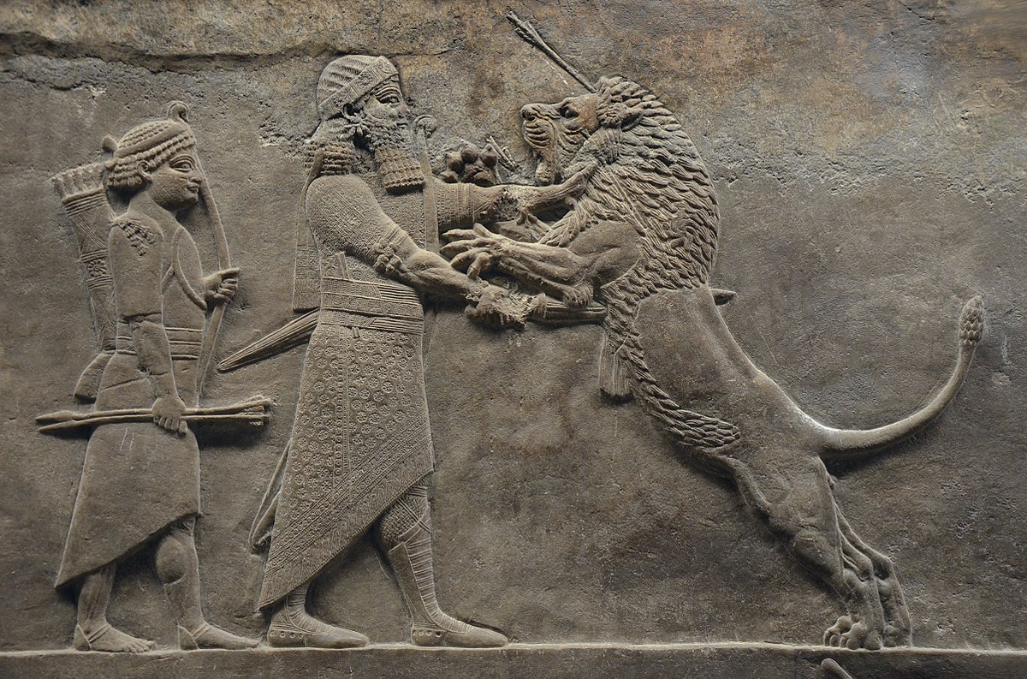
Background
Kings of Assyria
Esarhaddon: (681-669 BC)
Son of Sennacherib regains and rebuilds Babylon
Invades Egypt and conquers Memphis
City rebels when Pharaoh (Tirhakah) returns from Thebes
Ashurbanipal: (668-627 BC)
Son of Esarhaddon, recaptures Memphis and sacks Thebes (663)
Toward end of reign, a series Elamite, Arabian, Aramean, and Babylonian revolts and Assyria crumbles under his sons. Nineveh falls to Babylon and its allies in 612 BC.

Slide 9
Text
A Psalm of Destruction (ch 1)
A Picture of Destruction (ch 2)
The Reason for the Destruction (ch 3)

Slide 10
I. A Psalm of Destruction (ch 1)
What do verses 2 and 3 remind you of?
cf. Ex 19:16; 20:5; 34:6; Deut 32:35, 41
“From you has gone forth one who plotted evil…” (v11)
Who is the “you”? Who is the one who plotted evil?
Think through and try to identify all of the pronouns in verses 12-13
What is Judah’s proper response to this news?
cf. v15, Isaiah 40:9

Slide 11
II. A Picture of Destruction (ch 2)
“The one who scatters has come up against you”(v1)
Who is “the one who scatters” and who is “you”?
“The Lord will restore the splendor of Jacob like the splendor of Israel, even though…” (v2)
Who is the “he” in verses 3-4 and is it the same as the “he” in verse 5? What is being described?
“Though Nineveh was like a pool of water... now they are fleeing” (v8) (cf. v6)

Slide 12
II. A Picture of Destruction (ch 2)
“She is emptied. She is desolate” (v10)
“I will cut off your prey from the land and no longer will your voice be heard.” (v13)

Slide 13
III. The Reason for the Destruction (ch 3)
read verses 1-3 and picture it.
What is the reason for the destruction in verses 1-3? (cf. v4) Who is the harlot?
“I will lift up your skirt over your face and show to the nations your nakedness… your disgrace” (v5)
“Are you better than Thebes?... but she went into captivity” (v8, 10)
“the fire will consume...” (v15)
The destruction is great and detailed.
“For on whom has not come your unending evil?” (v19)

