Slide 1
Haggai
By Stephen Curto
For Homegroup
February 11, 2018

Slide 2
Ordering the Prophets

Slide 3
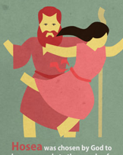
Ordering the Prophets

Slide 4
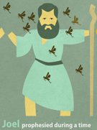
Ordering the Prophets

Slide 5
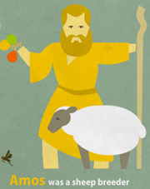
Ordering the Prophets

Slide 6
Ordering the Prophets

Slide 7
Ordering the Prophets

Slide 8
Ordering the Prophets

Slide 9
Ordering the Prophets

Slide 10
Ordering the Prophets

Slide 11
Ordering the Prophets

Slide 12
Ordering the Prophets

Slide 13
Ordering the Prophets

Slide 14
Ordering the Prophets

Slide 15
Ordering the Prophets

Slide 16
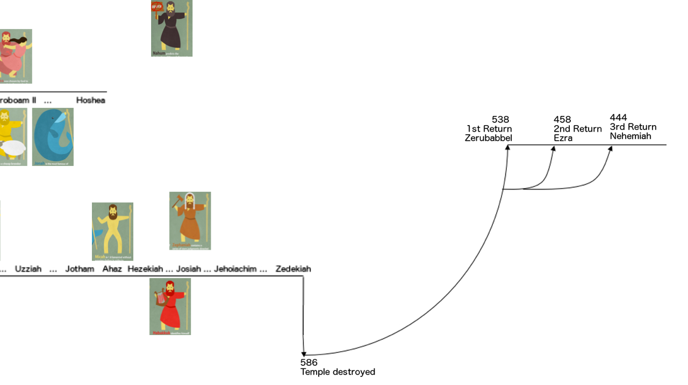
Ordering the Prophets

Slide 17
Ordering the Prophets

Slide 18
Ordering the Prophets

Slide 19
Ordering the Prophets

Slide 20
Ordering the Prophets

Slide 24
Outline
Introductory Issues
Background
Text

Slide 25
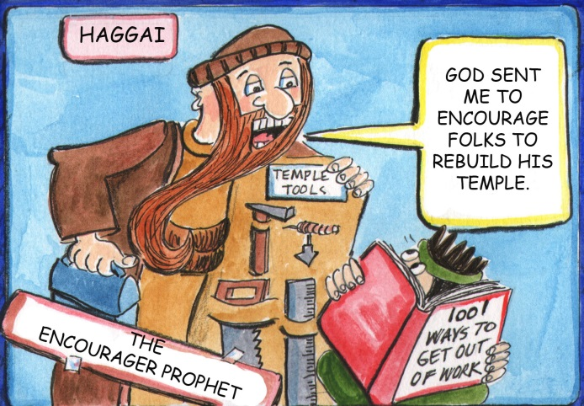
Introductory Issues
Author: Haggai (1:1) “Festival”
Date:
1st message: August 29, 520 BC (1:1)
2nd message: October 17, 520 BC (2:1)
3rd and 4th message: December 18, 520 BC (2:10, 20)
Audience: Jews returned to Jerusalem from Babylonian Exile
Purpose/Message: To “encourage” the post-exilic Jews to finish rebuilding the temple of God.

Slide 26
Background

Slide 27
Background

Slide 28
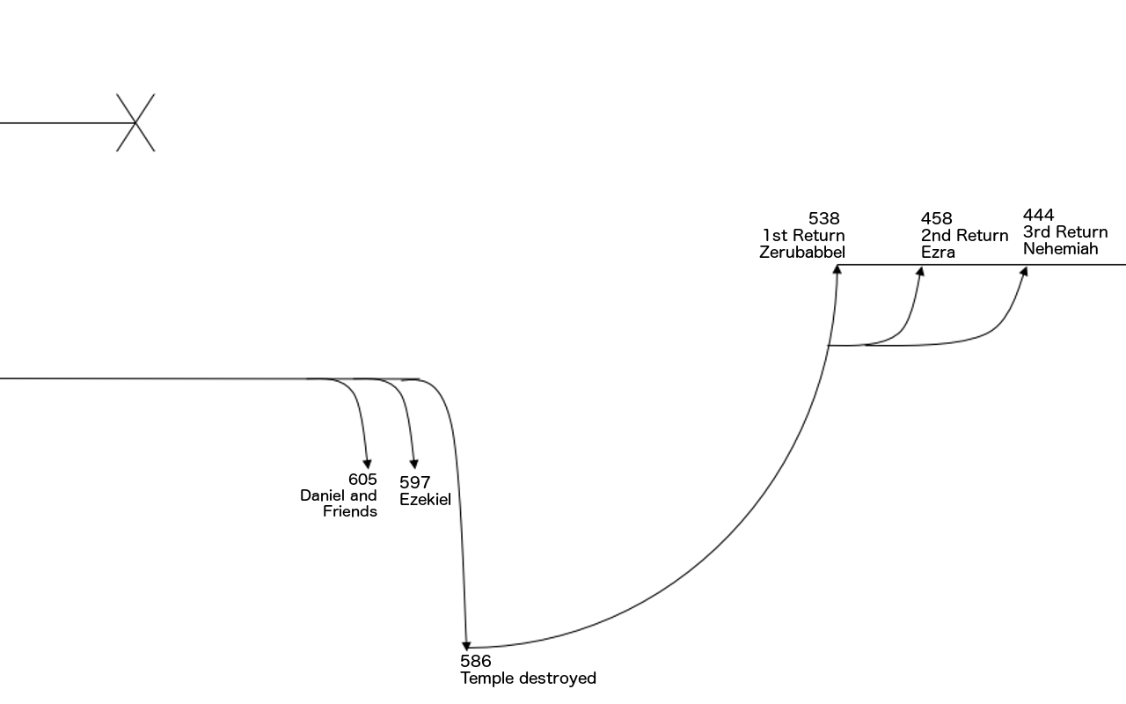
Background

Slide 29
Background
Cyrus the Great
Conquers Babylon in 539 (Daniel 5)
Makes decree that all captured people can return to home land
Zerubbabel leads first group of Jews back to Israel

Slide 30
Background
Ezra 3:8-4:5
Temple foundation is laid early on in return
Enemies of Judah opposed the rebuilding
“from the days of Cyrus to the days of Darius”
Nation becomes discouraged and begins “half” living in the land

Slide 31
Background
Persian Kings
Cyrus the Great – 559-530BC
Cambyses II – 530-522BC
Gaumata – 522BC
Darius I (the Great) – 522-486BC
Xerxes (Ahasuerus) – 486-465BC
Artaxerxes – 464-424BC

Slide 32
Background
Ezra 5-6
Read Ezra 1:1-2
Tattenai opposes the rebuild, writes to King Darius for direction
Darius discovers Cyrus’s decree
Darius issues instruction to “Leave this work on the house of God alone; let the governor of the Jews and the elders of the Jews rebuild this house of God on its site.”
Read Ezra 6:14-15

Slide 33
Text
Message 1: A Call to Rebuild (1:1-15)
Message 2: Promise of Future Glory of Temple (2:1-9)
Message 3: Priestly Illustration of Obedience (2:10-19)
Message 4: Messianic Prophecy (2:20-23)

Slide 34
Message 1: A Call to Rebuild (1:1-15)
Read verse 1. Who is talking to whom?
“These people say the time has not yet come…” (v2)
“Is it a time for you yourselves to dwell in your houses while this house (Temple) lies in ruin?” (v4)
“Consider your ways.” (v6)
What does this mean?

Slide 35
Message 1: A Call to Rebuild (1:1-15)
Consider your ways: (v5)
sown much/harvested little
eat and drink/never have enough
clothe yourselves/no warmth
earn wages/lose them
Consider your ways. (v7)
I have sent hardship until you build the temple. (v8-11)

Slide 36
Message 1: A Call to Rebuild (1:1-15)
“Then Zerubbabel and… obeyed the voice of YHWH... and the people feared YHWH.” (v12)
“And they came and worked on the house of YHWH (v14)

Slide 37
Message 2: Promise of Future Glory of Temple (2:1-9)
“Who is left among you who saw this house in its former glory? … Is it not as nothing in your eyes?” (v3) (cf. Ezra 3:8-13)
“Be strong... work, for I am with you...” (v4)
“... according to the covenant that I made with you when you came out of Egypt.” (v5)
what covenant is that?
“Yet once more I will shake (everything) so that the treasures of all nations shall come in” (v6-7)

Slide 38
Message 3: Priestly Illustration of Obedience (2:10-19)
“Ask the priests about the law” (v11)
Holy meat makes holy? - No. (v12)
Uncleaness makes unclean? - Yes. (v13)
This nation is unclean. (v14)
Previously you were not blessed, but from this day on I will bless you. (v19)

Slide 39
Message 4: Messianic Prophecy (2:20-23)
“I am about to shake the heavens and the earth and to overthrow the throne of kingdoms.” (v21)
What period is being described?
On that day… I will take you Zerbbabel... and make you like a signet ring.” (v23)
cf. Jer 22:24-25; Matt 1:12

