Slide 1
Zechariah Pt. 4
By Stephen Curto
For Homegroup
March 25, 2018

Slide 2
Ordering the Prophets

Slide 3
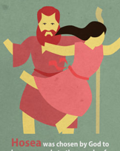
Ordering the Prophets

Slide 4
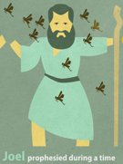
Ordering the Prophets

Slide 5
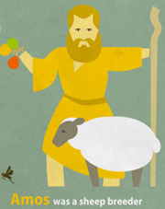
Ordering the Prophets

Slide 6
Ordering the Prophets

Slide 7
Ordering the Prophets

Slide 8
Ordering the Prophets

Slide 9
Ordering the Prophets

Slide 10
Ordering the Prophets

Slide 11
Ordering the Prophets

Slide 12
Ordering the Prophets

Slide 13
Ordering the Prophets

Slide 14
Ordering the Prophets

Slide 15
Ordering the Prophets

Slide 16
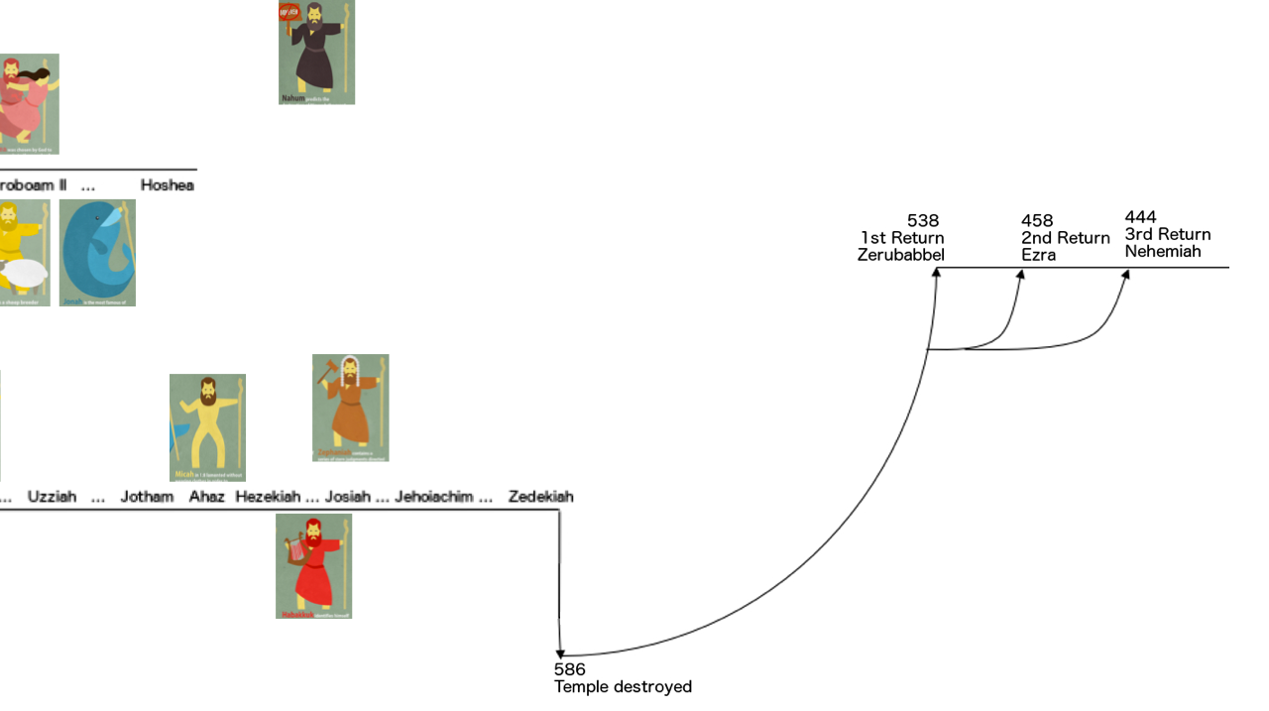
Ordering the Prophets

Slide 17
Ordering the Prophets

Slide 18
Ordering the Prophets

Slide 19
Ordering the Prophets

Slide 20
Ordering the Prophets

Slide 25
Outline
Introductory Issues
Background
Text

Slide 26
Introductory Issues
Author: Zechariah (1:1) “YHWH Remembers”
“Son of Iddo” cf. Neh 12:4, 16
Priest who returned with Zerubbabel
Zechariah is both prophet and priest
Liberal scholars began claiming multiple authors to Zechariah in the 17th century citing style and historical differences between 1-8 and 9-14
Date: First 8 visions- February 15, 519 BC (1:1-6)

Slide 27
Introductory Issues
Audience: Post-exilic Jews who are rebuilding the temple under his, and Haggai’s, prophetic encouragement.
Purpose/Message: To encourage the rebuilding of the temple and give hope concerning future domination of Israel over world powers.

Slide 28
Background

Slide 29
Background

Slide 30
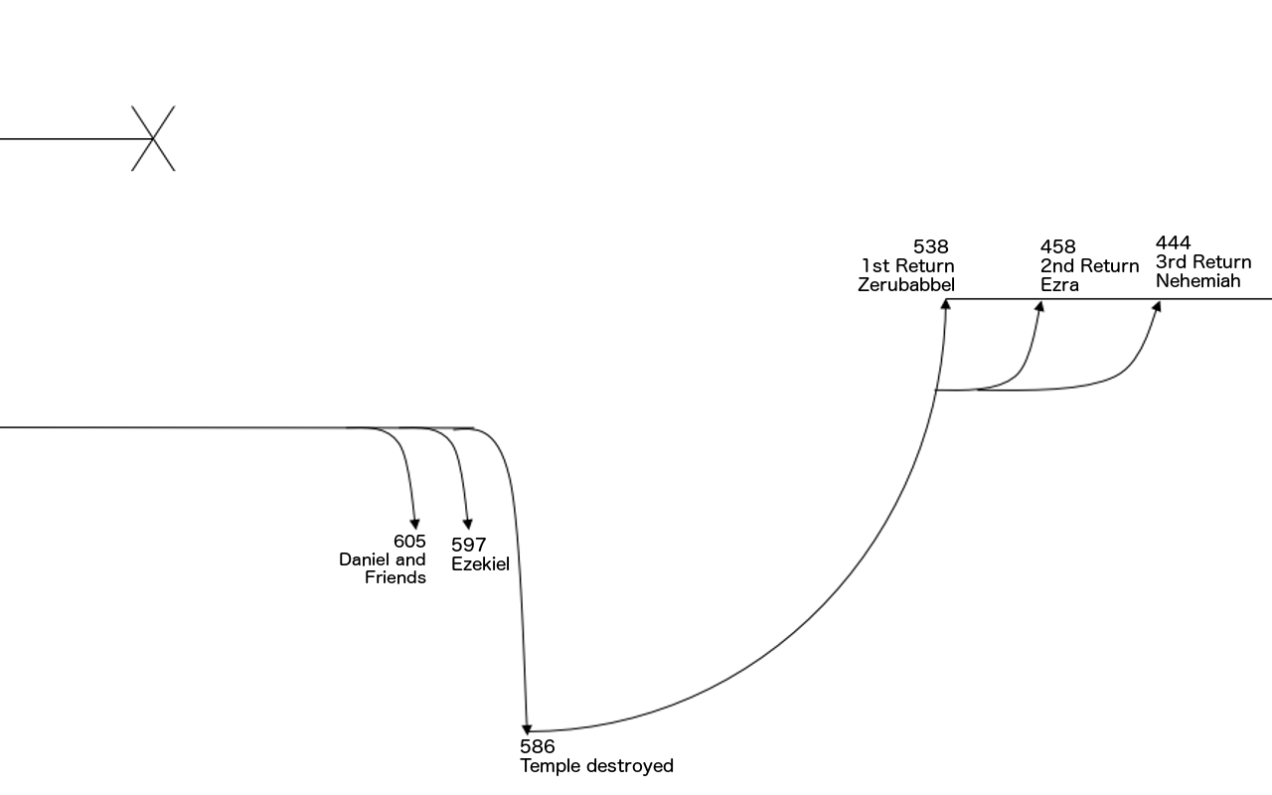
Background

Slide 31
Background
Cyrus the Great
Conquers Babylon in 539 (Daniel 5)
Makes decree that all captured people can return to home land
Zerubbabel leads first group of Jews back to Israel

Slide 32
Background
Ezra 3:8-4:5
Temple foundation is laid early on in return
Enemies of Judah opposed the rebuilding
“from the days of Cyrus to the days of Darius”
Nation becomes discouraged and begins “half” living in the land

Slide 33
Background
Persian Kings
Cyrus the Great – 559-530BC
Cambyses II – 530-522BC
Gaumata – 522BC
Darius I (the Great) – 522-486BC
Xerxes (Ahasuerus) – 486-465BC
Artaxerxes – 464-424BC

Slide 34
Background
Ezra 5-6
Read Ezra 1:1-2
Tattenai opposes the rebuild, writes to King Darius for direction
Darius discovers Cyrus’s decree
Darius issues instruction to “Leave this work on the house of God alone; let the governor of the Jews and the elders of the Jews rebuild this house of God on its site.”
Read Ezra 6:14-15

Slide 35
Text
8 Symbolic Visions (Ch 1-6)
4 Explanatory Messages (Ch 7-8)
2 Oracles (Ch 9-14)

Slide 36
I. 8 Symbolic Visions (Ch 1-6)
Red Horse and Rider (1:7-17)
Four Horns and Craftsmen (1:18-21)
Man with a Measuring Line (ch 2)
Joshua’s Clean Clothes (ch 3)
Gold Lampstand and Two Olive Trees (ch 4)
Flying Scrolls (5:1-4)
Woman in a Basket (5:5-11)
Four Chariots (6:1-8)

Slide 37
I. 8 Symbolic Visions (Ch 1-6)
1. Red Horse and Rider (1:7-17)
“a man was riding on a red horse, and he was standing among the myrtle trees which were in the ravine, with red, sorrel and white horses behind him.” (v8)
the man: “The Angel of the Lord” (v10-11)
the horses: Those whom had patrolled the earth (v10-11) (angels?)
myrtle trees: commonly represent peace/beauty. (cf. Is 55:13)

Slide 38
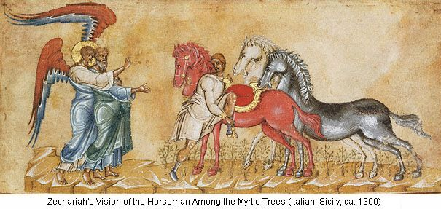
I. 8 Symbolic Visions (Ch 1-6)

Slide 39
I. 8 Symbolic Visions (Ch 1-6)
1. Red Horse and Rider (1:7-17)
“The AotL said ‘Oh YHWH of hosts, how long will You have no compassion for Jerusalem…?”(v12)
“YHWH spoke gracious comforting words.” (v13)
“I am jealous for Jerusalem and Zion and very angry with the nations at ease” (v14-15)
“My house shall be built… my cities shall overflow with prosperity” (v16-17)

Slide 40
I. 8 Symbolic Visions (Ch 1-6)
2. Four Horns and Craftsmen (1:18-21)
“I saw four horns… and YHWH showed me four craftsmen.” (v18,20)
“these are the horns that scattered Judah so that no one raised his head. And these (crasftmen) have come to terrify them, to cast down the horns of the nations who lifted up their horns against the land of Judah...” (v21)
Horns: conquering leaders that scattered Judah
Craftsmen: Angels who torment the leaders? Nations who depose the leaders?

Slide 41
I. 8 Symbolic Visions (Ch 1-6)
3. Man with a Measuring Line (ch 2)
“to measure Jerusalem” (v2)
“Jerusalem will be inhabited without walls because of the multitude of people and livestock in it.” (v4)
“And I will be to her a wall of fire and the glory in her midst” (v5)
“they shall become plunder for those who served them” (v9)
who is “they” and who is “those who served”?

Slide 42
I. 8 Symbolic Visions (Ch 1-6)
3. Man with a Measuring Line (ch 2)
“I will dwell in your midst” (v10)
Read verses 11-13.
What is being described?
Identify all of the nouns and pronouns in verse 11.

Slide 43
I. 8 Symbolic Visions (Ch 1-6)
4. Joshua’s Clean Clothes (ch 3)
“Joshua the High priest standing before the AotL and Satan (the accuser) standing at his right hand to accuse him.” (v1)
“Joshua was standing before the angel clothed with filthy garments, and the Angel said, ‘Remove the filthy garments from him.’ And to him he said, ‘Behold I have made your guilt pass from you and I will clothe you with pure royal robes.’” (v3-4)

Slide 44
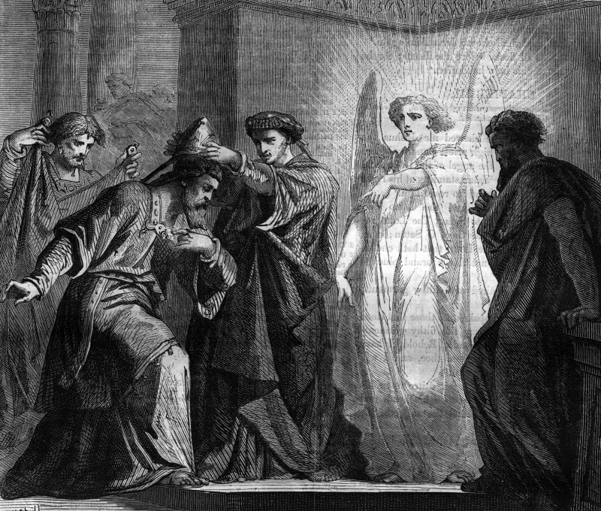
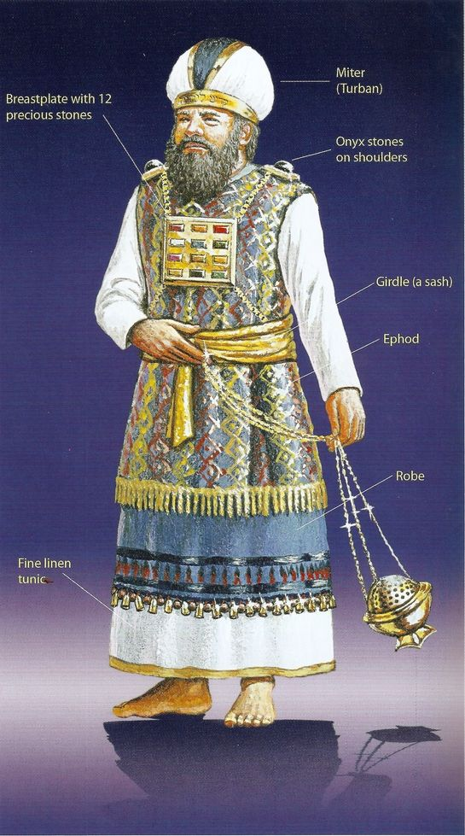
I. 8 Symbolic Visions (Ch 1-6)
4. Joshua’s Clean Clothes (ch 3)
“put a clean turban on his head.” (v5)
If you:
walk in my ways
keep my commands
Then you:
rule my house
keep my courts
give you free access among those standing here.

Slide 45
I. 8 Symbolic Visions (Ch 1-6)
4. Joshua’s Clean Clothes (ch 3)
“I will bring ‘my servant’ ‘the branch’” (v8)
cf. 6:11-12; Isa 42:1; 52:13; 53:11; Jer 23:5; 33:15
read verses 9-10.
What is the “stone with 7 eyes”? (cf. Rev 5:6) (only two references in the Bible.)
What day is “that day” in verse 10?

Slide 46
I. 8 Symbolic Visions (Ch 1-6)
5. Gold Lampstand and Two Olive Trees (ch 4)
“I see a lampstand all of gold with a bowl on the top of it, and seven lamps on it, with seven lips on each of the lamps.” (v2)
“two olive trees by it” (v3)
“Not by might nor power, but by my Spirit, says YHWH of hosts.” (v6)

Slide 47
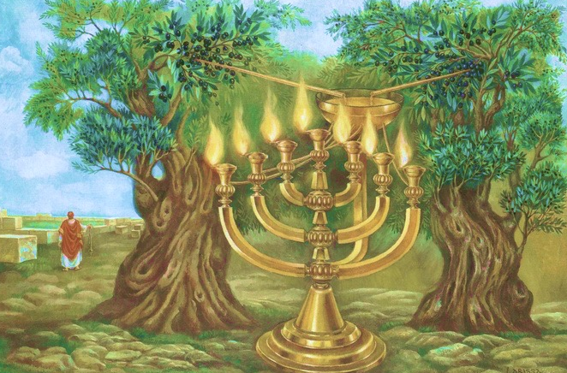
I. 8 Symbolic Visions (Ch 1-6)

Slide 48
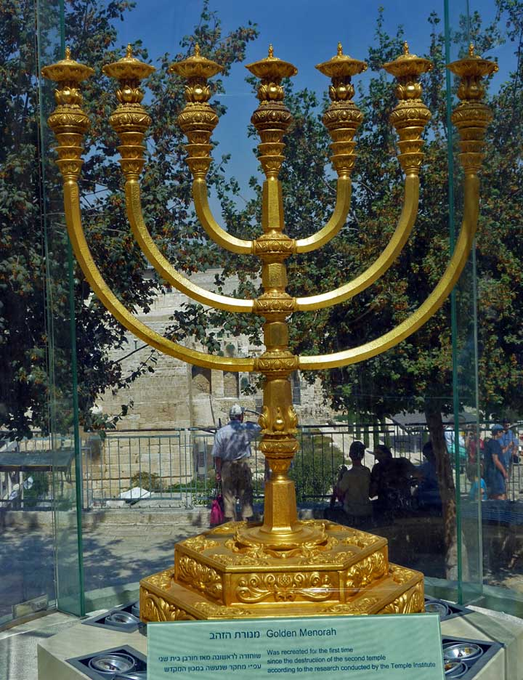
I. 8 Symbolic Visions (Ch 1-6)
5. Gold Lampstand and Two Olive Trees (ch 4)
“He shall bring forward the top stone amid shouts of ‘Grace, grace to it!’”
What does this mean? (cf. v8-9)
“What are these two olive trees…?” (v11)
“These are the two anointed ones (sons of oil) who stand by the Lord of the whole earth.” (v14)
Who might these two be?

Slide 49
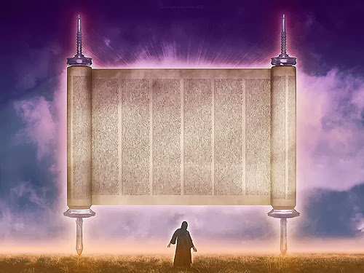
I. 8 Symbolic Visions (Ch 1-6)
6. Flying Scrolls (5:1-4)
“I see a flying scroll. It’s length is twenty cubits, and its width ten cubits.” (v2)
1 cubit = 1.5 feet

Slide 50
I. 8 Symbolic Visions (Ch 1-6)
6. Flying Scrolls (5:1-4)
“Everyone who steals shall be purged away according to what is written on one side, everyone who swears shall be purged according to what is written on the other side.” (v3)
cf. Ex 32:15, likely reference to whole law
“I will send it out” (v4)
Send what out?
“And it will remain in the house and consume it” (v4)

Slide 51
I. 8 Symbolic Visions (Ch 1-6)
7. Woman in a Basket (5:5-11)
“This is the basket (ephah) going out… This is their iniquity (lit. “eye”) in all the land.” (v6. ESV)
“A weighted cover was lifted ad there was a woman sitting in the basket. And he said ‘This is Wickedness.’” (v8)

Slide 52
I. 8 Symbolic Visions (Ch 1-6)
7. Woman in a Basket (5:5-11)
“Two women were coming... they had wings like the wings of a stork.” (v9)
“He said, [They are taking it] to the land of Shinar, to build a house (temple?) for it. And when prepared they will set the basked down there on its base.”
Where is Shinar? cf. Gen 11, Rev 17
Compare and contrast what is happening in Shinar and in Israel.

Slide 53
I. 8 Symbolic Visions (Ch 1-6)
7. Woman in a Basket (5:5-11)
“This is the basket (ephah) going out… This is their iniquity (lit. “eye”) in all the land.” (v6. ESV)
“A weighted cover was lifted ad there was a woman sitting in the basket. And he said ‘This is Wickedness.’” (v8)

Slide 54
I. 8 Symbolic Visions (Ch 1-6)
8. Four Chariots (6:1-8)
“Four chariots came out from between two… mountains of bronze.” (v1)
Are these specific mountains? cf. 14:3-4
4 “colors” of horses: Red, Black, White, Strong Spotted
“These are going out to the four winds of heaven, after presenting themselves before the Lord of all the earth.” (v5)

Slide 55
I. 8 Symbolic Visions (Ch 1-6)
8. Four Chariots (6:1-8)
Black horses = North
White horses = North, after the black
Strong Spotted horses = South
“Those who go toward the north country have set my Spirit at rest in the north country.” (v8)

Slide 56
I. 8 Symbolic Visions (Ch 1-6)
8. Four Chariots (6:1-8)
“Four chariots came out from between two… mountains of bronze.” (v1)
4 colors of horses: Red, Black, White, Spotted

Slide 57
I. 8 Symbolic Visions (Ch 1-6)
“Take from the silver and gold, and make a crow, and set it on the head of Joshua… the high priest.” (v11)
“Say to him, ‘Thus says YHWH of armies: Behold, the man! Branch, his name: for he shall branch out from this place and he shall build the temple of YHWH.’” (v12)
Who is talking to whom, about whom?
cf. 3:8; Jer 23:5; 33:15; Rev 5:5; 22:16

Slide 58
I. 8 Symbolic Visions (Ch 1-6)
“...and there shall be a priest on his throne and the counsel of peace shall be between them both.” (v13)
What both?
“And those who are far off shall come and help to build the house of YHWH, and you shall know that YHWH has sent me to you.” (v15)
Why is this included? cf. Deut 18:20

Slide 59
II. 4 Explanatory Messages (Ch 7-8)
Intro (7:1-3)
Rebuke (7:4-7)
Recall (7:8-14)
Restoration (8:1-17)
Rejoicing (8:18-23)

Slide 60
II. 4 Explanatory Messages (Ch 7-8)
Intro (7:1-3)
“The people of Bethel sent… ‘Should I weep and fast in the fifth month as I have done for so many years?’”
5th month: month of temple destruction in 586BC (2 Kngs 25:8)
Bethel:
Place of Jacob’s vision of the stairway to heaven (Gen 28)
Center of heavy idolatry in north during divided kingdom (cf. 1 Kngs 12:29-33)

Slide 61
II. 4 Explanatory Messages (Ch 7-8)
Rebuke (7:4-7)
“When you fasted… was it for me?” (v5)
When you ate and drank... wasn’t it for yourselves?” (v6)

Slide 62
II. 4 Explanatory Messages (Ch 7-8)
Recall (7:8-14)
Instruction on action: v9-10
“They refused to pay attention… stopped their ears... made their hearts hard...” (v11-12)
“Lest they should hear the law and the words that YHWH of armies had sent by his Spirit through the former prophets.” (v12)
Who did what in this verse?

Slide 63
II. 4 Explanatory Messages (Ch 7-8)
Recall (7:8-14)
“As he called, and they would not turn, so they called and I would not hear” (v12)
Who is the “He” the “They” and the “I”?
“And I scattered them among the nations... and the pleasant land was made desolate.” (v14)

Slide 64
II. 4 Explanatory Messages (Ch 7-8)
Restoration (8:1-17)
“I am very jealous for Zion... with great wrath” (v2)
cf. 1:14 (argument for unity)
A picture of the future of Jerusalem: v3-8. Summarize what it will be like.
“And they shall be my people and I shall be their God.” (v8)
cf. Gen 17:7-8; Ex 29:45; Jer 31:31-33 (Heb 8:10); 32:28 Rev 21:7

Slide 65
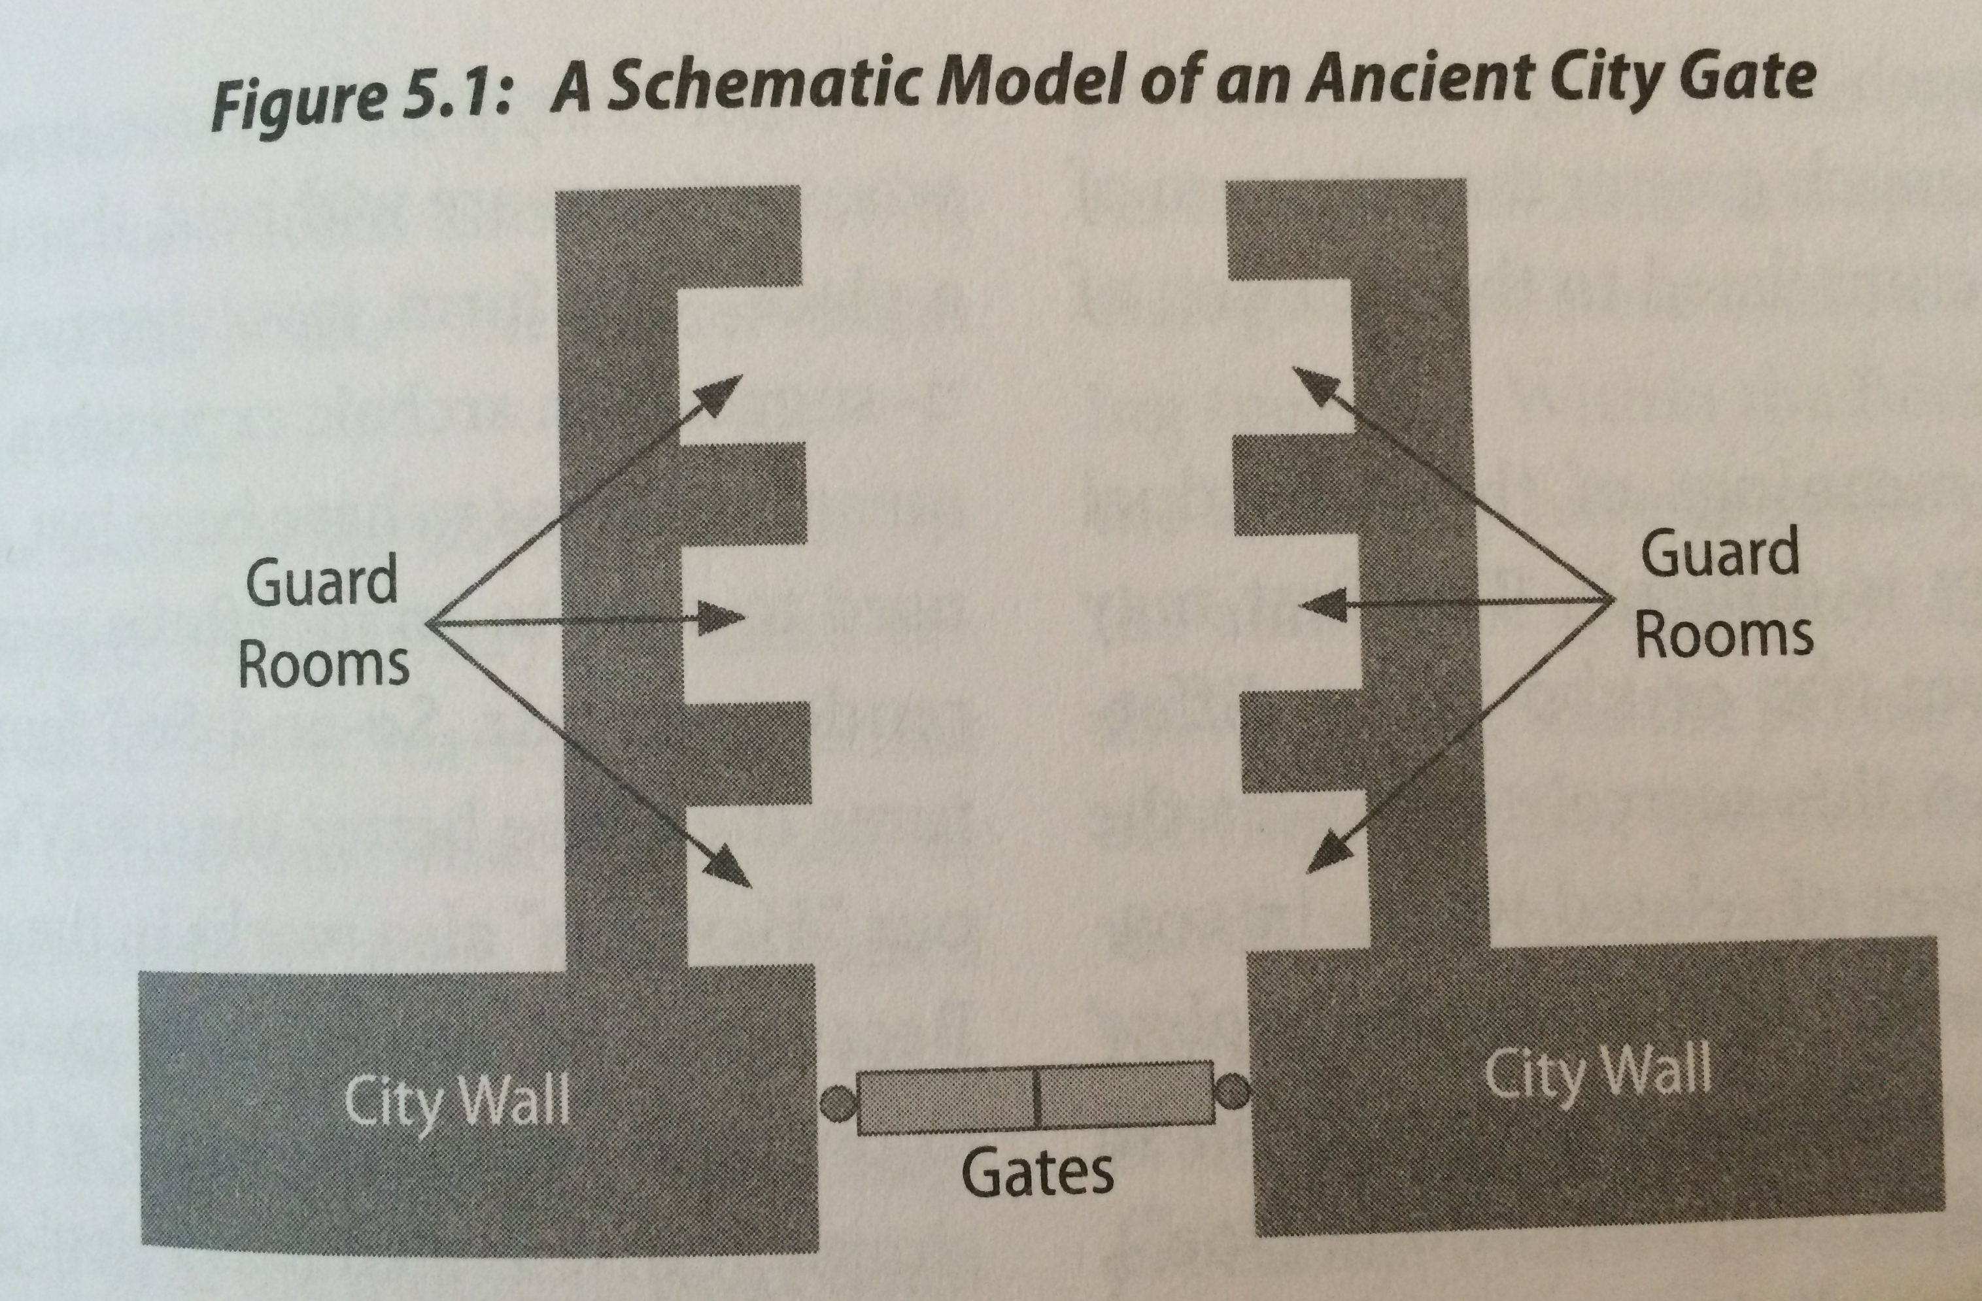
II. 4 Explanatory Messages (Ch 7-8)
Restoration (8:1-17)
I will deal differently with you now, than I have in the former days: v9-17
What are the general commands God gives to the people (v16-17)

Slide 66
II. 4 Explanatory Messages (Ch 7-8)
Rejoicing (8:18-23)
“The fast of the fourth, fifth, seventh, and tenth month shall be to the house of Judah, seasons of Joy and gladness and cheerful feasts.” (v19)
Fasts change to feasts. When does this happen?
During this time, season of feasts, inhabitants of all nations will come and go into Jerusalem. (v20-23) What time period is being described?

Slide 67
III. 2 Oracles (Ch 9-14)
Oracle 1: (9:1-11:17)
Oracle 2: (12:1-14:21)

Slide 68
III. 2 Oracles (Ch 9-14)
Oracle 1: (9:1-11:17)
Geographical Judgment 9:1-8
Read verses 7-8. What is being described?
The Coming King 9:9-17
Read verses 9 and 10. Have they both happened yet?
Read verses 11-14. Name all the people groups or individuals and what they are doing.
What is the “waterless pit” and who was there?
What is happening in verses 15-17?

Slide 69
III. 2 Oracles (Ch 9-14)
Oracle 1: (9:1-11:17)
The future of Israel vs Surrounding Nations 10:1-11:3
Explain verses 3-5.
“I will save the house of Joseph and I will bring them back” (v7)
What time period is being described in verses 8-10?
What awaits the other nations?

Slide 70
III. 2 Oracles (Ch 9-14)
Oracle 1: (9:1-11:17)
An Allegorical Shepherding 11:4-17
4-14:
who are the “players”
what is the point?
What analogies stand out?
15-17
Same questions

Slide 71
III. 2 Oracles (Ch 9-14)
Oracle 2: (12:1-14:21)
Future Jerusalem (12:1-13:9)
The Return of the King (14)

Slide 72
III. 2 Oracles (Ch 9-14)
Oracle 2: (12:1-14:21)
Future Jerusalem (12:1-13:9)
Jerusalem in relation to the nations (12:1-12:9)
Sin, Forgiveness, and Mourning (12:10-13:1)
False Prophets Ashamed (13:2-6)
The Purification of his People (13:7-9)

Slide 73
III. 2 Oracles (Ch 9-14)
Oracle 2: (12:1-14:21)
Future Jerusalem (12:1-13:9)
The Return of the King (14)
Jerusalem’s Destruction (v1-2)
The Lord’s Return Fire (v3-5)
No Night There (v6-11)
The Nations in “That” time (v11-21)

