Slide 1
Malachi
By Stephen Curto
For Homegroup
April 9, 2018

Slide 3
Ordering the Prophets

Slide 4
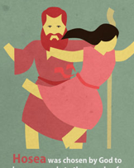
Ordering the Prophets

Slide 5
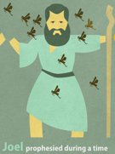
Ordering the Prophets

Slide 6
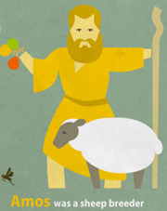
Ordering the Prophets

Slide 7
Ordering the Prophets

Slide 8
Ordering the Prophets

Slide 9
Ordering the Prophets

Slide 10
Ordering the Prophets

Slide 11
Ordering the Prophets

Slide 12
Ordering the Prophets

Slide 13
Ordering the Prophets

Slide 14
Ordering the Prophets

Slide 15
Ordering the Prophets

Slide 16
Ordering the Prophets

Slide 17
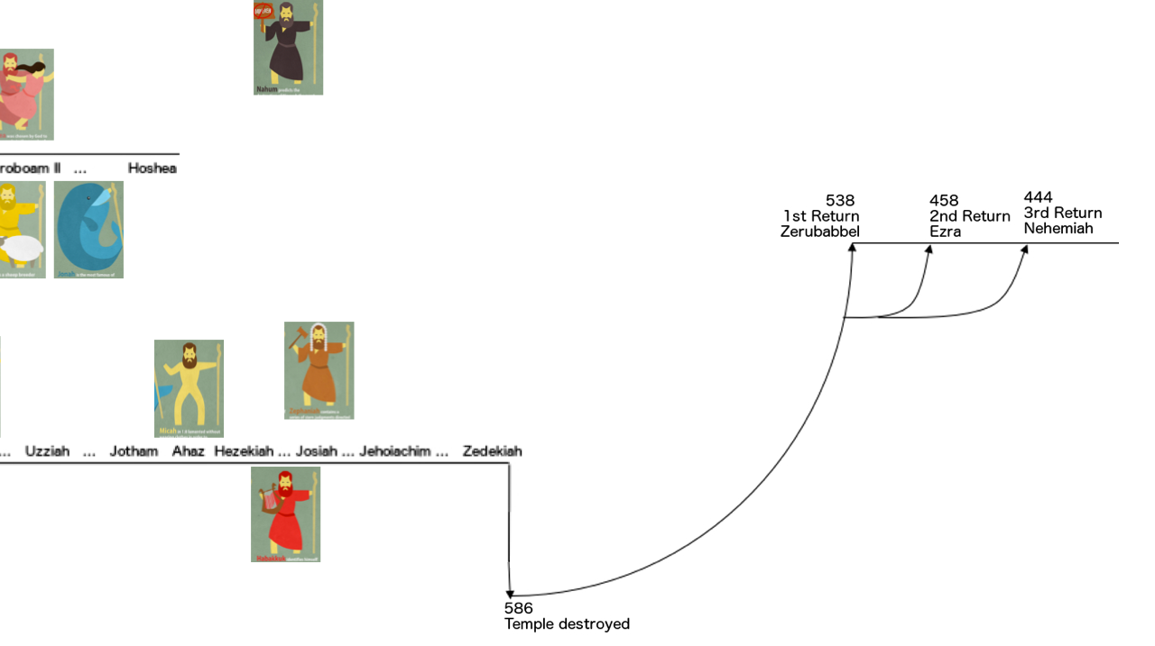
Ordering the Prophets

Slide 18
Ordering the Prophets

Slide 19
Ordering the Prophets

Slide 20
Ordering the Prophets

Slide 21
Ordering the Prophets

Slide 27
Outline
Introductory Issues
Background
Text

Slide 28
Introductory Issues
Author: Malachi (1:1) “My Messenger”
Many contend this is not a name and the book is anonymous
Some argue the book is actually part of Zechariah (the same who argue Zechariah is not a unity)
Date: Between 500-400BC
Purpose: To convict the nation for their unlawful worship, and encourage them toward right worship.

Slide 29
Background
3 returns from Babylonian Exile
Zerubabbel (Temple Foundation)
Ezra (Temple)
Nehemiah (City Wall)
Ezra 9ff; Nehemiah 13:23ff

Slide 30
Text Outline
Oracle 1: God’s Love for Israel (1:1-5)
Oracle 2: Against Leadership (1:6-2:9)
Oracle 3: Unlawful Marriage Practices (2:10-16)
Oracle 4: The Coming of the Lord (2:17-3:6)
Oracle 5: Blessed Obedience (3:7-12)
Oracle 6: The Day of the Lord (3:13-4:3)
Conclusion: The Coming of Elijah (4:4-6)

Slide 31
Oracle 1: God’s Love for Israel (1:1-5)
“I have loved you” (v2)
How?
Jacob and Esau (v3-5)

Slide 32
Oracle 2: Against Leadership (1:6-2:9)
“Where is my honor… respect?” (v1:6)
”You despise my name” (v6)
How?
Unfit sacrifices = “despising the food” (v7-13)
“For I am a great king, my name is feared among the nations” (v14)
“This commandment is for you, priests” (v2:1)

Slide 33
Oracle 2: Against Leadership (1:6-2:9)
“My covenant with Levi will stand” (v2:4)
The Covenant:
Life and Peace (v5)
Fear (v5)
Instruction (v6)
“The lips of a priest guard knowledge and men will seek instruction from his mouth” (v7)

Slide 34
Oracle 3: Unlawful Marriage Practices (2:10-16)
“Have we not all one father?” (v10)
Introducing a section on family relations.
First time we see God referred to as “father” before Jesus uses it.
“Judah has dealt treacherously… and has married the daughter of a foreign God.” (v11)
“The Lord has been witness between you and the wife of your youth... she is your wife by covenant” (v14)

Slide 35
Oracle 3: Unlawful Marriage Practices (2:10-16)
“Did he not make one, and a remnant spirit to him? And what was the one seeking? A seed of God.”(v15)
“Take heed then of your spirit and let no one deal treacherously against the wife of your youth.” (v15)
What is he saying here?

Slide 36
Oracle 4: The Coming of the Lord (2:17-3:6)
“Behold, I am going to send my messenger (malachi)” (v1)
“he will clear the way before me” (v1)
Who is the messenger?
“And the Lord will suddenly come into his temple” (v1)
“But who can withstand the day of his coming?” (v2)
Read vs. 2-6.
what time period is being described?

Slide 37
Oracle 5: Blessed Obedience (3:7-12)
“You have robbed me” (v8)
How?
Tithes and offerings (v8-9)
How do we fix it?
Bring them back to me. (v10-12)

Slide 38
Oracle 6: The Day of the Lord (3:13-4:3)
“Your words have been arrogant against me” (v13)
How?
you said “it is vain to serve God… what’s the use” and “the wicked prosper from wickedness without punishment” (v14-15)
Those who fear the Lord are called “My people” (v16-17)
“On the day I make special treasure I will spare them” (v3:17-4:3)

Slide 39
Conclusion: The Coming of Elijah (4:4-6)
“Remember the law of Moses” (v4)
“I am going to send you Elijah the prophet before the coming of the great and terrible day of the Lord.” (v5)
What is “the great and terrible day of the Lord”?
Was this the coming of John the Baptist? cf. Matt 17:9-13; Luke 1:17; cff. John 1:19-26

