Slide 1
Questions on Culture
A Discussion Starter
By Stephen Curto
For Homegroup
May 6, 2018

Slide 2
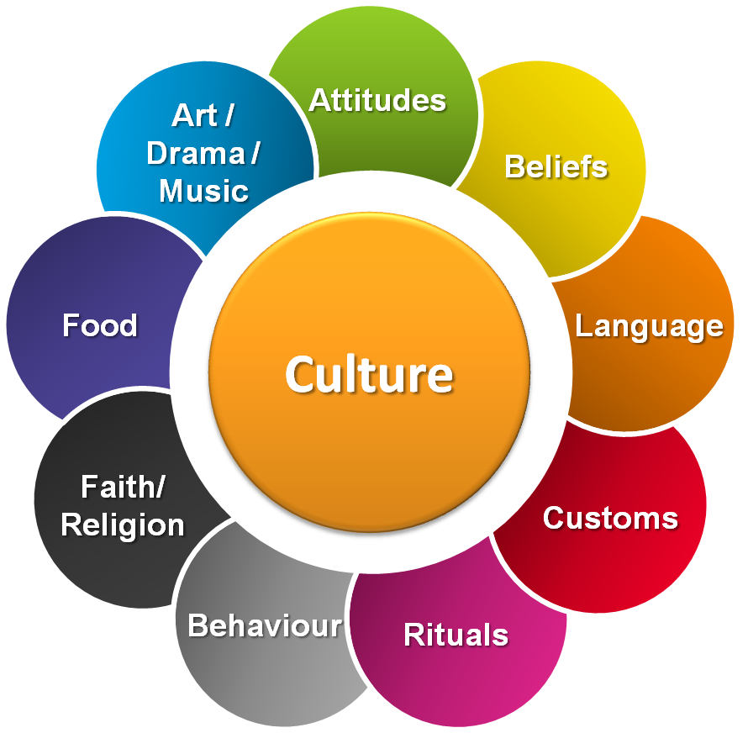
What is Culture?
“the arts and other manifestations of human intellectual achievement regarded collectively.” - google dictionary
What is the relationship between values/beliefs and culture?

Slide 3
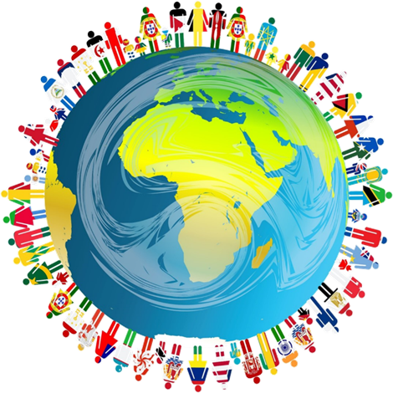
Race and Culture
What is the relationship between race and culture?
Is there such a thing as “Black culture” “White culture” and “Asian culture”? If so, what are these things as distinct from each other?

Slide 4
“The Culture Wars”
What are the drivers of American culture?
Are these the correct drivers?
How do politics interact with culture?
Are some cultures better than others? If so, why?

Slide 5
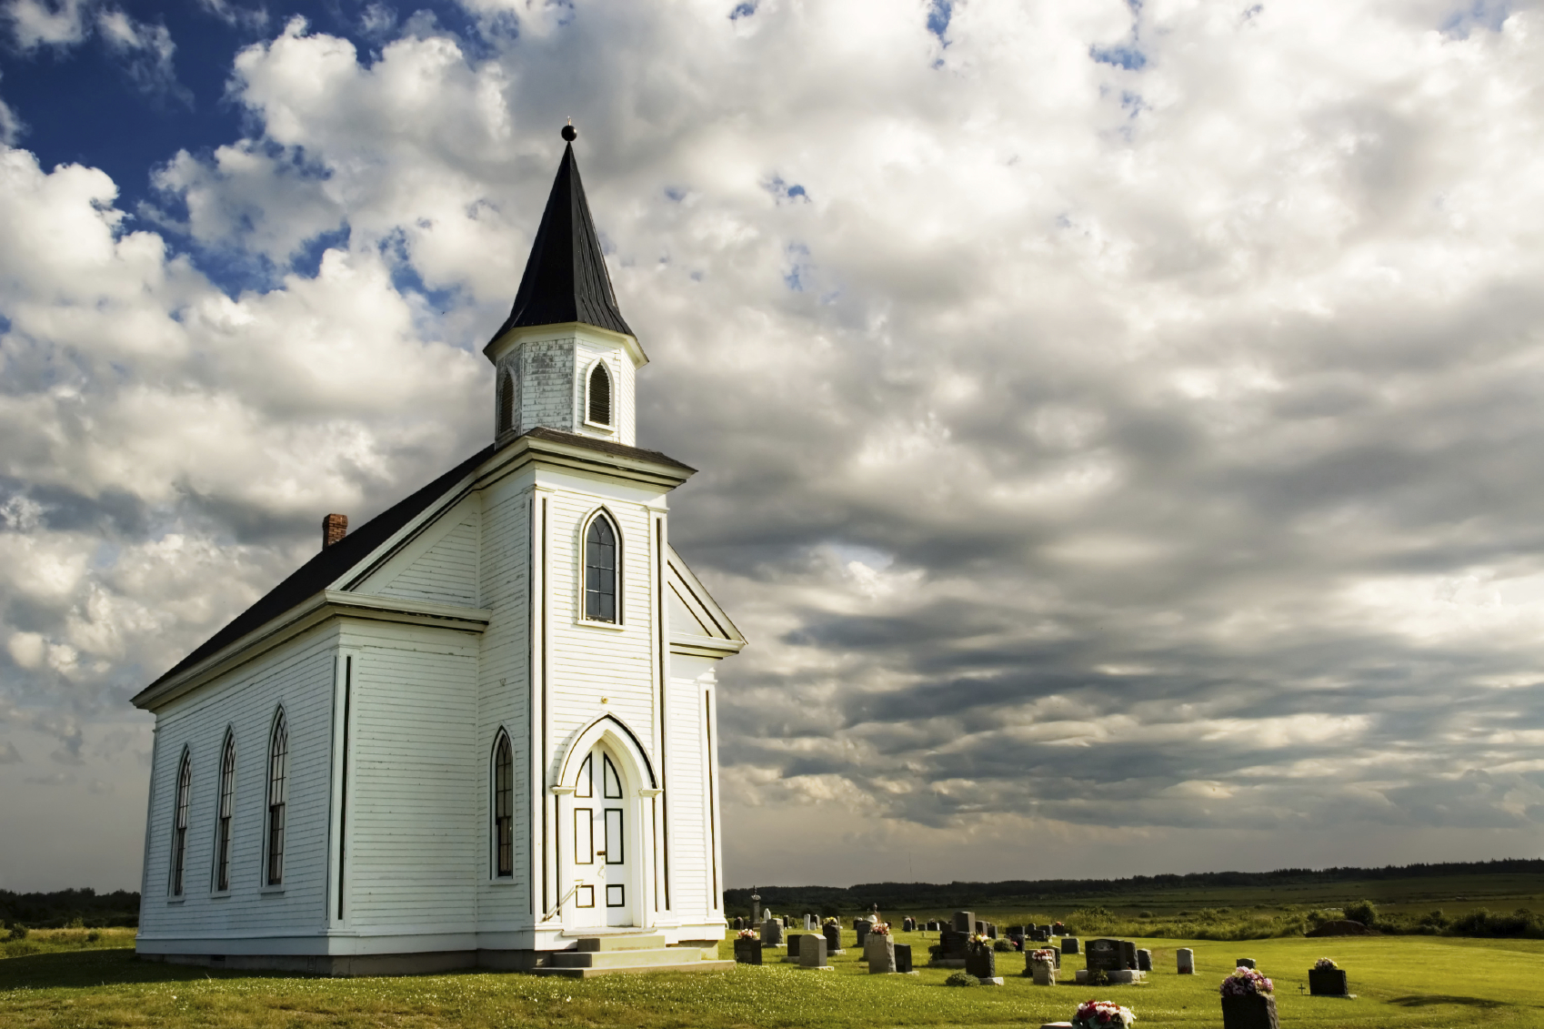
Christianity and Culture
What is the relationship between the church (universal) and culture?
How should the church (local) interact with and regard culture?
To what extent does the original culture of Christianity determine our practice of it today?

