Slide 1
Exodus 2:1-10
Moses. The seed?
By Stephen Curto
For Homegroup
June 10, 2018

Slide 2
Outline
Context (Gen 1-Ex 1:22)
v1-2 : Setting the Stage
v3-4: Actions of the Family
v5-6: Actions of Pharaoh's Daughter
v7-10: Moses’s Mothers Mothering
Application

Slide 3
Context (Gen 1-Ex 1:22)
Creation, Noah, Abraham-Jacob, Joseph, Family> Egypt
Ex 1:
v11 “They appointed task masters over them to afflict them with slavery”
v12 “the more they afflicted them, the more they multiplied…”
Midwives who lie to Pharaoh to save Hebrew babies

Slide 4
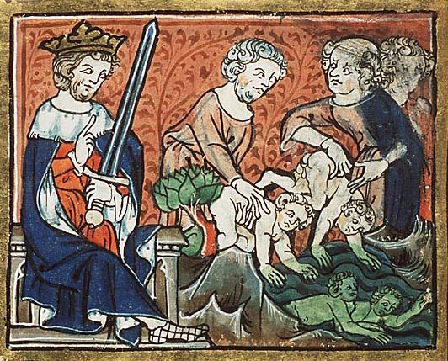
Context (Gen 1-Ex 1:22)
from the Golden Haggadah, Catalonia, early 14th century
Ex 1:
v22 “The Pharaoh commanded all his people saying, “every son who is born you are to throw into the Nile, and every daughter you are to keep alive.”

Slide 5
v1-2 : Setting the Stage
“a man from the house of Levi, married a daughter of Levi” (v1)
cf. Gen 49:5-8
”Swords are implements of violence”
“Let my glory not be united with their assembly”
“I will disperse them in Jacob, and scatter them in Israel”
What are we expecting from Levi?

Slide 6
v1-2 : Setting the Stage
“The woman conceived and bore a son” (v2)
cf. Gen 3:16, 4:1, 17; 16:4; 19:36; 21:2; 25:21; ch. 29-30; 38:3, 4, 18, 49:26
What are we tracking in this story?
“When she saw that he was tov” (v2)
cf. Gen 1
What is the reader thinking about this baby so far?

Slide 7
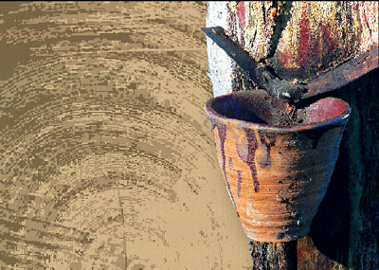
v3-4: Actions of the Family
“She grabbed a wicker ark and covered it over with tar and pitch” (v3)
cf. Gen 6
“She put the child into it and set it in the reeds on the bank of the Nile.” (v3)
cf. Ex 1:22
”His sister stood, away, to know what would be done to him.” (v4)

Slide 8
v5-6: Actions of Pharaoh's Daughter
“The daughter of Pharaoh came down to bathe… saw the basket among the reeds and sent her maid and she brought it” (v5)
Did the basket move?
“she had compassion on him and said, “This is one of the Hebrews’ children.” (v6)

Slide 9
v7-10: Moses’s Mothers Mothering
“Shall I go and call a woman giving suck for you from the Hebrew women that she may suckle the child for you?” (v7)
“So the girl went and called the child’s mother.”(v8)
“So the woman took the child and nursed him.”(v9)

Slide 10
v7-10: Moses’s Mothers Mothering
“And she brough him to Pharaoh’s daughter and he became her son, and she named him Moshe “because from the water I masha-ed him.”
What is the significance of Pharaoh’s daughter’s naming of Moses?
Trace the basic salvation arch through this vignette.

Slide 11
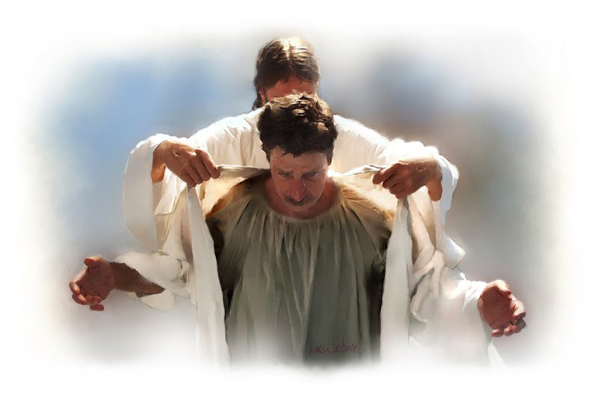
Application
Why is this little story here?
How does it connect what came before, with what comes after?
Are there any gospel truths apparent here?

