Slide 1
Acts 27:13-44
Paul Shipwrecked
By Stephen Curto
For Homegroup
July 8, 2018

Slide 2
Outline
Context (Gen 1-Acts 27:12)
The Storm (v13-20)
Paul’s First Speech (v21-26)
Night Fourteen (v27-32)
Breaking Bread (v33-36)
Abandoning Ship (37-44)
Contribution to Story/Application

Slide 3
Context (Gen 1-Acts 27:12)
Creation, Noah, Abraham-Jacob, Joseph, Family> Egypt, Exodus, Law, Golden Calf, 12 Spies, 40 Years Wandering, Moses Dies, Joshua and his conquest, Period of the Judges, Saul, David, Solomon, Divided Kingdom, 722 North Destruction, 586 South Exile, 400’s 3 returns, Messiah Comes, Israel Rejects Messiah/Crucifixion, Gospel goes to Jews, Paul Converted, Gospel goes to Gentiles, Paul’s Missionary Journeys, Paul arrested and set to Rome

Slide 4
Context (Gen 1-Acts 27:12)
Acts 15-27
15: Jerusalem Council, Beginning 2nd Missionary Journey
16: Crossing to Europe (Macedonia), Imprisoned in Phillipi
17: Chased out of Thessolonica to Berea, Then Athens/Mars Hill
18: Long Stay in Corinth, Beginning of 3rd Missionary Journey
19: Paul’s long time in Ephesus and Correcting Apollos Convert, Riot in the Theater at Ephesus
20: Paul’s Final Goodbye Tour, Eutychus’s Fall
21: Paul to Jerusalem, arrested at Temple

Slide 5
Context (Gen 1-Acts 27:12)
Acts 15-27
22: Defense Before on the Temple Mount to the Crowd
23: Defense Before the Sanhedrin, Jews Resolve to Kill Him, Moved to Caesarea
24: Defense Before Felix
25: Defense Before Festus
26: Defense Before Agrippa
27: Sent to Rome

Slide 6
The Storm (v13-20)

Slide 7
The Storm (v13-20)
“…they weighed anchor and were sailing along Crete” (v13)
“… let ourselves be driven along [...] scarecely able to get the skiff under control” (V16)
“…used supporting cables in undergirding the ship” (v17)
“... lowered the sea anchor and let themselves be driven along thusly” (v17)
Day 2: jettisoned cargo (v18) Day 3: jettisoned all equipment (v19)
“all hope of being saved was gradually abandoned” (v20)

Slide 8
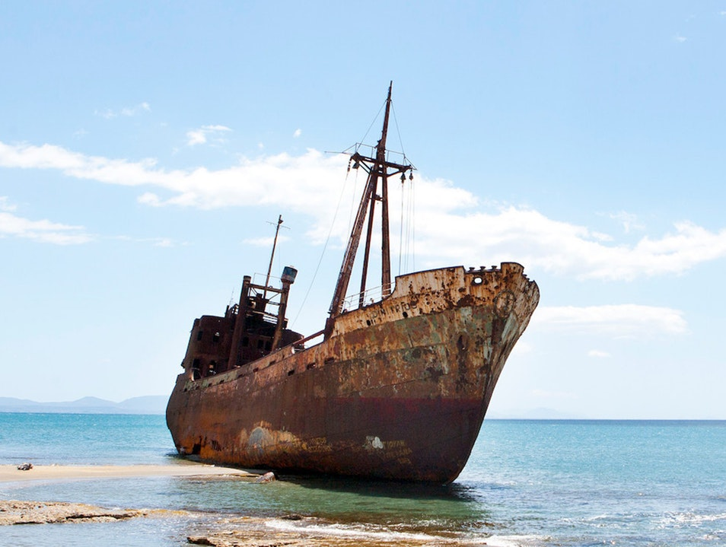
Paul’s First Speech (v21-26)
“you ought to have followed my advice not to have set sail from Crete” (v21)
cf. 27:9-11
“there will be no loss of life among you, but of the ship” (v22)
How does he know this? (cf. v23-24)
“for I believe in God, that it will happen exactly as I have been told.” (v26)

Slide 9
Night Fourteen (v27-32)
Night 14: begin to see signs of land (v27-28)
“fearing that we might run aground on rocks, they cast four anchors from the stern” (v29)
“sailors were trying to escape… on the pretense of laying out anchors from the bow” (v30)
What do their actions display about their beliefs?
“Paul said, ‘Unless these men remain in the ship, you yourselves cannot be saved’” (v32)
What do the men do after this instruction? Why?

Slide 10
Breaking Bread (v33-36)
“take some food, this is for your salvation, for not a hair from your head will perish” (v34)
“He took bread and gave thanks to God...” (v35)
What does this little scene sound like?
“All of them were encouraged” (v36)

Slide 11
Abandoning Ship (37-44)
“they observed a bay with a beach, and resolved to drive the ship onto it…” (v39)
“but striking a reef where two seas met, they ran the vessel aground” (v41)
“the stern was being broken up with the force” (v41)
“The soldiers’ plan was to kill the prisoners” (v42)

Slide 12
Abandoning Ship (37-44)
“but the centurion… kept them from their intention” (v43)
Why does the centurion do this?
“and so it happened that they all were brought safely to land.” (v44)

Slide 13
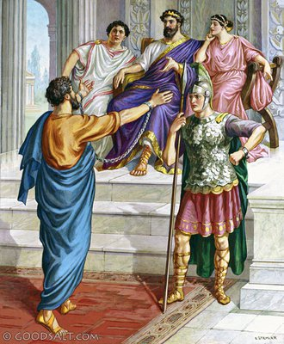
Contribution to Story/Application
How does this event contribute to the story? (What is the story about at this point in time? What are we looking forward to?)
What does this tell us about God?

