Slide 1
Matthew 3:13-17
Baptism of Jesus
By Stephen Curto
For Homegroup
July 15, 2018

Slide 2
Outline
Context (Gen 1-Matt 3:12)
Jesus Arrives (v13)
John’s Rebuttal (v14)
Jesus’s Rebuttal (v15)
The Trinity’s Confirmation (v16-17)
Application/Contribution to the Story

Slide 3
Context (Gen 1-Matt 3:12)
Creation, Noah, Abraham-Jacob, Joseph, Family> Egypt, Exodus, Law, Golden Calf, 12 Spies, 40 Years Wandering, Moses Dies, Joshua and his conquest, Period of the Judges, Saul, David, Solomon, Divided Kingdom, 722 North Destruction, 586 South Exile, 400’s 3 returns, Messiah is Presented to Israel with various signs: Matt 1-Geneaology, prophets Isaiah, Matt 2 – prophets Micah, Hosea, Jeremiah, Matt 3 – Elijah, the voice in the wilderness

Slide 4
Context (Gen 1-Matt 3:12)
John the Baptist in Matthew
What is his summarized message? (v2)
What is Isaiah’s description of him? (v3)
What is his message to the Pharisees and Sadducees? (v7-10)
What is his view of Jesus? (v11-12)
“St. John the Baptist” by Leonardo Da Vinci, 1516

Slide 5
Jesus Arrives (v13)
“Then Jesus arrived from Galilee on toward John to be baptized by him” (v13)
What has Jesus done so far in this book? What do we know about him?
Why did Jesus come?
What does ”Baptize” mean?
From baptein meaning “to dip, soak, dye in color”
What is John’s Baptism for? (cf. v5-6, 11)
Have we seen baptism before in the story?

Slide 6
John’s Rebuttal (v14)
But John hindered him saying, “I need to be baptized by you, and you come to me?” (v14)
Why does John think he needs to be baptized by Jesus?
What problem does he see with Jesus being baptized by him?
”The Baptism of Christ” by Bartolomé Esteban Murillo, 1655

Slide 7
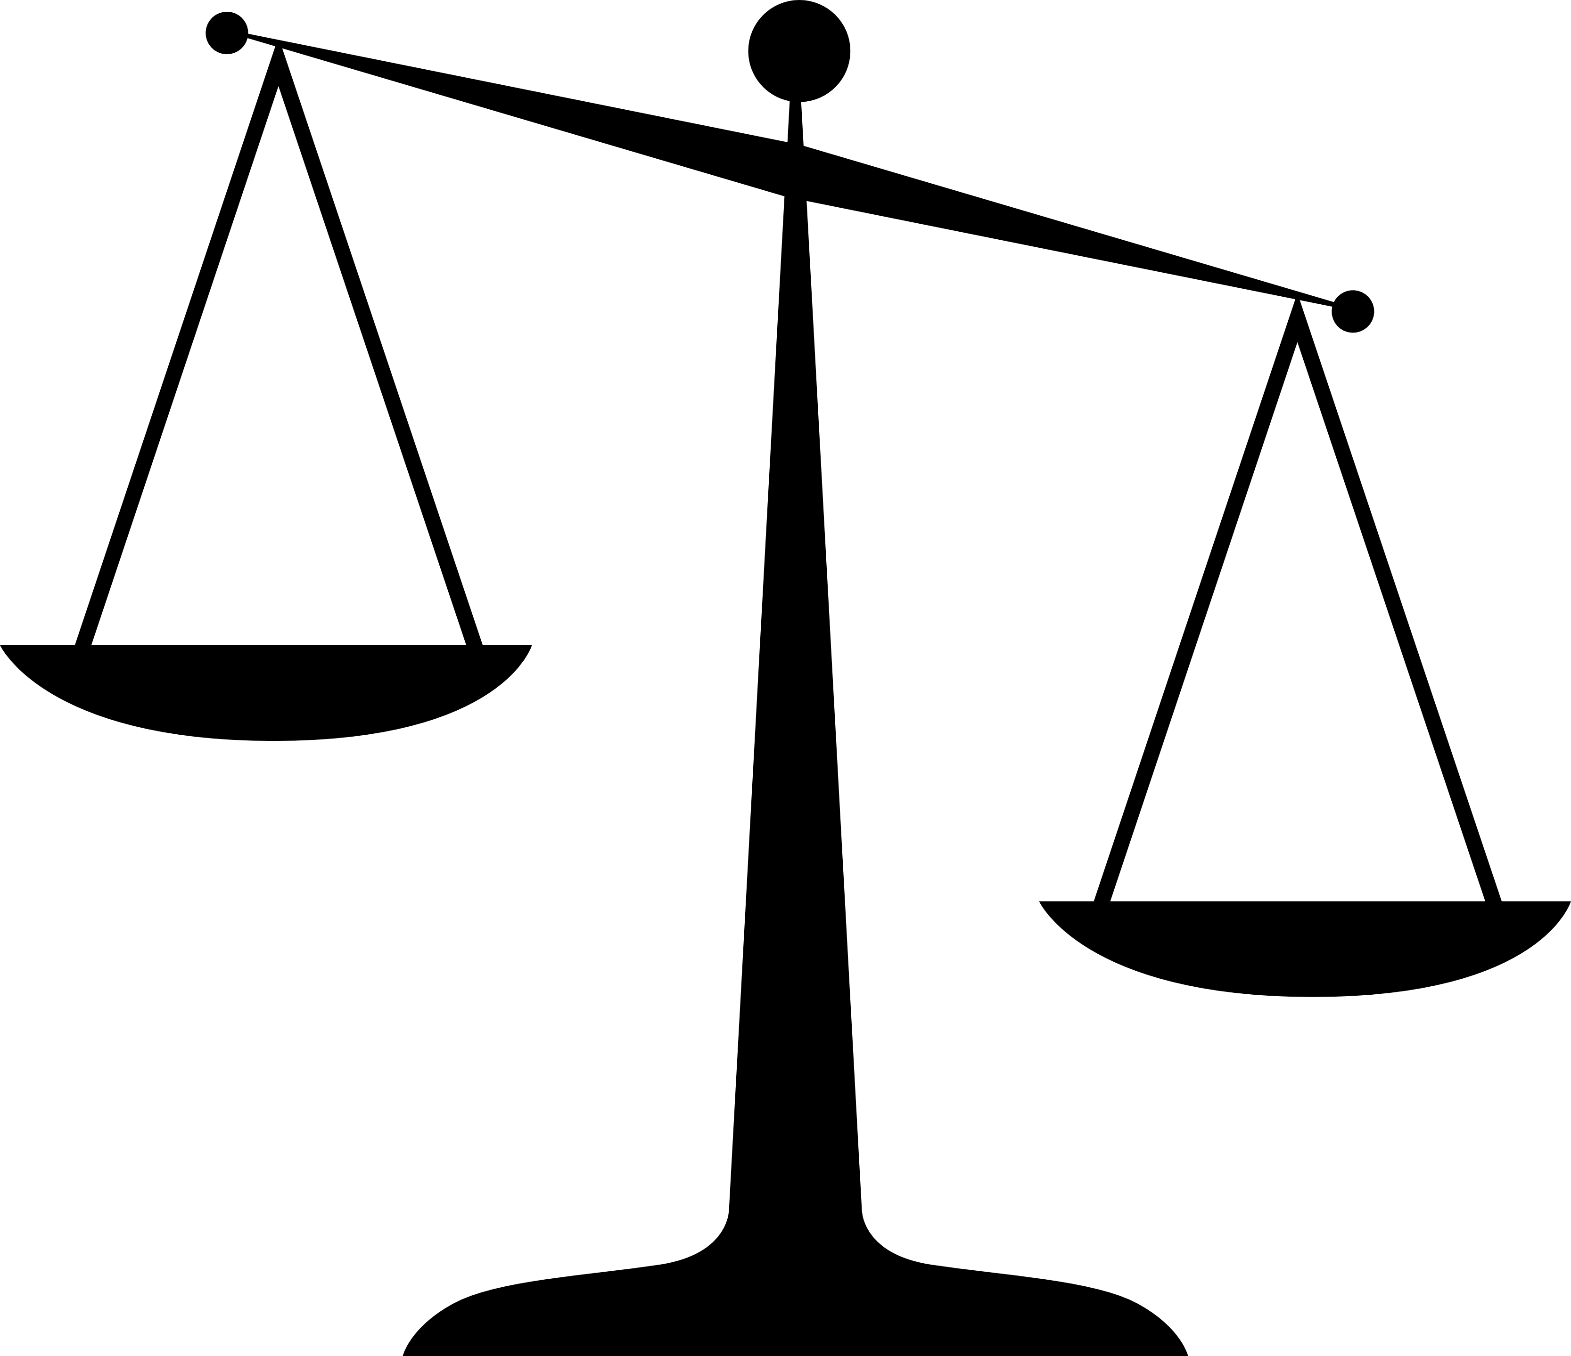
Jesus’s Rebuttal (v15)
“But Jesus answered and said to him, ‘Permit it now, for this is fitting for us to fulfill all righteousness.’ then he permitted him.” (v15)
define and discuss “fitting” and “fulfill all righteousness”

Slide 8
The Trinity’s Confirmation (v16-17)
“And Jesus, being baptized, immediately came up from the water. And, behold, the heavens were opened to him, and he saw the spirit of God coming down as like a dove and coming on him.” (v16)
What exactly did Jesus see?
what literal reality is the simile “as/like a dove” describing?
cf. Num 11:25; 24:2; Judges 3:10; 6:34; 11:29; 14:6, 9, 19; 1 Sam 10:10; 11:6; 16:13; 18:10; 19:20; 1 Chron 12:18; 15:1; 2 Chron 20:14; 24:20; Acts 2:4; 10:45; 19:6

Slide 9
The Trinity’s Confirmation (v16-17)
“And behold, a voice from the heavens was saying, ‘This is my son, the beloved, in whom I think well.’” (v17)
what does it mean to be “the beloved” or “the beloved son”?
“The Baptism of Christ II” by Daniel Bonnell, 2013

Slide 10
Application/Contribution to the Story
How does this move the story along?
What is Matthew doing at this point in the story?
Where is this headed in Matthew?
What is the point for us, as we read this part of the story?

