Slide 1
Dispensationalism
By Stephen Curto
For Homegroup
August 12, 2018

Slide 2
Outline
Definition
Characterizations
General Beliefs
Opposing Views

Slide 3
Definition
It is a system of interpreting the bible that holds to three basic tenets:
Consistent application of a plain, normal, literal, grammatical-historical hermeneutic,
Because of this hermeneutic we discover that the Church is distinct from Israel…
And we discover that the overall purpose of God is doxological (to glorify himself).

Slide 4
Definition
Consistent – follow these rules for the whole bible, not just parts
Plain – the most obvious intent of the author
normal – The usual physical meaning of words, not the spiritual

Slide 5
Definition
literal – The literal meaning of words and phrases, not the allegorical meaning (accounting for figures of speech) according to the author’s intended meaning
grammatical-historical – take into account what the the word meant in the historical context of the author
Hermeneutic – method of interpretation

Slide 6
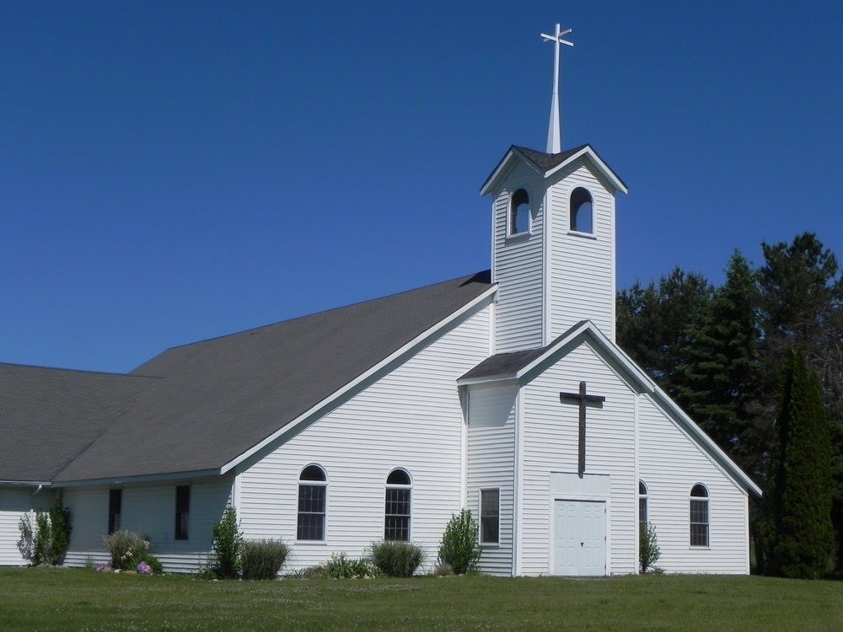
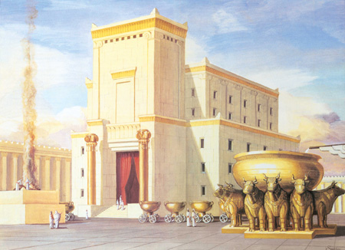
Definition
The Church is distinct from Israel
Israel has a separate future
The church is temporary
The promises made to Israel will be fulfilled in Israel, literally.
Doxological Purpose of God
God’s overarching purpose is His own glory
The redemption of humanity is one of the means to an end (the end = God’s glory)

Slide 7
Definition
The Church is distinct from Israel
Israel has a separate future
The church is temporary
The promises made to Israel will be fulfilled in Israel, literally.
Doxological Purpose of God
God’s overarching purpose is His own glory
The redemption of humanity is one of the means to an end (the end = God’s glory)

Slide 8
Definition
The Word “Dispensation”
English - dispensation
Latin – dispensatio
Greek – oikonomia
from “oikos”= House “nomos”=law
A compound word that means “to divide, administer, or manage the affairs of a house.”
Often translated “stewardship” “dispensation” “administration” or “job”
20 times in the New Testament
Twice in the exact dispensational sense.

Slide 9
Definition
Eph 1:9-10
Eph 3:2-3

Slide 10
The 7 Dispensations

Slide 11
Characterizations
End Times Nuts
Dogmatic and Dis-unifying
Science Deniers

Slide 12
Characterizations
End Times Nuts
Dogmatic and Dis-unifying
Science Deniers

Slide 13
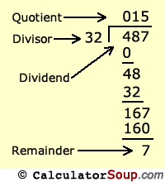
Characterizations
End Times Nuts
Dogmatic and Dis-unifying
Science Deniers

Slide 14
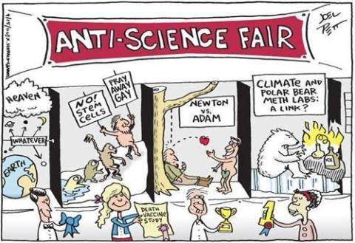
Characterizations
End Times Nuts
Dogmatic and Dis-unifying
Science Deniers

Slide 15
General Beliefs - Salvation
In every Dispensation:
the basis of salvation is the death of Christ, a free gift from God.
the requirement for salvation is faith.
the object of the faith is God.
What Changes between Dispensations:
The content of the faith.

Slide 16
General Beliefs - Salvation
In other Words:
Every person who ever lived on earth is responsible for responding to the revelation available to them with an equitable faith in the true triune God, who does the entire work of saving.

Slide 17
General Beliefs – End Times
Dispensationalists are:
Always Premillennial
Usually Pre-Tribulational
Usually 7yr Tribulational
Never Postmillennial

Slide 18
General Beliefs – The Church
Dispensationalists say the church…
began at Pentecost and will end at the rapture (or 2nd coming)
is not in the Old Testament
is not Israel
‘s job is to fulfill the great commission (Matt 28)

Slide 19
Opposing Views - Covenant Theology
Two Covenant View
Covenant of Works (creation to Fall)
Covenant of Grace (Fall to GWTJ)
Three Covenant View
Covenant of Redemption (Eternity past to Creation/GWTJ)
Works (Creation to Fall)
Grace (Fall to GWTJ)

Slide 20
Opposing Views - Covenant Theology
On Hermeneutics
Allow “Spiritual” Interpretation
Read NT into OT
On the Church
The Church has replaced Israel (Replacement Theology)
The Church is Israel (Remnant Theology)
On the Purpose of God
Christological (Christ’s work is the overall purpose)

Slide 21
Opposing Views - Covenant Theology
Criticisms:
The two (or three covenants) aren’t in the Bible (Theologically implicit)
Misunderstanding of Abrahamic Covenant promises and fulfillment
Usually Post or Amillennial
Not consistent in their hermeneutic

