Slide 1
Apologetics Introduction
Worldviews, Truth, Why We Do Apologetics, and Presuppositionalism vs Evidentialism
By Stephen Curto
For Homegroup
September 30, 2018

Slide 2
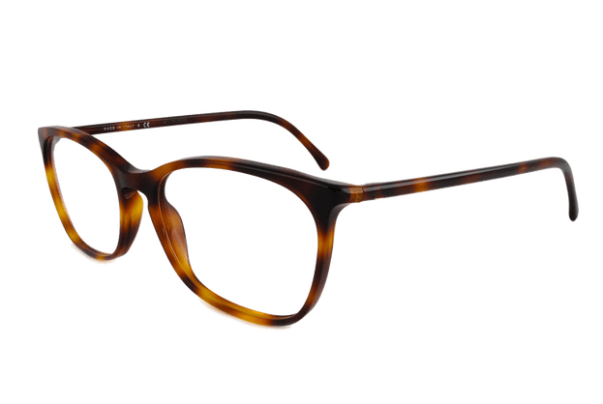
Worldviews
What is a worldview?
“A worldview is simply the total of our beliefs about the world, the ‘big picture’ that directs our daily decisions and actions.”-Chuck Colson & Nancy Pearcey, How Now Shall We Live?
“A habituated way of seeing and doing.” -Paul Shockley
core beliefs that determine how we live
Who has a worldview?
What are the components of any worldview?

Slide 3
Worldviews
What is a worldview?
Who has a worldview?
Everyone. No exceptions.
What are the components of any worldview?

Slide 4
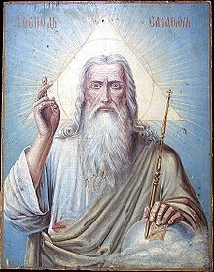
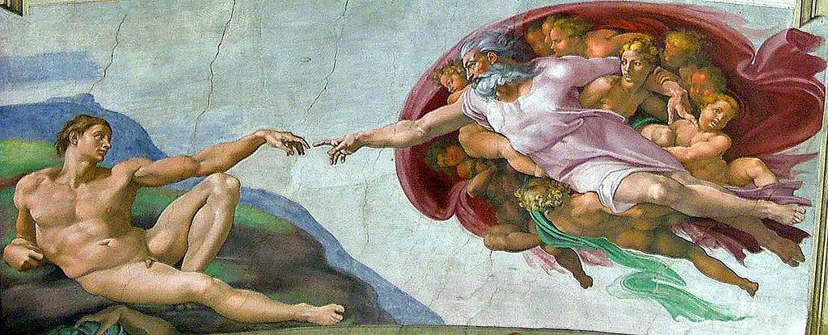
Worldviews
What is a worldview?
Who has a worldview?
What are the components of any worldview?
View of God, Truth, Reality, Knowledge, Ethics, Humanity, Evil

Slide 5
Truth
Truth is objective, not subjective.
(aka. Truth is absolute, not relative.)
Truth is knowable, not unknowable.
Truth can be stated in rational propositions.
Truth can be discovered by investigation.
Truth can be divinely revealed.

Slide 6
Why We Do Apologetics
Commands:
1 Peter 3:15-16
1 John 4:1
Examples:
Matt 22:29 (Jesus correcting error)
Matt 15:6-9 (Jesus Refuting false teaching)
Acts 17:16-17 (Paul reasons with them)
Titus 1:9 (Paul refuted opposition to truth)
Phil 1:7 (Paul defended the gospel)

Slide 7
Why We Do Apologetics
To preach the gospel
To remove false obstacles
To defend Christian doctrine
To have fun

Slide 8
Presuppositionalism vs Evidentialism
Presuppositionalism
examples of a presupposition:
When did you buy the book?
You bought a book.
Julie’s cat is cute.
Julie has a cat.
You are late again.
You’ve been late before.
In the beginning God created the heavens and the earth.
God existed in the beginning.

Slide 9
Presuppositionalism vs Evidentialism
Presuppositionalism
“A neutral ground, criteria or standard that both believer and unbeliever can accept without compromising their system [does not exist].” - John Frame
“For the Christian, all standards of rationality, truth, knowledge, and reality, are based on the nature and character of the God in whom they believe, therefore they share no ground with the unbeliever who accepts no God to establish such standards.” – Stephen Curto
Switzerland Does Not Exist.

Slide 10
Presuppositionalism vs Evidentialism
Presuppositionalism
the truth of Christianity can only be learned through divine revelation,
therefore the central and ultimate criterion for truth and defense of Christianity is the word of God
All men know the truth of God and suppress it in unrighteousness,
therefore it is incorrect to assume that even the “atheist” is fully committed to his claims (Rom 1)

Slide 11
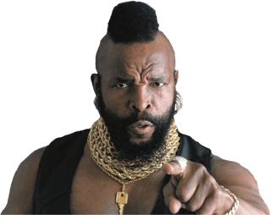
Presuppositionalism vs Evidentialism
Presuppositionalism
Jude 3
1 Corinthians 1:18-25
Leading Presuppositional Apologists:
Cornelius Van Til, John Frame, Vern Poythress, James White, Abraham Kuyper

Slide 12
Presuppositionalism vs Evidentialism
Evidentialism (or Classical/Traditional Apologetics)
in arguing for any truth claim the Christian should argue in an unbiased, neutral, way that makes no religious assumptions
The criteria used for arguing must be those which the unbeliever accepts (logic, facts, experience, reason)
The Bible is not used as evidence until after it has been “proved” reliable

Slide 13
Presuppositionalism vs Evidentialism
Evidentialism (or Classical/Traditional Apologetics)
Leading Classical Apologists
Justin Martyr, Thomas Aquinas, St. Augustine, Norman Geisler, William Lane Craig, C. S. Lewis

