Slide 1
The Reliability of the Bible
The Story, Internal Evidence, External Evidence
By Stephen Curto
For Homegroup
October 7, 2018

Slide 2
4:21-7:37 Andy Stanley “Who Needs God Part 3”
https://www.youtube.com/watch?v=I_ArfwxAXpo

Slide 3
The Story: BIbliology
”The Bible is a story about God and how he governs/interacts with man. It is making one major argument throughout: God is good and created humans good, but they became sinful/selfish and incurred on themselves the punishment of death. They cannot save themselves from that punishment. This story details God and God’s way of resolving that problem, namely, sending his son to pay the penalty of death, and bestow eternal life on those who have faith in Him to do so.” – Stephen Curto
(2 Tim 3:15; Romans 15:4)

Slide 4
The Story: BIbliology
Facts about this story:
It contains many genres
It spans all of human history
It claims to be true

Slide 5
The Story: BIbliology
Facts about this story:
It contains many genres
It spans all of human history
It claims to be true
narrative
poetry
proverb
song
census data
genealogical record
legal documents
letters

Slide 6
The Story: BIbliology
Facts about this story:
It contains many genres
It spans all of human history
the full story (from conflict
to resolution) has not been
witnessed by any single human.
The current time in human history occurs in the midst of the story. i.e. We’re currently in it!
It claims to be true

Slide 7
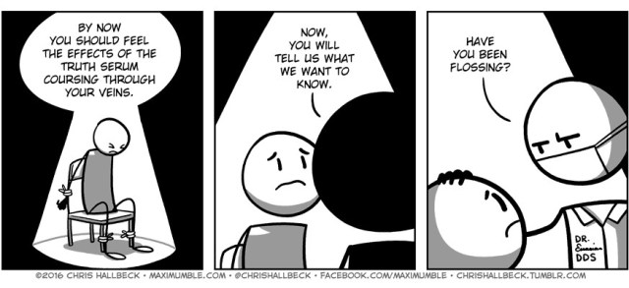
The Story: BIbliology
Facts about this story:
It contains many genres
It spans all of human history
It claims to be true
Philosophically?
Morally
Historically?
Scientifically?
In what sense?

Slide 8
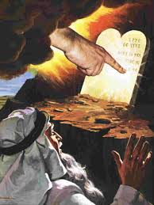
Internal Evidence
Scriptures:
2 Timothy 3:13-17 (Purpose and ability of Scripture)
Ex 31:18; 2 Peter 1:19-21 (Source of Scripture)
John 10:34-35 (Enduring Authority of Scripture)
2 Peter 3:15-16 (New Testament Authority as Scripture)
John 5:37-47; Luke 24:13-27 (The Testimony of Scripture)

Slide 9
Internal Evidence
Fulfillment of Bible Prophecy
27% of Scripture is Prophetic
OT: 6,641 predictive verses (28.6%)
NT: 1,711 predictive verses (21.6%)
The chance of Jesus randomly fulfilling only 48 of the prophecies made about him is 1 in 10^157
60 are clearly already fulfilled
*see chart on Fulfilled Prophecies

Slide 10
External Evidence
The main external argument comes from recognizing the cumulative uniqueness of the Bible as compared to other books.
When this is recognized, the divine act in producing such a work is more “believable.”

Slide 11
External Evidence
Unique in Continuity
Unique in Circulation
Unique in Translation
Unique in Survival

Slide 12
External Evidence
Unique in Continuity
Written over 1,500 years
Written by more than 40 authors
Written in Different places
Written on 3 continents
Written in 3 languages
Written in a wide variety of styles
Unique in Circulation
Unique in Translation
Unique in Survival

Slide 13
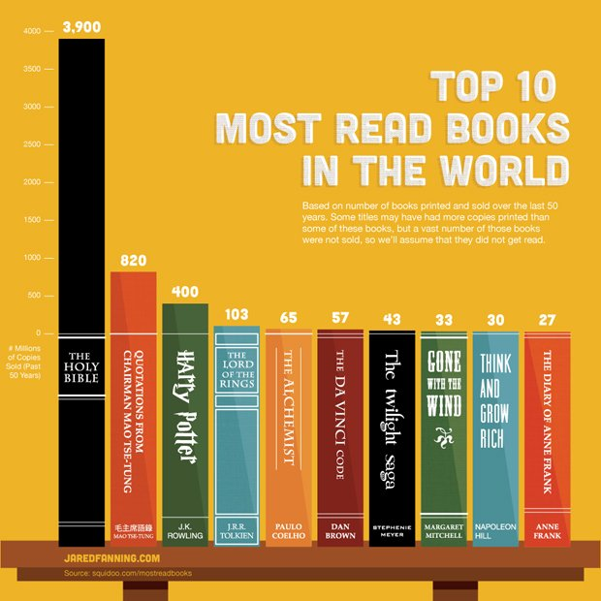
External Evidence
Unique in Continuity
Unique in Circulation
Worldwide #1 book sold
In 1998 585 million were
distributed by the United
Bible Societies alone
Unique in Translation
Unique in Survival

Slide 14
External Evidence
Unique in Continuity
Unique in Circulation
Unique in Translation
Translated into 2,200 languages
Wycliffe has 6,000 people working in 850 different languages
Unique in Survival

Slide 15
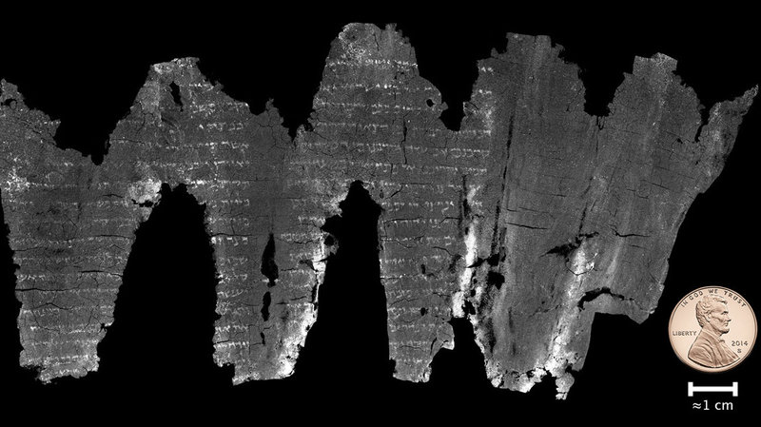
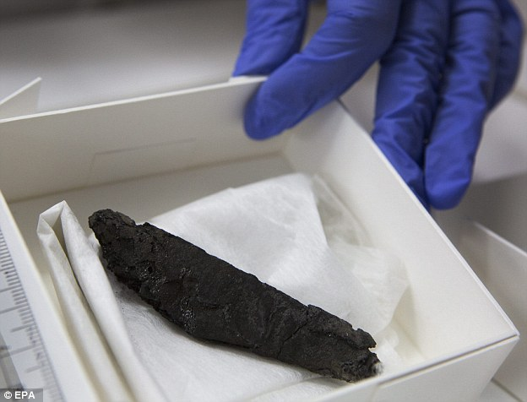
External Evidence
Unique in Continuity
Unique in Circulation
Unique in Translation
Unique in Survival
Old Testament Preservation of Text
3rd Century En-Gedi Scroll
4th Century B.C. Dead Sea Scrolls
New Testament Manuscript Evidence

Slide 18
Common Criticisms
The Bible is full of miracles.
The Bible isn’t historically accurate.
The Bible has little to no archaeological support.
You can’t use the Bible to prove the Bible; that’s circular reasoning.

