Slide 1
The Existence of God
Part 1: The Four Major Arguments
By Stephen Curto
For Homegroup
October 28, 2018

Slide 2
The Goal of Any Theistic Argument
To remove objections to the existence of the God of the Bible.
Remove Objections, not “Prove”
The God of the Bible, not just any supernatural being.
Personal
All-knowing
All-powerful
Unchanging
Self-existent
Etc.

Slide 3
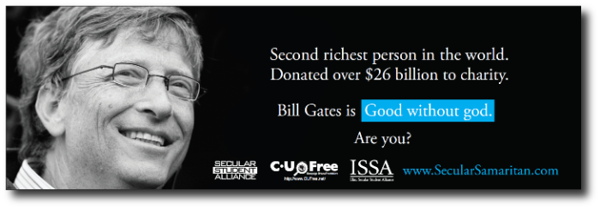
The Moral Law Argument
The presence of a moral law suggests a moral law-giver.
Defining by Negation
Not about whether someone can behave morally without believing in God.
Not about whether moral behavior can be defined without reference to God.
Primary Text: Romans 1-2

Slide 4
The Moral Law Argument
The presence of a moral law suggests a moral law-giver.
“If obligations arise from personal relationships, then absolute obligations must arise from our relationship with an absolute person.” - John Frame, Apologetics
“The Law of Human Nature, or of Right and Wrong, must be something above and beyond the actual facts of human behaviour. In this case, besides the actual facts, you have something else a real law which we did not invent and which we know we ought to obey.” - C.S. Lewis, Mere Christianity

Slide 5
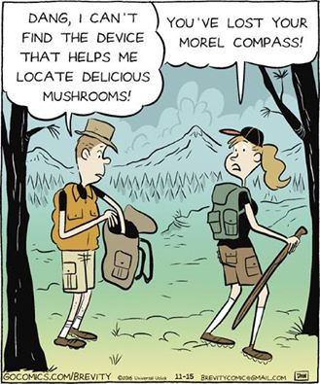
The Moral Law Argument
The presence of a moral law suggests a moral law-giver.
“If obligations arise from personal relationships, then absolute obligations must arise from our relationship with an absolute person.” - John Frame, Apologetics
“The Law of Human Nature, or of Right and Wrong, must be something above and beyond the actual facts of human behaviour. In this case, besides the actual facts, you have something else a real law which we did not invent and which we know we ought to obey.” - C.S. Lewis, Mere Christianity

Slide 6
The Moral Law Argument
Dealing with the Culture:
“Morality is not objective, it’s relative.”
“There doesn’t have to be anything above or beyond the moral laws themselves.”

Slide 7
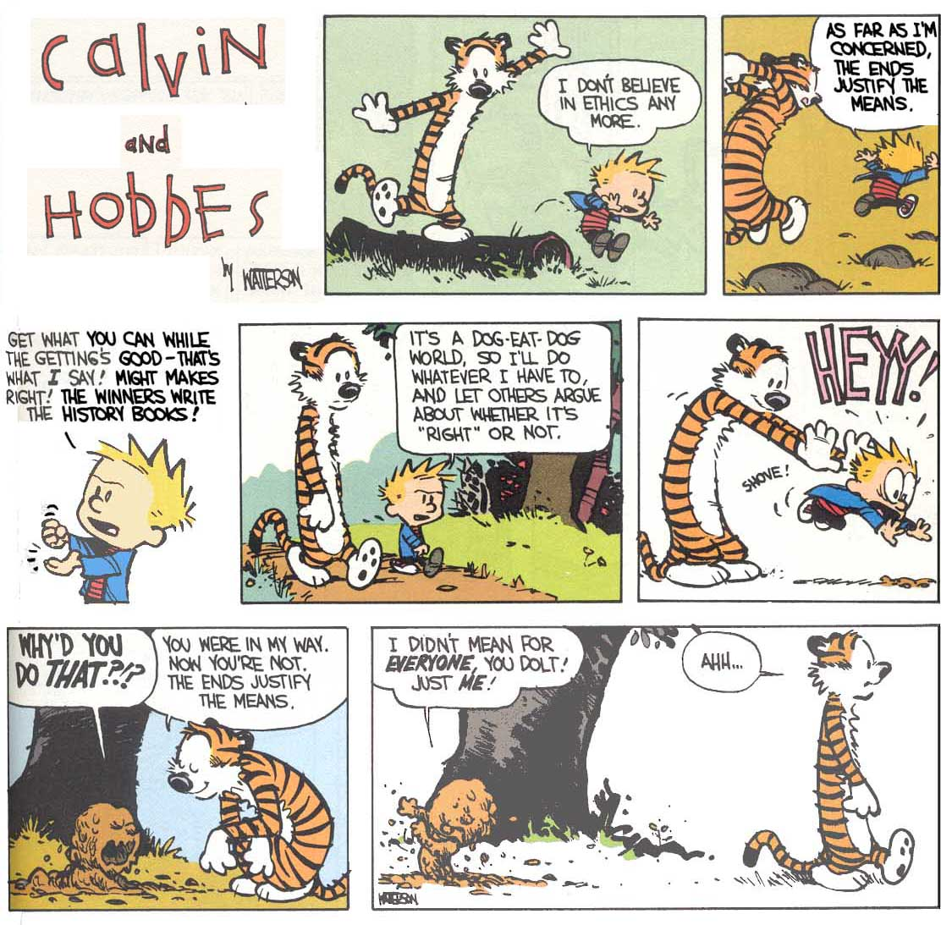
The Moral Law Argument
Dealing with the Culture:
“Morality is not objective, it’s relative.”
Rape, Incest, Murder
If morality is relative to cultures, then which culture decides what is moral?
If morality is relative to individuals, punch them in the face and walk away.
“There doesn’t have to be anything above or beyond the moral laws themselves.”

Slide 8
The Moral Law Argument
Dealing with the Culture:
“Morality is not objective, it’s relative.”
Rape, Incest, Murder
If morality is relative to cultures, then which culture decides what is moral?
If morality is relative to individuals, punch them in the face and walk away.
“There doesn’t have to be anything above or beyond the moral laws themselves.”

Slide 9
The Moral Law Argument
Dealing with the Culture:
“Morality is not objective, it’s relative.”
“There doesn’t have to be anything above or beyond the moral laws themselves.”
The moral laws themselves are invisible, eternally existent, define good, bad, and justice, and hold man accountable to his relationships. These are all descriptions of the God of the Bible.

Slide 10
The Teleological Argument
The presence of design in the universe suggests a designer.
Telos = purpose, completeness, end
Aka. “Fine Tuning Argument” or “Watchmaker Analogy”
Important note: designed but fallen
Primary Text: Psalm 8:3-4

Slide 11
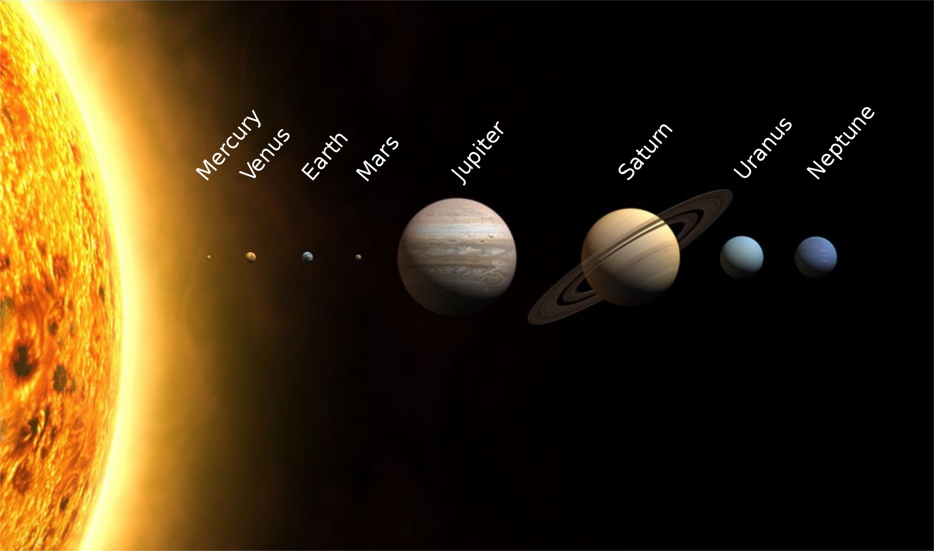
The Teleological Argument
The presence of design in the universe suggests a designer.
Examples of Design/Purpose:
Solar system
DNA
Photosynthesis
Biology
Laws of Logic

Slide 16
The Teleological Argument
Dealing with the Culture:
“This place is pretty poorly designed!”
The problem of evil will be dealt with in future lesson.
The curse/fall explain the inefficiencies/death/decay.
Just because we don’t know a thing’s purpose, does not mean it has no purpose. E.g. appendix.

Slide 17
The Cosmological Argument
All effects have a cause, the universe’s cause is God.
kosmos = world
Aka. “Unmoved Mover” “Uncaused Cause” “Necessary Being”
Thomas Aquinas, Summa Theologica “Infinite Regress”
The universe is finite, time-bound, space-bound, changing, material, therefore its cause must be independent of those constraints. (infinite, timeless, spaceless… etc.)

Slide 18
The Cosmological Argument
All effects have a cause, the universe’s cause is God.
Stack of books analogy (contingency)
Dominos analogy
Primary Text: Genesis 1:1

Slide 19
The Cosmological Argument
Dealing with the Culture:
“Your argument is self-defeating. If all things must be caused, then what or who caused God?”
“God is not necessary, the big bang explains the first cause.”

Slide 20
The Cosmological Argument
Dealing with the Culture:
“Your argument is self-defeating. If all things must be caused, then what or who caused God?”
This misunderstands the definition of God.
“God is not necessary, the big bang explains the first cause.”

Slide 21
The Cosmological Argument
Dealing with the Culture:
“Your argument is self-defeating. If all things must be caused, then what or who caused God?”
“God is not necessary, the big bang explains the first cause.”
The big bang, stated in its simple and absurd form, is “Nothing existed, which exploded.” For the big bang to have the same explanatory power as the Cosmological Argument, it must explain how something came from nothing.

Slide 22
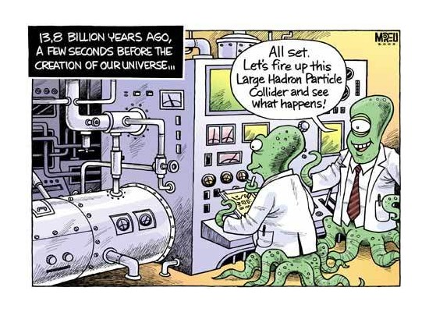
The Cosmological Argument
Dealing with the Culture:
“Your argument is self-defeating. If all things must be caused, then what or who caused God?”
“God is not necessary, the big bang explains the first cause.”
The big bang, stated in its simple and absurd form, is “Nothing existed, which exploded.” For the big bang to have the same explanatory power as the Cosmological Argument, it must explain how something came from nothing.

Slide 23
The Ontological Argument
The idea of a perfect being suggests the existence of a perfect being.
God is understood as the greatest conceivable being, by even the fool.
A thing exists either in (a) the understanding only or (b) in both the understanding and reality. (e.g. painter and his painting)
It is “greater” to exist in reality than to exist merely in understanding.
If God exists merely in understanding, then God is not the greatest possible being, since a being that existed in reality would be greater.
But God is by definition the greatest possible being.
Therefore, God exists not merely in understanding, but in reality as well.

Slide 24
The Ontological Argument
The idea of a perfect being suggests the existence of a perfect being.
God has all perfections.
Necessary existence is a perfection.
Therefore God exists necessarily.

Slide 25
The Ontological Argument
The idea of a perfect being suggests the existence of a perfect being.
ὤν on = “being”
Anselm Proslogium puzzling over “the fool”
The most frustrating and fascinating of the arguments.
Primary Text: Psalm 14:1, Romans 1:13ff

Slide 26
The Ontological Argument
Dealing with the Culture:
“I have an idea of the flying spaghetti monster.”
The flying spaghetti monster (and other non-Gods) are not perfect in their being. E.g. Roman Gods flaws.

