Slide 1
The Universality of Sin and the Moral Law
By Stephen Curto
For Homegroup
October 21, 2018

Slide 2
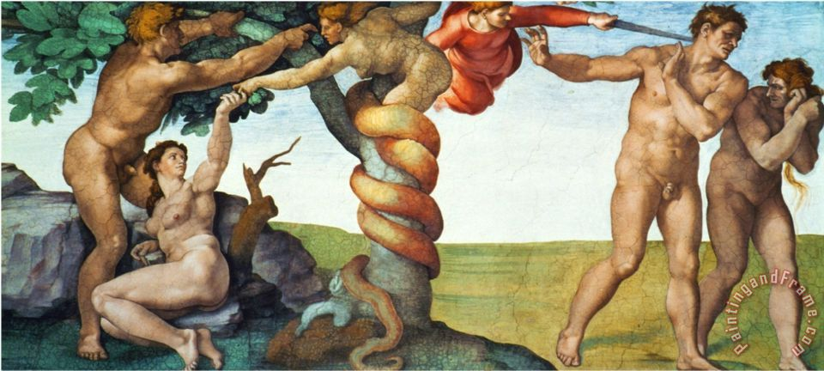
The Universality of Sin
Hamartiology and Anthropology Basics
Sin is any fed desire in a human that is contrary to the prescriptive will of God.
Rebellion against God.
Creation and Fall
Genesis 3:1-8
1 Cor 15:22 (”In Adam”)

Slide 3
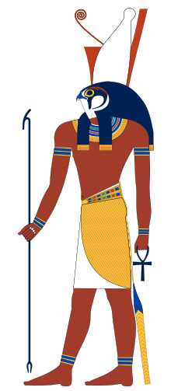
The Universality of Sin
Hamartiology and Anthropology Basics
Rom 1:13-2:16
The Gospel (1:13-17)
Man’s Rebellion (1:18-32)
The Result for “You” and “Them” (2:1-16)

Slide 4
The Universality of Sin
Sum up why we’re doing this:
All have sinned and fallen short of the glory of God.
Everyone knows this, because of the conscience. There is no excuse.
The penalty for sin is death.
There is one solution to death, resurrection.
Resurrection comes only from faith in Jesus of Nazareth.

Slide 5
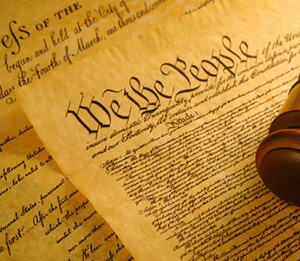
The Moral Law
If all have sinned, against what or whom have they sinned?
Answer: God and his moral law.
What is the nature of this God and this moral law?

Slide 6
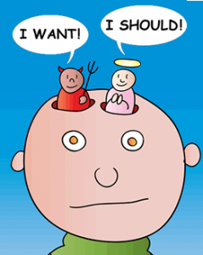
The Moral Law
The Nature of Morality
“Want”, “Can”, or “Ought”?
Instinct or a director of instincts?
Objective across time, culture, individuals or not?
Obligation to act, prohibition from action, both, or neither?

Slide 7
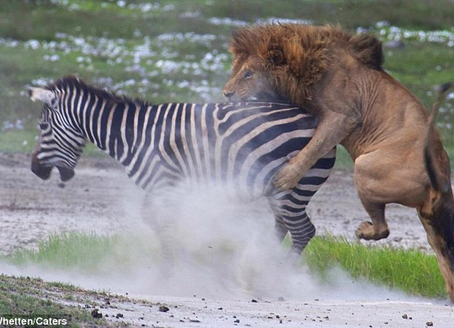
The Moral Law
The Nature of Morality
“Want”, “Can”, or “Ought”?
Instinct or a director of instincts?
Objective across time, culture, individuals or not?
Obligation to act, prohibition from action, both, or neither?

Slide 8
The Moral Law
The Nature of Morality
“Want”, “Can”, or “Ought”?
Instinct or a director of instincts?
Objective across time, culture, individuals or not?
Obligation to act, prohibition from action, both, or neither?

Slide 9
The Moral Law
The Nature of Morality
“Want”, “Can”, or “Ought”?
Instinct or a director of instincts?
Objective across time, culture, individuals or not?
Obligation to act, prohibition from action, both, or neither?

Slide 10
The Moral Law
The Source of Morality
The Euthyphro Dilemma
"Is the pious loved by the gods because it is pious, or is it pious because it is loved by the gods?”

Slide 12
The Moral Law
The Source of Morality
The Euthyphro Dilemma
"Is the pious loved by the gods because it is pious, or is it pious because it is loved by the gods?”
Genesis 1 (“God saw that it was good” x5-6)
Genesis 3:6 (“She saw that the tree was good…”)
God defines what is good by his own unchanging nature.

Slide 13
The Moral Law
Difficulties Outlining the Moral Law
Consequentialism
The outcome is either right or wrong
Utilitarianism
The Trolley Problem
Virtue Ethics
i.e. specific virtues/character traits are right or wrong
Aristotle’s Golden Mean
Deontology
i.e. Specific actions are right or wrong

